Slide 1



Deep Learning for Network Biology
Marinka Zitnik and Jure Leskovec
Stanford University

Slide 2

This Tutorial
snap.stanford.edu/deepnetbio-ismb
ISMB 2018
July 6, 2018, 2:00 pm - 6:00 pm

Slide 3
This Tutorial
1) Node embeddings
  Map nodes to low-dimensional embeddings
  Applications: PPIs, Disease pathways
2) Graph neural networks
    Deep learning approaches for graphs
    Applications: Gene functions
  3) Heterogeneous networks
    Embedding heterogeneous networks
    Applications: Human tissues, Drug side effects

Slide 4
Part 3:
Heterogeneous Networks

Slide 5
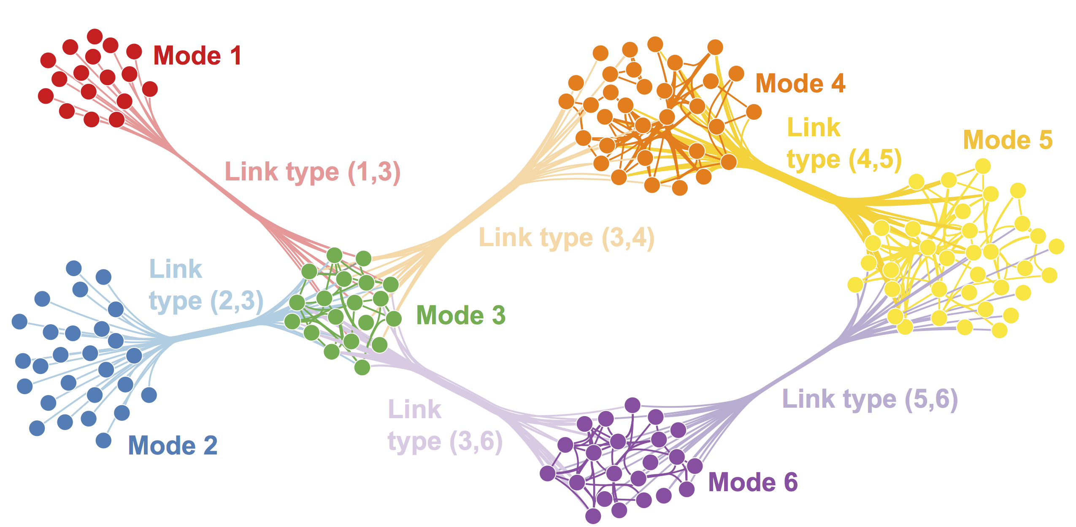
Homogeneous Nets
So far we have embedded homogeneous networks
Can we embed heterogeneous networks (i.e., het nets)?

Slide 6
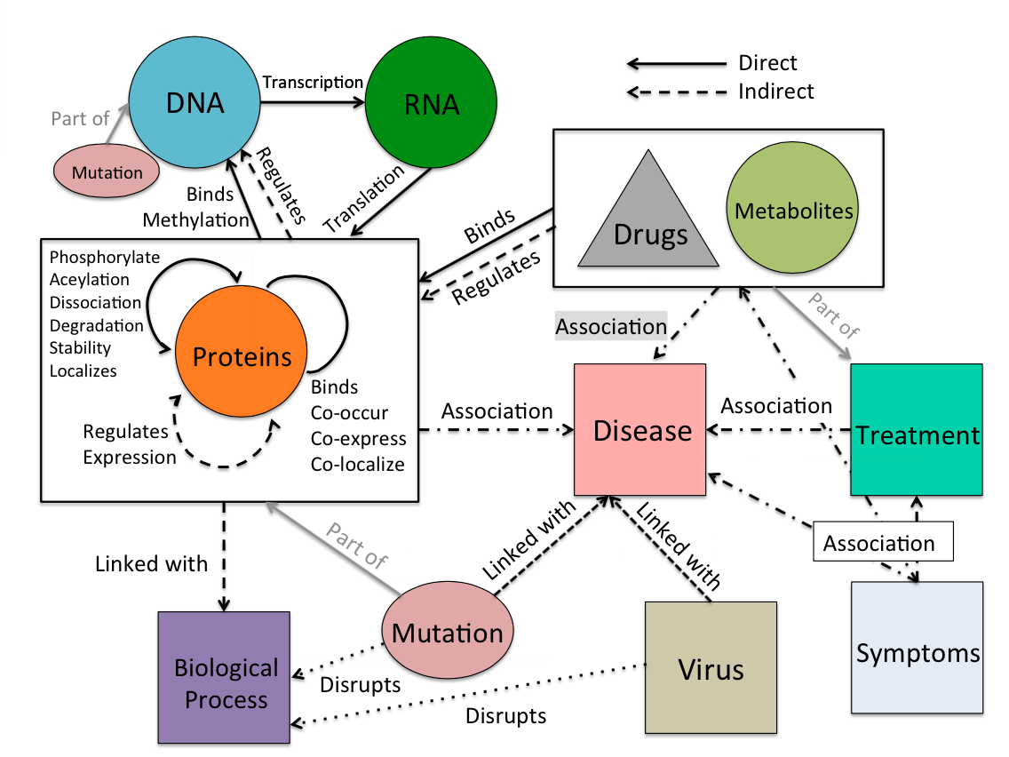
Many Het Nets in Biology

Slide 7
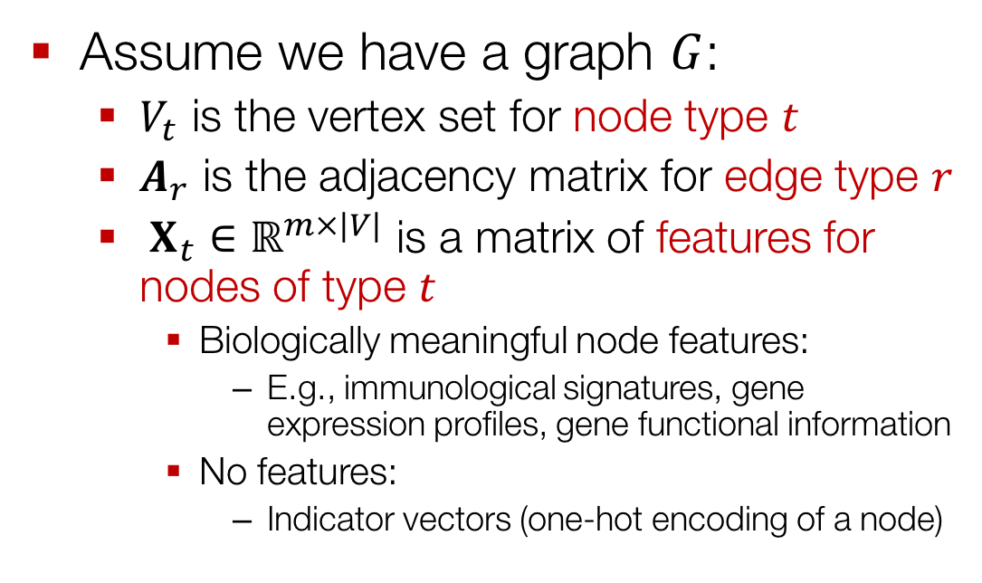
Setup
Assume we have a graph $G$:
  $V_{t}$ is the vertex set for node type $t$
  $A_{r}$ is the adjacency matrix for edge type $r$
  $X_{t}∈{\text{ℝ}}^{m×|V|}$ is a matrix of features for nodes of type $t$
    Biologically meaningful node features:
      E.g., immunological signatures, gene expression profiles, gene functional information
    No features:
      Indicator vectors (one-hot encoding of a node)

Slide 8
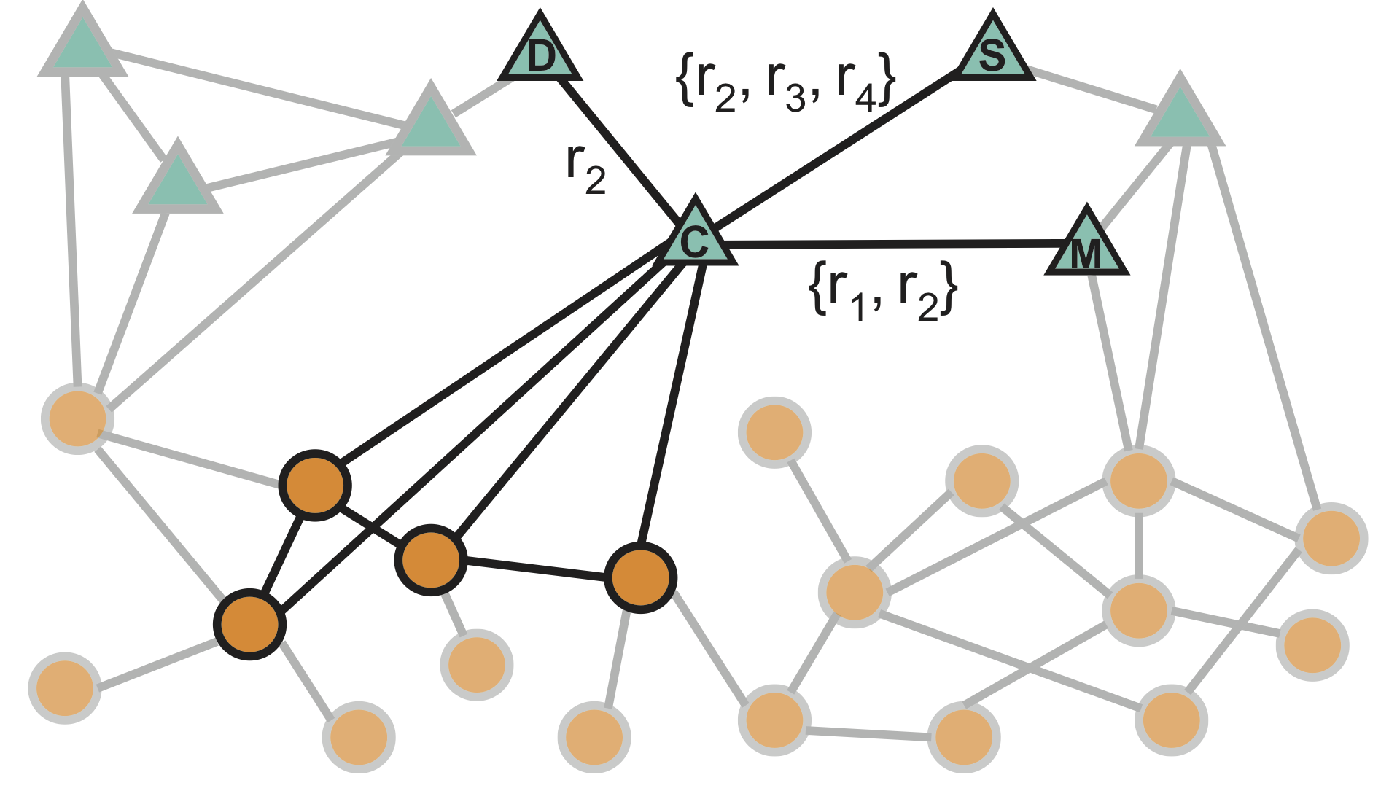
Example: Het Net

Slide 9
Tutorial Resource
MAMBO: Multimodal biomedical networks
Tool for construction, representation and analysis of large multimodal networks:
  Nets with millions of nodes and billions of edges
  Nets with thousands of modes (i.e., entity types) and links (i.e., relationship types)
Network analytics through SNAP
http://snap.stanford.edu/mambo

Slide 10
Outline of This Section
  Shallow embeddings for het nets:
    OhmNet
    Metapath2vec
  Deep embeddings for het nets:
    Decagon

Slide 11
OhmNet
Based on material from:
Zitnik et al., 2017. Predicting multicellular function through multi-layer tissue networks. ISMB & Bioinformatics.

Slide 12
Embedding Layered Graphs
Extending node2vec to multi-layer graphs

Slide 13
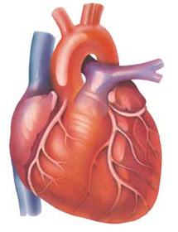
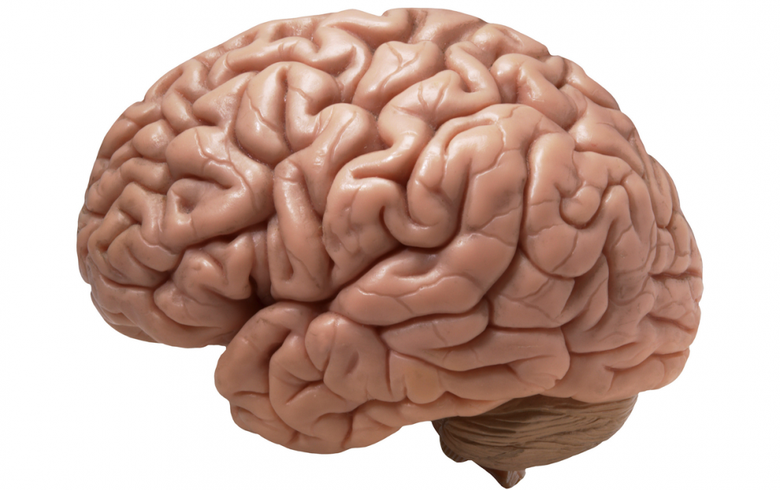
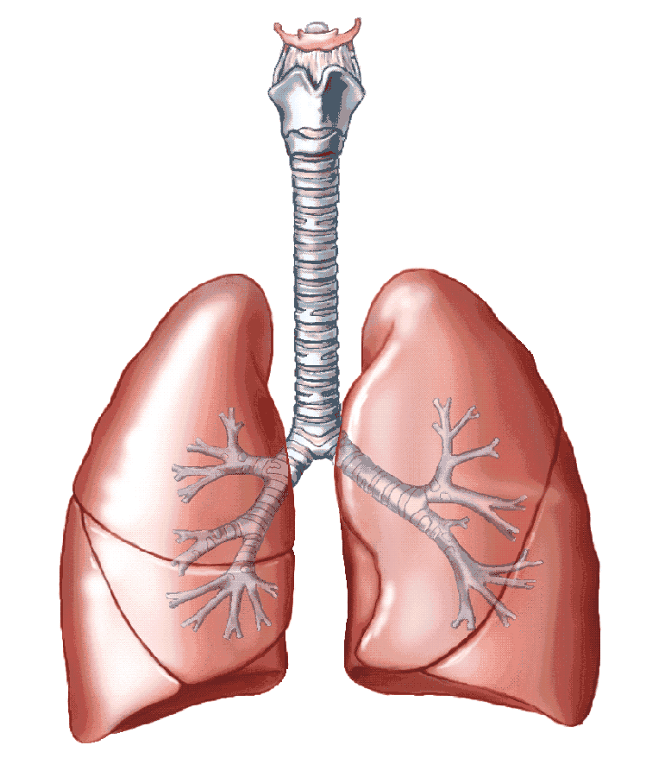
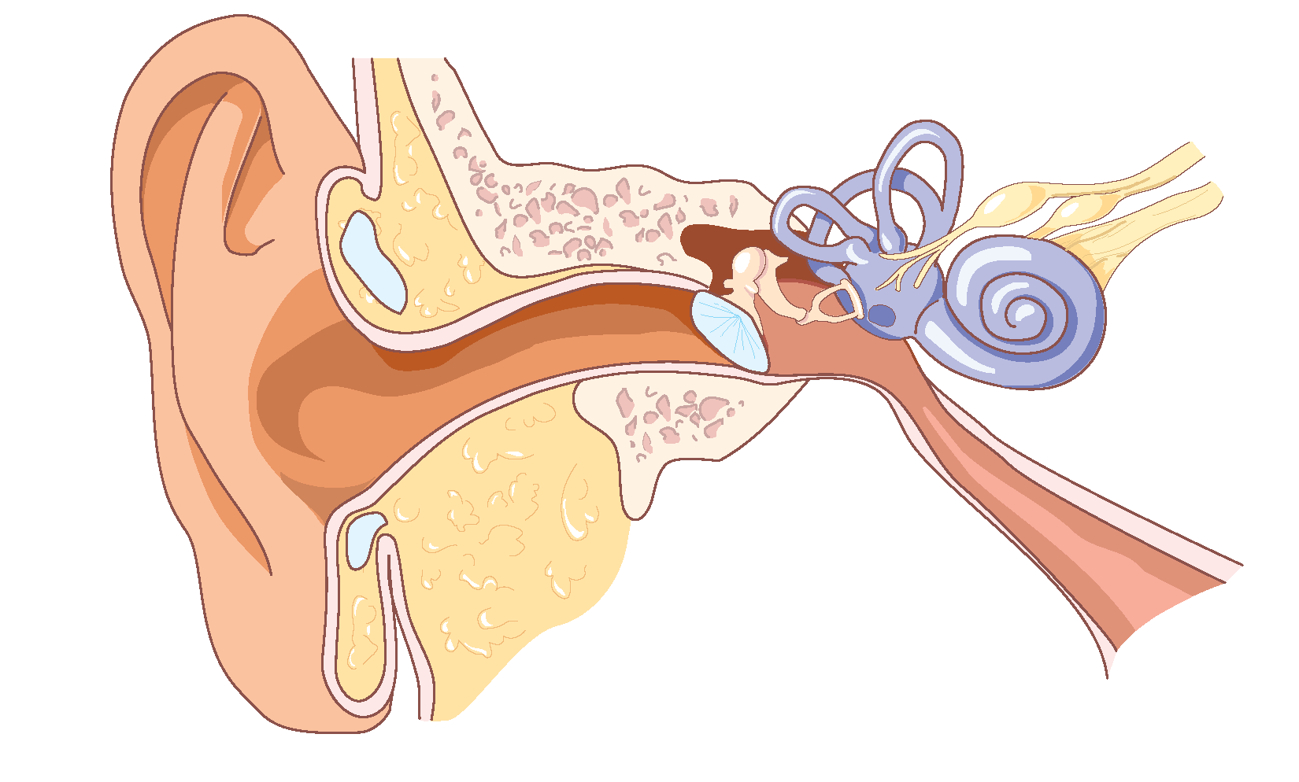

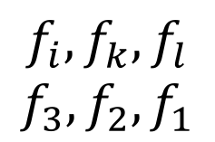


OhmNet: Multi-Layer Graphs
Embeddings
$$f_{i}, f_{k}, f_{l}$$
$$f_{3}, f_{2}, f_{1}$$
$$u\overset{→}{}ℝ^{d}$$
Input
Output
How to learn mapping functions $f_{i}$?

Slide 14

Multi-Layer Graphs
Input: Given graphs $Gi$ and hierarchy $M$
Output: Embeddings for:
  Nodes in each graph
  Nodes in each sub-hierarchy
Capture hierarchical structure of $M$

Slide 15
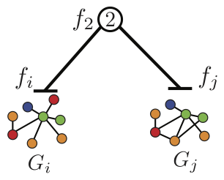
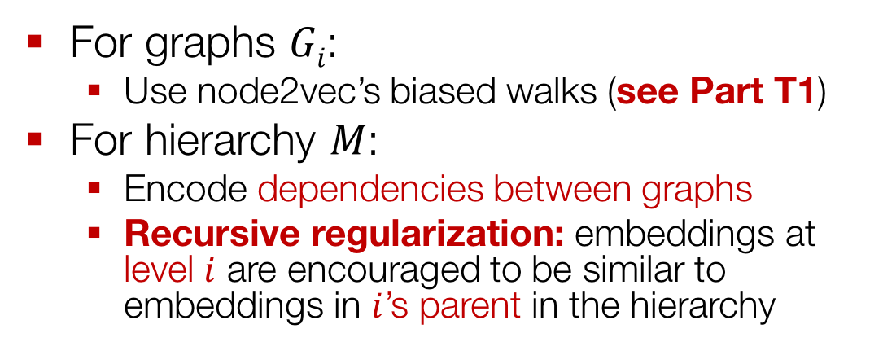
Multi-Layer Graphs
For graphs $Gi$:
  Use node2vec’s biased walks (see Part T1)
For hierarchy $M$:
  Encode dependencies between graphs
  Recursive regularization: embeddings at level $i$ are encouraged to be similar to embeddings in $i$’s parent in the hierarchy

Slide 16
Random Walk Optimization
Given simulated random walks for each graph:
  Optimize node embeddings as described in Part T1
  Extra: Include terms for recursive regularization in the loss function

Slide 17
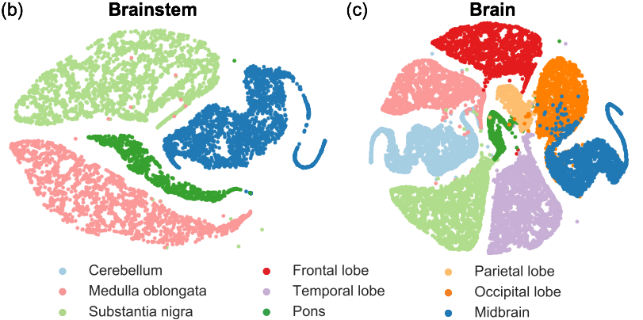
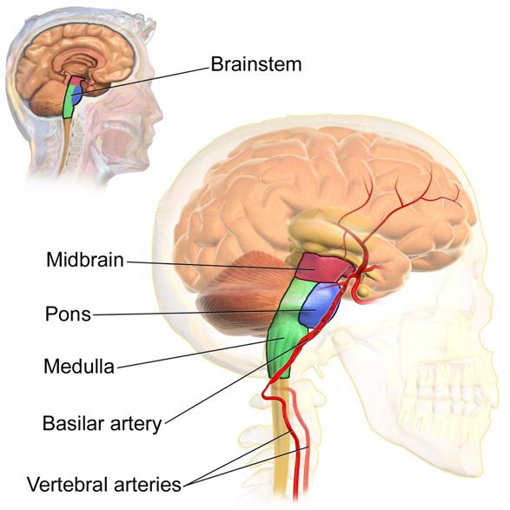
Example: Brain Networks
Do embeddings match human anatomy?
9 brain tissue PPI networks
in a two-level tissue hierarchy

Slide 18
Metapath2vec
Based on material from:
Dong et al., 2017. metapath2vec: Scalable representation learning for heterogeneous networks. KDD.

Slide 19
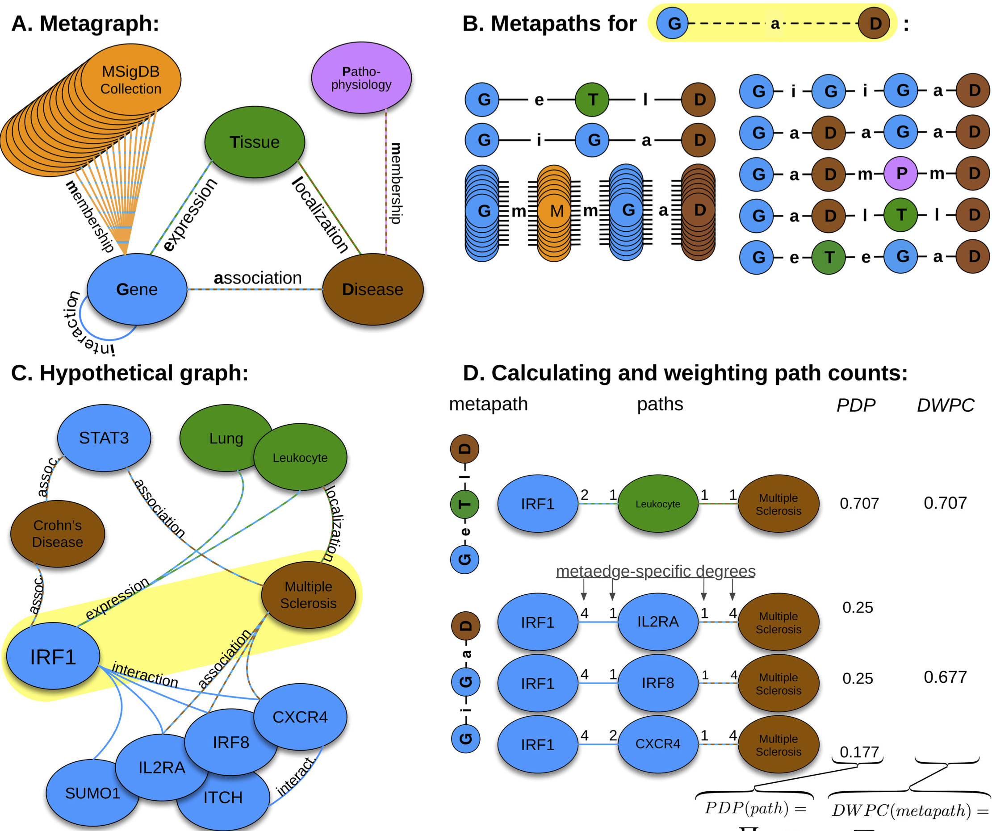
Metapaths
Image from: Himmelstein et al. 2015. Heterogeneous network edge prediction: A data integration approach to prioritize disease-associated genes. PLoS Comp Bio.

Slide 20
Metapath2vec: Two Main Steps
Extending node2vec to het nets:
Metapath-based random walks
  Specify a metapath of interest
  Run random walks that capture structural correlations between different node types
Random walk optimization
  Given the random walks, optimize node embeddings (similar to Part T1)

Slide 21
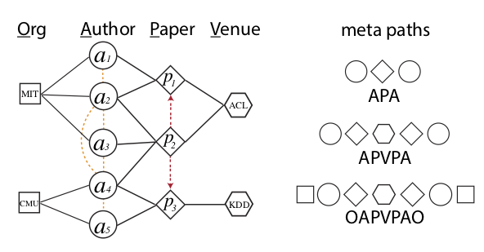
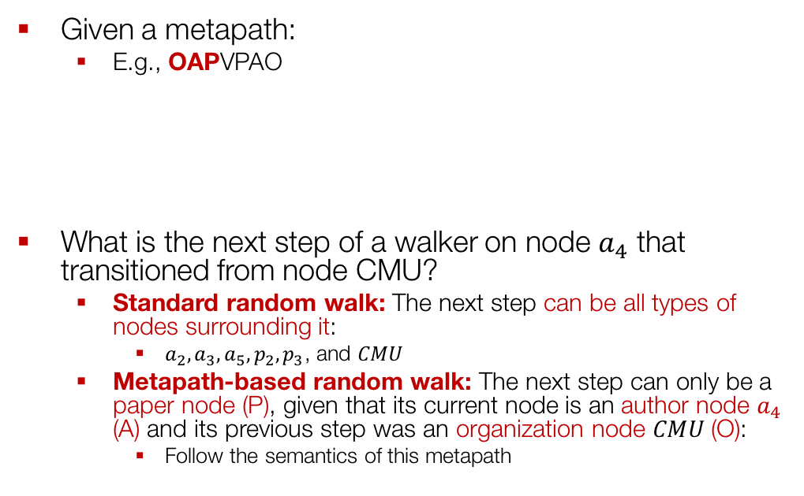
Step 1: Run Random Walks
Given a metapath:
  E.g., OAPVPAO
What is the next step of a walker on node $a_{4}$ that transitioned from node CMU?
  Standard random walk: The next step can be all types of nodes surrounding it:
    $a_{2}, a_{3}, a_{5}, p_{2}, p_{3}$, and $CMU$
  Metapath-based random walk: The next step can only be a paper node (P), given that its current node is an author node $a_{4}$ (A) and its previous step was an organization node $CMU$(O):
    Follow the semantics of this metapath

Slide 22
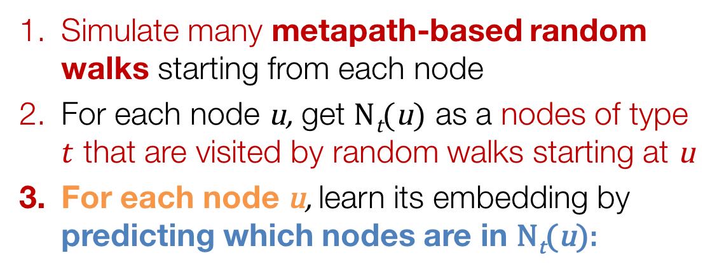
Step 2: Optimize
Simulate many metapath-based random walks starting from each node
For each node u, get N_{t}(u) as a nodes of type $t$ that are visited by random walks starting at u
For each node u, learn its embedding by predicting which nodes are in N_{t}(u):
Notes:
$\mathcal{L} = \sum_{u \in V} \sum_{t \in V_t} \sum_{v \in N_t(u)} - \log(P(v | \mathbf{z}_u))$

Slide 23
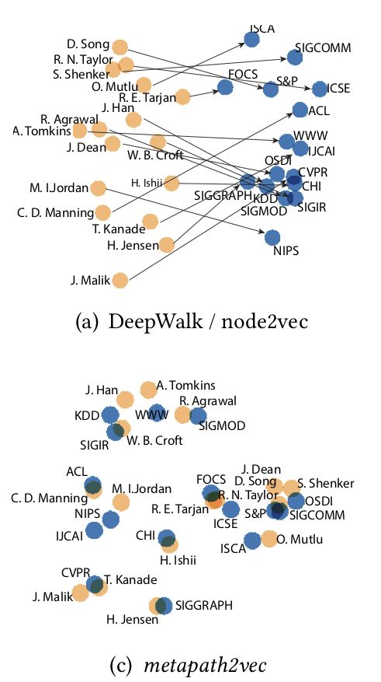
Metapath2vec: Example
2D projections of the learned embeddings for:
  16 CS conferences and corresponding high-profile researchers in each field
Metapath2vec:
  Groups author-conference pairs closely
  Automatically organizes these two types of nodes
  Learns internal relationships between them:
    E.g., J. Dean → OSDI
    E.g., C. D. Manning → ACL
Not possible using methods for homogeneous networks

Slide 24
Outline of This Section
  Shallow embeddings for het nets:
    OhmNet
    Metapath2vec
  Deep embeddings for het nets:
    Decagon

Slide 25
Deep Embeddings
for Heterogeneous Graphs
Based on material from:
Zitnik et al., 2018. Modeling polypharmacy side effects with graph convolutional networks. ISMB & Bioinformatics.

Slide 26
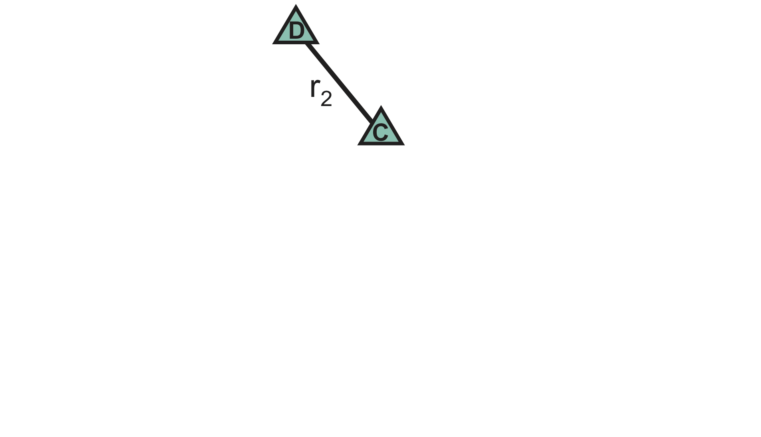
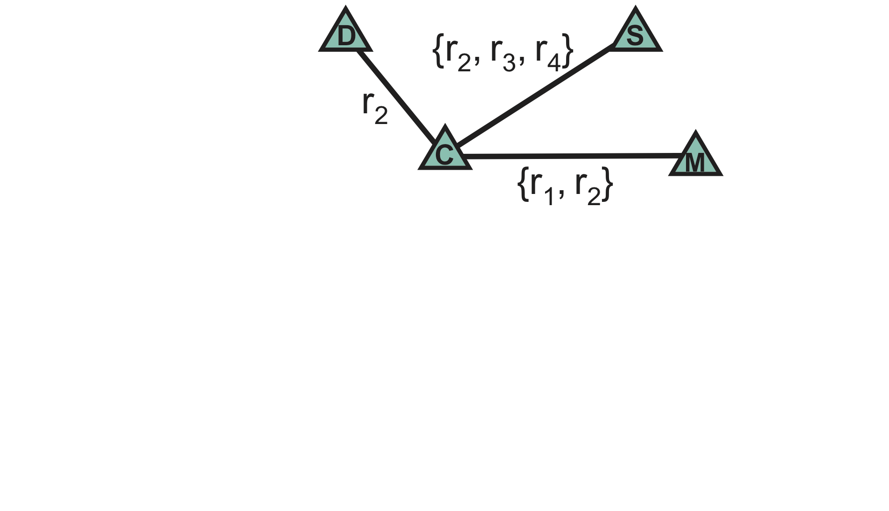
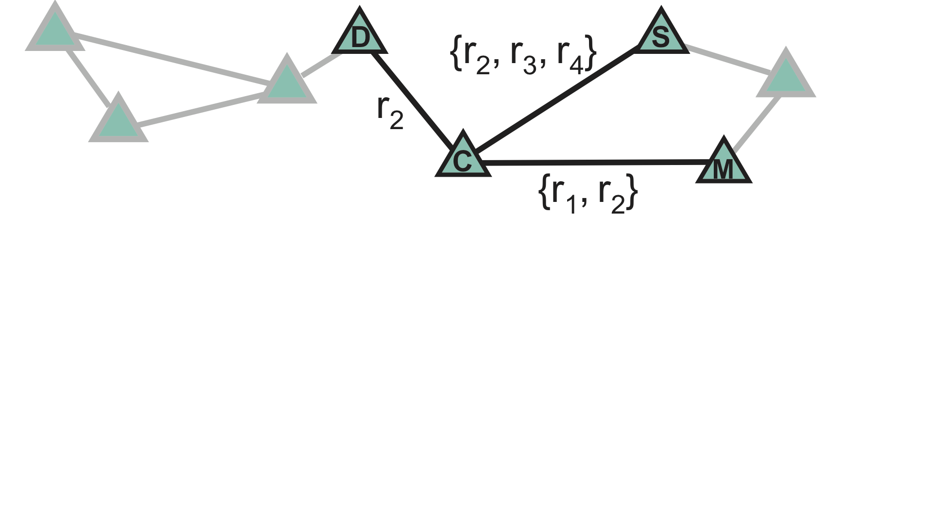
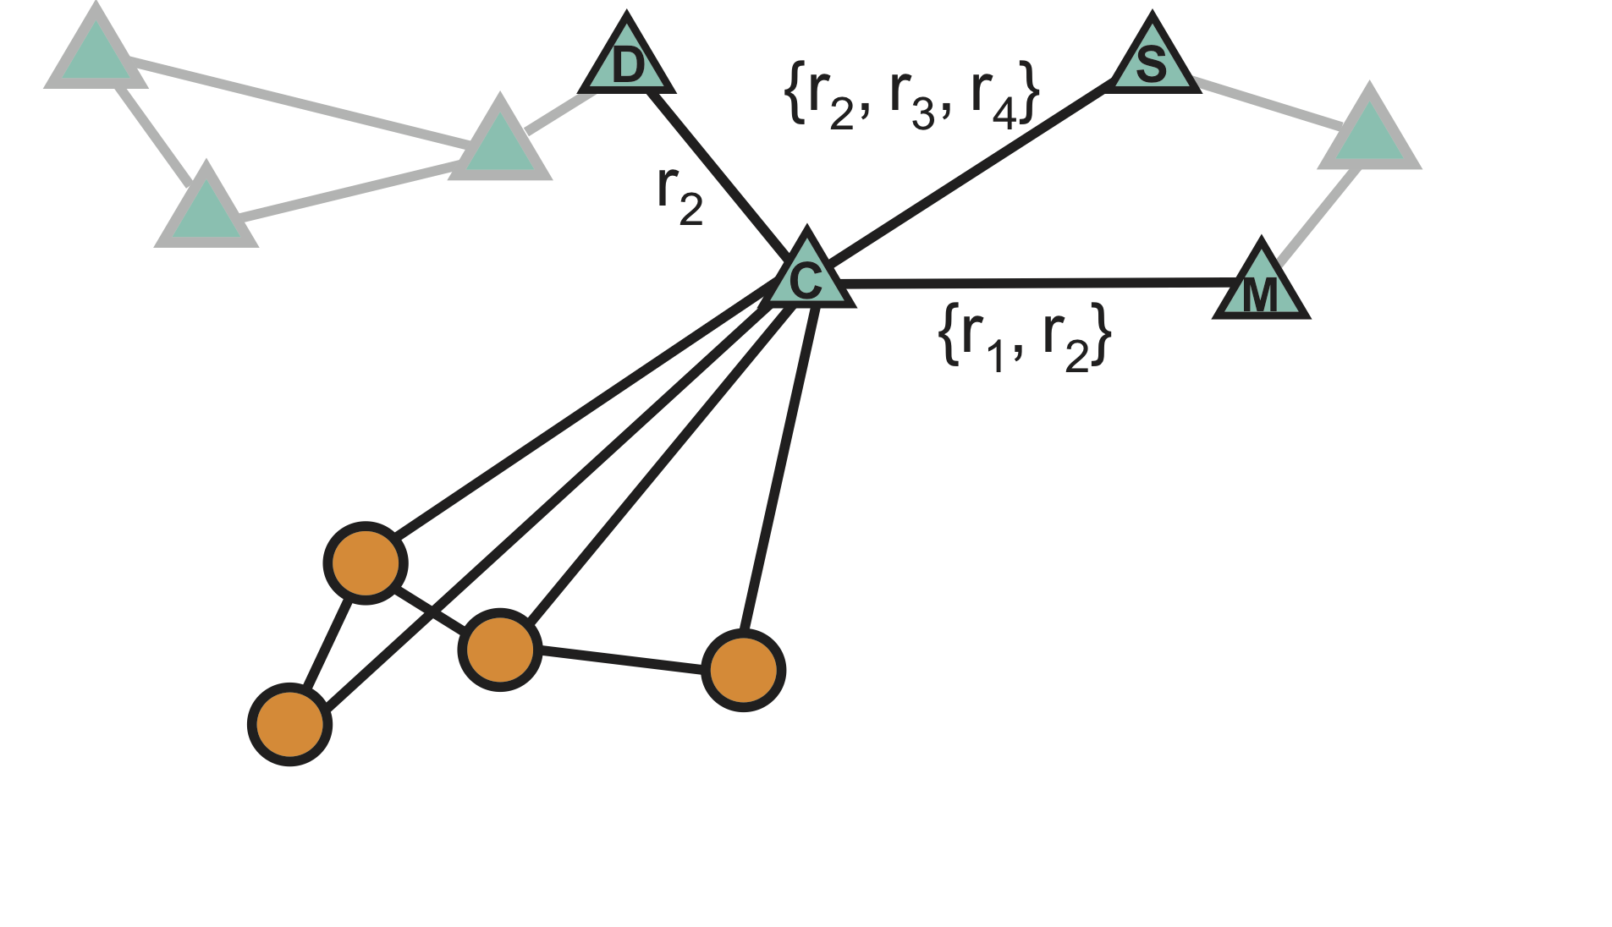
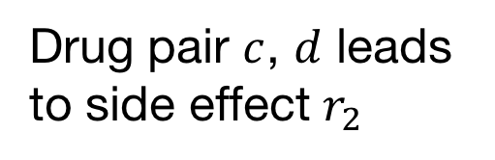
Running Het Net Example
Drug pair $c$, $d$ leads to side effect $r_{2}$
Notes:
We use the language of graphs to mathematically represent side effects. To describe which drug pairs lead to which side effects, we represent each side effect type with a different edge type. Here, drugs C and D lead to bradycardia side effect. It is important to note here that bradycardia occurs when a patient takes C and D together. Bradycardia cannot be attrributed to C or D alone.
Drug C can lead to many different side effects when taken in combination with other drugs. For example, it can lead to three different side effects when taken together with S, which we represent with multiple edges between drug nodes, each of different type.
C indicate that this drug targets four proteins. These proteins interact with each other which is described by protein-protein interaction network.
All together, we consider a two-layer multimodal graph/network of two node types: drugs and proteins. Drug-drug interaction network contains 964 different types of edges (one for each side effect type) and describes which drug pairs lead to which side effects.
Rok:
-- Drugs and proteins notation
– Dashed lines (input, known vs. prediction)

Slide 27
Idea: Aggregate Neighbors
Key idea: Generate node embeddings based on network neighborhoods separated by edge type

Slide 28
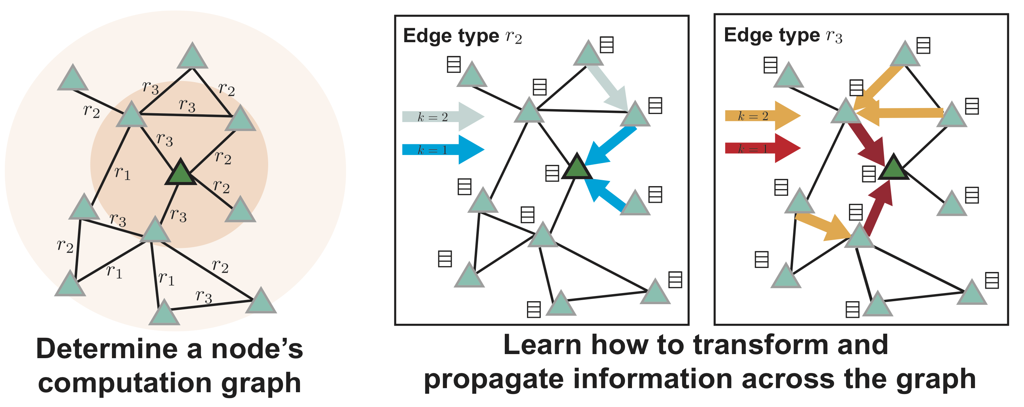
Idea: Aggregate Neighbors
    Each edge type is modeled separately
    A node’s neighborhood defines a computation graph
Notes:
The principle is that Decagon learns how to transform and propagate information across the graph in most useful way. The way information is shared and propagated in the graph is defined by a node’s network neighborhood in each edge type.
To illustrate this point, let us consider an example shown on the left and focus on the dark green node in the center. This example shows a two-hop neighborhood of the green node. This node has four neighbors. Two nodes are connected to the green node through r_3 edge type, and the other two through r_2 edge type.
Decagon propagates node feature information across edges of the graph, while taking into account the type of an edge. Thus, in the r_2 channel, the green node receives node feature information from its two neighbors and then aggregates and transforms this information. The two neighbors each receive node feature information from their neighbors and so on.
Similarly, in the r3 channel, the green node receives and aggregates information from its two neighbors.
Rok:
-- “Black border around arrows”
-- Explain better diffusion
-- Multiple edge example

Slide 29
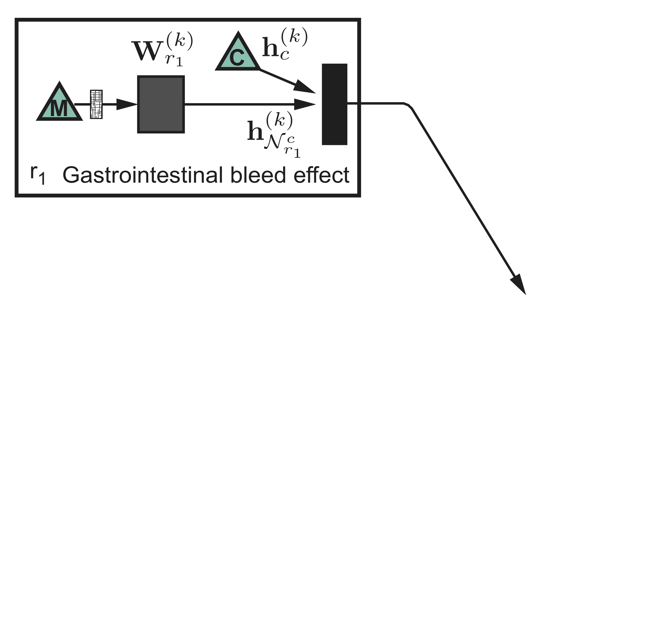
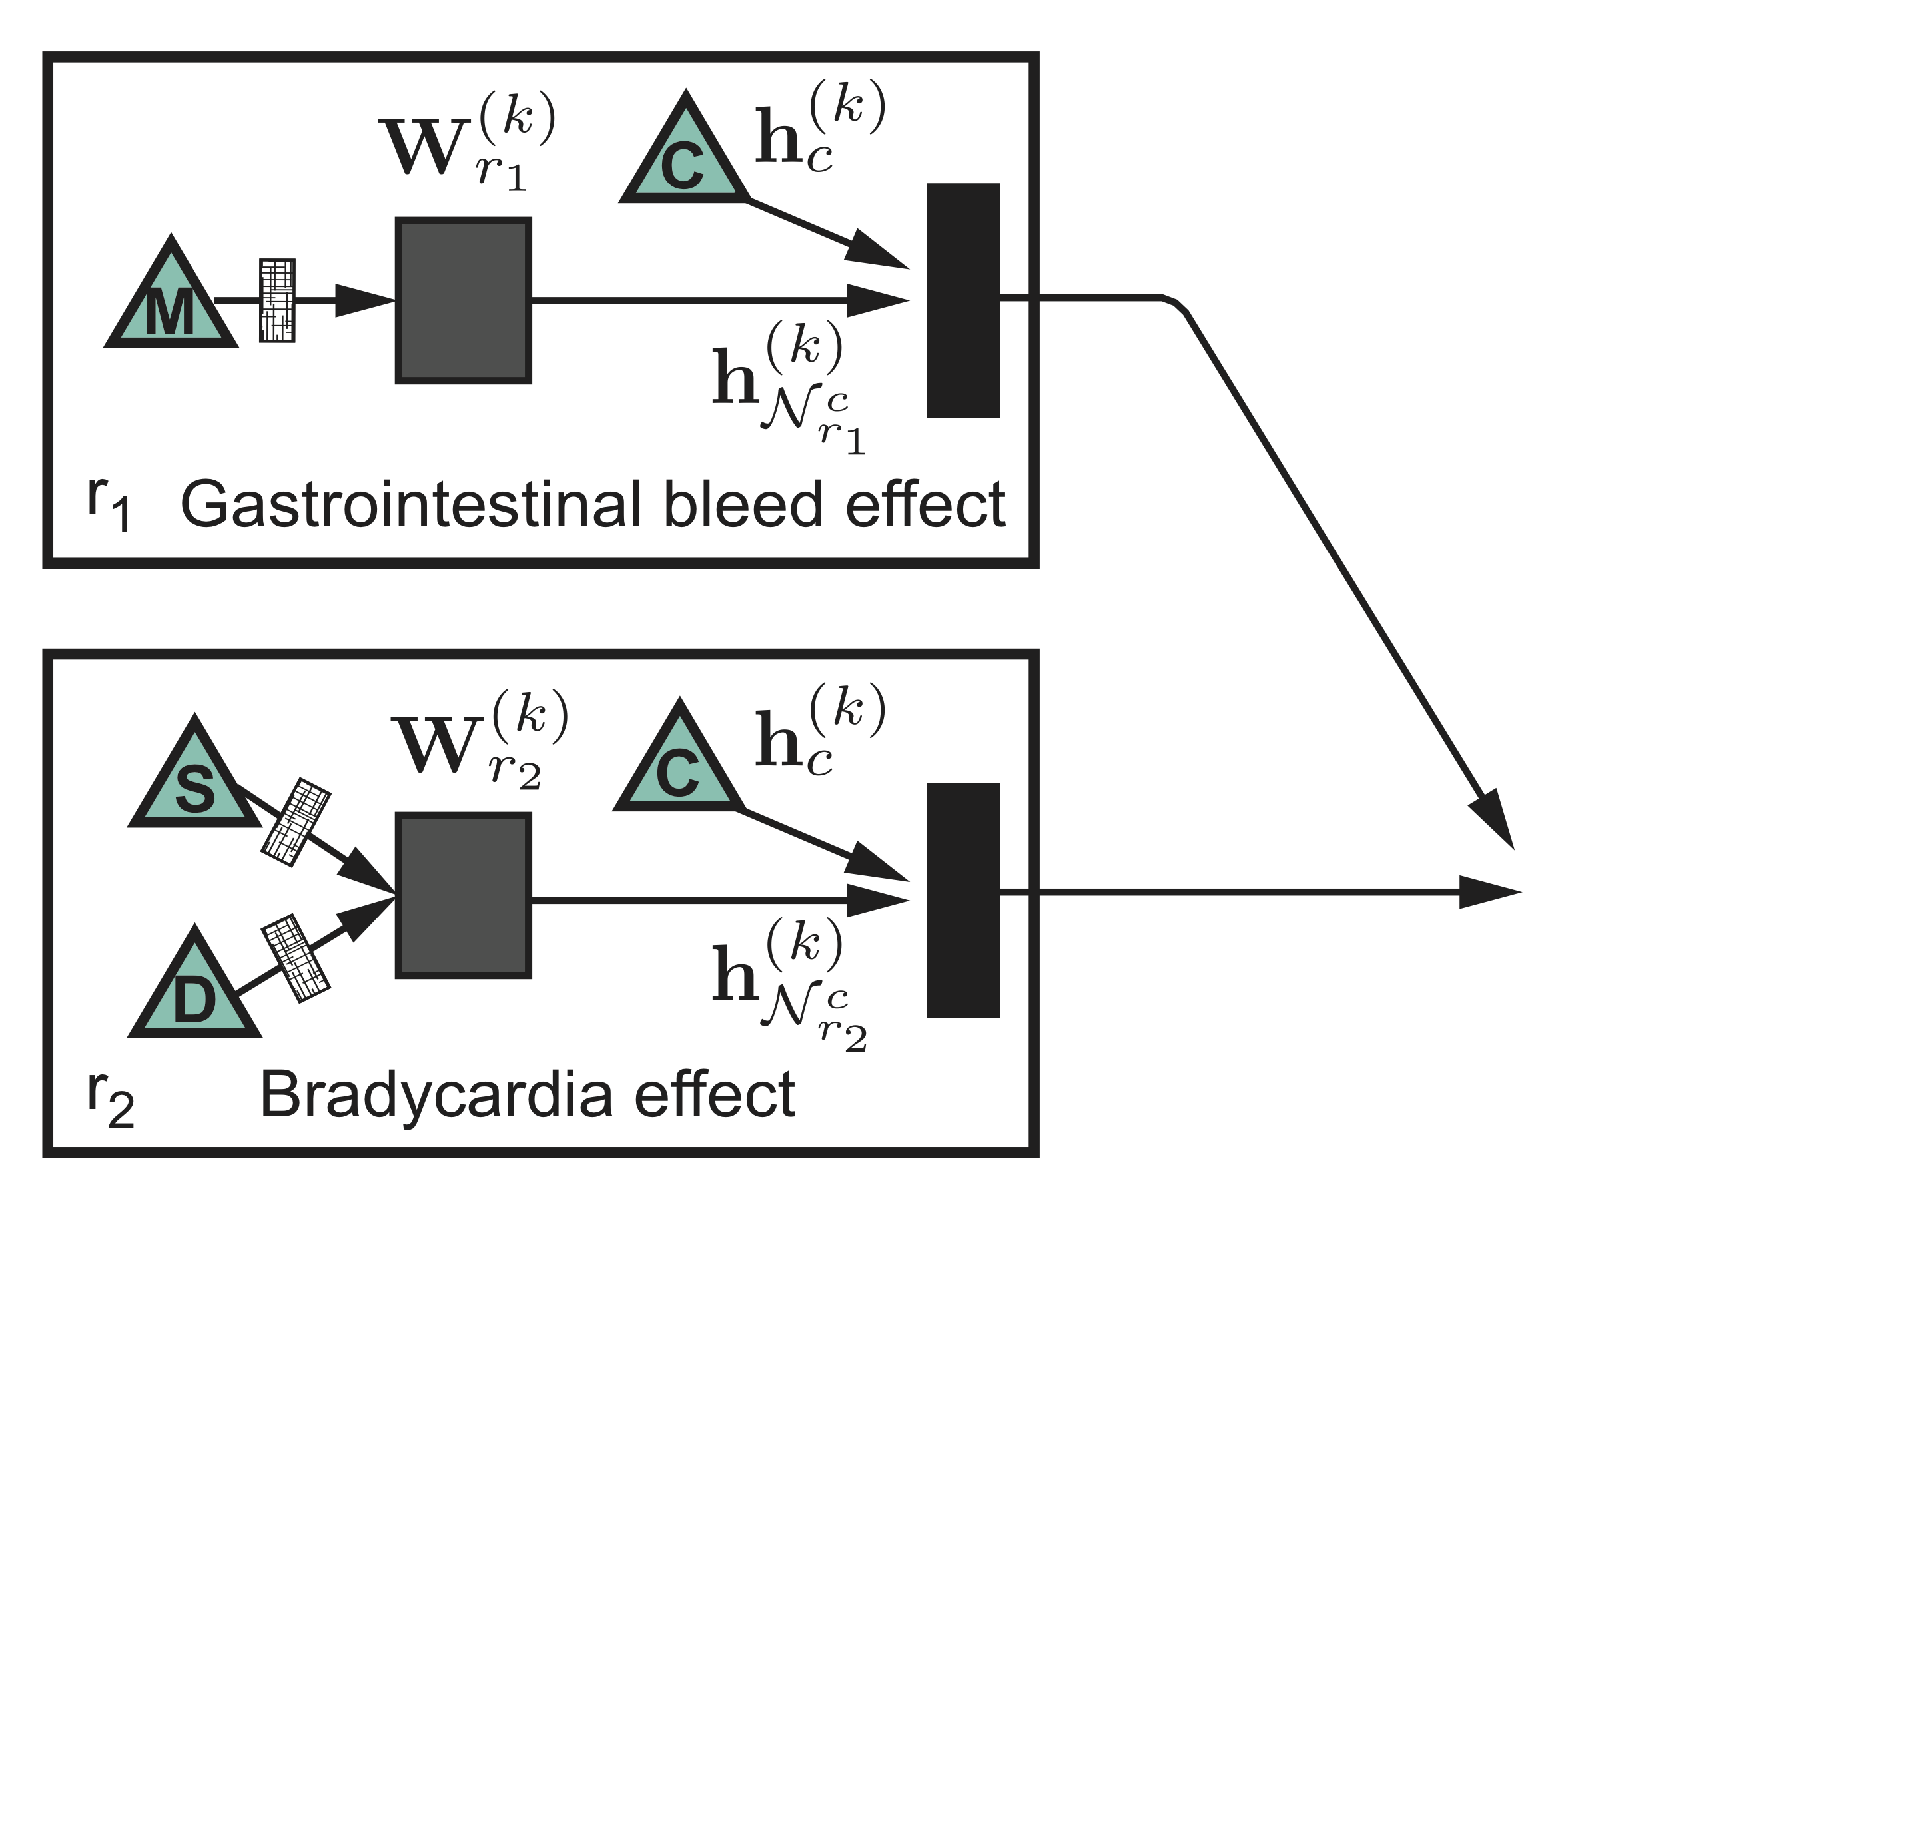
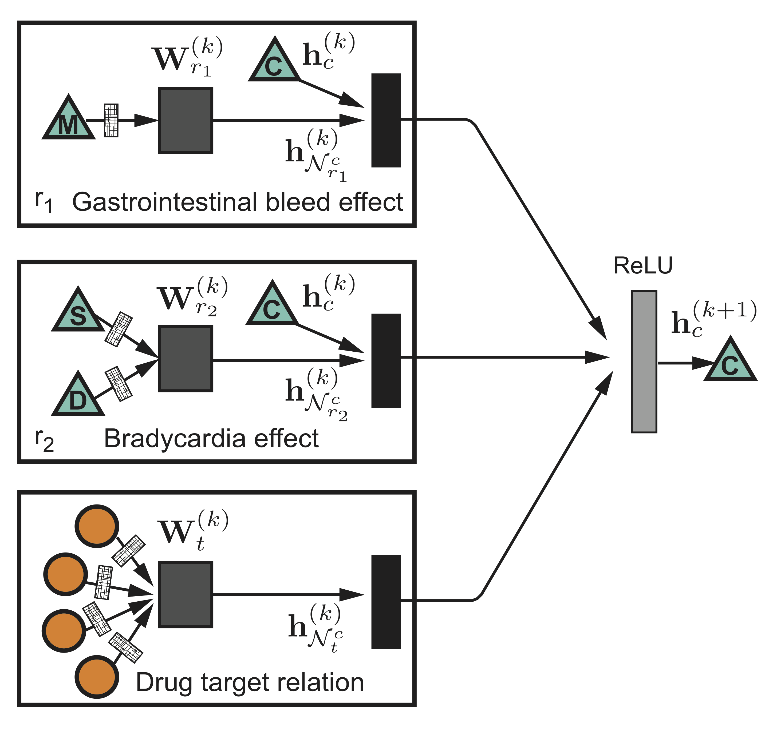
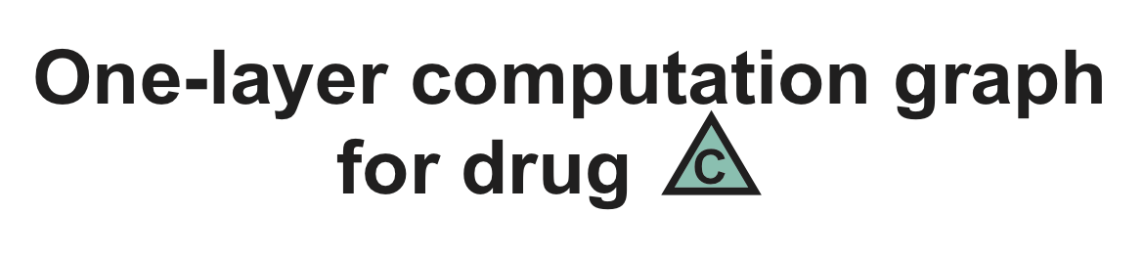
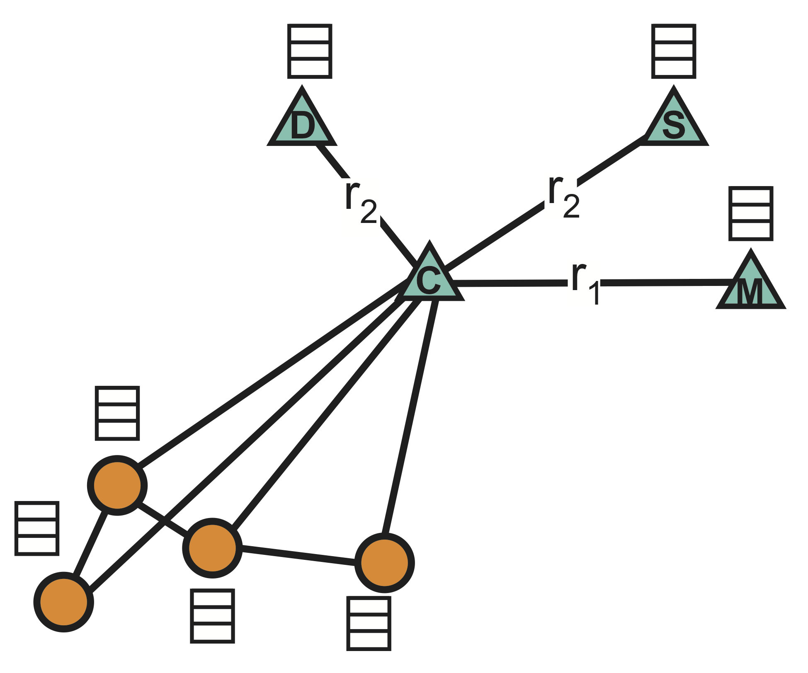
Example: Aggregation
Neural network weight matrices
Notes:
A node’s computation graph determines the neural architecture for that node
Let’s examine a one-layer architecture for drug node C in the left. For each edge type individually (i.e., gastrointestinal bleed, bradycardia, and drug target relation), feature information from neighboring nodes are gathered and then transformed. The resulting representation is accumulated in a normalized sum and passed through a non-linear activation function (i.e., ReLU) to produce hidden state of node in the (k + 1)-th layer.

Slide 30
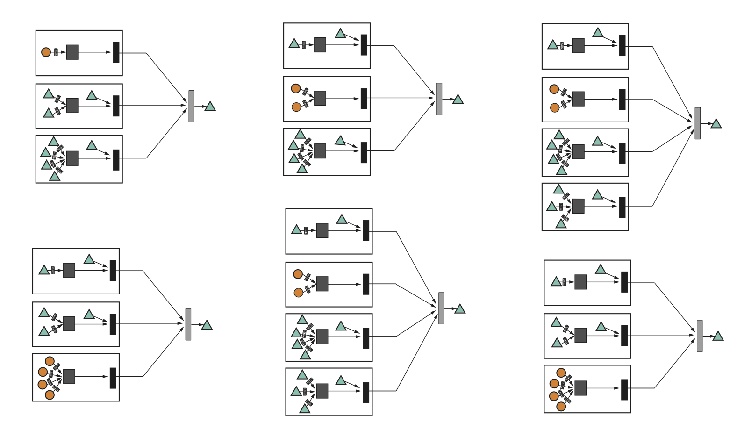
Example: Aggregation
An example batch of computation graphs
Neural network weight matrices
Notes:
This per-node update is computed in parallel with shared parameters for all nodes in the graph. Importantly, these architectures then share neural network weights.
Here, W are weight matrices, which we learn. They specify how information is propagated and transformed across the graph.
Rok:
For n nodes, dots
Use embedding symbol

Slide 31
The Math: Deep Encoder
Approach: Average neighbor messages for each edge type and apply a neural network
Previous layer embedding of v
Initial 0-th layer embeddings are equal to node features
Aggregate neighbor’s previous layer embeddings
Embedding after K layers of neighborhood aggregation
Non-linearity (e.g., ReLU)
Notes:
$\mathbf{h}_v^{k} = \phi \bigg(\sum_{r} \left(\mathbf{W}_r^{k-1} \sum_{u \in N_r(v)} \frac{\mathbf{h}_u^{k-1}}{\sqrt{|N_r(v)| |N_r(u)|}} + \frac{\mathbf{h}_v^{k-1}}{|N_r(v)|} \right)\bigg)
$

Slide 32
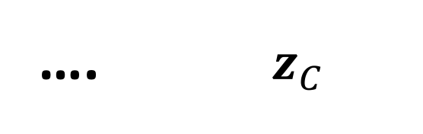
Training the Model
How do we train the model to generate embeddings?
…. $z_{C}$
Need to define a loss function on the embeddings!

Slide 33

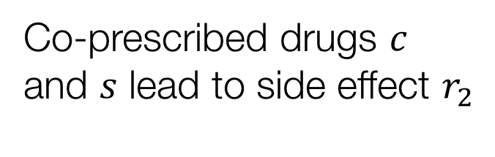
Example: Drug Side Effects
Goal: Predict labeled edges between drug nodes
Query: Given a drug pair $c,s$, how likely does an edge $(c,r_{2},s)$ exist?
Co-prescribed drugs $c$ and $s$ lead to side effect $r_{2}$
Notes:
Using the graph G, our goal is to predict labeled edges between drug nodes.
This is a multirelational link prediction task. Given a drug pair (c, s) our aim is to determine how likely an edge (c,s) of type r exist, meaning that concurrent use of drugs c and s leads to a side effect r in the human patient population.
“Lower-case vs. Upper case”

Slide 34
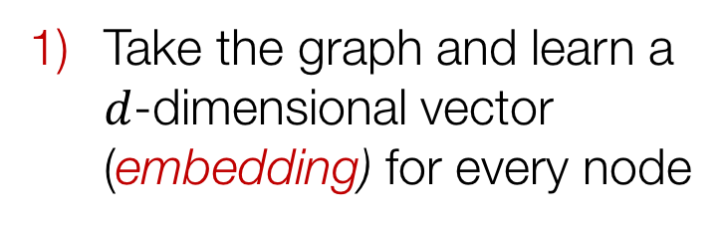
Example: Drug Side Effects
Take the graph and learn a $d$-dimensional vector (embedding) for every node
Embedding
Use the learned embeddings to predict side effects of drug pairs
r, ?
Notes:
we develop a multi-layer convolutional graph neural network model Decagon that operates directly on graph G.
Decagon has two main components:
-- An encoder that takes a heterogeneous graph and learns an embedding for each node in the graph.
-- And a decoder, which uses the learned embeddings to predict then predict side effects.
Rok:
- Change decoder (vertical)

Slide 35
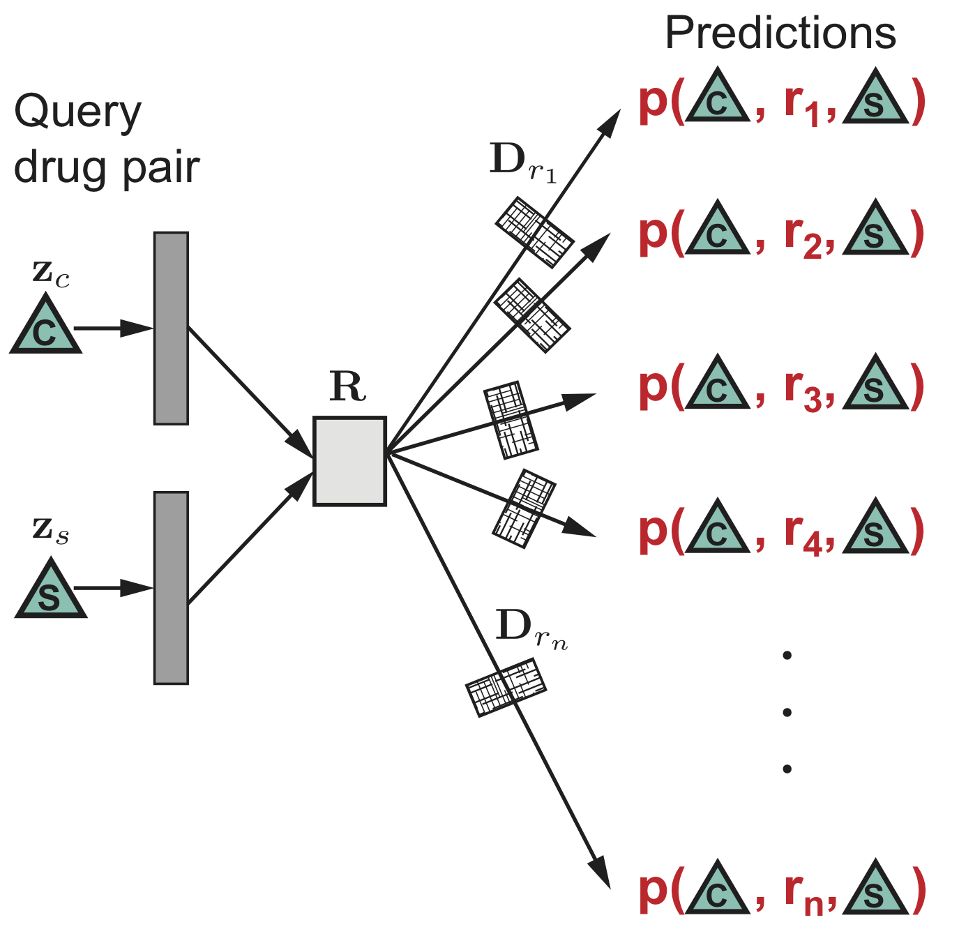
Example: Drug Side Effects
This is multi-relational link
prediction task!
Neural network weight matrices
Notes:
Using embeddings returned by Decagon’s encoder, the decoder predicts a labeled edge through a sequence of matrix operations. These matrix operations depend on the type of edge we are trying to predict.
In particular, decoder uses the same global drug-drug interaction model (i.e., matrix R) containing patterns that hold true across all side effect types. We expect that this decoding parameterization can alleviate overfitting on rare side effects. Additionally, every edge type is associated with a diagonal matrix D_r that models each edge type individually.
Rok:
-- Show only decoder, no encoder part
-- Overall pipeline

Slide 36

Modeling Polypharmacy Side Effects with Graph Convolutional Networks
July 10, 2018 at 12:20 pm
http://snap.stanford.edu/decagon

Slide 37
Outline of This Section
  Shallow embeddings for het nets:
    OhmNet
    Metapath2vec
  Deep embeddings for het nets:
    Decagon

Slide 38
This Tutorial
1) Node embeddings
  Map nodes to low-dimensional embeddings
  Applications: PPIs, Disease pathways
2) Graph neural networks
    Deep learning approaches for graphs
    Applications: Gene functions
  3) Heterogeneous networks
    Embedding heterogeneous networks
    Applications: Human tissues, Drug side effects

Slide 39

































Industry Partnerships
PhD Students
Claire
Donnat
Mitchell
Gordon
David
Hallac
Emma
Pierson
Geet
Sethi
Funding
Himabindu
Lakkaraju
Rex
Ying
Tim
Althoff
Will
Hamilton
Alex
Porter
Post-Doctoral Fellows
Collaborators
Dan Jurafsky, Linguistics, Stanford University
Christian Danescu-Miculescu-Mizil, Information Science, Cornell University
Stephen Boyd, Electrical Engineering, Stanford University
David Gleich, Computer Science, Purdue University
VS Subrahmanian, Computer Science, University of Maryland
Sarah Kunz, Medicine, Harvard University
Russ Altman, Medicine, Stanford University
Jochen Profit, Medicine, Stanford University
Eric Horvitz, Microsoft Research
Jon Kleinberg, Computer Science, Cornell University
Sendhill Mullainathan, Economics, Harvard University
Scott Delp, Bioengineering, Stanford University
Jens Ludwig, Harris Public Policy, University of Chicago
Baharan
Mirzasoleiman
Marinka
Zitnik
Michele
Catasta
Srijan
Kumar
Research
Staff
Stephen
Bach
Adrijan
Bradaschia
Rok
Sosic

Slide 40

Many interesting high-impact projects
in Machine Learning and Large Biomedical Data
Applications: Precision Medicine & Health, Drug Repurposing, Drug Side Effect modeling, Network Biology, and many more

