Slide 1



Deep Learning for Network Biology
Marinka Zitnik and Jure Leskovec
Stanford University

Slide 2

This Tutorial
snap.stanford.edu/deepnetbio-ismb
ISMB 2018
July 6, 2018, 2:00 pm - 6:00 pm

Slide 3
This Tutorial
1) Node embeddings
  Map nodes to low-dimensional embeddings
  Applications: PPIs, Disease pathways
2) Graph neural networks
    Deep learning approaches for graphs
    Applications: Gene functions
  3) Heterogeneous networks
    Embedding heterogeneous networks
    Applications: Human tissues, Drug side effects

Slide 4
Part 1:
Node Embeddings
Some materials adapted from:
Hamilton et al. 2018. Representation Learning on Networks. WWW.

Slide 5
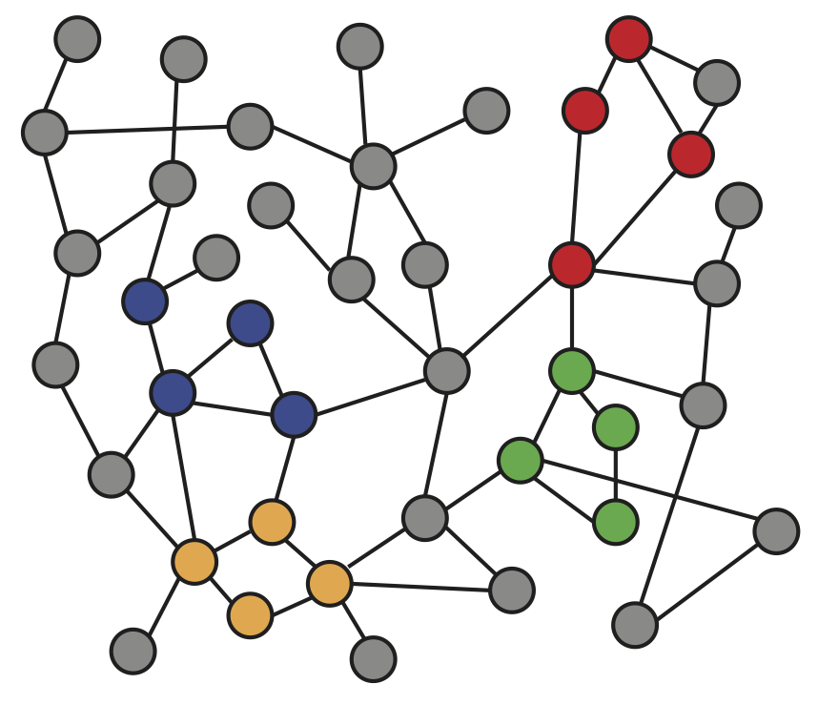
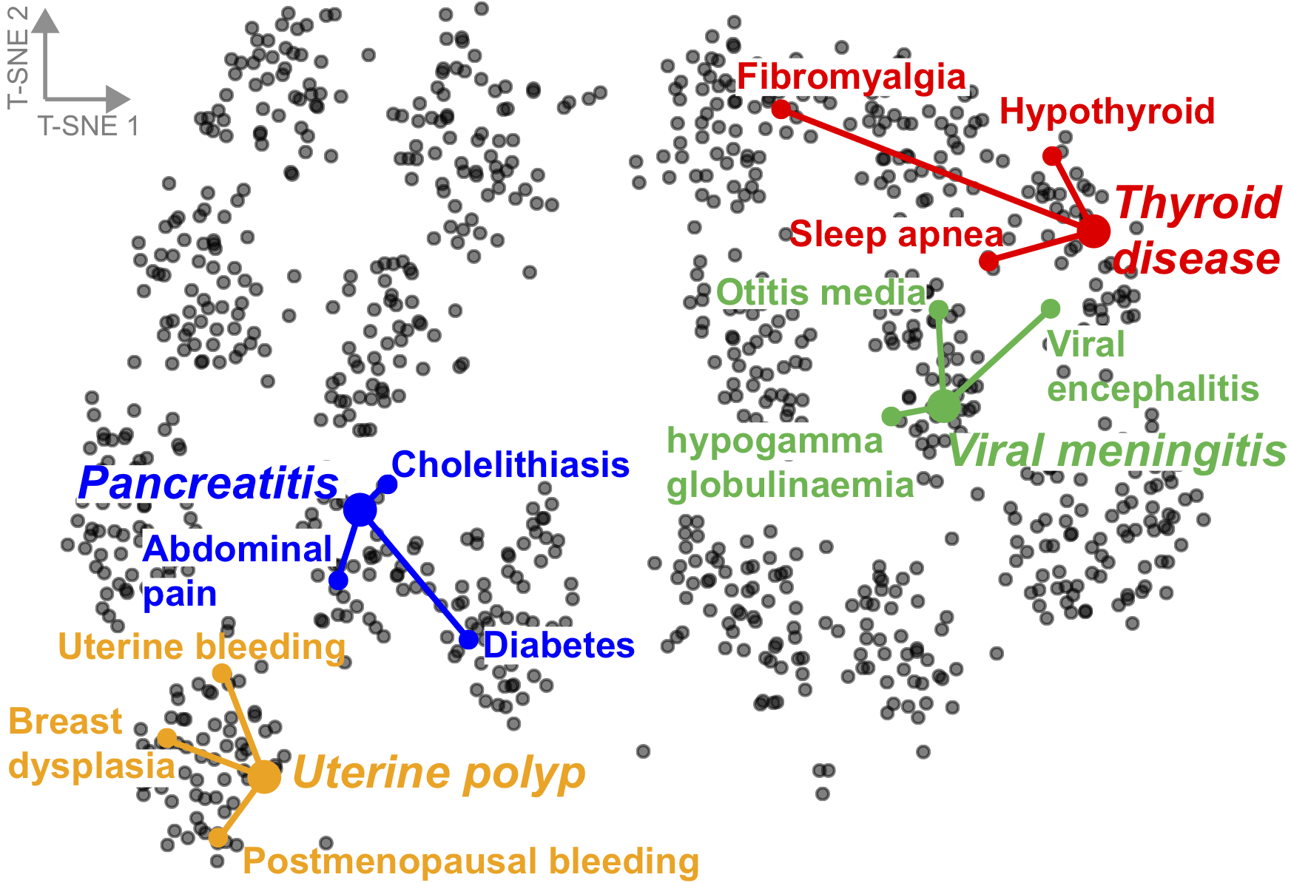
Embedding Nodes
Input
Output
Intuition: Map nodes to d-dimensional embeddings such that similar nodes in the graph are embedded close together

Slide 6
Setup
Assume we have a graph G:
  V is the vertex set
  A is the adjacency matrix (assume binary)
  No node features or extra information is used!

Slide 7
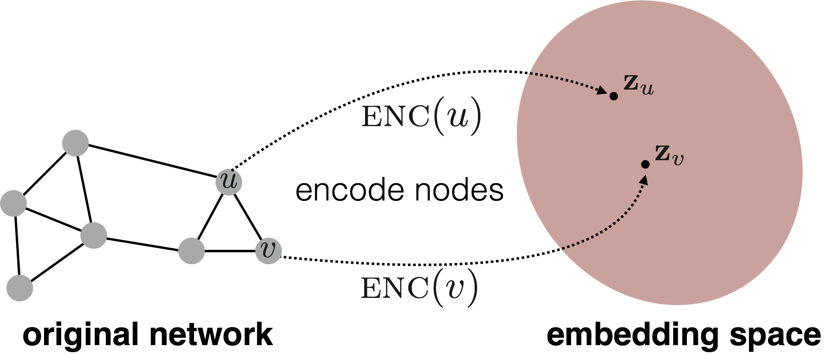
Embedding Nodes
Goal: Map nodes so that similarity in the embedding space (e.g., dot product) approximates similarity in the network
d-dimensional
embedding space
Input network

Slide 8
Embedding Nodes
Goal:
Need to define!
d-dimensional
embedding space
Input network

Slide 9
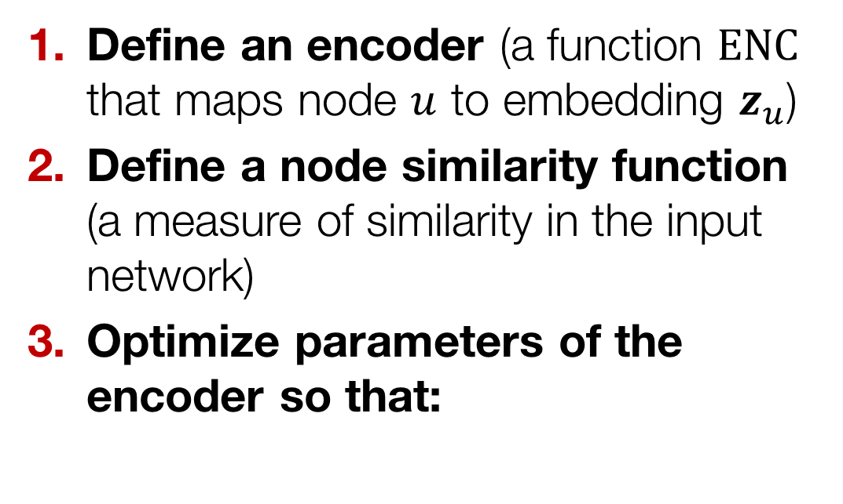
Learning Node Embeddings
Define an encoder (a function $ENC$ that maps node $u$ to embedding $z_{u}$)
Define a node similarity function (a measure of similarity in the input network)
Optimize parameters of the encoder so that:
Notes:
Note that other distance measures other than dot products could be used (e.g., Euclidean distance), but the dot product is the standard measure of similarity used.

Slide 10
Two Key Components
Encoder maps a node to a d-dimensional vector:
Similarity function defines how relationships in the input network map to relationships in the embedding space:
d-dimensional embedding
node in the input graph
Similarity of u and v in the network
dot product between node embeddings
Notes:
Note again that other distance measures other than dot products could be used (e.g., Euclidean distance), but the dot product is the standard measure of similarity used.

Slide 11
Embedding Methods
Many methods use similar encoders:
  node2vec, DeepWalk, LINE, struc2vec
These methods use different notions of node similarity:
  Two nodes have similar embeddings if:
    they are connected?
    they share many neighbors?
    they have similar local network structure?
    etc.

Slide 12
Outline of This Section
Adjacency-based similarity
Random walk approaches
Biomedical applications

Slide 13
Adjacency-based
Similarity
Material based on:
Ahmed et al. 2013. Distributed Natural Large Scale Graph Factorization. WWW.

Slide 14
Adjacency-based Similarity
Similarity function is the edge weight between u and v in the network
Intuition: Dot products between node embeddings approximate edge existence
loss (what we want to minimize)
embedding similarity
(weighted) adjacency matrix for the graph
sum over all node pairs

Slide 15
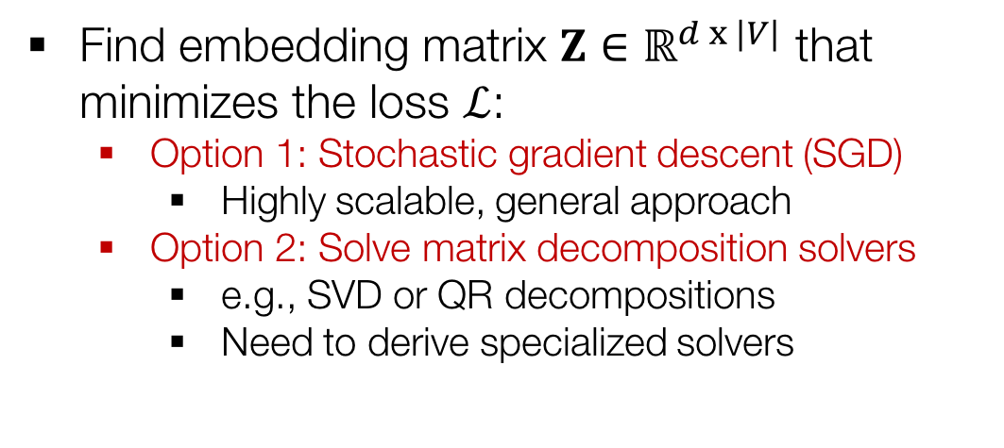
Adjacency-based Similarity
Find embedding matrix $Z∈ℝ^{d x |V|}$ that minimizes the loss $ℒ$:
  Option 1: Stochastic gradient descent (SGD)
    Highly scalable, general approach
  Option 2: Solve matrix decomposition solvers
    e.g., SVD or QR decompositions
    Need to derive specialized solvers

Slide 16
Adjacency-based Similarity
O(|V|²) runtime
  Must consider all node pairs
  O([E|) if summing over non-zero edges (e.g., Natarajan et al., 2014)
O(|V|) parameters
  One learned embedding per node
Only consider direct connections
Red nodes are obviously more similar to Green nodes compared to Orange nodes, despite none being directly connected

Slide 17
Outline of This Section
Adjacency-based similarity
Random walk approaches
Biomedical applications

Slide 18
Random Walk
Approaches
Material based on:
Perozzi et al. 2014. DeepWalk: Online Learning of Social Representations. KDD.
Grover et al. 2016. node2vec: Scalable Feature Learning for Networks. KDD.
Ribeiro et al. 2017. struc2vec: Learning Node Representations from Structural Identity. KDD.

Slide 19
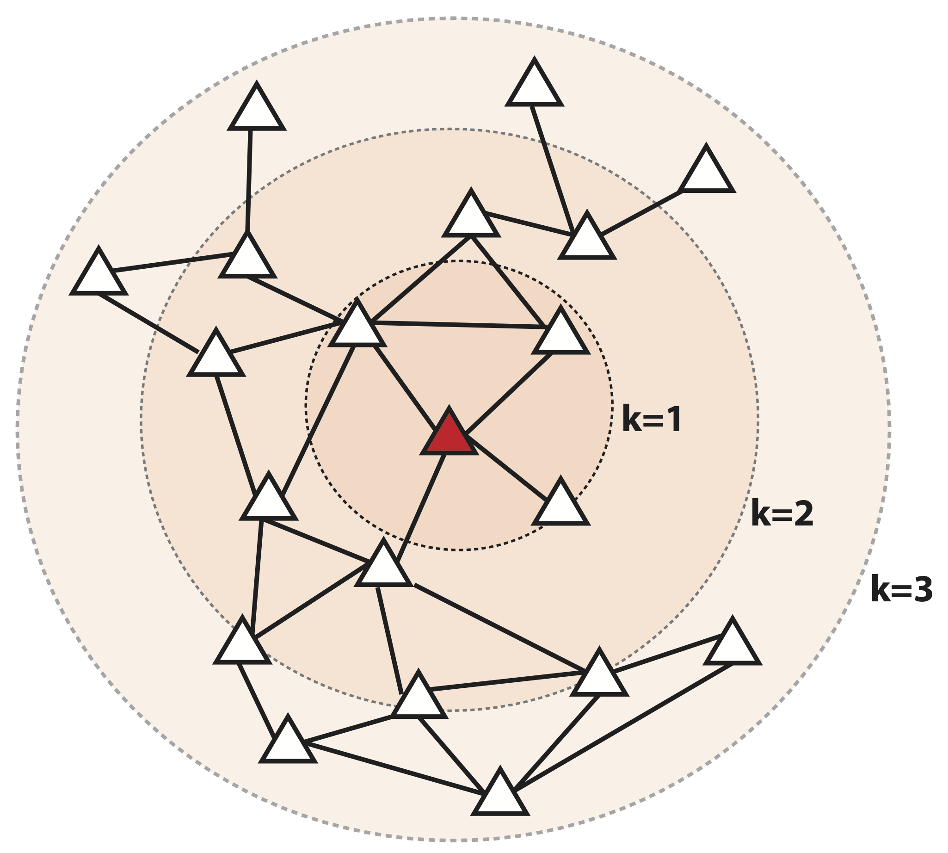
Multi-Hop Similarity
Idea: Define node similarity function based on higher-order neighborhoods
Red: Target node
k=1: 1-hop neighbors
  A (i.e., adjacency matrix)
k= 2: 2-hop neighbors
k=3: 3-hop neighbors
  How to stochastically define these higher-order neighborhoods?

Slide 20
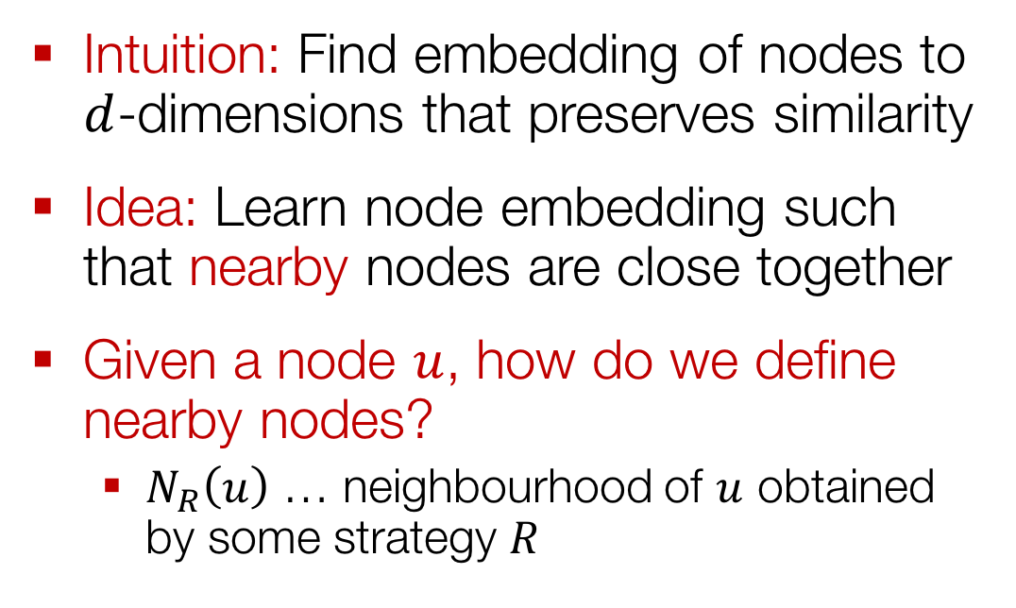
Unsupervised Feature Learning
Intuition: Find embedding of nodes to
$d$-dimensions that preserves similarity
Idea: Learn node embedding such that nearby nodes are close together
Given a node $u$, how do we define nearby nodes?
  $N_{R}\left(u\right)$ … neighbourhood of $u$ obtained by some strategy $R$

Slide 21
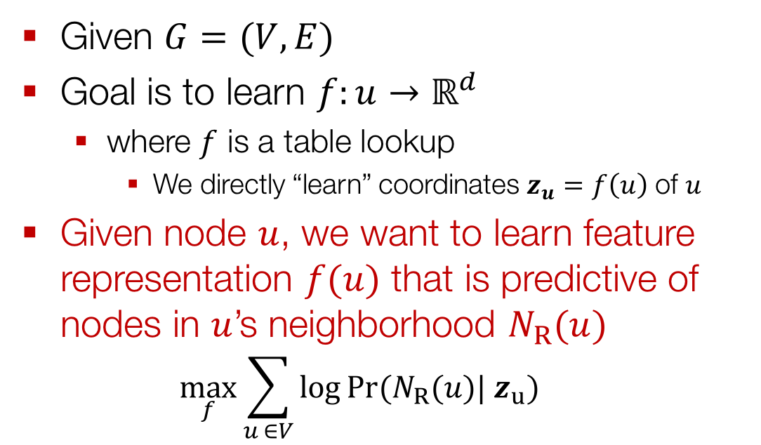
Feature Learning as Optimization
Given $G=(V,E)$
Goal is to learn $f:u→ℝ^{d}$
  where $f$ is a table lookup
    We directly “learn” coordinates $z_{u}=f\left(u\right)$ of $u$
Given node $u$, we want to learn feature representation $f(u)$ that is predictive of nodes in $u$’s neighborhood $N_{R}(u)$
  $$\max_{f}{\sum_{u ∈V}{\log{Pr(N_{R}(u})| z_{u})}}$$

Slide 22
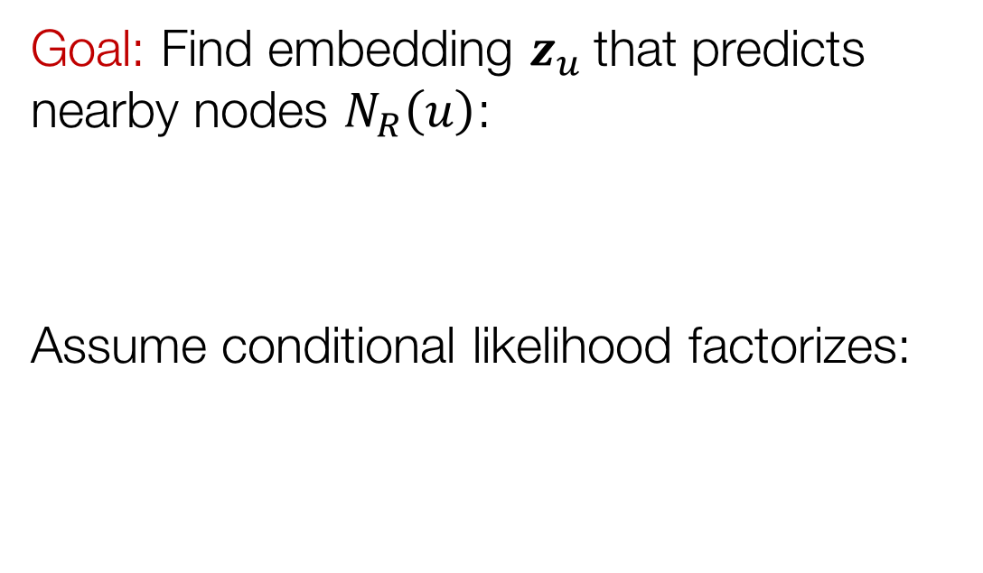
Unsupervised Feature Learning
Goal: Find embedding $z_{u}$that predicts nearby nodes $N_{R}\left(u\right)$:
Assume conditional likelihood factorizes:

Slide 23
Random-walk Embeddings
Probability that u and v co-occur in a random walk over the network

Slide 24
Why Random Walks?
Flexibility: Stochastic definition of node similarity:
  Local and higher-order neighborhoods
Efficiency: Do not need to consider all node pairs when training
  Consider only node pairs that co-occur in random walks

Slide 25
Random Walk Optimization
Simulate many short random walks starting from each node using a strategy R
For each node u, get N_{R}(u) as a sequence of nodes visited by random walks starting at u
For each node u, learn its embedding by predicting which nodes are in N_{R}(u):

Slide 26
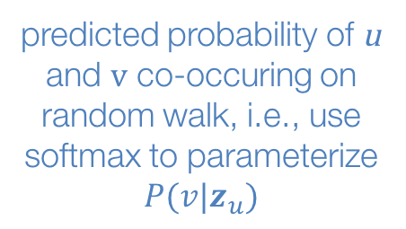
Random Walk Optimization
sum over all nodes u
sum over nodes v seen on random walks starting from u
predicted probability of u and v co-occuring on random walk, i.e., use softmax to parameterize $P(v|z_{u})$
Random walk embeddings = $z_{u}$ minimizing L

Slide 27
Random Walk Optimization
But doing this naively is too expensive!
Nested sum over nodes gives O(|V|²) complexity!
The problem is normalization term in the softmax function?

Slide 28
Solution: Negative Sampling
Solution: Negative sampling (Mikolov et al., 2013)
i.e., instead of normalizing w.r.t. all nodes, just normalize against k random negative samples
random distribution over all nodes
sigmoid function

Slide 29
Random Walks: Overview
Simulate many short random walks starting from each node using a strategy R
For each node u, get N_{R}(u) as a sequence of nodes visited by random walks starting at u
For each node u, learn its embedding by predicting which nodes are in N_{R}(u):
Can efficiently approximate using negative sampling

Slide 30
What is the strategy R?
So far:
  Given simulated random walks, we described how to optimize node embeddings
What strategies can we use to obtain these random walks?
  Simplest idea:
    Fixed-length, unbiased random walks starting from each node (i.e., DeepWalk from Perozzi et al., 2013)
  Can we do better?
    Grover et al., 2016; Ribeiro et al., 2017; Abu-El-Haija et al., 2017 and many others

Slide 31
node2vec: Biased Walks
Idea: Use flexible, biased random walks that can trade off between local and global views of the network (Grover and Leskovec, 2016)

Slide 32
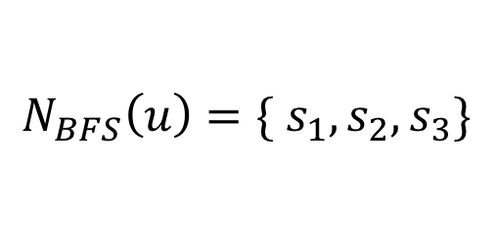
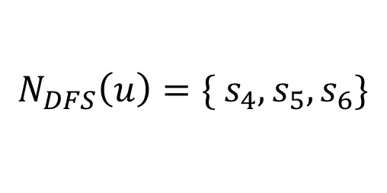

node2vec: Biased Walks
Two classic strategies to define a neighborhood $N_{R}\left(u\right)$ of a given node $u$:
$$N_{BFS}\left(u\right)=\{ s_{1},s_{2},s_{3}\}$$
Local microscopic view
$$N_{DFS}\left(u\right)=\{ s_{4},s_{5},s_{6}\}$$
Global macroscopic view

Slide 33
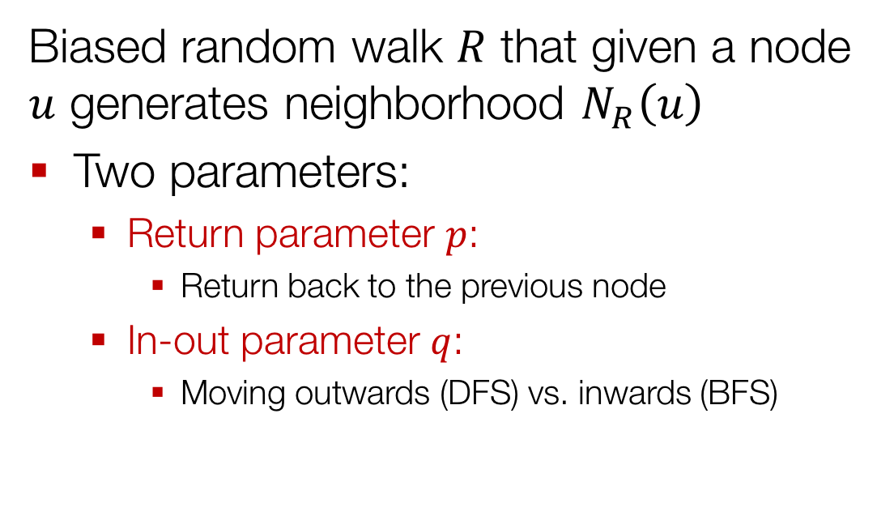
Interpolate BFS and DFS
Biased random walk $R$ that given a node $u$ generates neighborhood $N_{R}\left(u\right)$
Two parameters:
  Return parameter $p$:
    Return back to the previous node
  In-out parameter $q$:
    Moving outwards (DFS) vs. inwards (BFS)

Slide 34



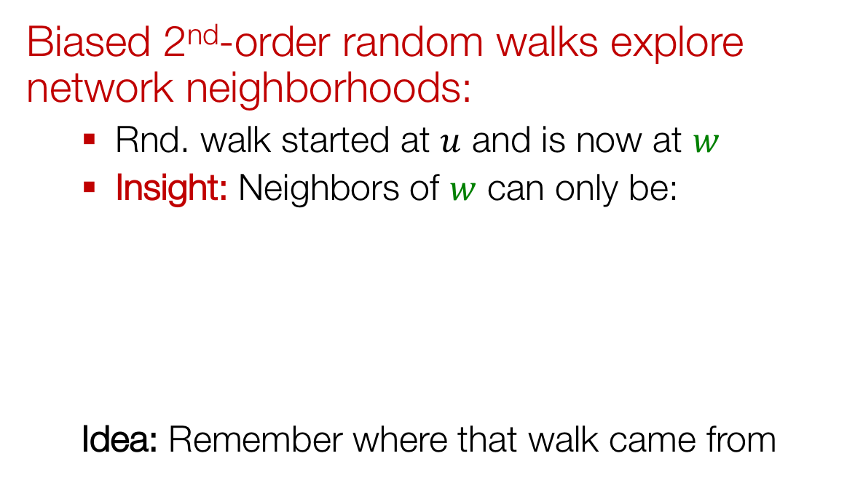
Biased Random Walks
Biased 2nd-order random walks explore network neighborhoods:
  Rnd. walk started at $u$ and is now at $w$
  Insight: Neighbors of $w$ can only be:
  Idea: Remember where that walk came from
Same distance to $u$
s₂
s₃
w
Farther from $u$
u
s₁
Closer to $u$

Slide 35



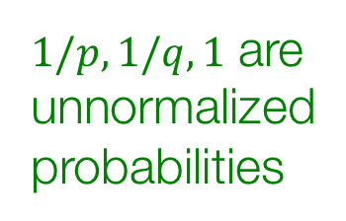

Biased Random Walks
Walker is at $w$. Where to go next?
$p,q$ model transition probabilities
  $p$ … return parameter
  $q$ … ”walk away” parameter
s₂
$$1$$
s₃
$1/p,1/q,1$ are unnormalized
probabilities
w
$$1/q$$
u
s₁
$$1/p$$

Slide 36

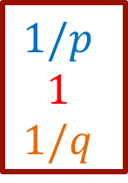

Biased Random Walks
Walker is at $w$. Where to go next?
  BFS-like walk: Low value of $p$
  DFS-like walk: Low value of $q$
$N_{S}(u)$ are the nodes visited by the walker
s₂
$$1$$
s₃
s₁
s₂
s₃
$$1/p$$
$$1$$
$$1/q$$
w
$w→$
$$1/q$$
u
s₁
$$1/p$$
Unnormalized
transition prob.

Slide 37
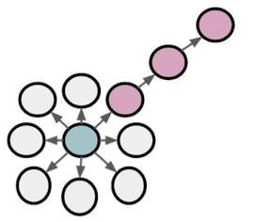
BFS vs. DFS
u
BFS:
Micro-view of neighbourhood
DFS:
Macro-view of neighbourhood

Slide 38
Experiment: Micro vs. Macro
Interactions of characters in a novel:
p=1, q=2
Microscopic view of the network neighbourhood
p=1, q=0.5
Macroscopic view of the network neighbourhood

Slide 39
Summary So Far
Idea: Embed nodes so that distances in the embedding space reflect node similarities in the network
Different notions of node similarity:
  Adjacency-based (i.e., similar if connected)
  Random walk approaches:
    Fixed-length, unbiased random walks starting from each node in the original network (Perozzi et al., 2013)
    Fixed-length, biased random walks on the original network (node2vec, Grover et al., 2016)

Slide 40
Summary So Far
So what method should I use..?
No one method wins in all cases….
  e.g., node2vec performs better on node classification while multi-hop methods performs better on link prediction (Goyal and Ferrara, 2017 survey).
Random walk approaches are generally more efficient (i.e., O(|E|) vs. O(|V|²))
In general: Must choose def’n of node similarity that matches application!

Slide 41
Outline of This Section
Adjacency-based similarity
Random walk approaches
Biomedical applications

Slide 42
Biomedical
Applications
Material based on:
Grover et al. 2016. node2vec: Scalable Feature Learning for Networks. KDD.
Zitnik and Leskovec. 2017. Predicting Multicellular Function through Multilayer Tissue Networks. ISMB.
Agrawal et al. 2018. Large-scale analysis of disease pathways in the human interactome. PSB.

Slide 43
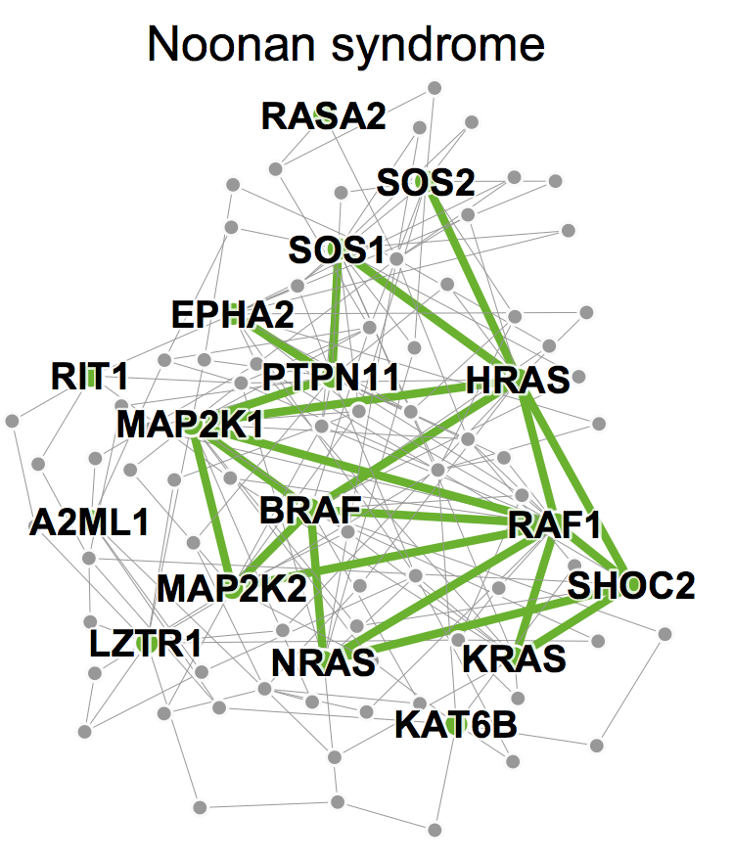
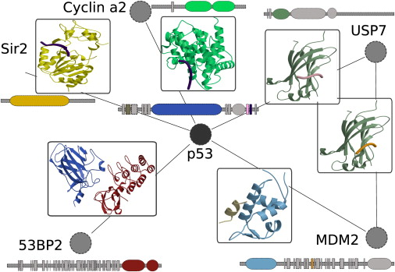
Biomedical Applications
Disease pathway detection:
  Identify proteins whose mutation is linked with a particular disease
  Task: Multi-label node classification
Protein interaction prediction:
  Identify protein pairs that physically interact in a cell
  Task: Link prediction

Slide 44
Human Interactome
RAD50
RFC1
MSH4
BRCA2
PCNA
FEN1
MED6
MSH5
DMC1
RAD51

Slide 45
Human Interactome
RAD50
RFC1
MSH4
BRCA2
Key principle (Cowen et al., 2017):
Proteins that interact underlie similar phenotypes (e.g., diseases)
PCNA
FEN1
MED6
MSH5
DMC1
RAD51

Slide 46


Disease Pathways
Pathway: Subnetwork of interacting proteins associated with a disease
RAD50
RFC1
MSH4
BRCA2
PCNA
Lung carcinoma
pathway
FEN1
MED6
MSH5
RAD51
DMC1

Slide 47
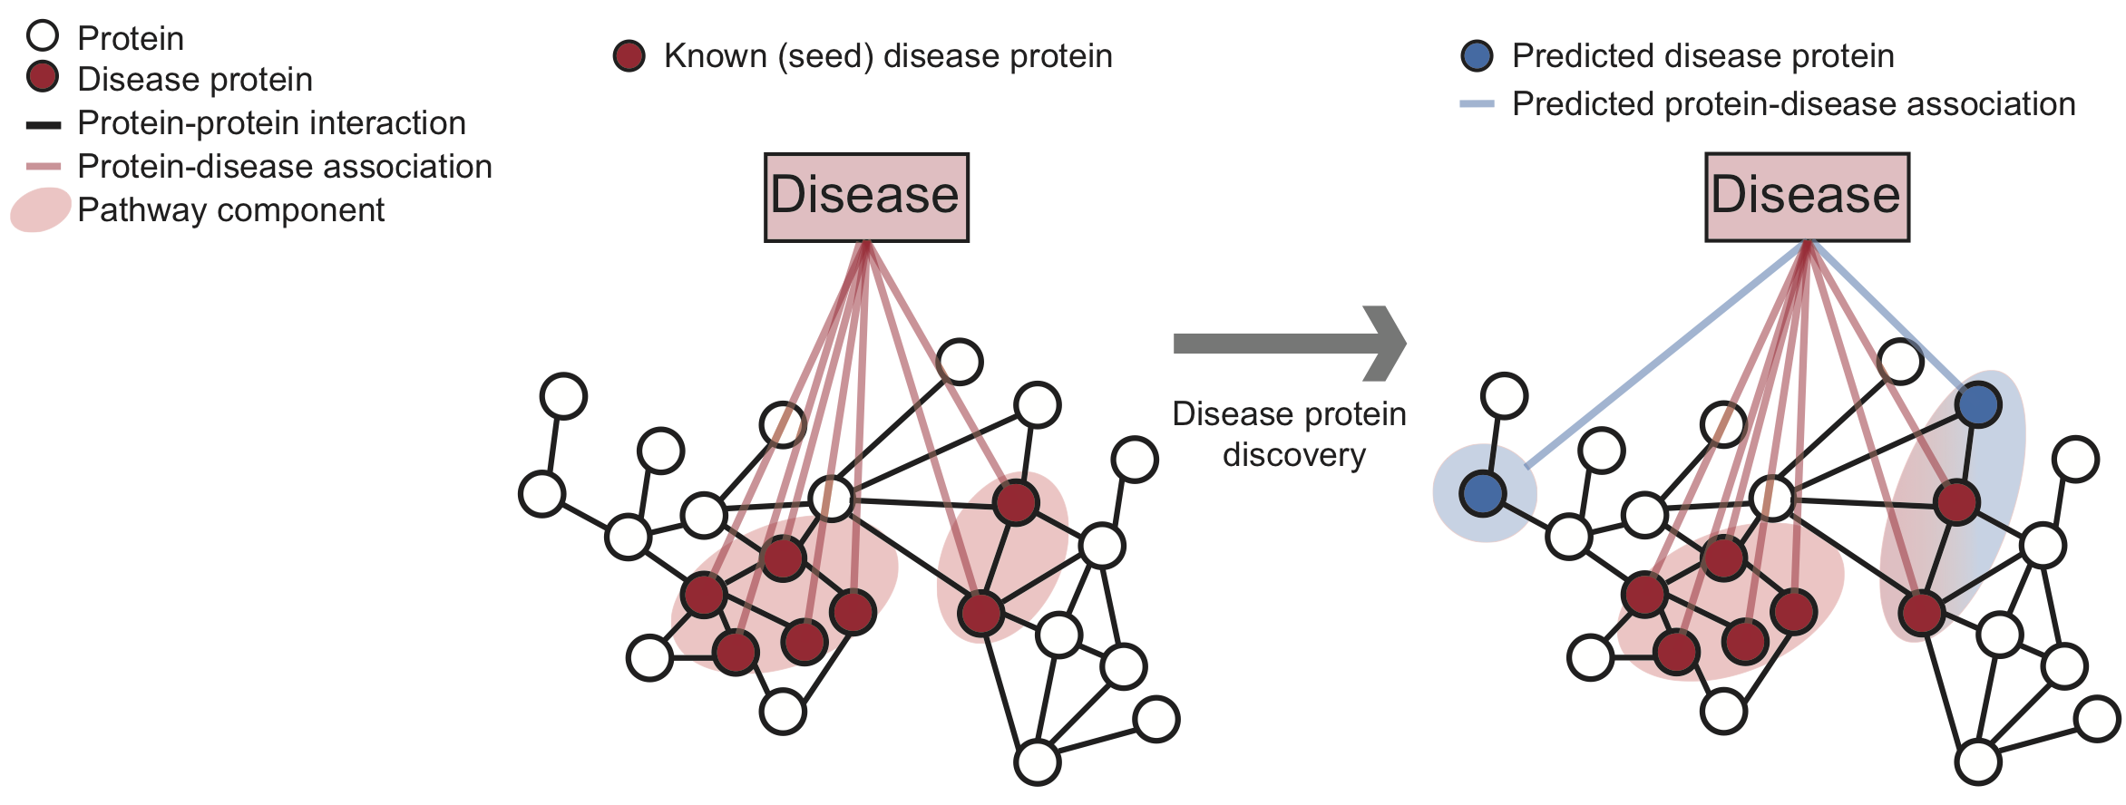
Disease Pathways: Task

Slide 48
Disease Pathway Dataset
Protein-protein interaction (PPI) network culled from 15 knowledge databases:
  350k physical interactions, e.g., metabolic enzyme-coupled interactions, signaling interactions, protein complexes
  All protein-coding human genes (21k)
Protein-disease associations:
  21k associations split among 519 diseases
Multi-label node classification: every node (i.e., protein) can have 0, 1 or more labels (i.e., disease associations)

Slide 49
Experimental Setup
Two main stages:
  Take the PPI network and use node2vec to learn an embedding for every node
  For each disease:
    Fits a logistic regression classifier that predicts disease proteins based on the embeddings:
      Train the classifier using training proteins
      Predict disease proteins in the test test: probability that a particular protein is associated with the disease

Slide 50
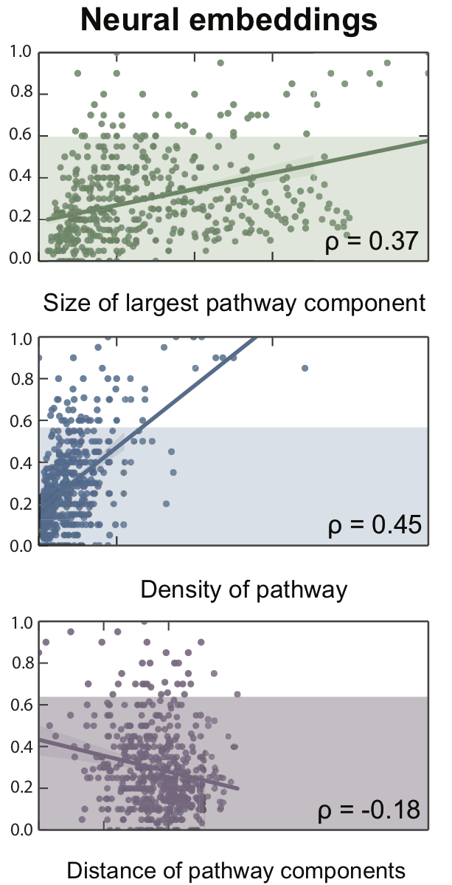
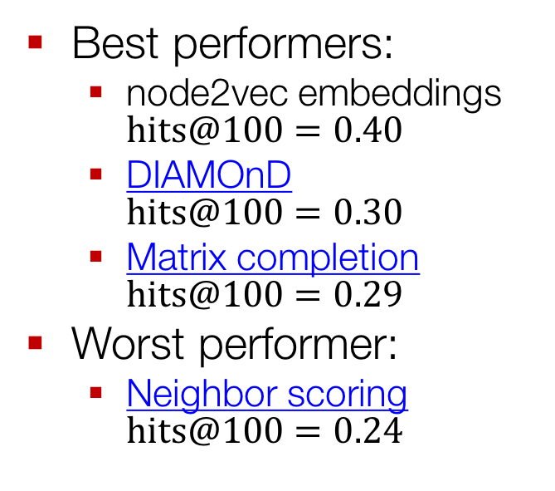

Pathways: Results
node2vec embeddings
Best performers:
  node2vec embeddings $hits@100=0.40$
  DIAMOnD $hits@100=0.30$
  Matrix completion $hits@100=0.29$
Worst performer:
  Neighbor scoring $hits@100=0.24$
hits@100
hits@100
hits@100
$hits@100$: fraction of all the disease proteins are
ranked within the first 100 predicted proteins

Slide 51
Biomedical Applications
Disease pathway detection:
  Identify proteins whose mutation is linked with a particular disease
  Task: Multi-label node classification
Protein interaction prediction:
  Identify protein pairs that physically interact in a cell
  Task: Link prediction

Slide 52
Protein-Protein Interaction
Image from: Perkins et al. Transient Protein-Protein Interactions: Structural,
Functional, and Network Properties. Structure. 2010.

Slide 53
Network Data
Human PPI network:
  Experimentally validated physical protein-protein interactions from the BioGRID
Link prediction: Given two proteins, predict probability that they interact
MSH4
RAD50
RFC1
BRCA2
PCNA
?
FEN1
MED6
?
?
MSH5
RAD51
DMC1

Slide 54
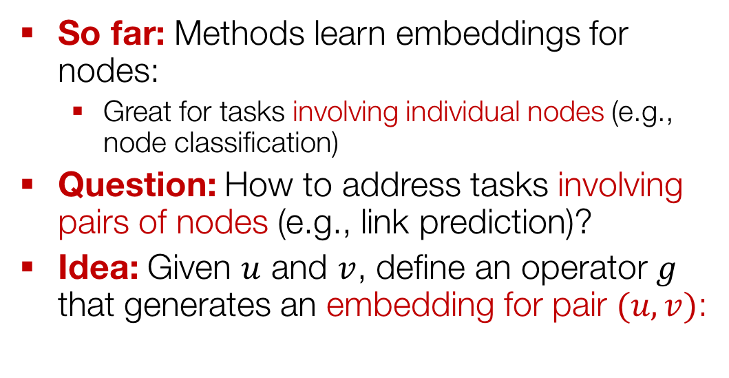

Learning Edge Embeddings
So far: Methods learn embeddings for nodes:
  Great for tasks involving individual nodes (e.g., node classification)
Question: How to address tasks involving pairs of nodes (e.g., link prediction)?
Idea: Given $u$ and $v$, define an operator $g$ that generates an embedding for pair $(u,v)$:
$$z_{(u,v)}=g(u, v)$$

Slide 55
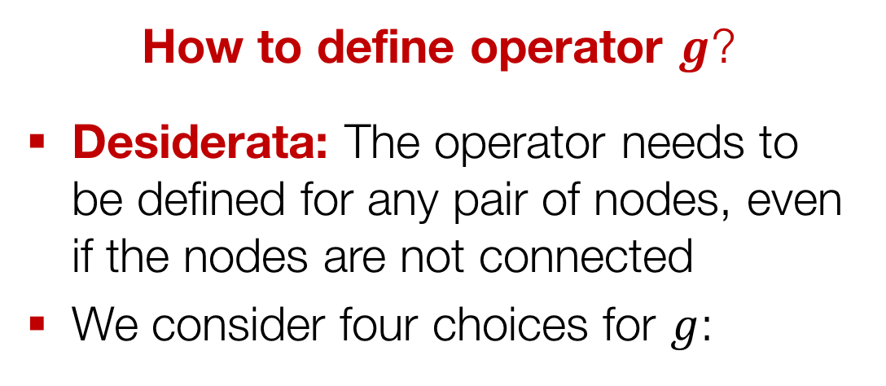
Learning Edge Embeddings
How to define operator $g$?
Desiderata: The operator needs to be defined for any pair of nodes, even if the nodes are not connected
We consider four choices for $g$:

Slide 56
Experimental Setup
  We are given a PPI network with a certain fraction of edges removed:
    Remove about 50% of edges
    Randomly sample an equal number of node pairs at random which have no edge connecting them
    Explicitly removed edges and non-existent (or false) edges form a balanced test data set
Two main stages:
  Use node2vec to learn an embedding for every node in the filtered PPI network
  Predict a score for every protein pair in the test set based on the embeddings

Slide 57
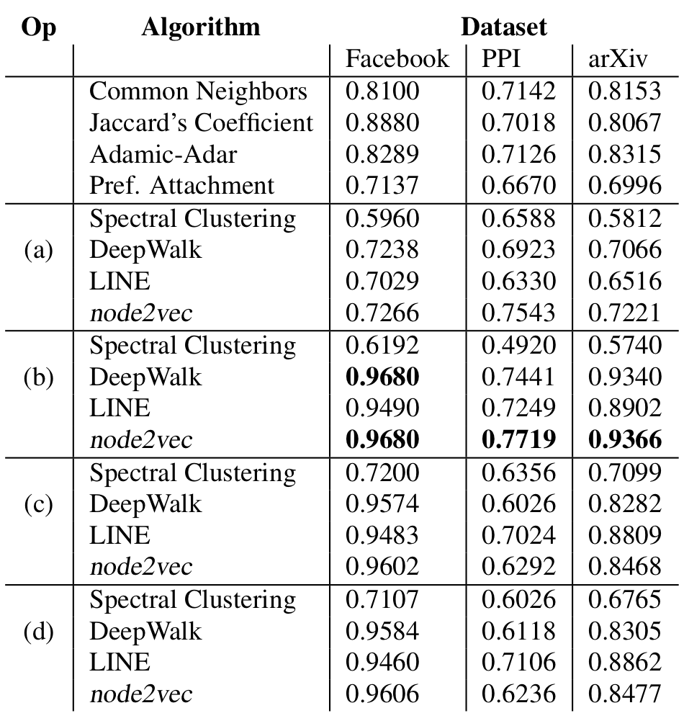
PPI Prediction: Results
Learned embeddings drastically outperform heuristic scores
Hadamard operator:
  Highly stable
  Best average performance
F1 – scores are in [0,1], higher is better
Notes:
\begin{table}
\centering
\begin{tabular}{l|c}
\textbf{Scoring node pairs} & \textbf{Definition} \\ \hline
(a) Average & $[\mathbf{z}_u \boxplus \mathbf{z}_v]_i = \frac{\mathbf{z}_u(i) +\mathbf{z}_v(i)}{2}$ \\
(b) Hadamard & $[\mathbf{z}_u \boxdot \mathbf{z}_v]_i = \mathbf{z}_u(i)*\mathbf{z}_v(i)$ \\
(c) Weighted-L1 & $\|\mathbf{z}_u \cdot \mathbf{z}_v\|_{\bar{1}i} = |\mathbf{z}_u(i)-\mathbf{z}_v(i)|$ \\
(d) Weighted-L2 & $\|\mathbf{z}_u \cdot \mathbf{z}_v\|_{\bar{2}i} = |\mathbf{z}_u(i)-\mathbf{z}_v(i)|^2$
\end{tabular}
\vspace{-0.2cm}
\vspace{-0.4cm}
\label{tab:edgeop}
\end{table}

Slide 58
Biomedical Applications
Disease pathway detection:
  Identify proteins whose mutation is linked with a particular disease
  Task: Multi-label node classification
Protein interaction prediction:
  Identify protein pairs that physically interact in a cell
  Task: Link prediction

Slide 59
Outline of This Section
Adjacency-based similarity
Random walk approaches
Biomedical applications

Slide 60








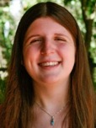


















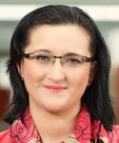





Industry Partnerships
PhD Students
Claire
Donnat
Mitchell
Gordon
David
Hallac
Emma
Pierson
Geet
Sethi
Funding
Himabindu
Lakkaraju
Rex
Ying
Tim
Althoff
Will
Hamilton
Alex
Porter
Post-Doctoral Fellows
Collaborators
Dan Jurafsky, Linguistics, Stanford University
Christian Danescu-Miculescu-Mizil, Information Science, Cornell University
Stephen Boyd, Electrical Engineering, Stanford University
David Gleich, Computer Science, Purdue University
VS Subrahmanian, Computer Science, University of Maryland
Sarah Kunz, Medicine, Harvard University
Russ Altman, Medicine, Stanford University
Jochen Profit, Medicine, Stanford University
Eric Horvitz, Microsoft Research
Jon Kleinberg, Computer Science, Cornell University
Sendhill Mullainathan, Economics, Harvard University
Scott Delp, Bioengineering, Stanford University
Jens Ludwig, Harris Public Policy, University of Chicago
Baharan
Mirzasoleiman
Marinka
Zitnik
Michele
Catasta
Srijan
Kumar
Research
Staff
Stephen
Bach
Adrijan
Bradaschia
Rok
Sosic

Slide 61

Many interesting high-impact projects
in Machine Learning and Large Biomedical Data
Applications: Precision Medicine & Health, Drug Repurposing, Drug Side Effect modeling, Network Biology, and many more

