Slide 1

Optimizing Submodular Functions
-- Final exam logistics
-- Please fill out course evaluation forms (THANKS!!!)
CS246: Mining Massive Datasets
Jure Leskovec, Stanford University
http://cs246.stanford.edu

Slide 2
Announcement:
Final Exam Logistics

Slide 3
Final: Logistics
Date:
  Tuesday, March 20, 3:30-6:30 pm
Location:
  Gates B01 (Last name A-H)
  Skilling Auditorium (Last name I-N)
  NVIDIA Auditorium (Last name O-Z)
SCPD:
  Your exam monitor will receive the exam this week
  You may come to Stanford to take the exam, or take it at most 48 hours before the exam time
  Email exam PDF to cs246.mmds@gmail.com by Tuesday, March 20, 11:59 pm Pacific Time
  Call Jessica at +1 561-543-1855 if you have questions during the exam, or email the course staff mailing list

Slide 4
Final: Instructions
Final exam is open book and open notes
A calculator or computer is REQUIRED
  You may only use your computer to do arithmetic calculations (i.e. the buttons found on a standard scientific calculator)
  You may also use your computer to read course notes or the textbook
  But no internet/google/python access is allowed
Anyone who brings a power strip to the final exam gets 1 point extra credit for helping out their classmates

Slide 5
Optimizing Submodular Functions
CS246: Mining Massive Datasets
Jure Leskovec, Stanford University
http://cs246.stanford.edu

Slide 6


Recommendations: Diversity
Redundancy leads to a bad user experience
  Uncertainty around information need => don’t put all eggs in one basket
How do we optimize for diversity directly?
Notes:
Users can get bored from redundancy
Putting all of our eggs in one basket
How do we optimize for this directly?

Slide 7
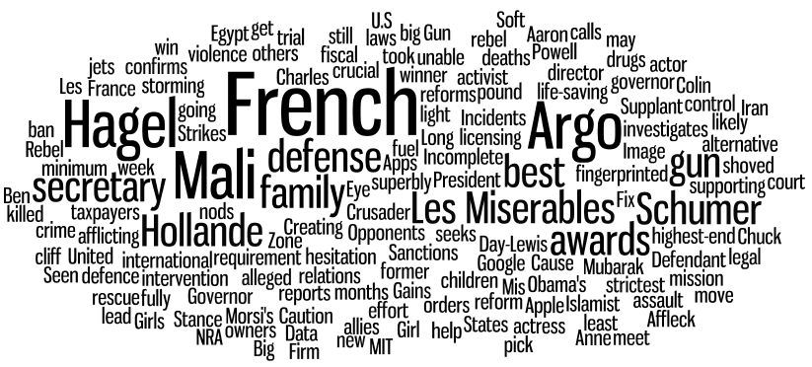
Covering the day’s news
France intervenes
Chuck for Defense
Argo wins big
Hagel expects fight
Monday, January 14, 2013
Notes:
And so, with this as motivation, our goal in this work is to Turn Down the Noise in the Blogosphere by presenting users with a small set of representative posts that cover the important stories. We refer to this as coverage.
<click>
For example, this is what a typical day looks like in the blogosphere. In this word cloud, the size of a word represents its frequency in the blogosphere for this day, January 17.
<click>
As we can see, the important features here are Obama, Israel – Gaza, New York, etc.

Slide 8
Covering the day’s news
France intervenes
Chuck for Defense
Argo wins big
New gun proposals
Monday, January 14, 2013
Notes:
And so, with this as motivation, our goal in this work is to Turn Down the Noise in the Blogosphere by presenting users with a small set of representative posts that cover the important stories. We refer to this as coverage.
<click>
For example, this is what a typical day looks like in the blogosphere. In this word cloud, the size of a word represents its frequency in the blogosphere for this day, January 17.
<click>
As we can see, the important features here are Obama, Israel – Gaza, New York, etc.

Slide 9
Encode Diversity as Coverage
Idea: Encode diversity as coverage problem
Example: Word cloud of news for a single day
  Want to select articles so that most words are “covered”

Slide 10
Diversity as Coverage

Slide 11

What is being covered?
Q: What is being covered?
A: Concepts (In our case: Named entities)
Q: Who is doing the covering?
A: Documents
France
Mali
Hagel
Pentagon
Obama
Romney
Zero Dark Thirty
Argo
NFL
Hagel expects fight

Slide 12
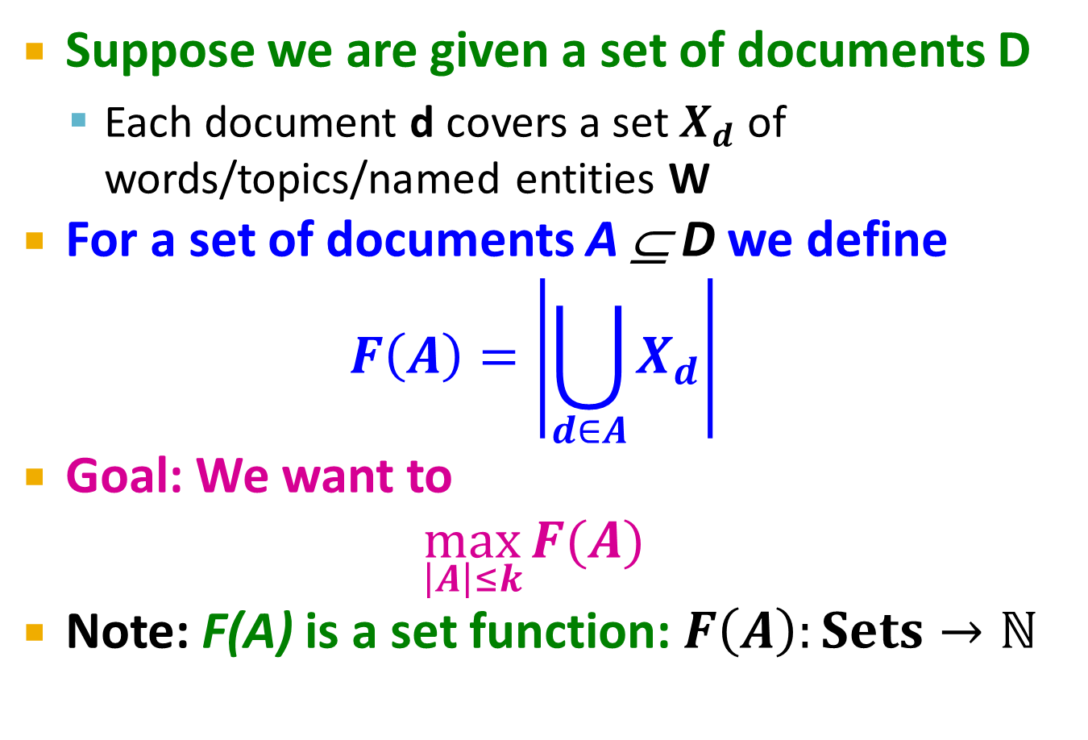
Simple Abstract Model
Suppose we are given a set of documents D
  Each document d covers a set $X_{d}$ of words/topics/named entities W
For a set of documents A ⊆ D we define
$$F\left(A\right)=\left|\bigcup_{d∈A}{X_{d}}\right|$$
Goal: We want to
$$\max_{\left|A\right|≤k}{F(A)}$$
Note: F(A) is a set function: $F\left(A\right):Sets→ℕ$

Slide 13

Maximum Coverage Problem
Given universe of elements $W = \{w1,…,w_{n}\}$ and sets $X1,…, X_{m}  W$
Goal: Find k sets X_{i} that cover the most of W
  More precisely: Find k sets X_{i} whose size of the union is the largest
  Bad news: A known NP-complete problem
X₃
X₁
W
X₂
X₄

Slide 14


Simple Greedy Heuristic
Simple Heuristic: Greedy Algorithm:
Start with $A0=\{ \}$
For $i=1…k$
  Find set $d$ that $max⁡F(A_{i−1}∪\{d\})$
  Let $A_{i}=A_{i−1 } \{d\}$
Example:
  Eval. $F\left(\left\{d_{1}\right\}\right),…, F(\{d_{m}\})$, pick best (say $d_{1}$)
  Eval. $F\left(\left\{d_{1}\}∪\{d_{2}\right\}\right),…, F(\{d_{1}\}∪\{d_{m}\})$, pick best (say $d_{2}$)
  Eval. $F({\{d}_{1},d_{2}\}∪\{d_{3}\}),…, F(\{d_{1},d_{2}\}∪\{d_{m}\})$, pick best
  And so on…
$$F\left(A\right)=\left|\bigcup_{d∈A}{X_{d}}\right|$$

Slide 15
Simple Greedy Heuristic
Goal: Maximize the covered area

Slide 16
Simple Greedy Heuristic
Goal: Maximize the covered area

Slide 17
Simple Greedy Heuristic
Goal: Maximize the covered area

Slide 18
Simple Greedy Heuristic
Goal: Maximize the covered area

Slide 19
Simple Greedy Heuristic
Goal: Maximize the covered area

Slide 20
When Greedy Heuristic Fails?
A
B
C
Goal: Maximize the size of the covered area
Greedy first picks A and then C
But the optimal way would be to pick B and C

Slide 21
Approximation Guarantee
Greedy produces a solution A
where: F(A) ≥ (1-1/e)*OPT (F(A) ≥ 0.63*OPT)
[Nemhauser, Fisher, Wolsey ’78]
Claim holds for functions F(·) with 2 properties:
  F is monotone: (adding more docs doesn’t decrease coverage)
  if A ⊆ B then F(A) ≤ F(B) and F({})=0
  F is submodular:
  adding an element to a set gives less improvement
  than adding it to one of its subsets

Slide 22
Submodularity: Definition
Definition:
Set function F(·) is called submodular if:
For all A,B⊆ W:
F(A) + F(B) ≥ F(A∪ B) + F(A∩ B)
+
≥
+
A
B
A ∪ B
A ∩ B

Slide 23
Submodularity: Or equivalently
Diminishing returns characterization
Equivalent definition:
Set function F(·) is called submodular if:
For all A⊆ B, d∉B:
F(A ∪ d) – F(A) ≥ F(B ∪ d) – F(B)
Gain of adding d to a small set
Gain of adding d to a large set
B
+
d
Large improvement
A
+
d
Small improvement

Slide 24

Example: Set Cover
F(·) is submodular: A ⊆ B
Natural example:
  Sets $d1, …, d_{m}$
  $F\left(A\right)=\left|\bigcup_{i∈A}{d_{i}}\right|$
  (size of the covered area)
  Claim:
  $F(A)$ is submodular!
F(A ∪ d) – F(A) ≥ F(B ∪ d) – F(B)
Gain of adding d to a small set
Gain of adding d to a large set
A
d
B
d
Notes:
SPLIT

Slide 25
Submodularity– Diminishing returns
Submodularity is discrete analogue of concavity
F(·)
F(B ∪ d)
  ∀A ⊆ B
F(B)
F(A ∪ d)
F(A)
Adding d to B helps less
than adding it to A!
Solution size |A|
F(A ∪ d) – F(A) ≥ F(B ∪ d) – F(B)
Gain of adding X_{d} to a small set
Gain of adding X_{d} to a large set

Slide 26

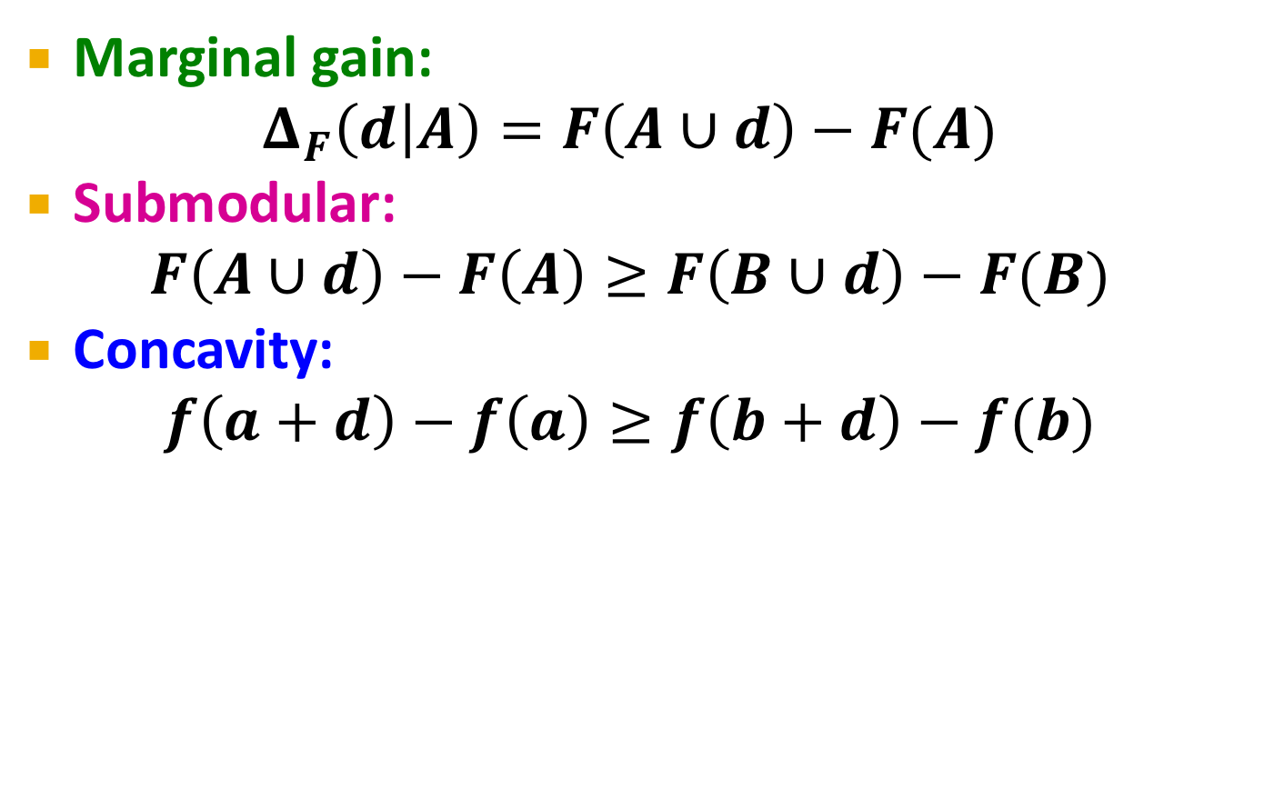

Submodularity & Concavity
Marginal gain:
$$Δ_{F}\left(d | A\right)=F\left(A∪d\right)−F(A)$$
Submodular:
$F\left(A∪d\right)−F\left(A\right)≥F\left(B∪d\right)−F(B)$
Concavity:
$f\left(a+d\right)−f\left(a\right)≥f\left(b+d\right)−f(b)$
$$A⊆B$$
$$a≤b$$
F(A)
|A|

Slide 27
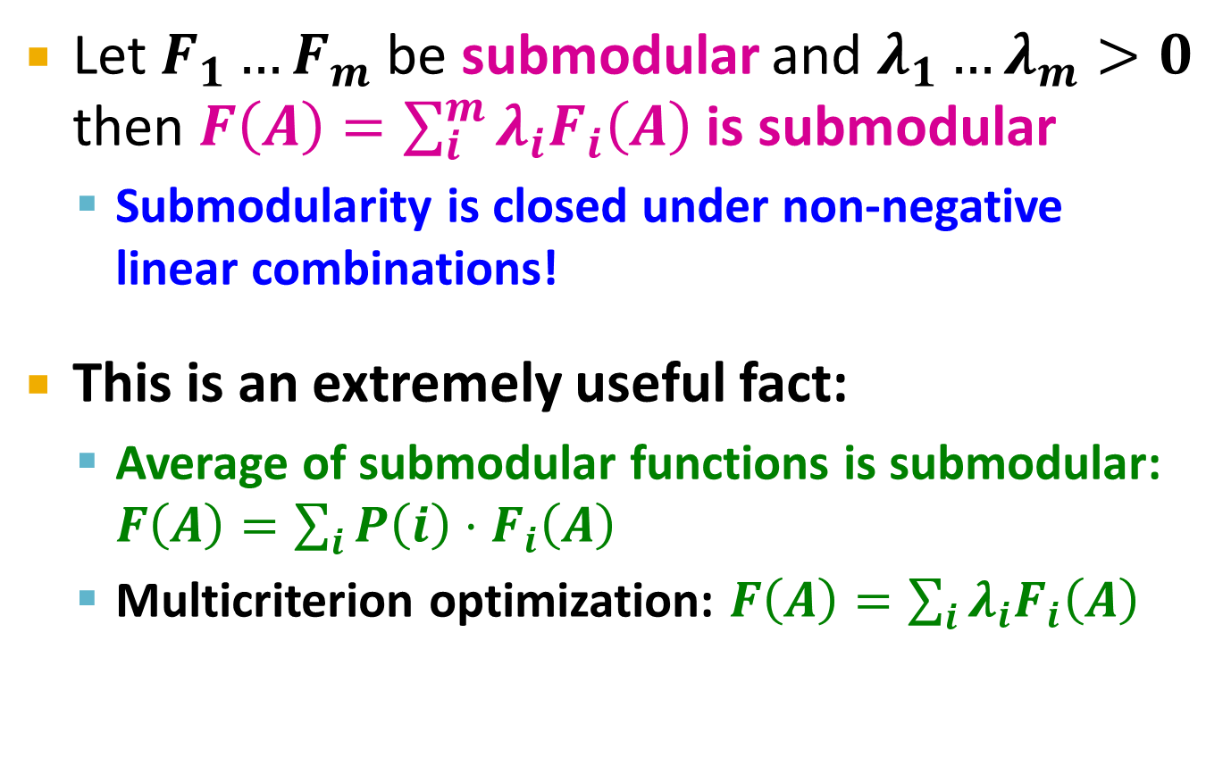
Submodularity: Useful Fact
Let $F_{1}…F_{m}$ be submodular and $λ_{1}…λ_{m}>0$ then $F\left(A\right)=\sum_{i}^{m}{λ_{i}F_{i}\left(A\right)}$ is submodular
  Submodularity is closed under non-negative linear combinations!
This is an extremely useful fact:
  Average of submodular functions is submodular: $F\left(A\right)=\sum_{i}{P\left(i\right)⋅F_{i}\left(A\right)}$
  Multicriterion optimization: $F\left(A\right)=\sum_{i}{λ_{i}F_{i}\left(A\right)}$

Slide 28
Back to our problem
Q: What is being covered?
A: Concepts (In our case: Named entities)
Q: Who is doing the covering?
A: Documents
France
Mali
Hagel
Pentagon
Obama
Romney
Zero Dark Thirty
Argo
NFL
Hagel expects fight

Slide 29
Back to our Concept Cover Problem
Objective: pick k docs that cover most concepts
F(A): the number of concepts covered by A
  Elements…concepts, Sets … concepts in docs
  F(A) is submodular and monotone!
  We can use greedy to optimize F
France
Mali
Hagel
Pentagon
Obama
Romney
Zero Dark Thirty
Argo
NFL
Enthusiasm for Inauguration wanes
Inauguration weekend

Slide 30
The Set Cover Problem
Objective: pick k docs that cover most concepts
France
Mali
Hagel
Pentagon
Obama
Romney
Zero Dark Thirty
Argo
NFL
Enthusiasm for Inauguration wanes
Inauguration weekend
The good:
The bad:
Penalizes redundancy
Concept importance?
Submodular
All-or-nothing too harsh

Slide 31
Probabilistic Set Cover

Slide 32

Concept importance?
Objective: pick k docs that cover most concepts
France
Mali
Hagel
Pentagon
Obama
Romney
Zero Dark Thirty
Argo
NFL
Enthusiasm for Inauguration wanes
Inauguration weekend
Each concept $c$ has importance weight $w_{c}$

Slide 33
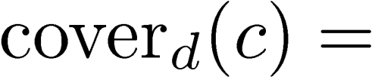
All-or-nothing too harsh
Document coverage function
probability document d covers
concept c
[e.g., how strongly d covers c]
Obama
Romney
Enthusiasm for Inauguration wanes
Notes:
Previously, a set of docs A covered c if at least one of the docs in A contained c
Now we have a probabilistic notion of document covg, so we’ll define set covg in the analogous way.

Slide 34
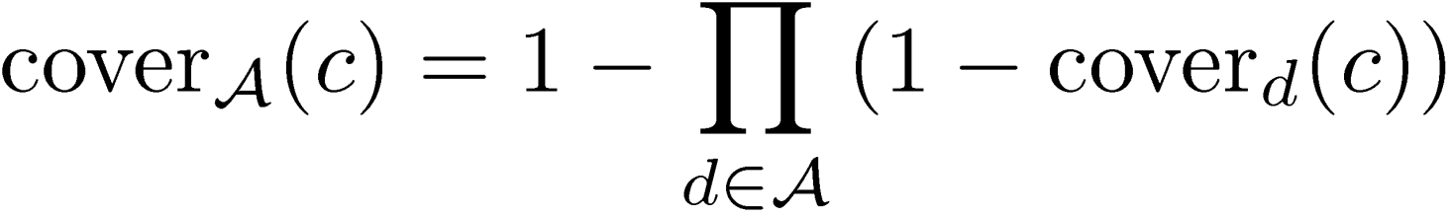
Probabilistic Set Cover
Document coverage function:
probability document d covers
concept c
    Cover_{d}(c) can also model how relevant is concept c for user u
Set coverage function:
  Prob. that at least one document in A covers c
Objective:
concept weights
Notes:
Previously, a set of docs A covered c if at least one of the docs in A contained c
Now we have a probabilistic notion of document covg, so we’ll define set covg in the analogous way.

Slide 35
Optimizing F(A)
The objective function is also submodular
  Intuitive diminishing returns property
  Greedy algorithm leads to a (1 – 1/e) ~ 63% approximation, i.e., a near-optimal solution

Slide 36
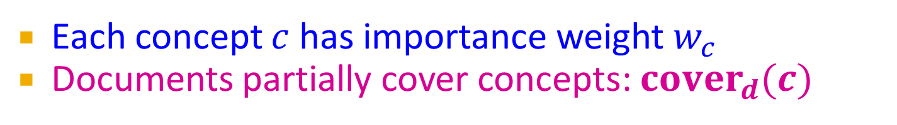
Summary: Probabilistic Set Cover
Objective: pick k docs that cover most concepts
France
Mali
Hagel
Pentagon
Obama
Romney
Zero Dark Thirty
Argo
NFL
Enthusiasm for Inauguration wanes
Inauguration weekend
Each concept $c$ has importance weight $w_{c}$
Documents partially cover concepts: $cover_{d}(c)$

Slide 37
Lazy Optimization of Submodular Functions

Slide 38
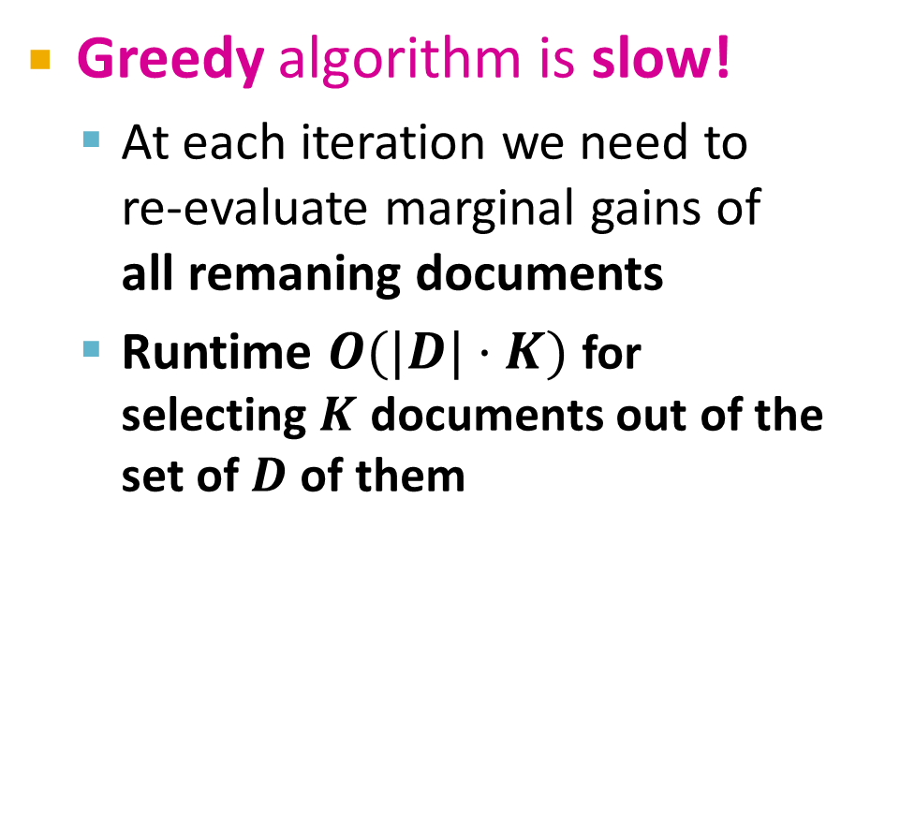
Submodular Functions
Greedy algorithm is slow!
  At each iteration we need to
  re-evaluate marginal gains of
  all remaning documents
  Runtime $O(|D|·K)$ for
  selecting $K$ documents out of the set of $D$ of them
Greedy
Marginal gain:
F(A∪x)-F(A)
a
b
c
d
e
Add document with
highest marginal gain

Slide 39
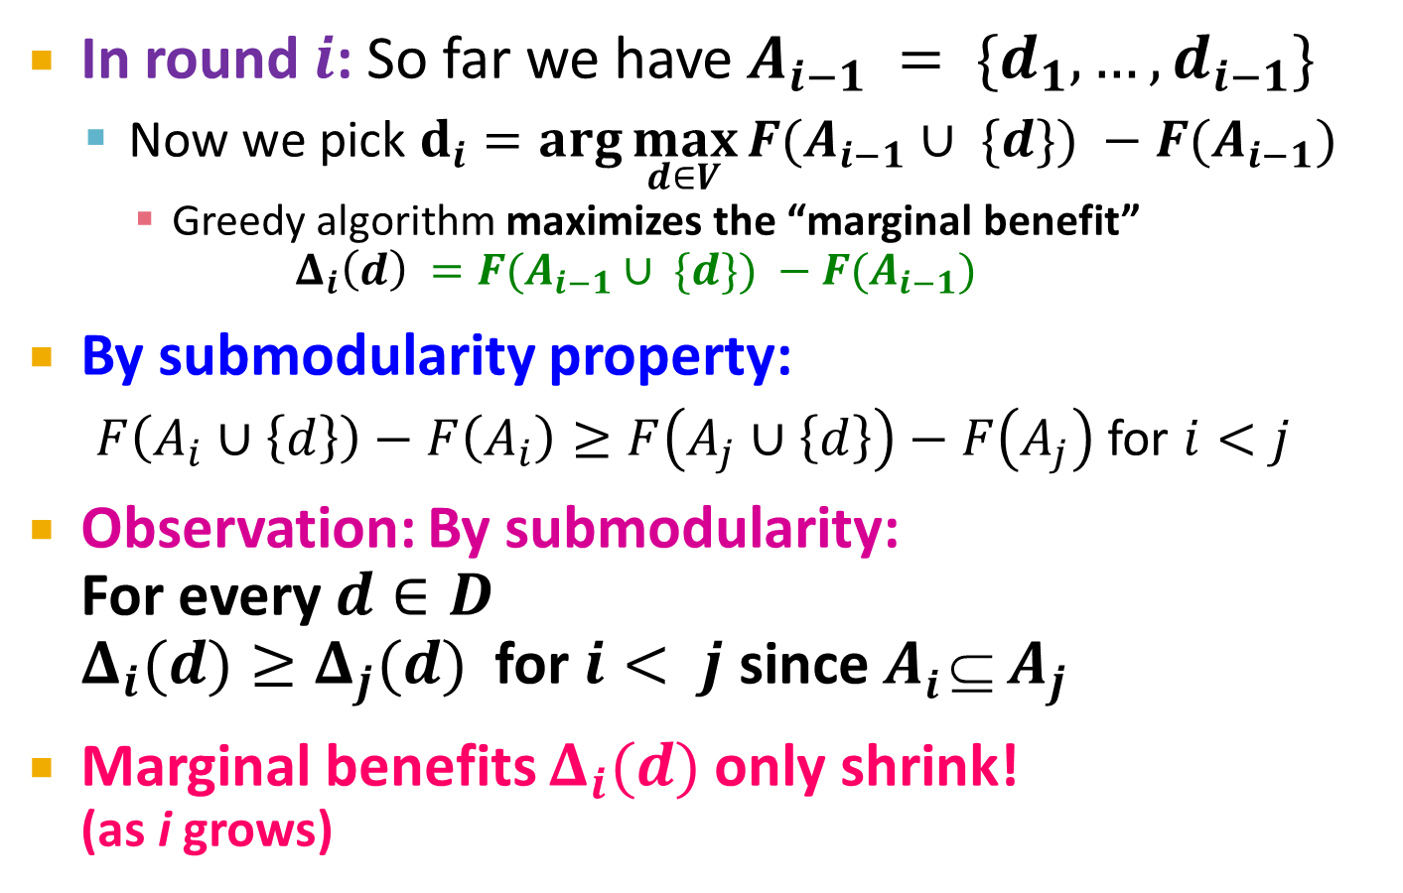
Speeding up Greedy
[Leskovec et al., KDD ’07]
In round $i$: So far we have $A_{i−1} = \{d_{1},…,d_{i−1}\}$
  Now we pick $d_{i}=\arg{\max_{d∈V}{F(A_{i−1}∪ \{d\}) −F(A_{i−1})}}$
    Greedy algorithm maximizes the “marginal benefit”
    $Δ_{i}\left(d\right) =F(A_{i−1}∪ \{d\}) −F(A_{i−1})$
By submodularity property:
  $F\left(A_{i}∪\left\{d\right\}\right)−F\left(A_{i}\right)≥F\left(A_{j}∪\left\{d\right\}\right)−F\left(A_{j}\right)$ for $i<j$
Observation: By submodularity:
For every $d∈D$
$Δ_{i}(d)≥Δ_{j}(d)$ for $i< j$ since $Ai  A_{j}$
Marginal benefits $Δ_{i}(d)$ only shrink!
(as i grows)
Δ_{i}(d)
≥ Δ _{j}(d)
d
Selecting document d in step i covers more words than selecting d at step j (j>i)

Slide 40
Lazy Greedy
[Leskovec et al., KDD ’07]
Idea:
  Use Δ_{i} as upper-bound on Δ_{j} (j > i)
Lazy Greedy:
  Keep an ordered list of marginal benefits Δ_{i} from previous iteration
  Re-evaluate Δ_{i} only for top element
  Re-sort and prune
(Upper bound on)
Marginal gain Δ₁
a
A₁={a}
b
c
d
e
F(A ∪ {d}) – F(A) ≥ F(B ∪ {d}) – F(B)
A ⊆ B

Slide 41
Lazy Greedy
[Leskovec et al., KDD ’07]
Idea:
  Use Δ_{i} as upper-bound on Δ_{j} (j > i)
Lazy Greedy:
  Keep an ordered list of marginal benefits Δ_{i} from previous iteration
  Re-evaluate Δ_{i} only for top element
  Re-sort and prune
Upper bound on
Marginal gain Δ₂
a
A₁={a}
b
c
d
e
F(A ∪ {d}) – F(A) ≥ F(B ∪ {d}) – F(B)
A ⊆ B

Slide 42
Lazy Greedy
[Leskovec et al., KDD ’07]
Idea:
  Use Δ_{i} as upper-bound on Δ_{j} (j > i)
Lazy Greedy:
  Keep an ordered list of marginal benefits Δ_{i} from previous iteration
  Re-evaluate Δ_{i} only for top element
  Re-sort and prune
Upper bound on
Marginal gain Δ₂
a
A₁={a}
d
A₂={a,b}
b
e
c
F(A ∪ {d}) – F(A) ≥ F(B ∪ {d}) – F(B)
A ⊆ B
Notes:
If that removes it from the top, pick next sensor
Continue until top remains unchanged

Slide 43
Summary so far
Summary so far:
  Diversity can be formulated as a set cover
  Set cover is submodular optimization problem
  Can be (approximately) solved using greedy algorithm
  Lazy-greedy gives significant speedup
400
exhaustive search
300
(all subsets)
Lower is better
naive
running time (seconds)
200
greedy
100
Lazy
0
1
2
3
4
5
6
7
8
9
10
number of blogs selected

Slide 44

But what about personalization?
Election trouble
model
Songs of Syria
Sandy delays
Recommendations

Slide 45





Concept Coverage
We assumed same concept weighting for all users
France
Mali
Hagel
Pentagon
Obama
Romney
Zero Dark Thirty
Argo
NFL
France intervenes
Chuck for Defense
Argo wins big

Slide 46
Personal Concept Weights
Each user has different preferences over concepts
France
Mali
Hagel
Pentagon
Obama
Romney
Zero Dark Thirty
Argo
NFL
politico
France
Mali
Hagel
Pentagon
Obama
Romney
Zero Dark Thirty
Argo
NFL
movie buff

Slide 47
Personal concept weights
Assume each user u has different preference vector w_{c}^{(u)} over concepts c
Goal: Learn personal concept weights from user feedback

Slide 48
Interactive Concept Coverage
France
Mali
Hagel
Pentagon
Obama
Romney
Zero Dark Thirty
Argo
NFL
France intervenes
Chuck for Defense
Argo wins big
Notes:
Describe two intuitions

Slide 49
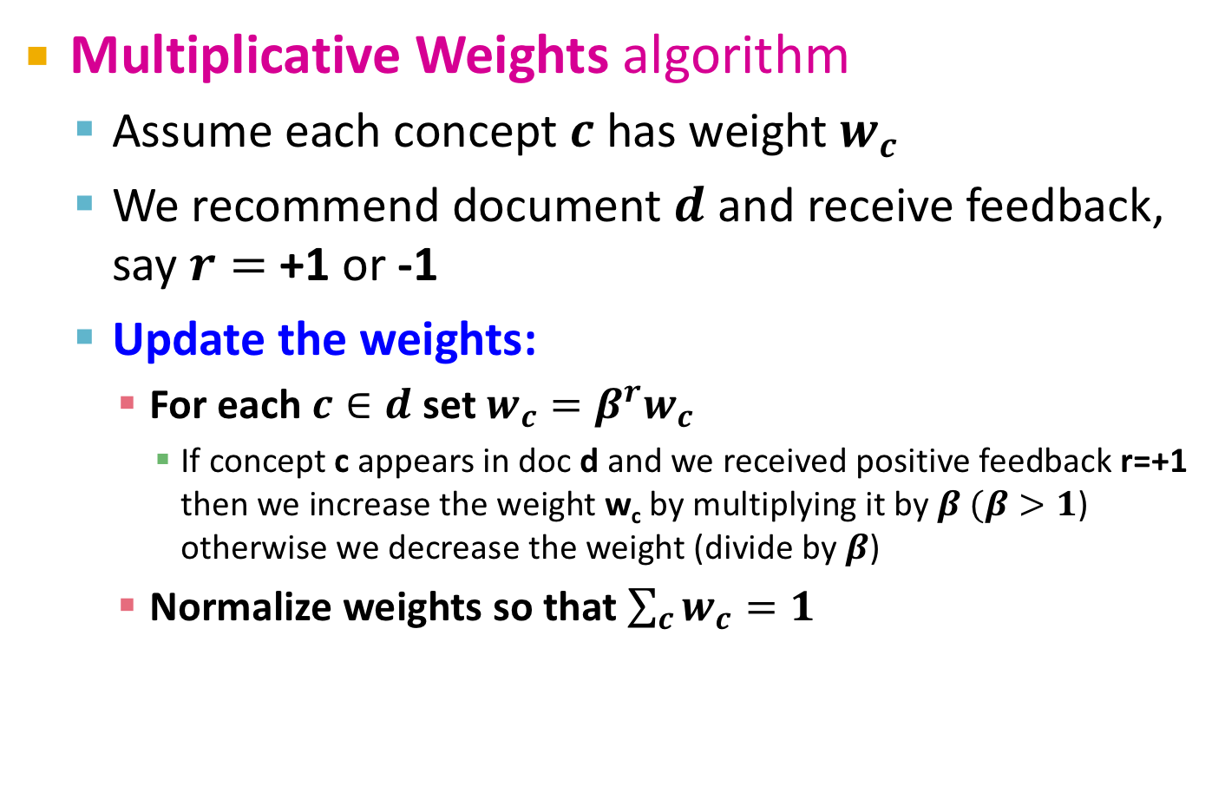
Multiplicative Weights (MW)
Multiplicative Weights algorithm
  Assume each concept $c$ has weight $w_{c}$
  We recommend document $d$ and receive feedback, say $r=$ +1 or -1
  Update the weights:
    For each $c∈d$ set $w_{c}={β^{r}w}_{c}$
      If concept c appears in doc d and we received positive feedback r=+1
      then we increase the weight w_{c} by multiplying it by $β (β>1$) otherwise we decrease the weight (divide by $β$)
    Normalize weights so that $\sum_{c}{w_{c}}=1$

Slide 50
Summary of the Algorithm
Steps of the algorithm:
  Identify items to recommend from
  Identify concepts [what makes items redundant?]
  Weigh concepts by general importance
  Define item-concept coverage function
  Select items using probabilistic set cover
  Obtain feedback, update weights

