Slide 1
Learning through Experimentation
CS246: Mining Massive Datasets
Jure Leskovec, Stanford University
http://cs246.stanford.edu

Slide 2
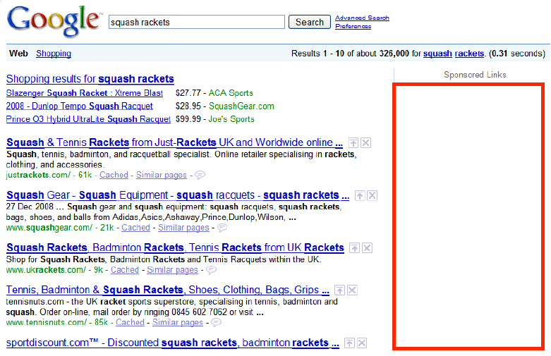
Learning through Experimentation
Web advertising
We discussed how to match advertisers to queries in real-time
But we did not discuss how to estimate the CTR (Click-Through Rate)
Recommendation engines
We discussed how to build recommender systems
But we did not discuss the cold-start problem

Slide 3
Learning through Experimentation
What do CTR and cold start have in common?
With every ad we show/ product we recommend we gather more data about the ad/product
Theme: Learning through experimentation

Slide 4
Example: Web Advertising
Google’s goal: Maximize revenue
The old way: Pay by impression (CPM)
Best strategy: Go with the highest bidder
But this ignores “effectiveness” of an ad
The new way: Pay per click! (CPC)
Best strategy: Go with expected revenue
What’s the expected revenue of ad a for query q?
E[revenue_{a,q}] = P(click_{a} | q) * amount_{a,q}
Prob. user will click on ad a given that she issues query q
(Unknown! Need to gather information)
Bid amount for ad a on query q
(Known)

Slide 5
Other Applications
Clinical trials:
Investigate effects of different treatments while minimizing patient losses
Adaptive routing:
Minimize delay in the network by investigating different routes
Asset pricing:
Figure out product prices while trying to make most money

Slide 6
Approach: Bandits

Slide 7
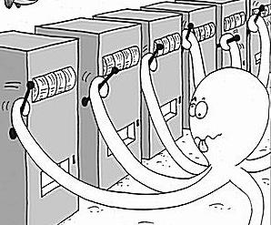
Approach: Multiarmed Bandits

Slide 8
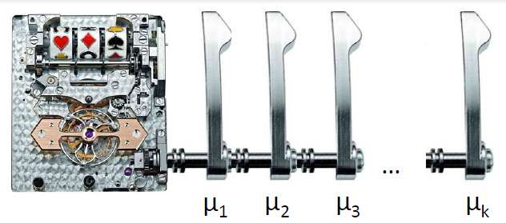
k-Armed Bandit
Each arm a
Wins (reward=1) with fixed (unknown) prob. μ_{a}
Loses (reward=0) with fixed (unknown) prob. 1-μ_{a}
All draws are independent given μ₁ … μ_{k}
How to pull arms to maximize total reward?

Slide 9
k-Armed Bandit
How does this map to our setting?
Each query is a bandit
Each ad is an arm
We want to estimate the arm’s probability of winning μ_{a} (i.e., ad’s the CTR μ_{a})
Every time we pull an arm we do an ‘experiment’

Slide 10
Stochastic k-Armed Bandit
The setting:
Set of k choices (arms)
Each choice a is associated with unknown probability distribution P_{a} supported in [0,1]
We play the game for T rounds
In each round t:
(1) We pick some arm j
(2) We obtain random sample X_{t} from P_{j}
Note reward is independent of previous draws
Our goal is to maximize $\sum_{t=1}^{T}{X_{t}}$
But we don’t know μ_{a}! But every time we pull some arm a we get to learn a bit about μ_{a}

Slide 11
Online Optimization
Online optimization with limited feedback
Like in online algorithms:
Have to make a choice each time
But we only receive information about the chosen action
Choices | X₁ | X₂ | X₃ | X₄ | X₅ | X₆ | …
a₁ |  |  |  |  | 1 | 1
a₂ | 0 |  | 1 | 0
…
a_{k} |  | 0
Time

Slide 12
Solving the Bandit Problem
Policy: a strategy/rule that in each iteration tells me which arm to pull
Hopefully policy depends on the history of rewards
How to quantify performance of the algorithm? Regret!

Slide 13
Performance Metric: Regret
Let be $μ_{a}$ the mean of $P_{a}$
Payoff/reward of best arm: $μ^{∗}=\max_{a}{μ_{a}}$
Let $i_{1},i_{2}…i_{T}$ be the sequence of arms pulled
Instantaneous regret at time $t$: $r_{t}=μ^{∗}−μ_{a_{t}}$
Total regret:
$$R_{T}=\sum_{t=1}^{T}{r_{t}}$$
Typical goal: Want a policy (arm allocation strategy) that guarantees: $\frac{R_{T}}{T}→0$ as $T→∞$
Note: Ensuring $R_{T}/T→0$ is stronger than maximizing payoffs (minimizing regret), as it means that in the limit we discover the true best hand.

Slide 14
Allocation Strategies
If we knew the payoffs, which arm would we pull?
$$Pick \arg{\max_{a}{μ_{a}}}$$
What if we only care about estimating payoffs $μ_{a}$?
Pick each of $k$ arms equally often: $\frac{T}{k}$
Estimate: $\hat{μ_{a}}=\frac{k}{T}\sum_{j=1}^{T/k}{X_{a,j} }$
Regret: $R_{T}=\frac{T}{k}\sum_{a=1}^{k}{(μ^{∗}−μ_{a})}$
$X_{a,j}$… payoff received when pulling arm $a$ for $j$-th time

Slide 15
Bandit Algorithm: First try
Regret is defined in terms of average reward
So, if we can estimate avg. reward we can minimize regret
Consider algorithm: Greedy Take the action with the highest avg. reward
Example: Consider 2 actions
A1 reward 1 with prob. 0.3
A2 has reward 1 with prob. 0.7
Play A1, get reward 1
Play A2, get reward 0
Now avg. reward of A1 will never drop to 0, and we will never play action A2

Slide 16
Exploration vs. Exploitation
The example illustrates a classic problem in decision making:
We need to trade off exploration (gathering data about arm payoffs) and exploitation (making decisions based on data already gathered)
The Greedy does not explore sufﬁciently
Exploration: Pull an arm we never pulled before
Exploitation: Pull an arm $a$ for which we currently have the highest estimate of $μ_{a}$

Slide 17
Optimism
The problem with our Greedy algorithm is that it is too certain in the estimate of $μ_{a}$
When we have seen a single reward of 0 we shouldn’t conclude the average reward is 0
Greedy does not explore sufﬁciently!

Slide 18
New Algorithm: Epsilon-Greedy
Algorithm: Epsilon-Greedy
For t=1:T
Set $ε_{t}=O\left(\frac{1}{t}\right)$ (that is, $ε_{t}$ decays over time $t$ as $1/t$)
With prob. $ε_{t}$: Explore by picking an arm chosen uniformly at random
With prob. ${1−ε}_{t}$: Exploit by picking an arm with highest empirical mean payoff
Theorem [Auer et al. ‘02] For suitable choice of $ε_{t}$ it holds that $R_{T}=O(k\log{T)}\overset{⇒}{}\frac{R_{T}}{T}=O\left(\frac{k\log{T}}{T}\right)→0$
k…number of arms

Slide 19
Issues with Epsilon Greedy
What are some issues with Epsilon Greedy?
“Not elegant”: Algorithm explicitly distinguishes between exploration and exploitation
More importantly: Exploration makes suboptimal choices (since it picks any arm equally likely)
Idea: When exploring/exploiting we need to compare arms

Slide 20
Comparing Arms
Suppose we have done experiments:
Arm 1: 1 0 0 1 1 0 0 1 0 1
Arm 2: 1
Arm 3: 1 1 0 1 1 1 0 1 1 1
Mean arm values:
Arm 1: 5/10, Arm 2: 1, Arm 3: 8/10
Which arm would you pick next?
Idea: Don’t just look at the mean (that is, expected payoff) but also the confidence!

Slide 21
Confidence Intervals (1)
A conﬁdence interval is a range of values within which we are sure the mean lies with a certain probability
We could believe $μ_{a}$ is within [0.2,0.5] with probability 0.95
If we would have tried an action less often, our estimated reward is less accurate so the conﬁdence interval is larger
Interval shrinks as we get more information (try the action more often)

Slide 22
Confidence Intervals (2)
Assuming we know the confidence intervals
Then, instead of trying the action with the highest mean we can try the action with the highest upper bound on its conﬁdence interval
This is called an optimistic policy
We believe an action is as good as possible given the available evidence

Slide 23
Confidence Based Selection
99.99% confidence interval
After more exploration
$$μ_{a}$$
$$μ_{a}$$
arm a
arm a

Slide 24
Calculating Confidence Bounds
Suppose we fix arm a:
Let $Y_{a,1}…Y_{a,m}$ be the payoffs of arm a in the first m trials
So, $Y_{a,1}…Y_{a,m}$ are i.i.d. rnd. vars. taking values in [0,1]
Mean payoff of arm a: $μ_{a}=E[Y_{a,m}]$
Our estimate: $\hat{μ_{a,m}}=\frac{1}{m}\sum_{ℓ=1}^{m}{Y_{a,ℓ}}$
Want to find $b$ such that with high probability $\left|μ_{a}−\hat{μ_{a,m}}\right|≤b$
Want $b$ to be as small as possible (so our estimate is close)
Goal: Want to bound $P(\left|μ_{a}−\hat{μ_{a,m}}\right|≤b)$

Slide 25
Hoeffding’s Inequality
Hoeffding’s inequality bounds $P(\left|μ_{a}−\hat{μ_{a,m}}\right|≤b)$
Let $X_{1}…X_{m}$ be i.i.d. rnd. vars. taking values in [0,1]
Let $μ=E[X]$ and $\hat{μ_{m}}=\frac{1}{m}\sum_{ℓ=1}^{m}{X_{ℓ}}$
Then: $P\left(\left|μ−\hat{μ_{m}}\right|≥b\right)≤2 exp\left(−2b^{2}m\right)=δ$
To find out the confidence interval $b$ (for a given confidence level $δ$) we solve:
$2e^{−2b^{2}m}≤δ$ then $−2b^{2}m≤ln⁡(δ/2)$
So: $b≥\sqrt{\frac{\ln\left(\frac{2}{δ}\right)}{2 m}}$

Slide 26
$P\left(\left|μ−\hat{μ_{m}}\right|≥b\right)≤2 exp\left(−2b^{2}m\right)$ where $b$ is our upper bound, $m$ number of times we played the action
Let’s set $b=b\left(a,T\right)=\sqrt{2log(T)/m_{a}}$
Then: $P\left(\left|μ−\hat{μ_{m}}\right|≥b\right)≤{2T}^{−4}$ which converges to zero very quickly:
Notice:
If we don’t play action $a$, its upper bound $b$ increases
This means we never permanently rule out an action not matter how poorly it performs
Prob. our upper bound is wrong decreases with time $T$

Slide 27
UCB1 Algorithm
[Auer et al. ‘02]
UCB1 (Upper confidence sampling) algorithm
Set: $\hat{μ_{1}}=…=\hat{μ_{k}}=0$ and $m_{1}=…=m_{k}=0$
$\hat{μ_{a}}$ is our estimate of payoff of arm $i$
$m_{a}$ is the number of pulls of arm $a$ so far
For t = 1:T
For each arm a calculate: $UCB\left(a\right)=\hat{μ_{a}}+α\sqrt{\frac{2 ln t}{m_{a}}}$
Pick arm $j=arg max_{a} UCB\left(a\right)$
Pull arm $j$ and observe $y_{t}$
Set: $m_{j}←m_{j}+1$ and $\hat{μ_{j}}←\frac{1}{m_{j}}(y_{t}+\left(m_{j}−1\right) \hat{μ_{j}})$
Upper confidence interval (Hoeffding’s inequality)
$α$…is a free parameter trading off exploration vs. exploitation
Notes:
Plugging in alpha SQRT 2 ln t / m_a
Gives us that P(Y>mu + a) < T^-4 which converges to zero.
http://jeremykun.com/2013/10/28/optimism-in-the-face-of-uncertainty-the-ucb1-algorithm/

Slide 28
UCB1: Discussion
$$b≥\sqrt{\frac{\ln\left(\frac{2}{δ}\right)}{2 m}}$$
$UCB\left(a\right)=\hat{μ_{a}}+α\sqrt{\frac{2 ln t}{m_{a}}}$
Conﬁdence interval grows with the total number of actions $t$ we have taken
But shrinks with the number of times $m_{a}$ we have tried arm $a$
This ensures each arm is tried inﬁnitely often but still balances exploration and exploitation
$α$ plays the role of $δ$: $α=f\left(\frac{2}{δ}\right)$
$$P\left(\left|μ−\hat{μ_{m}}\right|≥b\right)=δ$$
“Optimism in face of uncertainty”:
The algorithm believes that it can obtain extra rewards by reaching the unexplored parts of the state space

Slide 29
Performance of UCB1
Theorem [Auer et al. 2002]
Suppose optimal mean payoff is $μ^{∗}=\max_{a}{μ_{a}}$
And for each arm let $Δ_{a}=μ^{∗}−μ_{a}$
Then it holds that
$$E\left[R_{T}\right]≤\left[8 \sum_{a:μ_{a}<μ^{∗}}{\frac{ln T}{Δ_{a}}}\right]+\left(1+\frac{π^{2}}{3}\right)\left(\sum_{i=a}^{k}{Δ_{a}}\right)$$
So: $O\left(\frac{R_{T}}{T}\right)≤k \frac{ln T}{T}$
(note this is worst case regret)
$$O(k ln⁡T)$$
$$O(k)$$

Slide 30
Summary so far
k-armed bandit problem as a formalization of the exploration-exploitation tradeoff
Analog of online optimization (e.g., SGD, BALANCE), but with limited feedback
Simple algorithms are able to achieve no regret (in the limit)
Epsilon-greedy
UCB (Upper Confidence Sampling)

Slide 31
Example
10 actions, 1M rounds, uniform [0,1] rewards
Theoretical worse-case cumulative regret
Real cumulative regret

Slide 32
Use-case: Pinterest
Problem: For new pins/ads we do not have enough signal how good they are
How likely are people to interact with them
Idea:
Try to maximize the rewards from several unknown slot machines by deciding which machines and the order to play
Each pin is regarded as an arm, user engagement are considered as rewards
Making tradeoff between exploration and exploitation, avoid keep showing the best known pins and trap the system into local optimal

Slide 33
Use-case: Pinterest
Solution: Bandit algorithm in round t
(1) Algorithm observes user a set A of pins/ads
(2) Based on payoffs from previous trials, algorithm chooses arm a∈A and receives payoff r_{t,a}
Note only feedback for the chosen a is observed
(3) Algorithm improves arm selection strategy with each observation $(a, r_{t,a})$
If the score for a pin is low, filter it out

Slide 34
Use Case: A/B testing
A/B testing is a controlled experiment with two variants, A and B
Part of the traffic sees variant A, part variant B

Slide 35
Use Case: A/B testing
Part of the traffic sees variant A, part variant B
Hypothesis test, does variant A outperform variant B? What test to perform?
If A outperforms B, we want to stop the experiment as soon as possible
Assumed Distribution | Example | Standard Test
Gaussian | Average Revenue Per Paying User | Welch's t-test (Unpaired t-test)
Binomial | Click Through Rate | Fisher's exact test
Poisson | Transactions Per Paying User | E-test
Multinomial | Number of each product purchased | Chi-squared test

Slide 36
Use Case: A/B testing
Imagine you have two versions of the website and you’d like to test which one is better
Version A has engagement rate of 5%
Version B has engagement rate of 4%
You want to establish with 95% confidence that version A is better
You’d need 22,330 observations (11,165 in each arm) to establish that
Use t-test to establish the sample size
Can bandits do better?

Slide 37
Example: Bandits vs. A/B testing
How long it does it take to discover A > B?
A/B test: We need 22,330 observations. Assuming 100 observations/day, we need 223 days
The goal is to find the best action (A vs. B)
The randomization distribution (traffic to A vs. B) can be updated as the experiment progresses
Idea:
Twice per day, examine how each of the variations/arms has performed
Adjust the fraction of traffic that each arm will receive going forward
An arm that appears to be doing well gets more traffic, and an arm that is clearly underperforming gets less

Slide 38
Thompson Sampling
Thompson sampling assigns sessions to arms in proportion to the probability that each arm is optimal
Let:
$θ = (θ1, θ2,…, θk)$ … the vector of conversion rates for arms 1, …, k.
$θ$ = #successes/(#successes+#failures)
$y$ … the data observed thus far in the experiment
$Ia(θ)$… the indicator of the event that arm a is optimal
Then we can write:
$$P(Ia) = ∫Ia(θ) p(θ|y) dθ$$

Slide 39
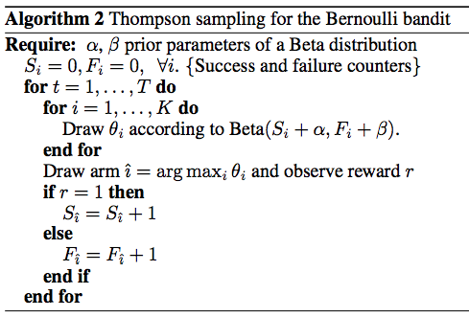
Thompson Sampling
Arm probabilities $θ$ can be computed using sampling:
Each element of $θ$ is an independent random variable from a Beta distribution ($α+successes, β+failures$)

Slide 40
Thompson Sampling
But, in our case we have to set the amount of traffic. Set it to be proportional to the $P(Ia)$:
(1) Simulate many draws from $Beta(α{+S}_{a},β+F_{a})$:
(2) The probability that arm a is optimal is the empirical fraction of rows for which arm a had the largest simulated value
(3) Set traffic to arm a to be equal to % of wins
Time | Arm 1 | Arm 2 | Arm 3
1 | 0.54 | 0.73 | 0.74
2 | 0.55 | 0.66 | 0.73
3 | 053 | 0.81 | 0.80
…

Slide 41
Use Case: A/B testing
Imagine you have two versions of the website and you’d like to test which one is better
Version A has engagement rate of 5%
Version B has engagement rate of 4%
You want to establish with 95% confidence that version A is better
You’d need 22,330 observations (11,165 in each arm) to establish that
Use t-test to establish the sample size
Can bandits do better?

Slide 42
Example
A/B test: We need 22,330 observations. Assuming 100 observations/day, we need 223 days
On 1st day about 50 sessions are assigned to each arm
Suppose A got really lucky on the first day, and it appears to have a 70% chance of being superior
Then we assign it 70% of the traffic on the second day, and the variant B gets 30%
At the end of the 2nd day we accumulate all the traffic we’ve seen so far (over both days), and recompute the probability that each arm is best

Slide 43
Simulation
The experiment finished in 66 days, so it saved you 157 days of testing (66 vs 223)

Slide 44
Generalization to multiple arms
Easy to generalize to multiple arms:

Slide 45
Relevance vs. Diversity
Interesting article on how to use bandits for website optimization: https://support.google.com/analytics/answer/2844870?hl=en

Slide 46
Announcement: Final Exam Logistics

Slide 47
Final: At Stanford
Alternate final: Mon 3/16 7:00-10:00pm in Cubberly Auditorium
Register here: http://goo.gl/forms/5505oC0Y94
Final: Fri 3/20 12:15-3:15pm in NVidia (lastname starting with A-J), GatesB01 (K-S), and Packard 101 (T-Z)
See http://campus-map.stanford.edu
Practice finals are posted on Piazza!
SCPD students can take the exam at Stanford!

Slide 48
Final: SCPD Students
Exam protocol for SCPD students:
On Monday 3/16 your exam proctor will receive the PDF of the final exam from SCPD
If you take the exam at Stanford:
Ask the exam monitor to delete the SCP email
If you don’t take the exam at Stanford:
Arrange 3h slot with your exam monitor
You can take the exam anytime but return it in time
Email exam PDF to cs246.mmds@gmail.com by Friday 3/15 15:00 Pacific time

Slide 49
(3) CS341: Project in Mining Massive Datasets

Slide 50
CS341
Data mining research project on real data
Groups of 3 students
We provide interesting data, computing resources (Amazon EC2) and mentoring
You provide project ideas
There are (practically) no lectures, only individual group mentoring
Information session:
Friday 3/14 5:30pm in Gates 415
(there will be pizza!)

Slide 51
CS341: Schedule
Thu 3/14: Info session
We will introduce datasets, problems, ideas
Students form groups and project proposals
Mon 3/25: Project proposals are due
We evaluate the proposals
Mon 4/1: Admission results
10 to 15 groups/projects will be admitted
Tue 4/30, Thu 5/2: Midterm presentations
Tue 6/4, Thu 6/6: Presentations, poster session
More info: http://cs341.stanford.edu

