Slide 1

Mining Data Streams
(Part 2)
CS341 info session is on Thu 3/1 5pm in Gates415
CS246: Mining Massive Datasets
Jure Leskovec, Stanford University
http://cs246.stanford.edu

Slide 2
Today’s Lecture
More algorithms for streams:
  (1) Filtering a data stream: Bloom filters
    Select elements with property x from stream
  (2) Counting distinct elements: Flajolet-Martin
    Number of distinct elements in the last k elements
    of the stream
  (3) Estimating moments: AMS method
    Estimate std. dev. of last k elements
  (4) Counting frequent items

Slide 3
(1) Filtering Data Streams

Slide 4
Filtering Data Streams
Each element of data stream is a tuple
Given a list of keys S
Determine which tuples of stream are in S
Obvious solution: Hash table
  But suppose we do not have enough memory to store all of S in a hash table
    E.g., we might be processing millions of filters
    on the same stream

Slide 5
Applications
Example: Email spam filtering
  We know 1 billion “good” email addresses
    Or, each user has a list of trusted addresses
  If an email comes from one of these, it is NOT spam
Publish-subscribe systems
  You are collecting lots of messages (news articles)
  People express interest in certain sets of keywords
  Determine whether each message matches user’s interest
Content filtering:
  You want to make sure the user does not see the same ad multiple times

Slide 6
First Cut Solution (1)
Given a set of keys S that we want to filter
Create a bit array B of n bits, initially all 0s
Choose a hash function h with range [0,n)
Hash each member of s∈ S to one of
n buckets, and set that bit to 1, i.e., B[h(s)]=1
Hash each element a of the stream and output only those that hash to bit that was set to 1
  Output a if B[h(a)] == 1

Slide 7
First Cut Solution (2)
Output the item since it may be in S.
Item hashes to a bucket that at least
one of the items in S hashed to.
Filter
Item
Hash
func h
0010001011000
Bit array B
Drop the item.
It hashes to a bucket set
to 0 so it is surely not in S.
Creates false positives but no false negatives
  If the item is in S we surely output it, if not we may still output it

Slide 8
First Cut Solution (3)
|S| = 1 billion email addresses
|B|= 1GB = 8 billion bits
If the email address is in S, then it surely hashes to a bucket that has the big set to 1,
so it always gets through (no false negatives)
Approximately 1/8 of the bits are set to 1, so about 1/8th of the addresses not in S get through to the output (false positives)
  Actually, less than 1/8th, because more than one address might hash to the same bit

Slide 9
Analysis: Throwing Darts (1)
More accurate analysis for the number of false positives
Consider: If we throw m darts into n equally likely targets, what is the probability that
a target gets at least one dart?
In our case:
  Targets = bits/buckets
  Darts = hash values of items

Slide 10
Analysis: Throwing Darts (2)
We have m darts, n targets
What is the probability that a target gets at least one dart?
Equals 1/e
as n →∞
Equivalent
n(
m
/ n)
1 -
(1 – 1/n)
1 – e^{–m/n}
Probability some
target X not hit
by a dart
Probability at
least one dart
hits target X
Approximation is
especially accurate
when n is large

Slide 11
Analysis: Throwing Darts (3)
Fraction of 1s in the array B =
= probability of false positive = 1 – e^{-m/n}
Example: 10⁹ darts, 8∙10⁹ targets
  Fraction of 1s in B = 1 – e^{-1/8} = 0.1175
    Compare with our earlier estimate: 1/8 = 0.125

Slide 12
Bloom Filter
Consider: |S| = m, |B| = n
Use k independent hash functions h₁ ,…, h_{k}
Initialization:
  Set B to all 0s
  Hash each element s∈ S using each hash function h_{i}, set B[h_{i}(s)] = 1 (for each i = 1,.., k)
Run-time:
  When a stream element with key x arrives
    If B[h_{i}(x)] = 1 for all i = 1,..., k then declare that x is in S
      That is, x hashes to a bucket set to 1 for every hash function h_{i}(x)
    Otherwise discard the element x
(note: we have a
single array B!)

Slide 13
Bloom Filter -- Analysis
What fraction of the bit vector B are 1s?
  Throwing k∙m darts at n targets
  So fraction of 1s is (1 – e^{-km/n})
But we have k independent hash functions
and we only let the element x through if all k hash element x to a bucket of value 1
So, false positive probability = (1 – e^{-km/n})^{k}

Slide 14
Bloom Filter – Analysis (2)
m = 1 billion, n = 8 billion
  k = 1: (1 – e^{-1/8}) = 0.1175
  k = 2: (1 – e^{-1/4})² = 0.0493
What happens as we
keep increasing k?
Optimal value of k: n/m ln(2)
  In our case: Optimal k = 8 ln(2) = 5.54 ≈ 6
    Error at k = 6: (1 – e^{-3/4})² = 0.0216
False positive prob.
Number of hash functions, k
Optimal k: k which gives the lowest false positive probability

Slide 15
Bloom Filter: Wrap-up
Bloom filters guarantee no false negatives, and use limited memory
  Great for pre-processing before more
  expensive checks
Suitable for hardware implementation
  Hash function computations can be parallelized
Is it better to have 1 big B or k small Bs?
  It is the same: (1 – e^{-km/n})^{k} vs. (1 – e^{-m/(n/k)})^{k}
  But keeping 1 big B is simpler

Slide 16
(2) Counting Distinct Elements

Slide 17
Counting Distinct Elements
Problem:
  Data stream consists of a universe of elements chosen from a set of size N
  Maintain a count of the number of distinct elements seen so far
Obvious approach:
Maintain the set of elements seen so far
  That is, keep a hash table of all the distinct elements seen so far

Slide 18
Applications
How many different words are found among the Web pages being crawled at a site?
  Unusually low or high numbers could indicate artificial pages (spam?)
How many different Web pages does each customer request in a week?
How many distinct products have we sold in the last week?

Slide 19
Using Small Storage
Real problem: What if we do not have space
to maintain the set of elements seen so far?
Estimate the count in an unbiased way
Accept that the count may have a little error, but limit the probability that the error is large

Slide 20
Flajolet-Martin Approach
Pick a hash function h that maps each of the N elements to at least log₂ N bits
For each stream element a, let r(a) be the number of trailing 0s in h(a)
  r(a) = position of first 1 counting from the right
    E.g., say h(a) = 12, then 12 is 1100 in binary, so r(a) = 2
Record R = the maximum r(a) seen
  R = max_{a} r(a), over all the items a seen so far
Estimated number of distinct elements = 2^{R}

Slide 21
Why It Works: Intuition
Very very rough and heuristic intuition why
Flajolet-Martin works:
  h(a) hashes a with equal prob. to any of N values
  Then h(a) is a sequence of log₂ N bits,
  where 2^{-r} fraction of all as have a tail of r zeros
    About 50% of as hash to ***0
    About 25% of as hash to **00
    So, if we saw the longest tail of r=2 (i.e., item hash
    ending *100) then we have probably seen
    about 4 distinct items so far
  So, it takes to hash about 2^{r} items before we
  see one with zero-suffix of length r

Slide 22
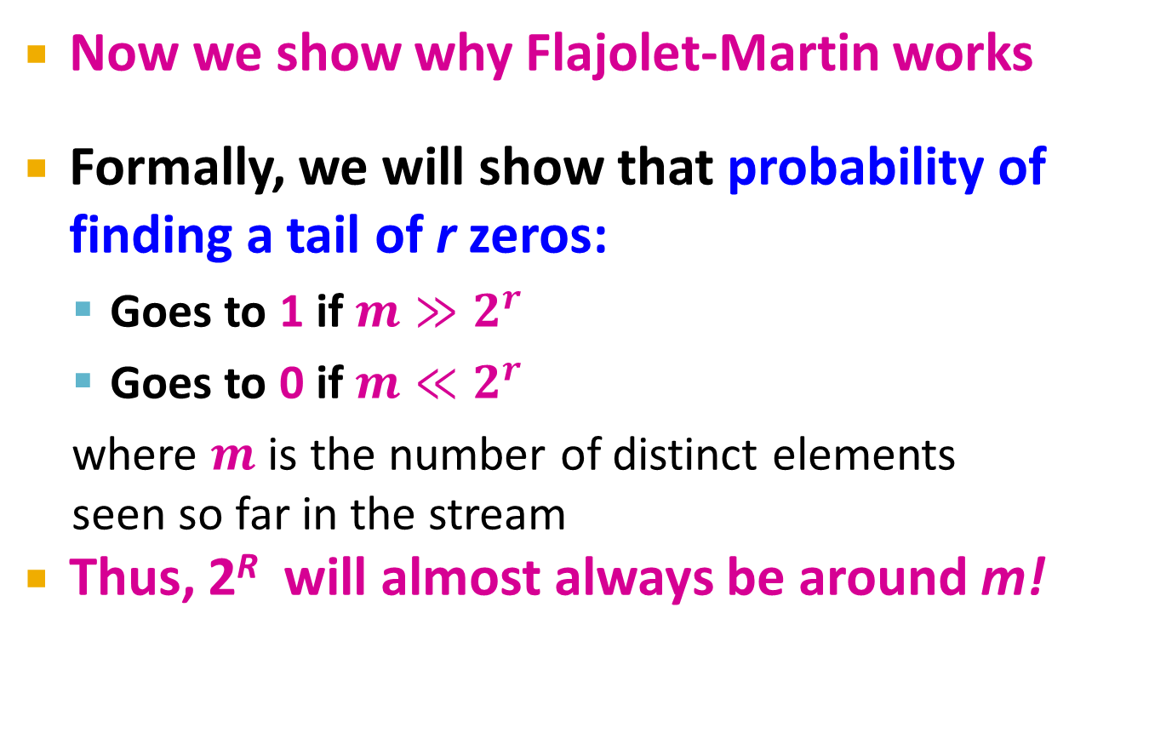
Why It Works: More formally
Now we show why Flajolet-Martin works
Formally, we will show that probability of finding a tail of r zeros:
  Goes to 1 if $m≫2^{r}$
  Goes to 0 if $m≪2^{r}$
  where $m$ is the number of distinct elements
  seen so far in the stream
Thus, 2^{R} will almost always be around m!

Slide 23
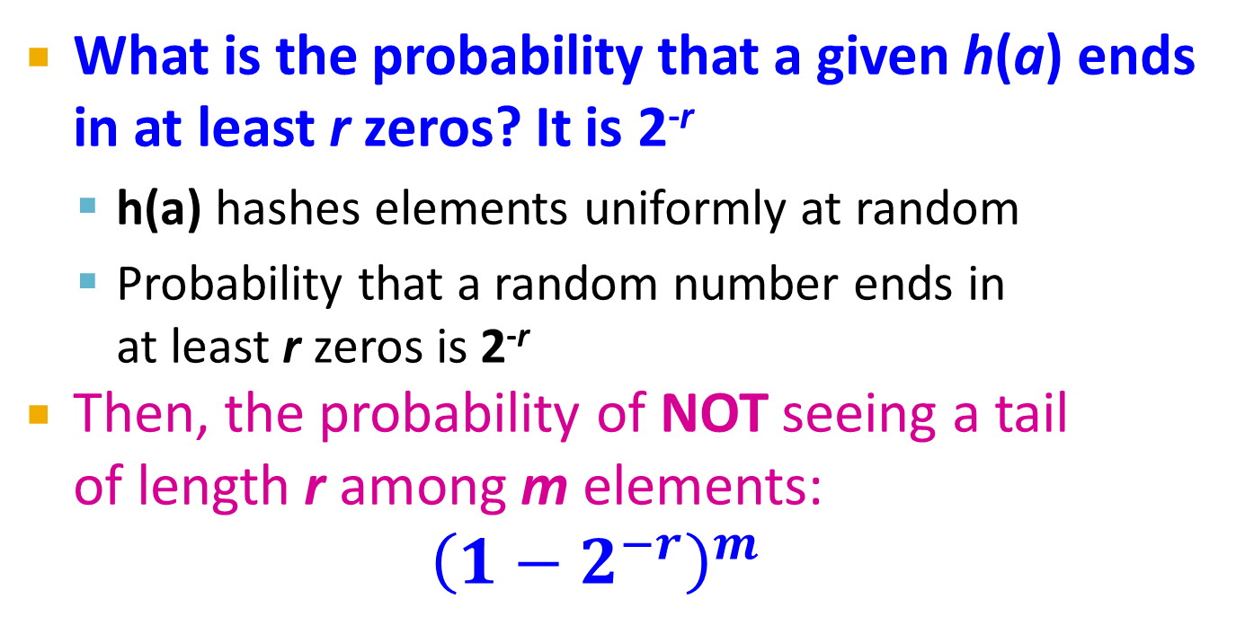
Why It Works: More formally
What is the probability that a given h(a) ends
in at least r zeros? It is 2^{-r}
  h(a) hashes elements uniformly at random
  Probability that a random number ends in
  at least r zeros is 2^{-r}
Then, the probability of NOT seeing a tail
of length r among m elements:
$${\left(1−2^{−r}\right)}^{m}$$
Prob. all end in
fewer than r zeros.
Prob. that given h(a) ends in fewer than r zeros

Slide 24
Why It Works: More formally
Note:
Prob. of NOT finding a tail of length r is:
  If m << 2^{r}, then prob. tends to 1
    as m/2^{r}→ 0
    So, the probability of finding a tail of length r tends to 0
  If m >> 2^{r}, then prob. tends to 0
    as m/2^{r} → ∞
    So, the probability of finding a tail of length r tends to 1
Thus, 2^{R} will almost always be around m!

Slide 25
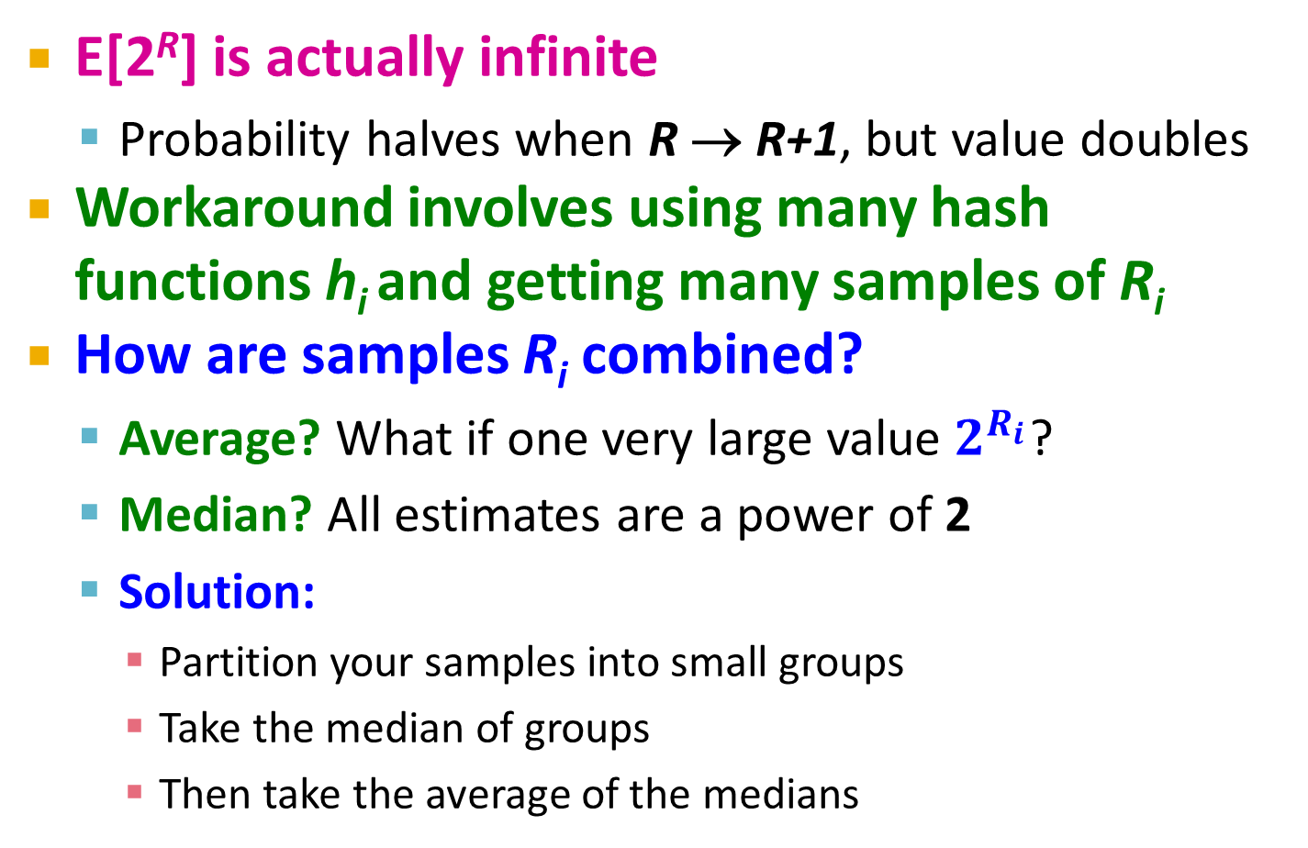
Why It Doesn’t Work
E[2^{R}] is actually infinite
  Probability halves when R → R+1, but value doubles
Workaround involves using many hash functions h_{i} and getting many samples of R_{i}
How are samples R_{i} combined?
  Average? What if one very large value $2^{R_{i}}$?
  Median? All estimates are a power of 2
  Solution:
    Partition your samples into small groups
    Take the median of groups
    Then take the average of the medians

Slide 26
(3) Computing Moments

Slide 27
Generalization: Moments
Suppose a stream has elements chosen
from a set A of N values
Let m_{i} be the number of times value i occurs in the stream
The k^{th} moment is
This is the same way as moments are defined in statistics. But
there we many times “center” the moment by subtracting the mean

Slide 28
Special Cases
0thmoment = number of distinct elements
  The problem just considered
1st moment = count of the numbers of elements = length of the stream
  Easy to compute
2nd moment = surprise number S =
a measure of how uneven the distribution is

Slide 29
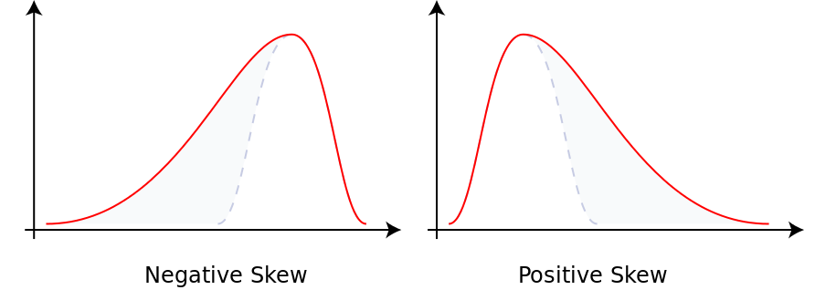
Moments
Third Moment is Skew:
Fourth moment: Kurtosis
  peakedness (width of peak), tail weight, and lack of shoulders (distribution primarily peak and tails, not in between).

Slide 30
Example: Surprise Number
Stream of length 100
11 distinct values
Item counts: 10, 9, 9, 9, 9, 9, 9, 9, 9, 9, 9 Surprise S = 910
Item counts: 90, 1, 1, 1, 1, 1, 1, 1 ,1, 1, 1 Surprise S = 8,110

Slide 31
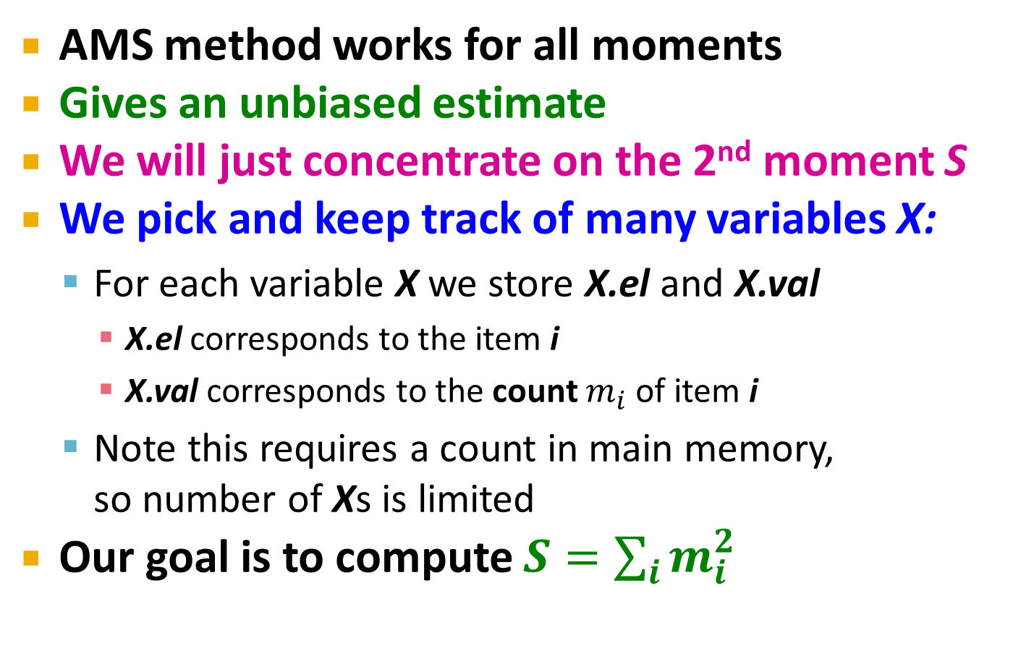
AMS Method
[Alon, Matias, and Szegedy]
AMS method works for all moments
Gives an unbiased estimate
We will just concentrate on the 2nd moment S
We pick and keep track of many variables X:
  For each variable X we store X.el and X.val
    X.el corresponds to the item i
    X.val corresponds to the count $m_{i}$ of item i
  Note this requires a count in main memory,
  so number of Xs is limited
Our goal is to compute $S=\sum_{i}{m_{i}^{2}}$

Slide 32
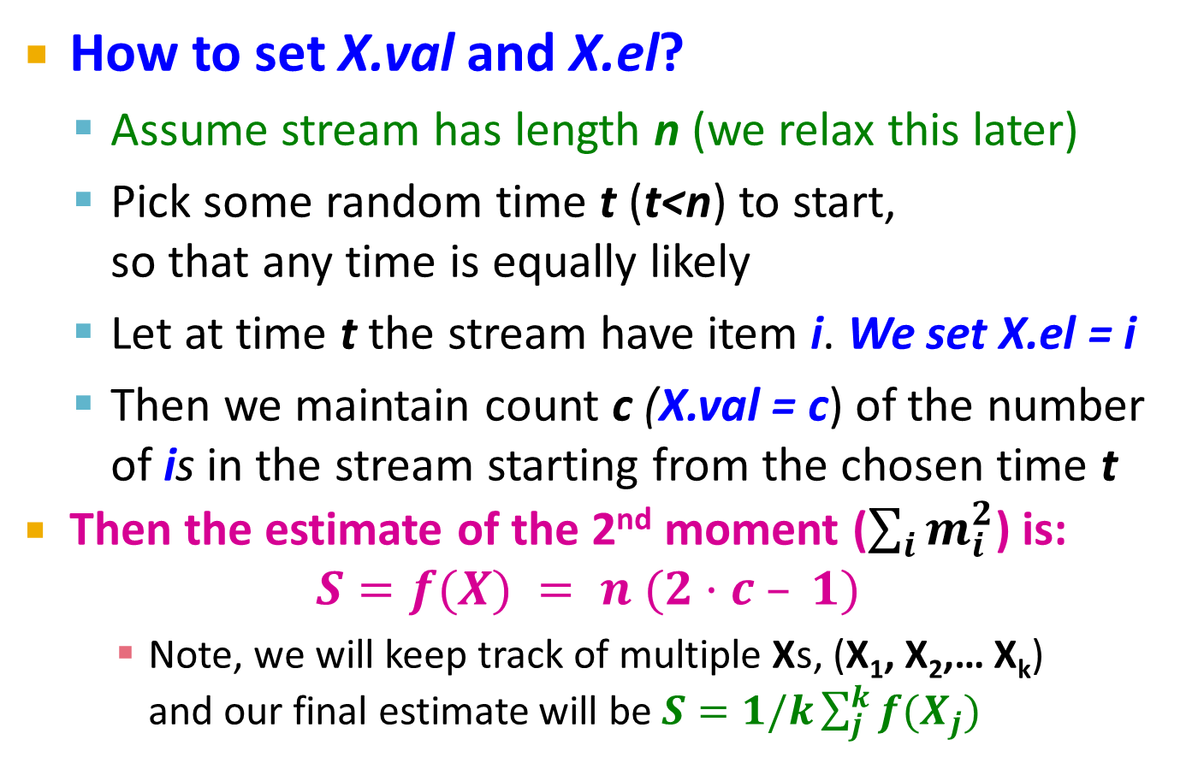
One Random Variable (X)
How to set X.val and X.el?
  Assume stream has length n (we relax this later)
  Pick some random time t (t<n) to start,
  so that any time is equally likely
  Let at time t the stream have item i. We set X.el = i
  Then we maintain count c (X.val = c) of the number of is in the stream starting from the chosen time t
  Then the estimate of the 2nd moment ($\sum_{i}{m_{i}^{2}}$) is:
  $S=f(X) = n (2·c – 1)$
    Note, we will keep track of multiple Xs, (X₁, X₂,… X_{k})
    and our final estimate will be $S=1/k\sum_{j}^{k}{f(X_{j})}$

Slide 33
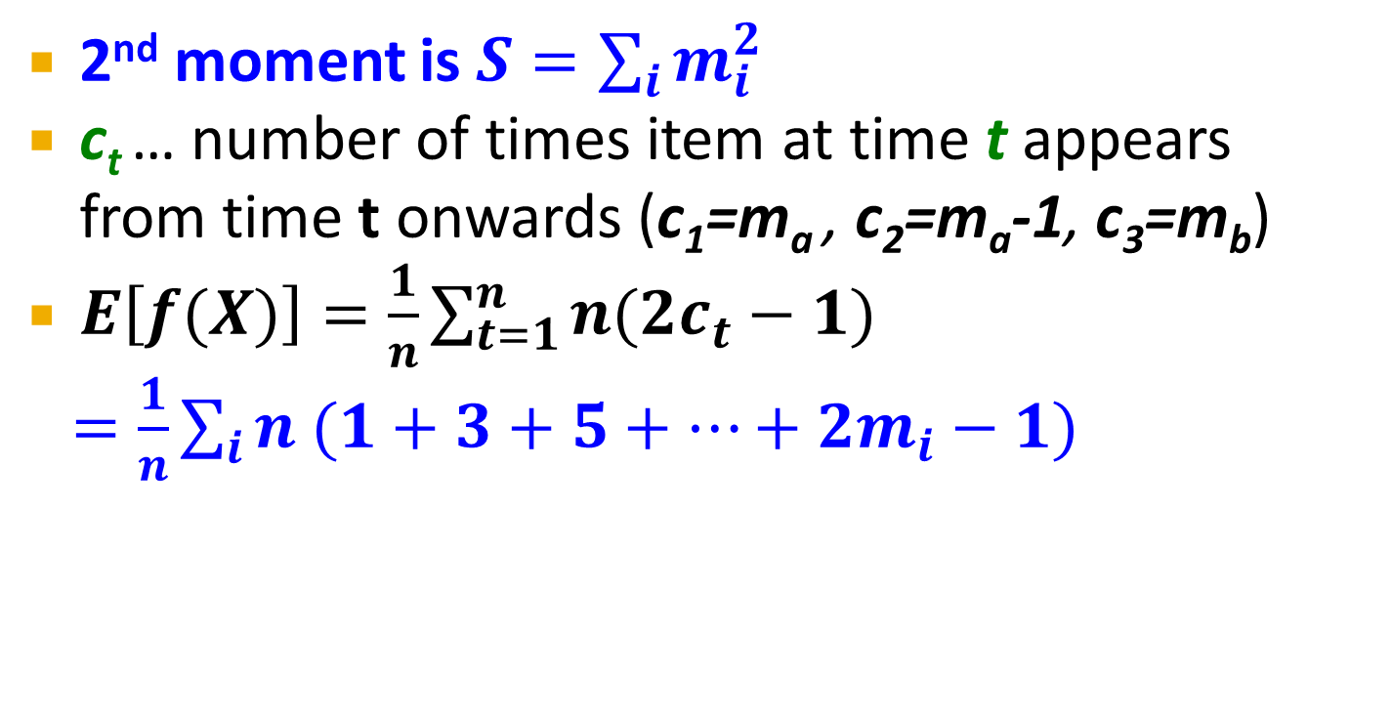
Expectation Analysis
1
2
1
2
3
m_{a}
Count:
Stream:
a
a
b
b
b
a
b
a
2nd moment is $S=\sum_{i}{m_{i}^{2}}$
c_{t} … number of times item at time t appears
from time t onwards (c₁=m_{a} , c₂=m_{a}-1, c₃=m_{b})
$E\left[f(X)\right]=\frac{1}{n}\sum_{t=1}^{n}{n(2c_{t}−1)}$
$=\frac{1}{n}\sum_{i}{n (1+3+5+…+2m_{i}−1)}$
m_{i} … total count of item i in the stream (we are assuming stream has length n)
Time t when
the penultimate
i is seen (c_{t}=2)
Time t when
the first i is
seen (c_{t}=m_{i})
Group times
by the value
seen
Time t when
the last i is
seen (c_{t}=1)

Slide 34
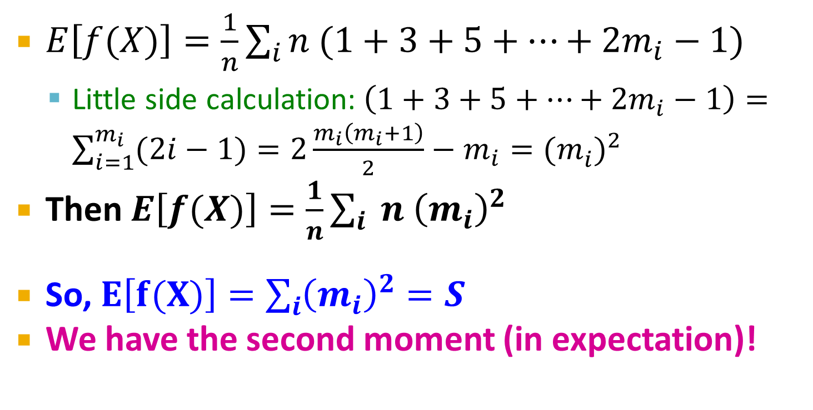
Expectation Analysis
Count:
1
2
3
m_{a}
Stream:
a
a
b
b
b
a
b
a
$E\left[f(X)\right]=\frac{1}{n}\sum_{i}{n (1+3+5+…+2m_{i}−1)}$
  Little side calculation:$\left(1+3+5+…+2m_{i}−1\right)=\sum_{i=1}^{m_{i}}{(2i−1)}=2\frac{m_{i}\left(m_{i}+1\right)}{2}−m_{i}={(m_{i}^{})}^{2}$
Then $E\left[f(X)\right]=\frac{1}{n}\sum_{i}{ n {\left(m_{i}\right)}^{2}}$
So, $E\left[f(X)\right]=\sum_{i}{{\left(m_{i}\right)}^{2}}=S$
We have the second moment (in expectation)!

Slide 35
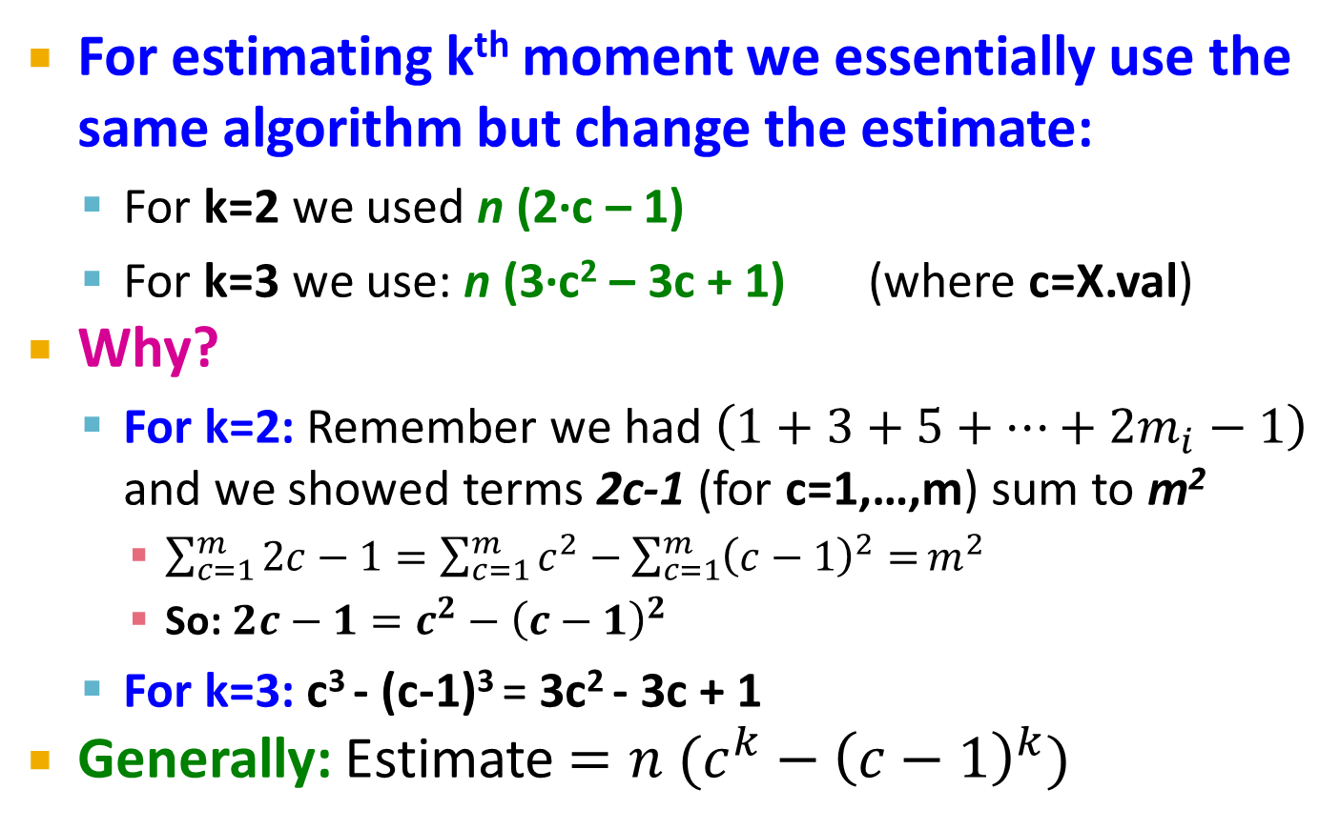
Higher-Order Moments
For estimating k^{th} moment we essentially use the same algorithm but change the estimate:
  For k=2 we used n (2·c – 1)
  For k=3 we use: n (3·c² – 3c + 1) (where c=X.val)
Why?
  For k=2: Remember we had $\left(1+3+5+…+2m_{i}−1\right)$ and we showed terms 2c-1 (for c=1,…,m) sum to m²
    $\sum_{c=1}^{m}{2c−1}=\sum_{c=1}^{m}{c^{2}}−\sum_{c=1}^{m}{{\left(c−1\right)}^{2}=}m^{2}$
    So: $2c−1=c^{2}−{\left(c−1\right)}^{2}$
  For k=3: c³ - (c-1)³ = 3c² - 3c + 1
Generally: Estimate $={n (c}^{k}−{\left(c−1\right)}^{k})$

Slide 36
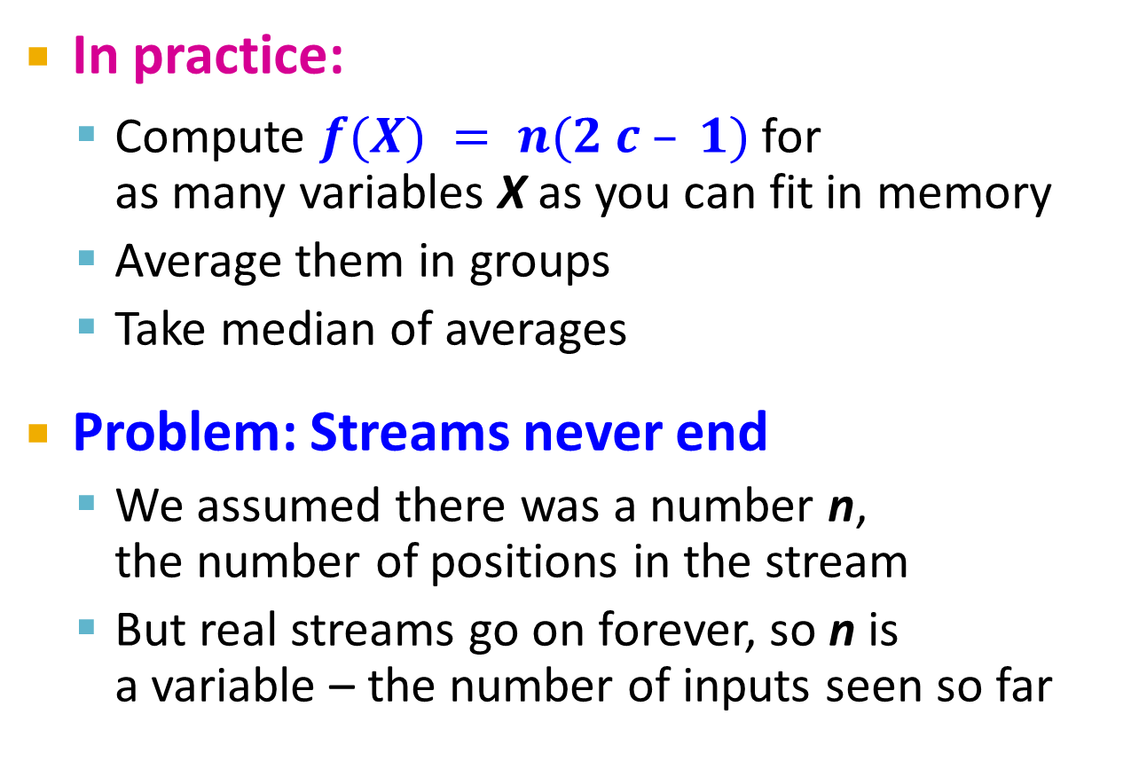
Combining Samples
In practice:
  Compute $f(X) = n(2 c – 1)$for
  as many variables X as you can fit in memory
  Average them in groups
  Take median of averages
Problem: Streams never end
  We assumed there was a number n,
  the number of positions in the stream
  But real streams go on forever, so n is
  a variable – the number of inputs seen so far

Slide 37
Streams Never End: Fixups
(1) The variables X have n as a factor –
keep n separately; just hold the count in X
(2) Suppose we can only store k counts.
We must throw some Xs out as time goes on:
  Objective: Each starting time t is selected with probability k/n
  Solution: (fixed-size sampling!)
    Choose the first k times for k variables
    When the n^{th} element arrives (n > k), choose it with probability k/n
    If you choose it, throw one of the previously stored variables X out, with equal probability

Slide 38
Counting Itemsets

Slide 39
Counting Itemsets
New Problem: Given a stream, which items appear more than s times in the window?
Possible solution: Think of the stream of baskets as one binary stream per item
  1 = item present; 0 = not present
  Use DGIM to estimate counts of 1s for all items
At least 1 of
size 16. Partially
beyond window.
2 of
size 8
2 of
size 4
1 of
size 2
2 of
size 1
1001010110001011010101010101011010101010101110101010111010100010110010
N
Notes:
s

Slide 40
Extensions
In principle, you could count frequent pairs or even larger sets the same way
  One stream per itemset
Drawbacks:
  Only approximate
  Number of itemsets is way too big

Slide 41
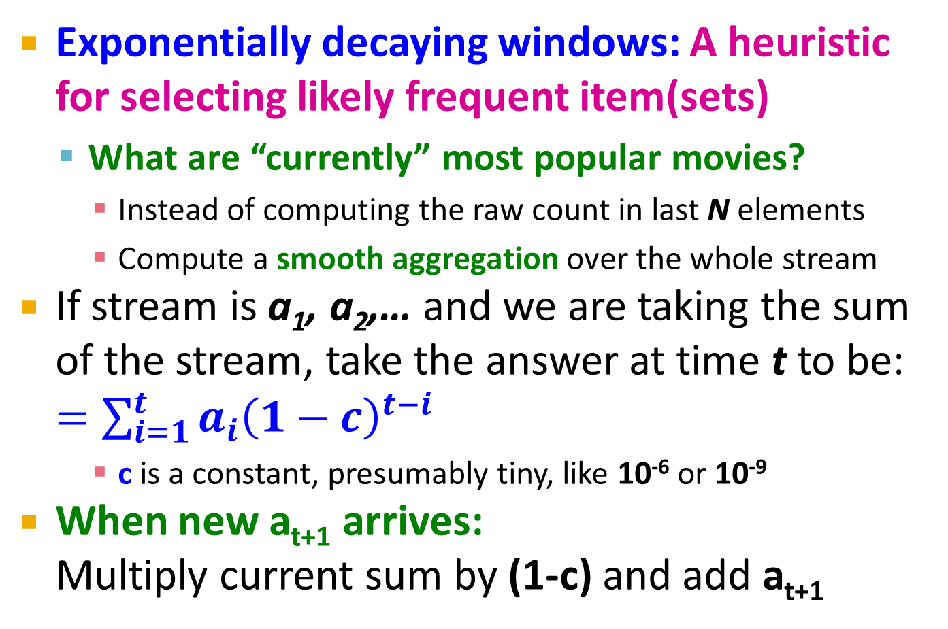
Exponentially Decaying Windows
Exponentially decaying windows: A heuristic for selecting likely frequent item(sets)
  What are “currently” most popular movies?
    Instead of computing the raw count in last N elements
    Compute a smooth aggregation over the whole stream
If stream is a₁, a₂,… and we are taking the sum of the stream, take the answer at time t to be: $=\sum_{i=1}^{t}{a_{i}{\left(1−c\right)}^{t−i}}$
    c is a constant, presumably tiny, like 10⁻⁶ or 10⁻⁹
When new a_{t+1} arrives:
Multiply current sum by (1-c) and add a_{t+1}

Slide 42
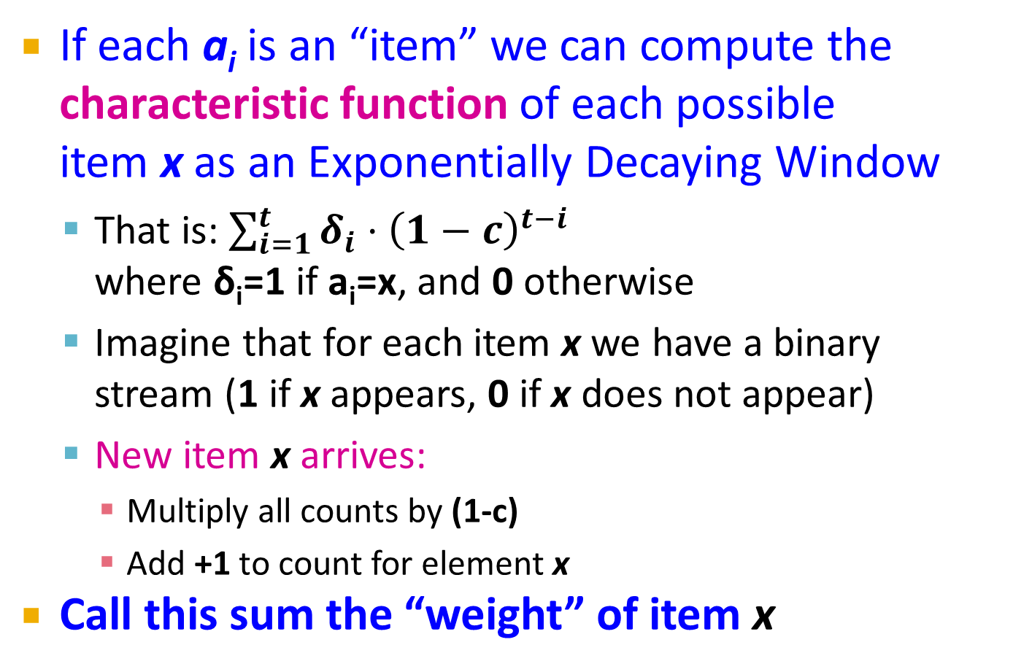
Example: Counting Items
If each a_{i} is an “item” we can compute the characteristic function of each possible
item x as an Exponentially Decaying Window
  That is: $\sum_{i=1}^{t}{δ_{i}{⋅\left(1−c\right)}^{t−i}}$
  where δ_{i}=1 if a_{i}=x, and 0 otherwise
  Imagine that for each item x we have a binary stream (1 if x appears, 0 if x does not appear)
  New item x arrives:
    Multiply all counts by (1-c)
    Add +1 to count for element x
Call this sum the “weight” of item x

Slide 43
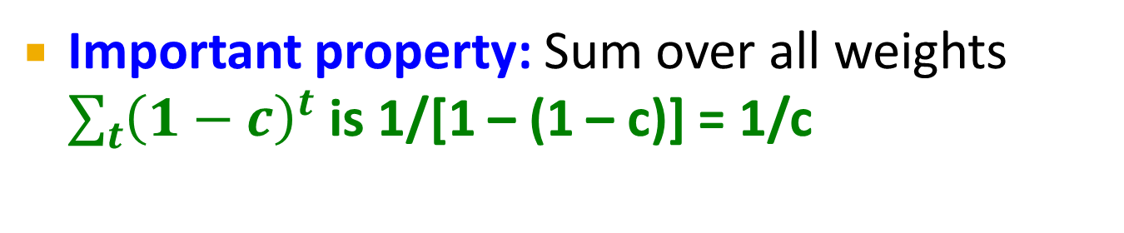
Sliding Versus Decaying Windows
. . .
1/c
Important property: Sum over all weights $\sum_{t}{{\left(1−c\right)}^{t}}$ is 1/[1 – (1 – c)] = 1/c

Slide 44
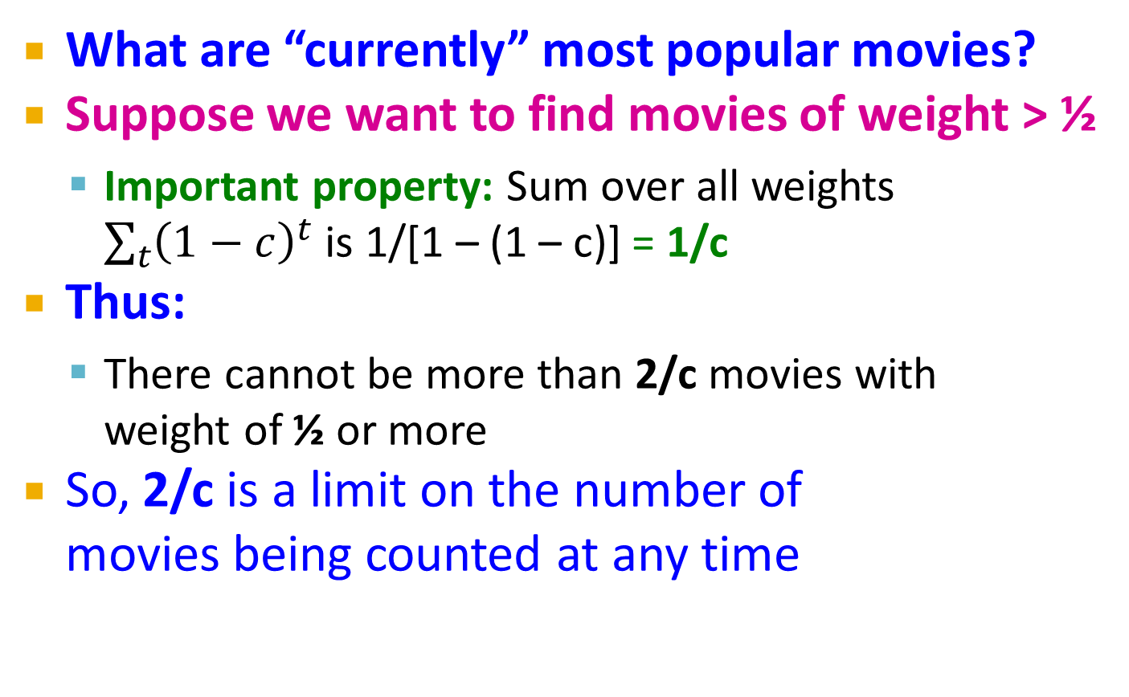
Example: Counting Items
What are “currently” most popular movies?
Suppose we want to find movies of weight > ½
  Important property: Sum over all weights $\sum_{t}{{\left(1−c\right)}^{t}}$ is 1/[1 – (1 – c)] = 1/c
Thus:
  There cannot be more than 2/c movies with
  weight of ½ or more
So, 2/c is a limit on the number of
movies being counted at any time

Slide 45
Extension to Itemsets
Count (some) itemsets in an E.D.W.
  What are currently “hot” itemsets?
    Problem: Too many itemsets to keep counts of
    all of them in memory
When a basket B comes in:
  Multiply all counts by (1-c)
  For uncounted items in B, create new count
  Add 1 to count of any item in B and to any itemset contained in B that is already being counted
  Drop counts < ½
  Initiate new counts (next slide)

Slide 46
Initiation of New Counts
Start a count for an itemset S ⊆ B if every proper subset of S had a count prior to arrival of basket B
  Intuitively: If all subsets of S are being counted this means they are “frequent/hot” and thus S has a potential to be “hot”
Example:
  Start counting S={i, j} iff both i and j were counted prior to seeing B
  Start counting S={i, j, k} iff {i, j}, {i, k}, and {j, k} were all counted prior to seeing B

Slide 47
How many counts do we need?
Counts for single items < (2/c)∙(avg. number of items in a basket)
Counts for larger itemsets = ??
But we are conservative about starting
counts of large sets
  If we counted every set we saw, one basket
  of 20 items would initiate 1M counts

