Slide 1

Community Detection in Graphs: Finding overlaps
CS246: Mining Massive Datasets
Jure Leskovec, Stanford University
http://cs246.stanford.edu

Slide 2
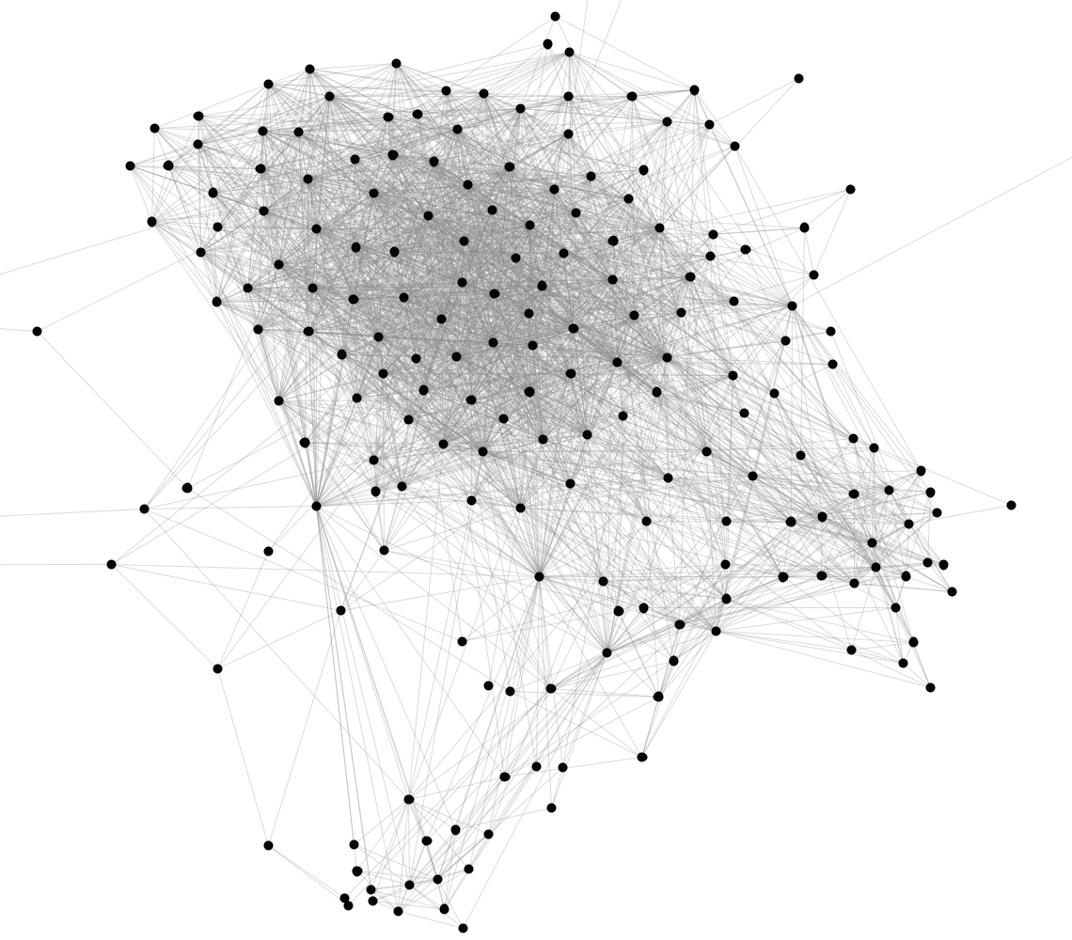
Facebook Network
Can we identify social communities?
Nodes: Facebook Users
Edges: Friendships

Slide 3
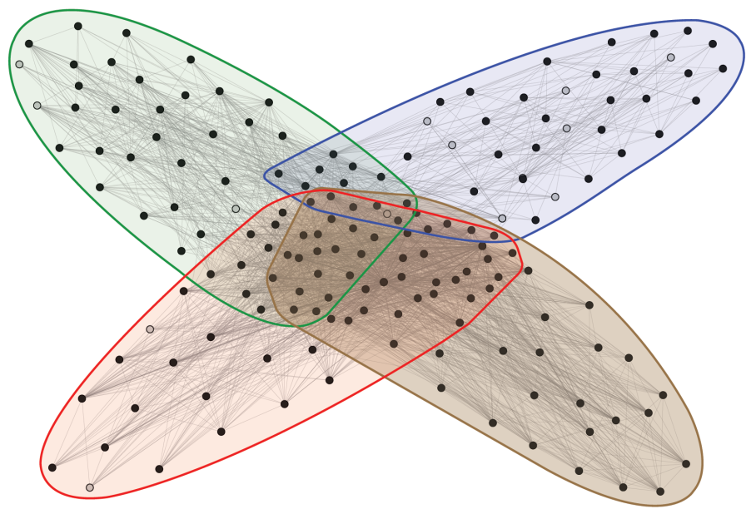
Facebook Network
Social communities
High school
Summer
internship
Stanford (Basketball)
Stanford (Squash)
Nodes: Facebook Users
Edges: Friendships

Slide 4
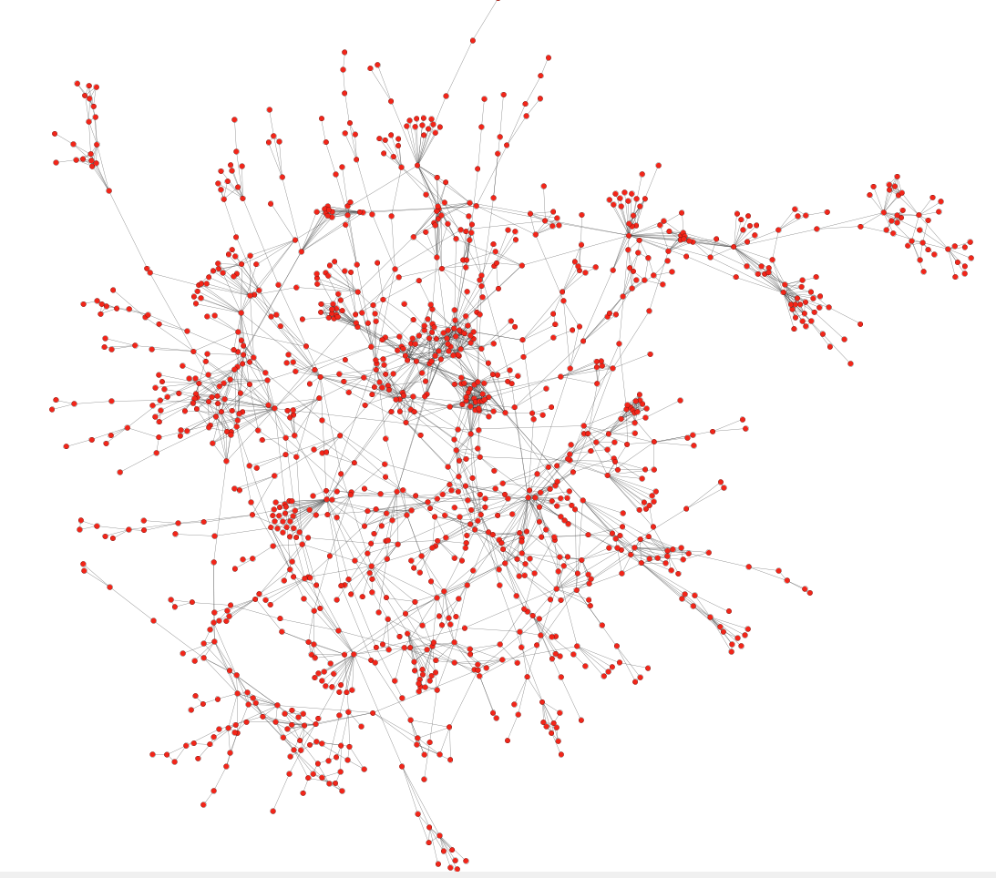
Protein-Protein Interactions
Can we identify functional modules?
Nodes: Proteins
Edges: Physical interactions

Slide 5
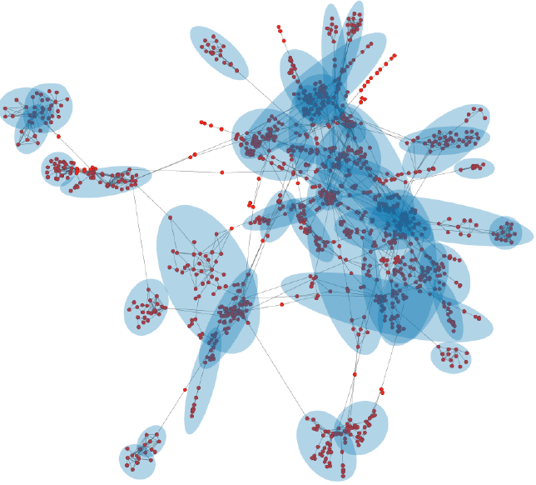
Protein-Protein Interactions
Functional modules
Nodes: Proteins
Edges: Physical interactions

Slide 6
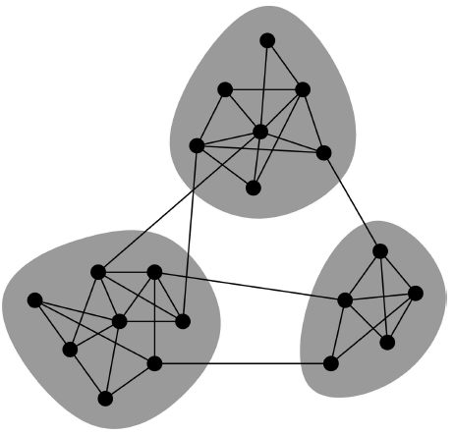
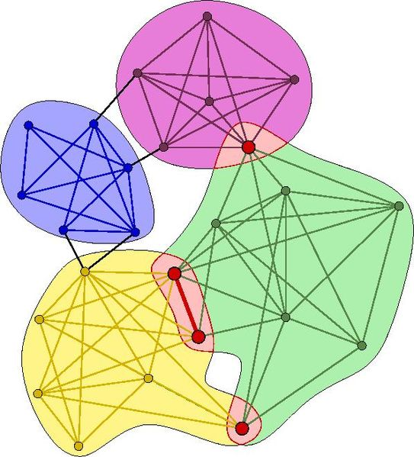
Overlapping Communities
Non-overlapping vs. overlapping communities
Previous lecture
Today

Slide 7
Non-overlapping Communities
Nodes
Nodes
Network
Adjacency matrix
Finding good “cuts”

Slide 8
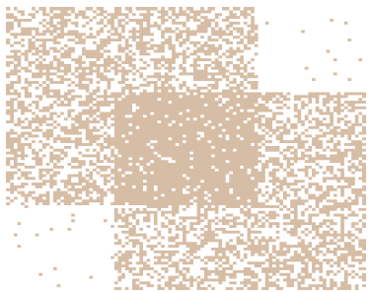
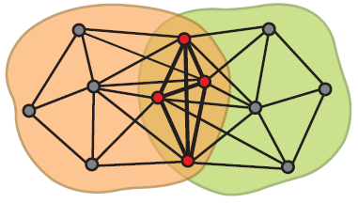
Communities as Tiles!
What if communities overlap?
Communities as “tiles”

Slide 9
Today’s lecture: Plan of attack
(1) Given a model, we generate the network:
(2) Given a network, find the “best” model
Generative model for networks
B
A
F
D
E
C
G
H
B
Generative model for networks
A
F
D
E
C
G
H

Slide 10
Model of networks
Goal: Define a model for generating networks
  The model will have a set of “parameters” that we will later want to estimate (to detect communities)
Q: Given a set of nodes and their community memberships, how do communities “generate” edges of the network?
Generative model for networks
B
A
F
D
E
C
G
H

Slide 11


Community-Affiliation Graph
Communities, C
p_{A}
p_{B}
Model
Memberships, M
Nodes, V
Model
Network
Generative model B(V, C, M, {p_{c}}) for graphs:
  Nodes V, Communities C, Memberships M
  Each community A has a single probability p_{A}
  (Later we fit the model to networks to detect communities,
  that is, for each node find communities it belongs to)

Slide 12
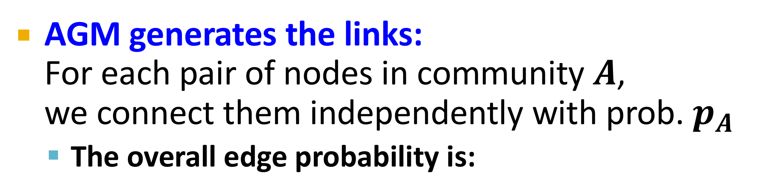
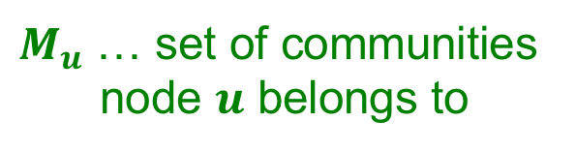
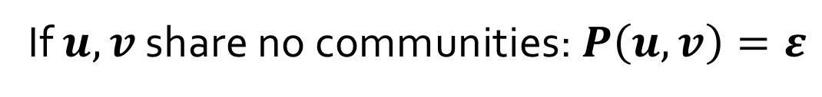
AGM: Generative Process
Communities, C
p_{A}
p_{B}
Model
Memberships, M
Nodes, V
Network
Model
AGM generates the links:
For each pair of nodes in community $A$,
we connect them independently with prob. $p_{A}$
  The overall edge probability is:
$M_{u}$ … set of communities
node $u$ belongs to
If $u,v$ share no communities: $P\left(u,v\right)=ε$
  Think of this as an “OR” function: If at least 1 community says “YES” we create an edge

Slide 13
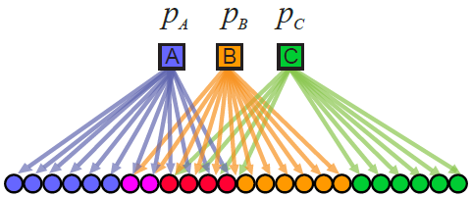
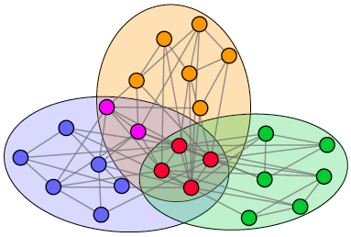
Recap: AGM networks
Model
Network

Slide 14
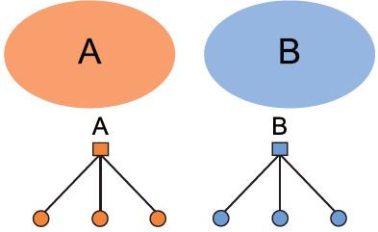
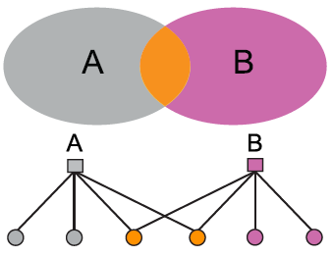
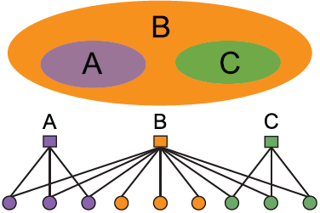
AGM is Expressive
AGM can express a variety of community structures:
Non-overlapping, Overlapping, Nested

Slide 15
How do we detect communities with AGM?

Slide 16
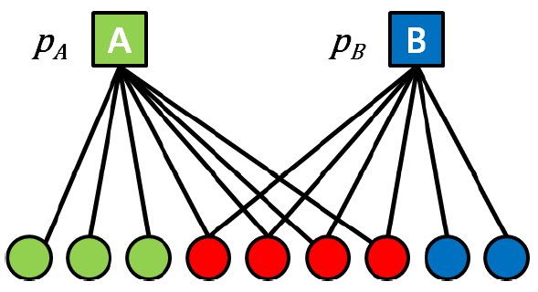

Detecting Communities
Detecting communities with AGM:
B
A
F
D
E
C
G
H
Given a Graph $G(V,E)$, find the AGM
Affiliation graph M
Number of communities C
Parameters p_{c}

Slide 17
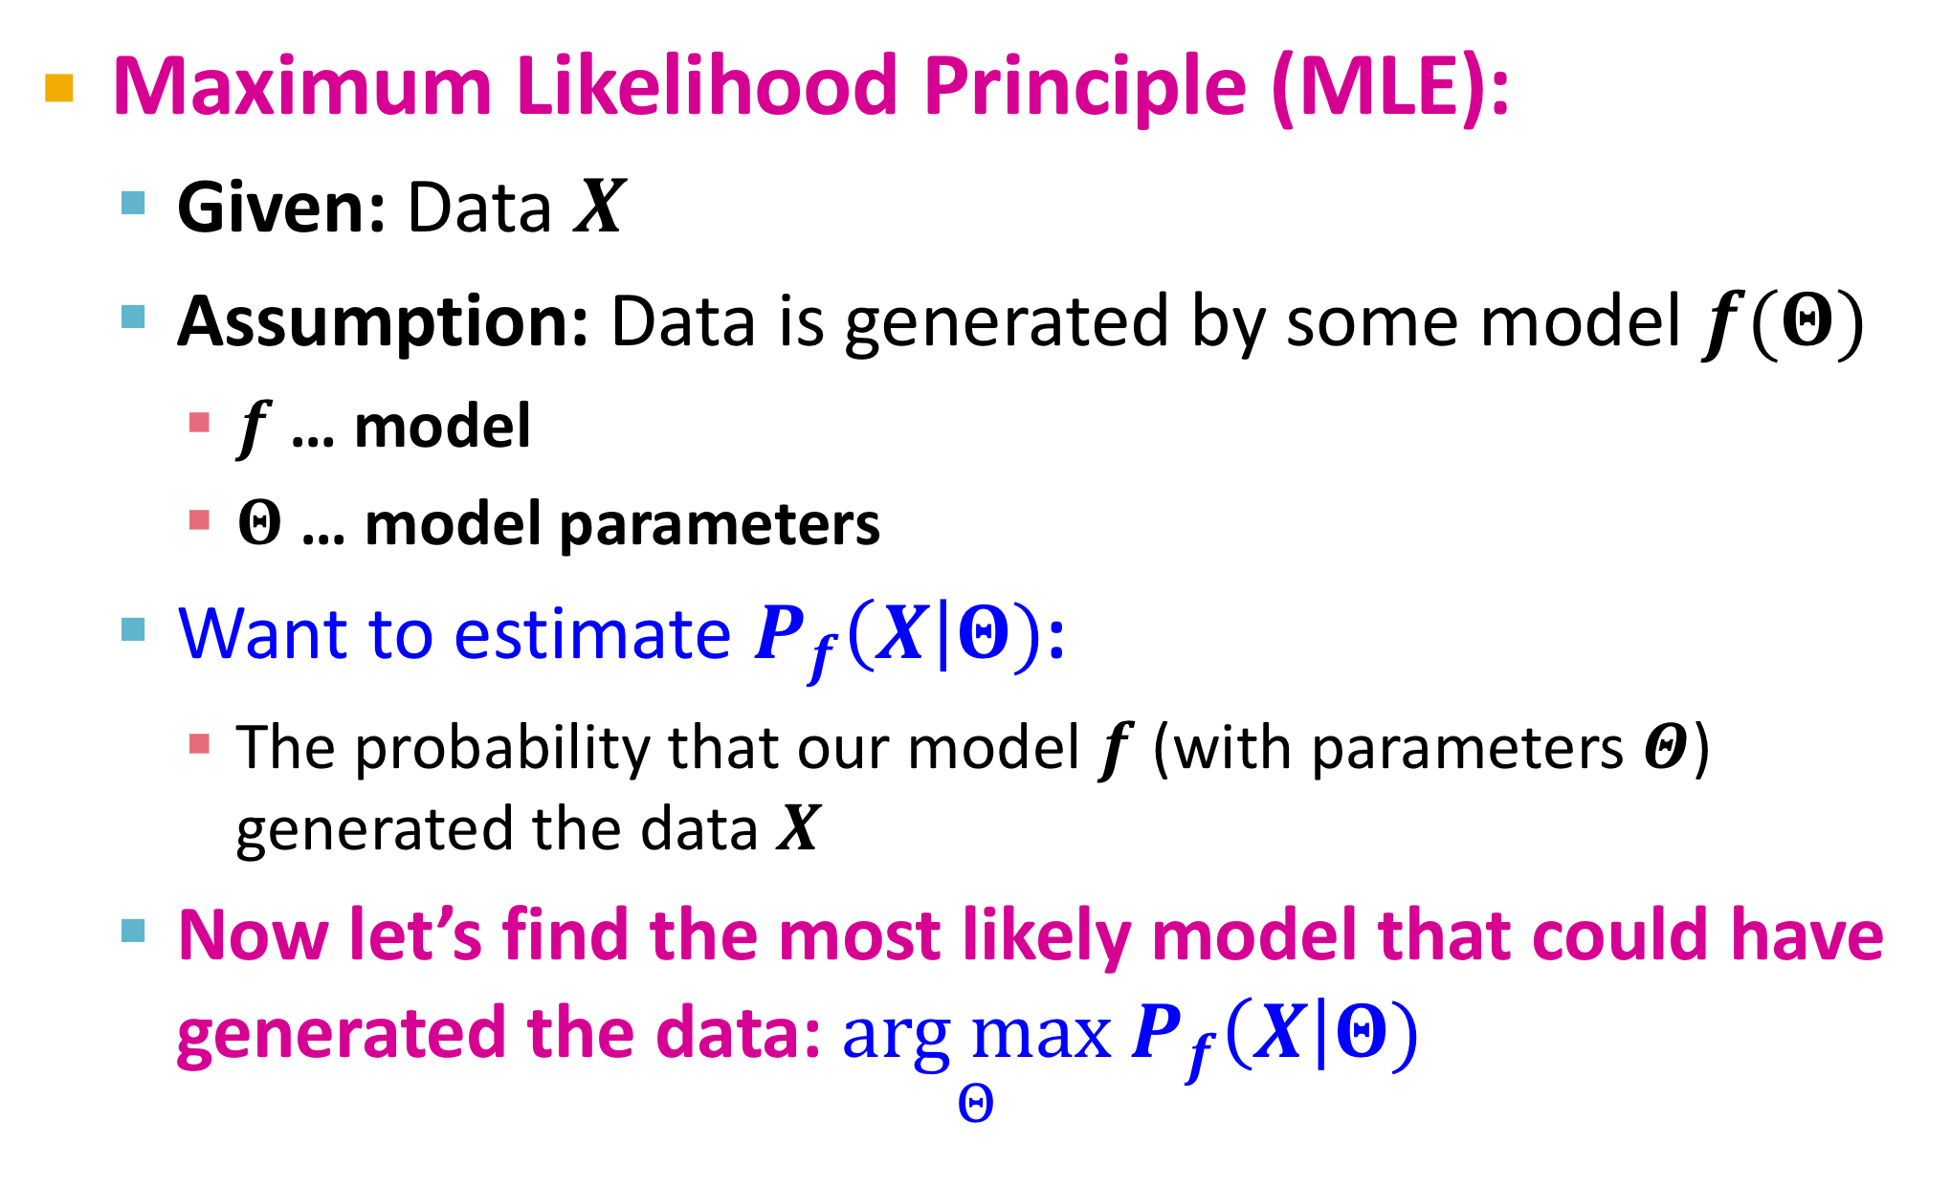
Maximum Likelihood Estimation
Maximum Likelihood Principle (MLE):
  Given: Data $X$
  Assumption: Data is generated by some model $f(Θ)$
    $f$ … model
    $Θ$ … model parameters
  Want to estimate $P_{f}\left(X\right|Θ)$:
    The probability that our model $f$ (with parameters $Θ$) generated the data $X$
  Now let’s find the most likely model that could have generated the data: $\underset{Θ}{arg max}{ P}_{f}\left(X\right|Θ)$

Slide 18
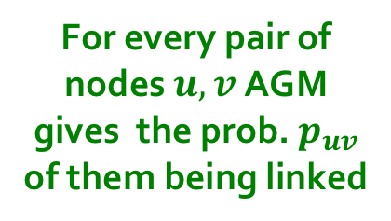

MLE for Graphs
How do we do MLE for graphs?
  AGM generates a probabilistic adjacency matrix
  We then flip all the entries of the probabilistic matrix to obtain the adjacency matrix of the graph G
The likelihood of AGM generating graph G:
Flip biased coins
$$G$$
For every pair of nodes $u,v$ AGM gives the prob. $p_{uv}$ of them being linked
0 | 0.10 | 0.10 | 0.04
0.10 | 0 | 0.02 | 0.06
0.10 | 0.02 | 0 | 0.06
0.04 | 0.06 | 0.06 | 0
0 | 1 | 0 | 0
1 | 0 | 1 | 1
0 | 1 | 0 | 1
0 | 1 | 1 | 0

Slide 19
Graphs: Likelihood P(G|Θ)
Given graph G(V,E) and Θ, we calculate likelihood that Θ generated G: P(G|Θ)
G
0 | 0.9 | 0.6 | 0.1
0.8 | 0 | 0.2 | 0
0.9 | 0.6 | 0 | 0.9
0 | 0 | 0.9 | 0
0 | 1 | 1 | 0
1 | 0 | 1 | 0
1 | 1 | 0 | 1
0 | 0 | 1 | 0
A
B
Θ=B(V, C, M, {p_{c}})
G
P(G|Θ)

Slide 20
Example: Likelihood of a Graph
2
C
D
Technically this
is 1 – (1-p_{C}).
1
4
3
1
2
3
4
C
D
p₁₂ = p₁₃ = p_{C}
Likelihood of this graph =
p₁₂ p₁₃ p₂₃ p₂₄ (1-p₁₄) (1-p₃₄) =
(p_{C})² (1 – (1-p_{C})(1-p_{D})) p_{D} (1-ε) (1-p_{D})
p₂₃ = 1 – (1-p_{C})(1-p_{D})
p₂₄ = p₃₄ = p_{D}
p₁₄ = ε
Very close to 1;
drop this factor

Slide 21
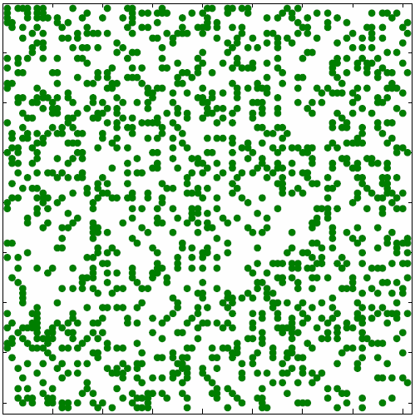
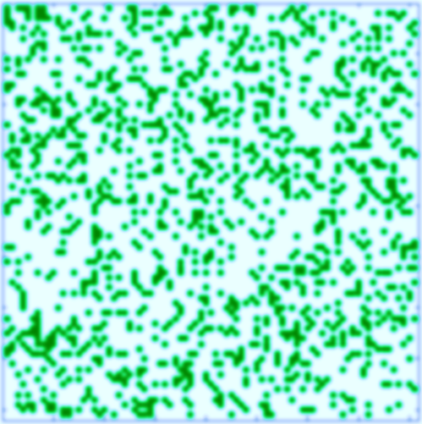





MLE for Graphs
Our goal: Find $Θ= (V,C,M,\left\{p_{C}\right\})$ such that:
Often we take the logarithm of the likelihood, and call it log-likelihood: $l\left(Θ\right)=log⁡P(G|Θ)$
P(
|
)
$$G$$
AGM
arg max
  $$P\left(G | Θ\right)=\prod_{u,v}{P{\left(u,v\right)}^{G_{uv}}{\left(1−P\left(u,v\right)\right)}^{1−G_{uv}}}$$
$G_{uv}$ … entry (u,v) of adjacency matrix

Slide 22
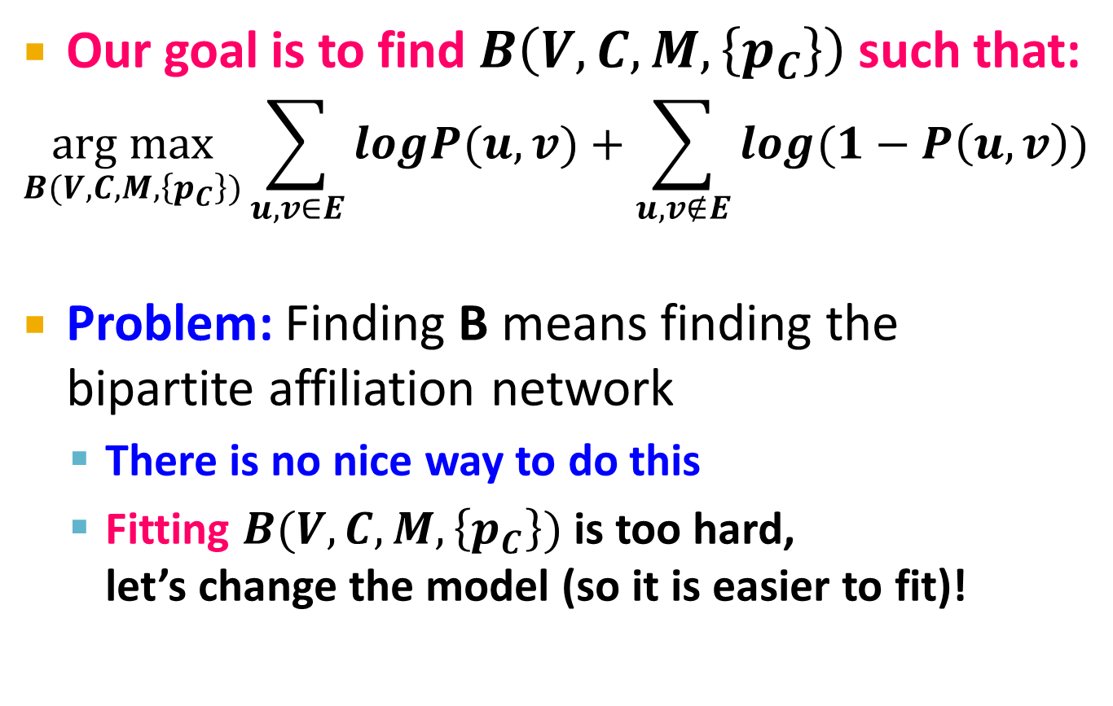
MLE for AGM
Our goal is to find $B\left(V,C,M,\left\{p_{C}\right\}\right)$ such that:
  $$\underset{B(V,C,M,\left\{p_{C}\right\})}{arg max}{\sum_{u,v∈E}{logP(u,v)}+\sum_{u,v∉E}{log(1−P\left(u,v\right))}}$$
Problem: Finding B means finding the bipartite affiliation network
  There is no nice way to do this
  Fitting $B(V,C,M,\left\{p_{C}\right\})$ is too hard,
  let’s change the model (so it is easier to fit)!

Slide 23

MLE for AGM
If $B(V, C, M)$ is given, finding ${\{p}_{C}\}$ is easy:
  Just write down the log-likelihood $l(G|Θ)$ as a function of $\left\{p_{C}\right\}$ by computing each $P\left(u,v\right)$
  Find $\{p_{C}\}$ that maximizes the log-likelihood

Slide 24
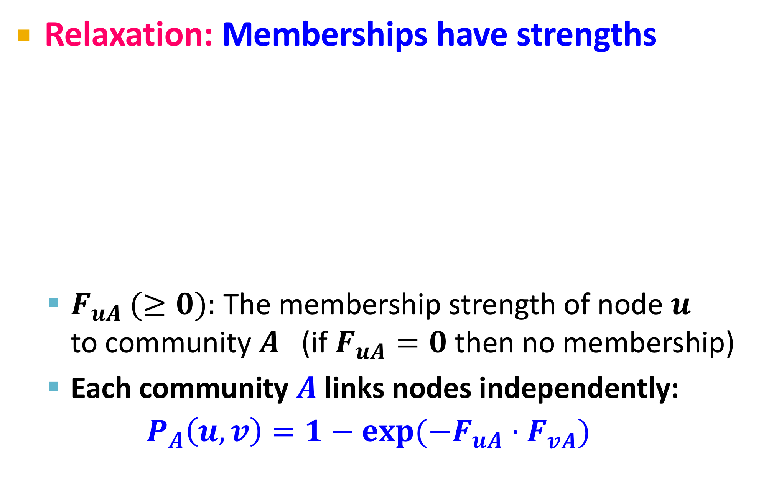


Relaxing AGM
Relaxation: Memberships have strengths
  $F_{uA} (≥0):$ The membership strength of node $u$
  to community $A$ (if $F_{uA}=0$ then no membership)
  Each community $A$ links nodes independently:
  $$P_{A}\left(u,v\right)=1−exp⁡(−F_{uA}⋅F_{vA}^{})$$
$$F_{uA}$$
$$F_{wB}$$
u
w

Slide 25

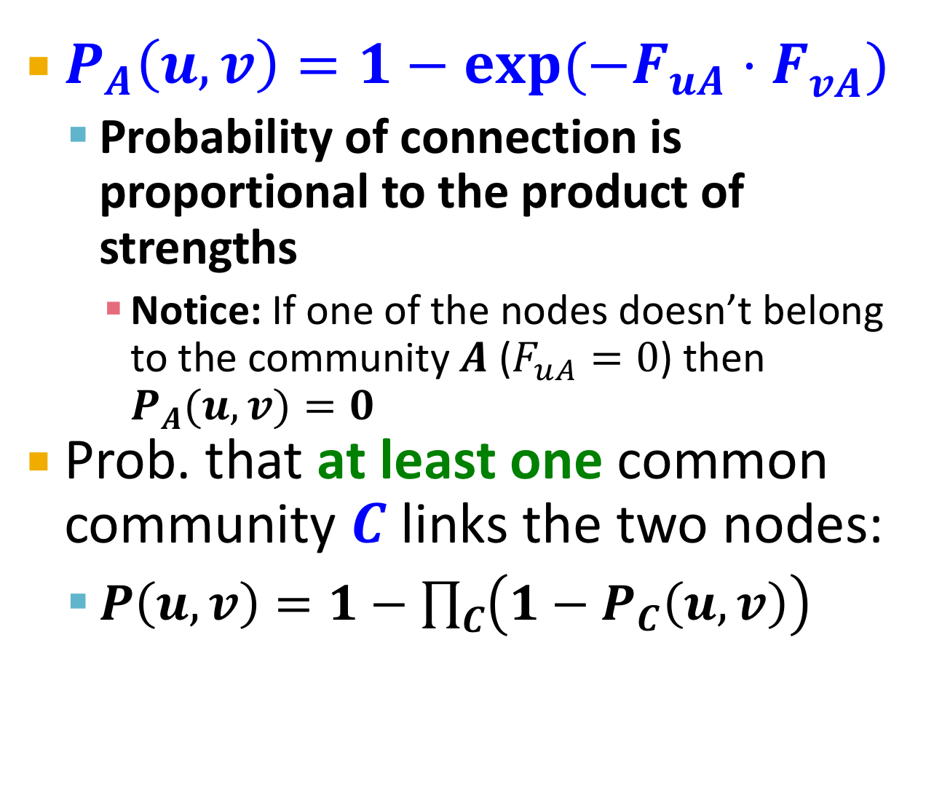

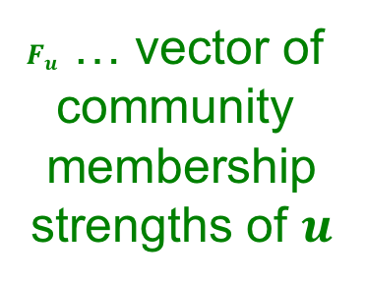
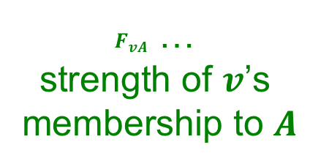
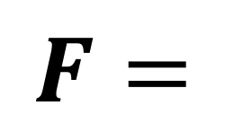
Factor Matrix $F$
Community membership strength matrix $F$
Communities
$P_{A}\left(u,v\right)=1−exp⁡(−F_{uA}⋅F_{vA}^{})$
  Probability of connection is
  proportional to the product of strengths
    Notice: If one of the nodes doesn’t belong to the community $A$ ($F_{uA}=0$) then $P_{A}(u,v)=0$
Prob. that at least one common community $C$ links the two nodes:
  $P\left(u,v\right)=1−\prod_{C}{\left(1−P_{C}\left(u,v\right)\right)}$
Nodes
 | j
$$F=$$
$F_{u}$ … vector of
community
membership
strengths of $u$
$F_{vA}$ …
strength of $v$’s
membership to $A$

Slide 26
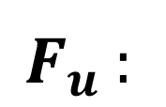
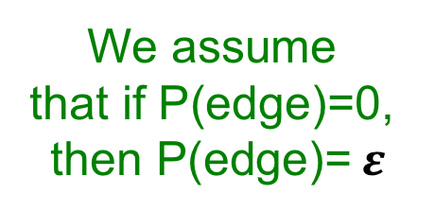
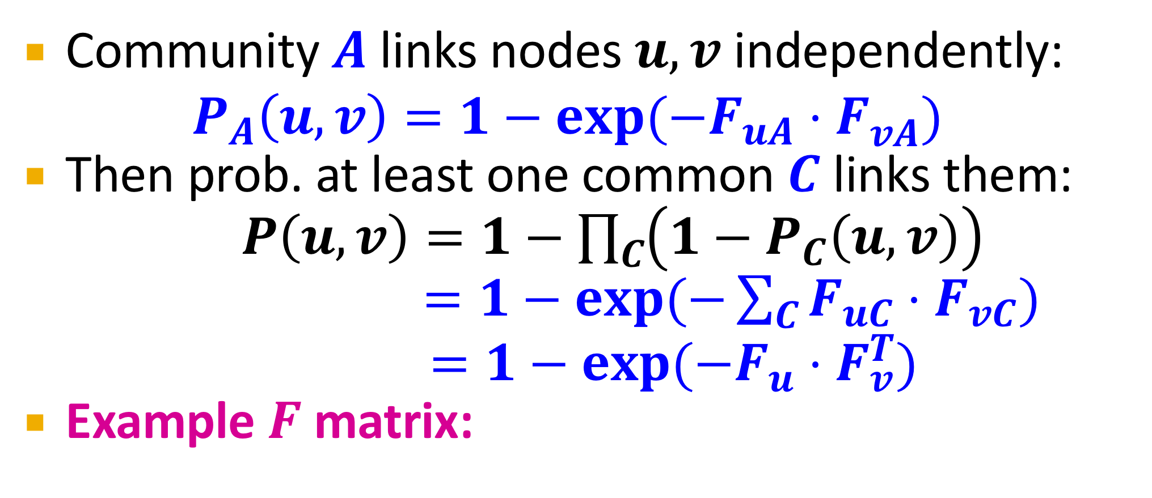
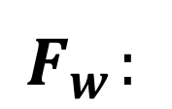
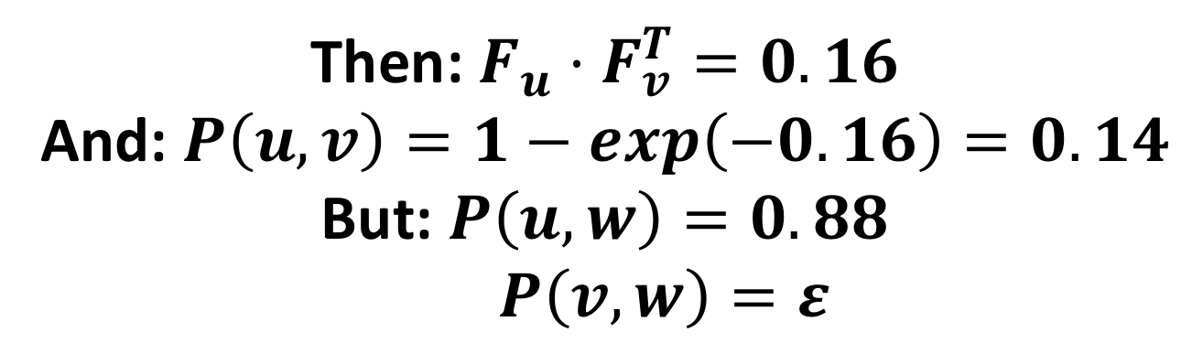
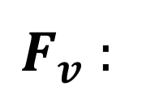
Relaxing AGM
Community $A$ links nodes $u,v$ independently:
$P_{A}\left(u,v\right)=1−exp⁡(−F_{uA}⋅F_{vA}^{})$
Then prob. at least one common $C$ links them:
$P\left(u,v\right)=1−\prod_{C}{\left(1−P_{C}\left(u,v\right)\right)}$
$=1−exp⁡(−\sum_{C}{F_{uC}⋅F_{vC}})$
$$=1−exp⁡(−F_{u}⋅F_{v}^{T})$$
Example $F$ matrix:
$$F_{u}^{}:$$
0 | 1.2 | 0 | 0.2
Then: $F_{u}⋅F_{v}^{T}=0.16$
And: $P\left(u,v\right)=1−exp\left(−0.16\right)=0.14$
But: $P\left(u,w\right)=0.88$
$P\left(v,w\right)=ε$
$$F_{v}^{}:$$
0.5 | 0 | 0 | 0.8
$$F_{w}^{}:$$
0 | 1.8 | 1 | 0
We assume
that if P(edge)=0,
then P(edge)= $ε$
Node community
membership strengths

Slide 27
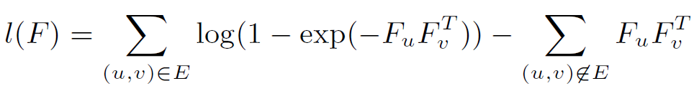
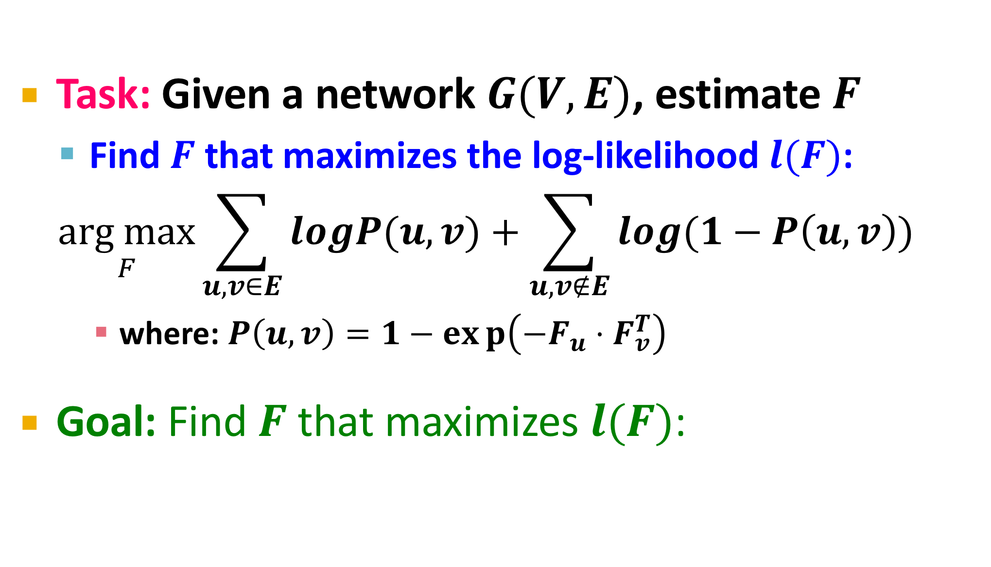
How to find F
Task: Given a network $G(V,E)$, estimate $F$
  Find $F$ that maximizes the log-likelihood $l(F)$:
  $$\underset{F}{arg max}{\sum_{u,v∈E}{logP(u,v)}+\sum_{u,v∉E}{log(1−P\left(u,v\right))}}$$
    where: $P\left(u,v\right)=1−exp\left(−F_{u}⋅F_{v}^{T}\right)$
Goal: Find $F$ that maximizes $l(F)$:

Slide 28
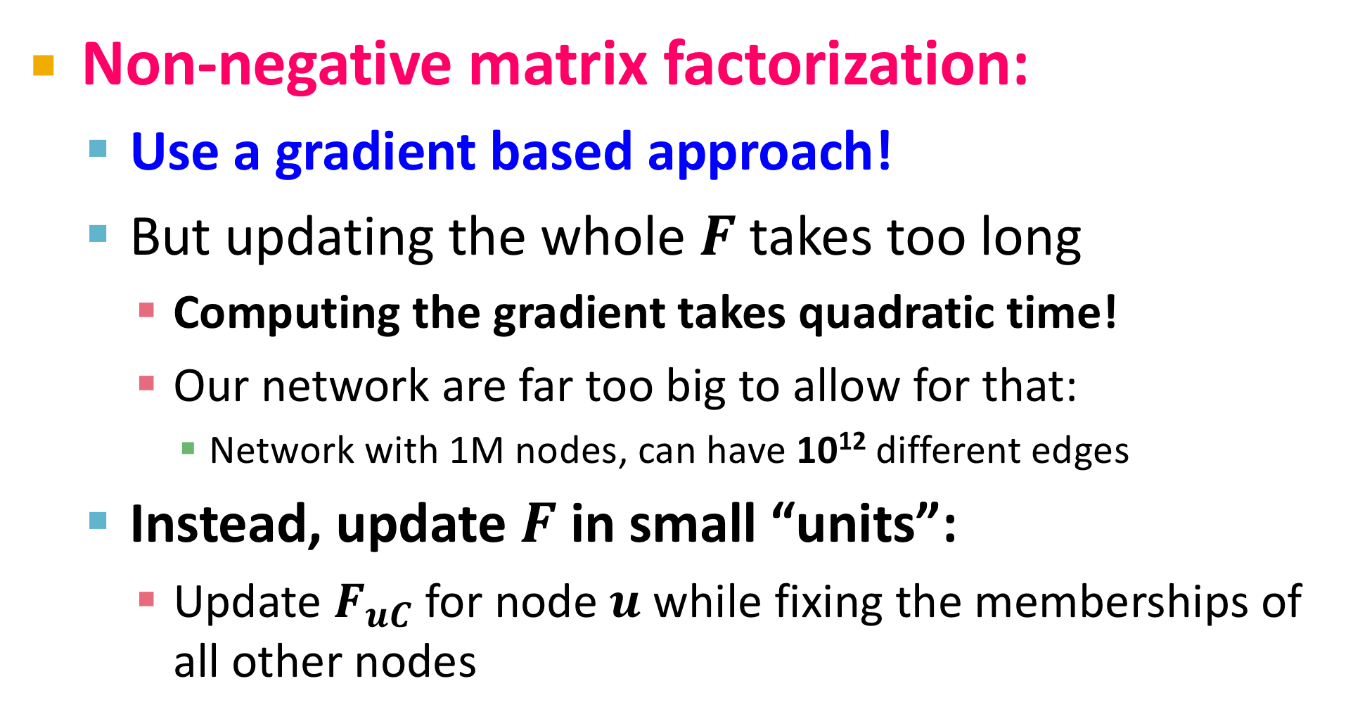
How to find F
Non-negative matrix factorization:
  Use a gradient based approach!
  But updating the whole $F$ takes too long
    Computing the gradient takes quadratic time!
    Our network are far too big to allow for that:
      Network with 1M nodes, can have 10¹² different edges
  Instead, update $F$ in small “units”:
    Update $F_{uC}$ for node $u$ while fixing the memberships of all other nodes

Slide 29

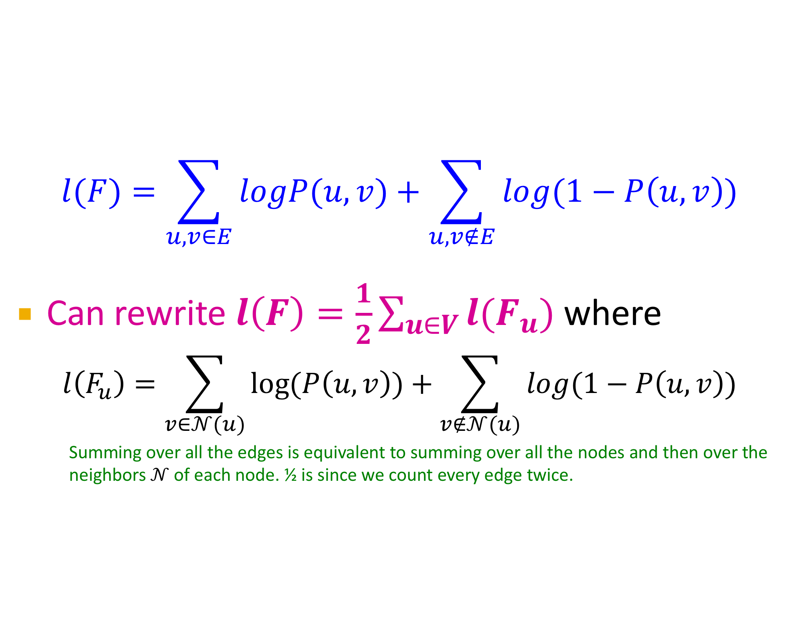
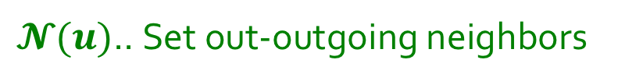
Optimizing Log-Likelihood
$$l(F)=\sum_{u,v∈E}{logP(u,v)}+\sum_{u,v∉E}{log(1−P\left(u,v\right))}$$
Can rewrite $l\left(F\right)=\frac{1}{2}\sum_{u∈V}{l(F_{u})}$ where
$$l\left(F_{u}\right)=\sum_{v∈𝒩(u)}{log⁡(P\left(u,v\right))}+\sum_{v∉𝒩(u)}{log(1−P\left(u,v\right))}$$
    Summing over all the edges is equivalent to summing over all the nodes and then over the neighbors $𝒩$ of each node. ½ is since we count every edge twice.
$𝓝(u)$.. Set out-outgoing neighbors

Slide 30
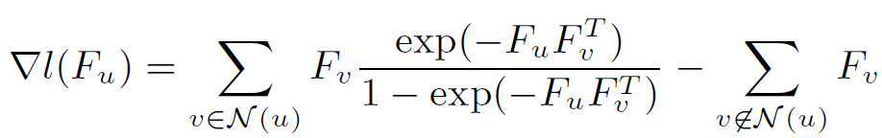
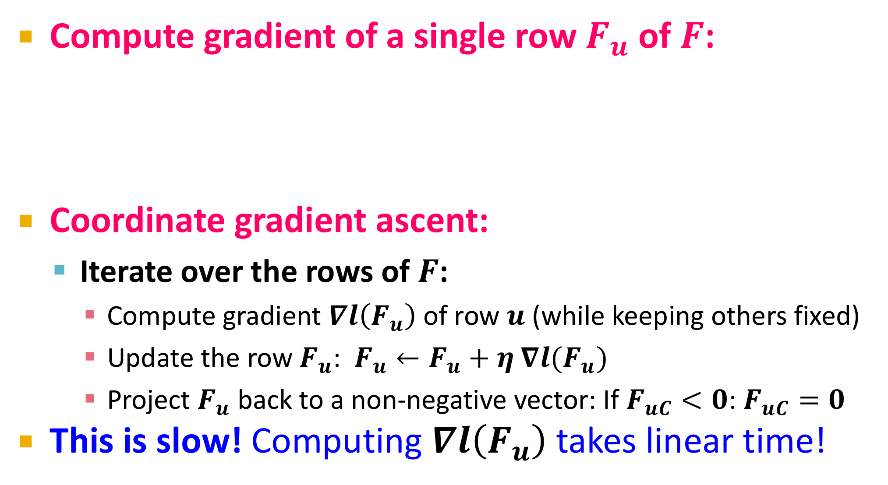
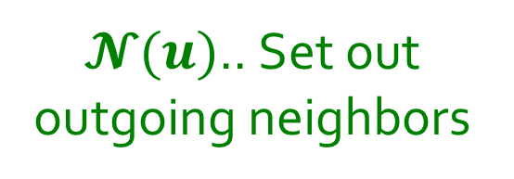
Optimizing Log-Likelihood
Compute gradient of a single row $F_{u}$ of $F$:
Coordinate gradient ascent:
  Iterate over the rows of $F$:
    Compute gradient $∇l\left(F_{u}\right)$ of row $u$ (while keeping others fixed)
    Update the row $F_{u}$: $F_{u}←F_{u}+η ∇l(F_{u})$
    Project $F_{u}$ back to a non-negative vector: If $F_{uC}<0$: $F_{uC}=0$
This is slow! Computing $∇l\left(F_{u}\right)$ takes linear time!
$𝓝(u)$.. Set out
outgoing neighbors

Slide 31
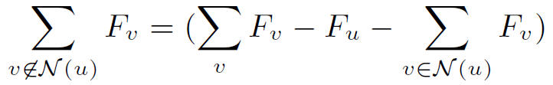
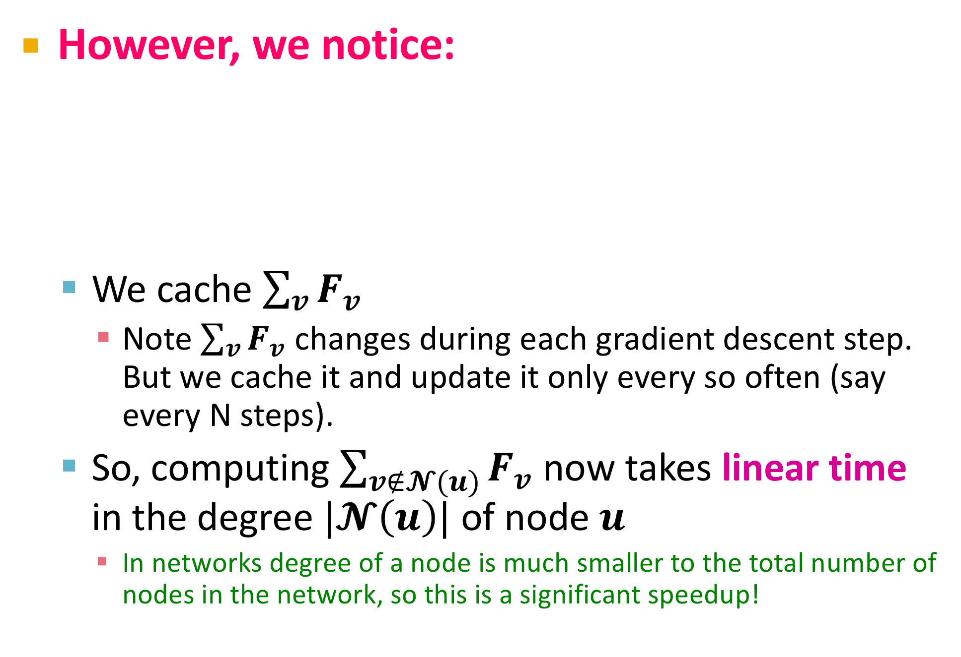
Faster Solution
However, we notice:
  We cache $\sum_{v}{F_{v}}$
    Note $\sum_{v}{F_{v}}$ changes during each gradient descent step. But we cache it and update it only every so often (say every N steps).
  So, computing $\sum_{v∉𝓝(u)}{F_{v}}$ now takes linear time
  in the degree $|𝓝\left(u\right)|$ of node $u$
    In networks degree of a node is much smaller to the total number of nodes in the network, so this is a significant speedup!

Slide 32
Node Classification in Networks: Guilt by Association

Slide 33
Finding “Guilty Associates”
Predict gene functions by guilty-by-association:
Protein folding
CDC48
Red: Genes involved in protein folding
White: Genes with unknown function
MCA1
CPR3
TDH2
Question: Which additional genes are involved in “protein folding”?
11/28/17

Slide 34
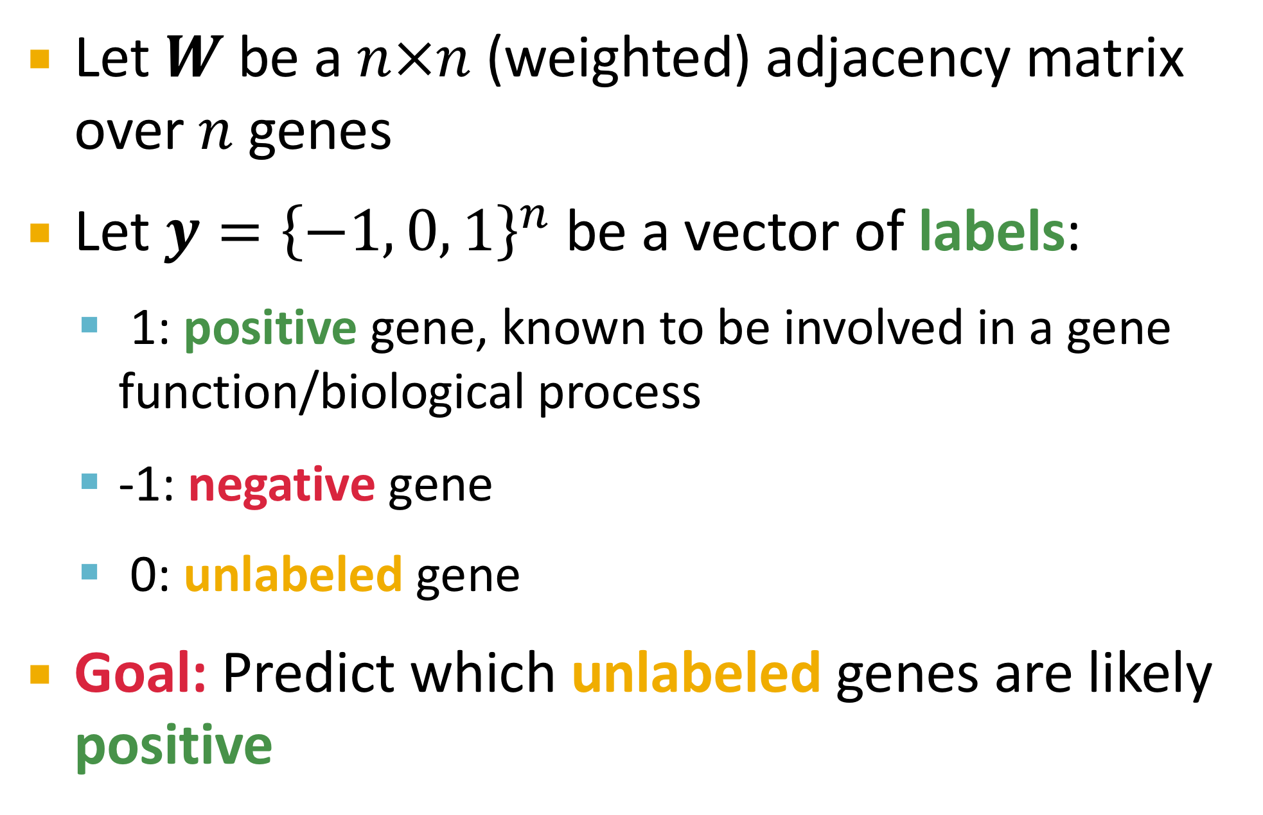
“Guilty Associates” Problem
Let $W$ be a $n×n$ (weighted) adjacency matrix over $n$ genes
Let $y={\left\{−1, 0, 1\right\}}^{n}$ be a vector of labels:
  1: positive gene, known to be involved in a gene function/biological process
  -1: negative gene
  0: unlabeled gene
Goal: Predict which unlabeled genes are likely positive
11/28/17

Slide 35
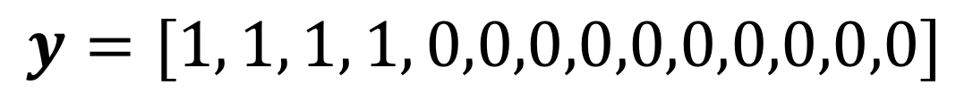



“Guilty Associates” Problem
Approach: Learn a vector of discriminant scores $f$, where $f_{i}$ is likelihood that node $i$ is positive
Example:
CDC48
$$y=[1, 1, 1, 1, 0,0,0,0,0,0,0,0,0,0]$$
MCA1
CPR3
$W=$ (weighted) adjacency matrix
GB
TDH2
GA
$$f= ?$$
GE
GC
GD
GF
11/28/17

Slide 36
Three Approaches
Three approaches to Guilt by Association
1) Neighbor scoring
2) Using Random Walks
3) Label propagation

Slide 37





Approach 1: Neighbor Scoring
Node score $f_{i}$ is weighted sum of the labels of $i$’s direct neighbors:
Example:
$$f_{i}=\sum_{j=1}^{n}{W_{ij}y_{j}}$$
CDC48
MCA1
$$f_{GA}=W_{GA, MCA1}{∙y}_{MCA1}$$
CPR3
$$f_{GB}=W_{GB, CDC48}∙y_{CDC48}+W_{GB, TDH2}∙y_{CDC48}$$
GB
TDH2
$$f_{GC}=W_{GC, TDH2}∙y_{TDH2}$$
GA
GE
GC
GD
Green: Positive nodes
White: $f_{i}=0$
GF
GG
11/28/17

Slide 38



Approach 1: Neighbor Scoring
Node score $f_{i}$ is weighted sum of the labels of $i$’s direct neighbors:
Example:
$$f_{i}=\sum_{j=1}^{n}{W_{ij}y_{j}}$$
CDC48
MCA1
$$f_{GA}=W_{GA, MCA1}{∙y}_{MCA1}$$
CPR3
$$f_{GB}=W_{GB, CDC48}∙y_{CDC48}+W_{GB, TDH2}∙y_{CDC48}$$
GB
TDH2
$$f_{GC}=W_{GC, TDH2}∙y_{TDH2}$$
GA
One half of GC’s neighbors are positives
One third of GA’s neighbors are positives
But: $f_{GC}=f_{GA}$ (if $W$ is binary)
GE
GC
GD
GF
Red: Positive genes
White: $f_{i}=0$
GG
11/28/17

Slide 39







Weighted Neighbors
Normalize matrix $W$by node degrees:
Example:
$$f_{i}=\frac{1}{d_{i}}\sum_{j=1}^{n}{W_{ij}y_{j}}, d_{i}=\sum_{j}{W_{ij}}$$
Matrix notation:
$$f_{i}=D^{−1}Wy$$
$$D=diag(d)$$
CDC48
$$f_{GA}=\frac{1}{3}W_{GA, MCA1}∙y_{MCA1}$$
MCA1
CPR3
$$f_{GB}={\frac{1}{3}(W}_{GB, CDC48}∙y_{CDC48}+W_{GB, TDH2}∙y_{TDH2})$$
GB
TDH2
GA
$$f_{GC}=\frac{1}{2}W_{GC, TDH2}∙y_{TDH2}$$
GE
GC
GD
Red: Positive genes
White: $f_{i}=0$
GF
11/28/17

Slide 40




Indirect Neighbor Scoring
See also CS224W lecture on Link Analysis
Matrix $P=D^{−1}W$ is known as Markov transition matrix
  $D$ is a diagonal matrix with diagonal elements $d_{i}$
  $P$ is a row stochastic matrix, $\sum_{j}{P_{ij}=1}$
Row $i$ is a probability distribution over the transition of a random walk starting at node $i$
$P_{ij}$ is probability of a random walker following a link from node $i$ to node $j$
$$P_{ij}$$
$$i$$
$$j$$
11/28/17

Slide 41







Approach 2: Random Walks
See also CS224W lecture on Link Analysis
Random walk interpretation extends a direct neighbor approach to include indirect neighbors
Idea: Extend direct neighbor scoring formula $f= D^{−1}Wy=Py$ to include second-degree neighbors
Probability of a random walk of length two between node $i$ and node $j$ is:
$$P_{kj}$$
$$j$$
$${[P^{2}]}_{ij} =\sum_{k=1}^{n}{P_{ik}P_{kj}}$$
$$P_{ik}$$
$$i$$
$$k$$
11/28/17

Slide 42




Approach 2: Indirect Neighbors
Consider second-degree neighbors when calculating node score $f_{i}$ as:
$$f_{i}= \sum_{j=1}^{n}{P_{ij}y_{j}}+\sum_{j=1}^{n}{{[P^{2}]}_{ij}}y_{j}$$
Direct
neighbors
Second-degree
neighbors
$$P_{kj}$$
$$j$$
$$P_{ik}$$
$$i$$
$$k$$
11/28/17

Slide 43






Example: Indirect Neighbors
$P=D^{−1}W$
CDC48
$$f_{i}= \sum_{j=1}^{n}{P_{ij}y_{j}}+\sum_{j=1}^{n}{{[P^{2}]}_{ij}}y_{j}$$
MCA1
CPR3
Direct
neighbors
Second-degree
neighbors
GB
GA
TDH2
GC
$$f_{GA}=P_{GA,MCA1}∙y_{MCA1}$$
GE
GD
$$f_{GE}=P_{GE, MCA1}^{2}∙y_{MCA1}+P_{GE, TDH2}^{2}∙y_{TDH2}$$
+ $P_{GE, CDC48}^{2}∙y_{CDC48}$
GF
Direct neighbor of a positive gene
Second-order neighbor of a positive gene
Red: Positive genes
White: $f_{i}=0$
${[P^{2}]}_{ij}>0$ if there is a walk of length $2$ between $i$ and$j$
11/28/17

Slide 44

Beyond Second-Degree Neighbors
This approach can be extended to include other nodes at a distance of length $r$ (usually $r<4$)
Increasing $r$ beyond 2 often results in degradation of prediction performance
Note: Probability of a random walk from $i$ to $j$ in $r$ steps is given by ${[P^{r}]}_{ij}$
Next: Use random walks to derive label propagation

Slide 45
Approach 3: Label Propagation
Label propagation generalizes neighborhood-based approaches by considering random walks of all lengths between nodes
The algorithm can be derived as:
  Iterative diffusion process [Zhou et al., NIPS 2004]
  Solution to a specific convex optimization task [Zhou et al., NIPS 2004, Zhu et al., ICML 2003]
  Maximum a posteriori (MAP) estimation in Gaussian Markov Random Fields [Rue and Held, Chapman & Hall, 2005]
Next: Derivation based on a diffusion process

Slide 46



Label Propagation: Intuition
Intuition: Diffuse labels through edges of the network
Score
high
low
Red: positive nodes
Pink: $f_{i}>0$
White: $f_{i}=0$
Red: positive nodes
White: unlabeled nodes

Slide 47

Diffusion Process: Idea
The diffusion process is defined as an iterative process
Diffuse labels through network edges:
  Start with initial label information, $f_{i}^{(0)}=y_{i}$
  In each iteration, each node $i$ receives label information from $i$’s neighbors, and also retains its initial label
  $λ$ specifies relative amount of label information from $i$’s neighbors and its initial label
  Finally, the label of each unlabeled node is set to be the class (-1 or 1) of which it has received most information

Slide 48



Diffusion Process: Formally
The diffusion process is defined as the following iteration
At iteration $r=0,$ define $f_{i}^{(0)}←y_{i}$
At iteration $r+1$, the score of node $i$ is the weighted average of the scores of $i$’s neighbors in iteration $r$, and $i$’s initial label:
$$f_{i}^{(r+1)}←\left(1−λ\right)y_{i}+λ\sum_{j=1}^{n}{W_{ij}f_{j}^{(r)}}$$
$0<λ<1$ is model parameter

Slide 49


Diffusion Process: Intuition
$$f_{i}^{(r+1)}←\left(1−λ\right)y_{i}+λ\sum_{j=1}^{n}{W_{ij}f_{j}^{(r)}}$$
$⇒$ Discriminant scores $f$ are weighted sum of walks of all lengths between the nodes
$⇒$ High score $f_{i}$ is assigned to $i$ if $i$ is connected to positively labeled nodes with many short walks

Slide 50


Diffusion Process: Intuition
Zhou et al., NIPS 2004
$f^{(R)}$ can be rewritten as:
  ${[W^{r}]}_{ij}>0$ if a walk of length $r$ between $i$ and$j$
  Weight $λ^{r}$ decreases with increasing distance
$⇒$ Discriminant scores $f$ are weighted sum of walks of all lengths between the nodes
$⇒$ High score $f_{i}$ is assigned to $i$ if $i$ is connected to positively labeled nodes with many short walks
$$f^{(R)}=(1−λ)\sum_{r=0}^{R}{{\left(λW\right)}^{r}y}$$

Slide 51







Diffusion Process: Example
Score
high
low
$$f^{(0)}=y$$
$$f^{(1)}=λWy+\left(1−λ\right)y$$
All nodes reachable with a walk of length 2 are assigned a non-zero value
Red: positive nodes
Pink: $f_{i}>0$
White: $f_{i}=0$
$$f^{(2)}=λWf^{(1)}+\left(1−λ\right)y$$

Slide 52




Diffusion Process: Example
Score
high
low
$$f^{(0)}=y$$
$$f^{(1)}=λWy+\left(1−λ\right)y$$
All nodes reachable with a walk of length 2 are assigned a non-zero value
Red: positive nodes
Pink: $f_{i}>0$
White: $f_{i}=0$
$$f=(1−λ)\sum_{r=0}^{∞}{{\left(λW\right)}^{r}y}$$
$$f^{(2)}=λWf^{(1)}+\left(1−λ\right)y$$

Slide 53





Normalize Adjacency Matrix W
$$f=(1−λ)\sum_{r=0}^{∞}{{\left(λW\right)}^{r}y}$$
Problem: The infinite sum
does not converge in general
Solution: Normalize $W$ before diffusion:
  Symmetric normalization:
  Signal is spread in a breadth-first search manner
  Asymmetric normalization:
$$S= D^{−1/2}WD^{−1/2}$$
$$D=diag(d)$$
$$P= D^{−1}W$$

Slide 54

Function Prediction: Setup
Multi-label node classification:
Node (gene) has 0+ labels (functions):
  Observe a fraction of nodes and their labels
  For each label, use a diffusion approach to predict node labels $f$ of the remaining nodes
Select optimal value for $λ$ using cross-validation

