Slide 1
CS246:Mining Massive Datasets Intro & MapReduce
CS246: Mining Massive Datasets
Jure Leskovec, Stanford University
http://cs246.stanford.edu

Slide 2
What is Data Mining? Knowledge discovery from data

Slide 3
Data contains value and knowledge

Slide 4
Data Mining
But to extract the knowledge data needs to be
Stored (systems)
Managed (databases)
And ANALYZED ← this class
Data Mining ≈ Big Data ≈ Predictive Analytics ≈ Data Science

Slide 5
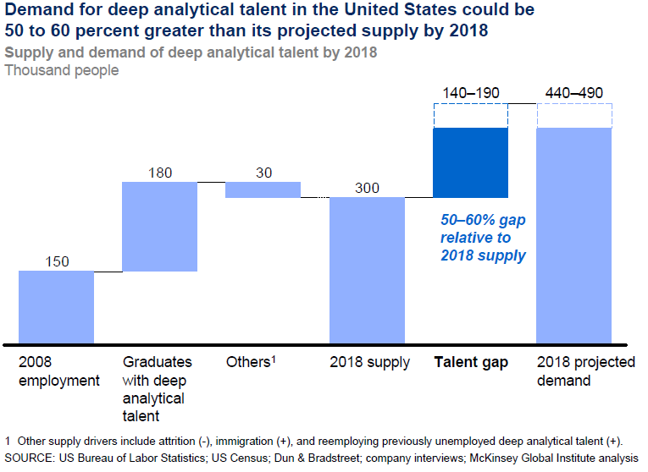
Good news: Demand for Data Mining

Slide 6
What This Course Is About
Data mining = extraction of actionable information from (usually) very large datasets, is the subject of extreme hype, fear, and interest
It’s not all about machine learning
But some of it is
Emphasis in CS246 on algorithms that scale
Parallelization often essential

Slide 7
Data Mining Methods
Descriptive methods
Find human-interpretable patterns that describe the data
Example: Clustering
Predictive methods
Use some variables to predict unknown or future values of other variables
Example: Recommender systems

Slide 8
This Class: CS246
This combines best of machine learning, statistics, artificial intelligence, databases but more stress on
Scalability (big data)
Algorithms
Computing architectures
Automation for handling large data
Theory, Algorithms
Machine
Learning
Data Mining
Database systems

Slide 9
What will we learn?
We will learn to mine different types of data:
Data is high dimensional
Data is a graph
Data is infinite/never-ending
Data is labeled
We will learn to use different models of computation:
MapReduce
Streams and online algorithms
Single machine in-memory

Slide 10
What will we learn?
We will learn to solve real-world problems:
Recommender systems
Market Basket Analysis
Spam detection
Duplicate document detection
We will learn various “tools”:
Linear algebra (SVD, Rec. Sys., Communities)
Optimization (stochastic gradient descent)
Dynamic programming (frequent itemsets)
Hashing (LSH, Bloom filters)

Slide 11
How the Class Fits Together
High dim. data
Locality sensitive hashing
Clustering
Graph data
PageRank, SimRank
Network Analysis
Infinite data
Filtering data streams
Web advertising
Dimensionality reduction
Spam Detection
Queries on streams
Machine learning
SVM
Decision Trees
Perceptron, kNN
Apps
Recommender systems
Association Rules
Duplicate document detection

Slide 12
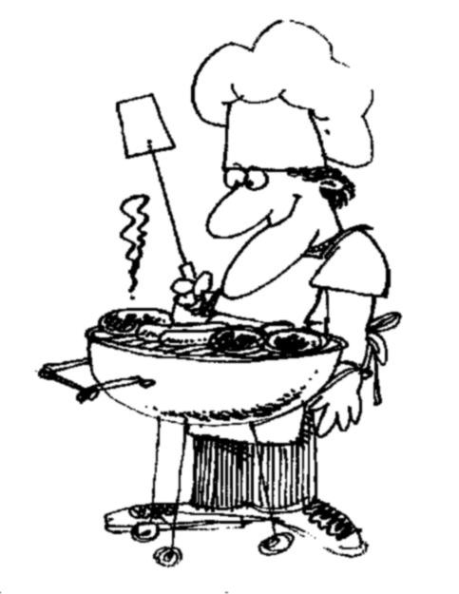
I ♥
data
How do you want that data?

Slide 13
Course Logistics

Slide 14
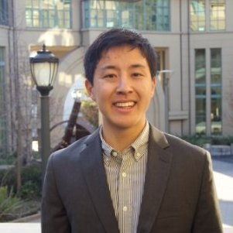
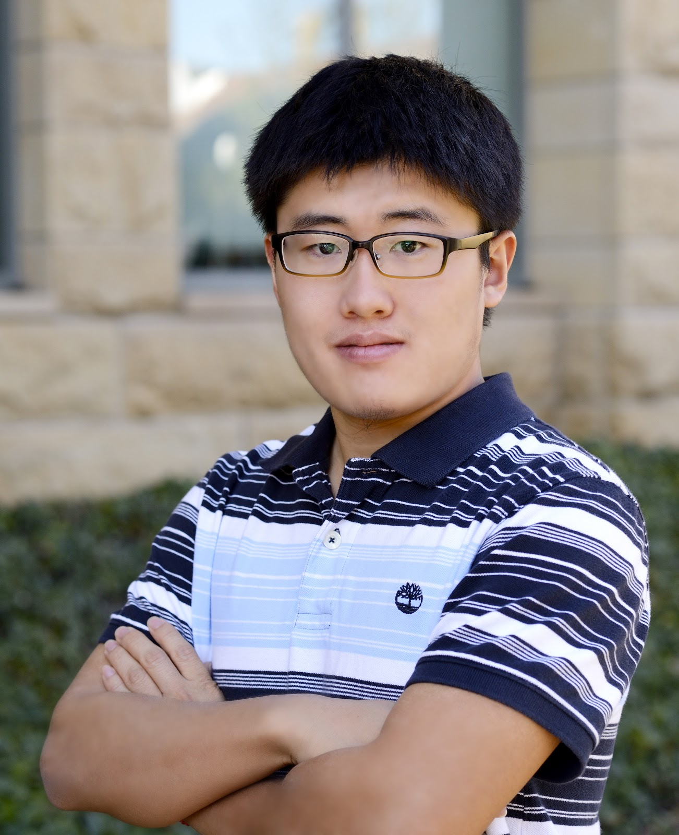
Daniel
Kush
Dylan
Qijia
Sanyam
Praty
Ansh
Hiroto
Jessica
Sen
Heather

Slide 15
CS246 Course Staff
Office hours:
See course website for TA office hours
We start Office Hours next week
Jure: Tuesdays 9-10am, Gates 418
For SCPD students we will use Google Hangout

Slide 16
Resources
Course website: http://cs246.stanford.edu
Lecture slides (at least 30min before the lecture)
Homeworks, solutions, readings
Class textbook: Mining of Massive Datasets by A. Rajaraman, J. Ullman, and J. Leskovec
Sold by Cambridge Uni. Press but available for free at http://mmds.org
MOOC: www.youtube.com /channel/UC_Oao2FYkLAUlUVkBfze4jg/videos

Slide 17
Special Tutorials
Spark tutorial and help session:
Thursday, January 11, from 4:30-5:50 pm in Skilling Auditorium
Review of linear algebra and proof techniques
Tuesday, January 16 from 4:30-5:50 pm in Skilling Auditorium
Review of probability:
Thursday, January 18 from 4:30-5:50 pm in Skilling Auditorium

Slide 18
Logistics: Communication
Piazza Q&A website:
https://piazza.com/class - winter2018/cs246
Use Piazza for all questions and public communication
Search the forum before asking a question
Please tag your posts and please no one-liners
For e-mailing course staff always use:
cs246-win1718-staff@lists.stanford.edu
We will post course announcements to Piazza (make sure you check it regularly)
Auditors are welcome to sit-in & audit the class

Slide 19
Work for the Course: Homeworks
4 longer homeworks: 40%
Four major assignments, involving programming, proofs, algorithm development.
“Warmup” assignment, called “HW0,” to introduce everyone to Spark has just been posted
Assignments take lots of time (+20h). Start early!!
How to submit?
Homework write-up:
Submit via Gradescope.com
Course code: MKYXN5
Everyone uploads code:
Put all the code for 1 question into 1 file and submit at: http://snap.stanford.edu/submit/

Slide 20
Homework Calendar
Homework schedule:
Two late periods for HWs for the quarter:
Late period expires on the following Tuesday 23:59 PT
Can use max 1 late period per HW
Date (23:59 PT) | Out | In
Today | HW0
01/11, Thu | HW1
01/25, Thu | HW2 | HW0, HW1
02/08, Thu | HW3 | HW2
02/22, Thu | HW4 | HW3
03/08, Thu |  | HW4

Slide 21
Work for the Course: Gradiance
Short weekly Gradiance quizzes: 20%
Quizzes are posted every Tuesday
Due 9 days later on Thursday 23:59 PT. No late days!
First quiz has already been posted
To register on Gradiance please use SUNetID or <legal first name>_<legal last name> for username
We have to be able to match your Gradiance ID and SUNetId
Sign up at www.gradiance.com/services and enter class 79D9D7F3
As many submissions as you like, your score is based on the most recent submission
After the due date, you can see the solutions to all problems by looking at one of your submissions, so you must try at least once

Slide 22
Work for the Course: Gradiance
You should work each of the implied problems before answering the multiple-choice questions.
That way, if you have to repeat the work to get 100%, you will have available what you need for the questions you have solved correctly, and the process can go quickly.
Note: There is a 10-minute delay between submissions, to protect against people who randomly fire off guesses.

Slide 23
Work for the Course: Final Exam
Final exam: 40%
Tuesday, March 20 3:30pm-6:30pm
There is no alternative final, but if you truly have a conflict, we can arrange for you to take the exam immediately after the regular final
Extra credit: Up to 1% of your grade
For participating in Piazza discussions
Especially valuable are answers to questions posed by other students
Reporting bugs in course materials

Slide 24
Prerequisites
Programming: Python or Java
Basic Algorithms: CS161 is surely sufficient
Probability: e.g., CS109 or Stat116
There will be a review session and a review doc is linked from the class home page
Linear algebra:
Another review doc + review session is available
Multivariable calculus
Database systems (SQL, relational algebra):
CS145 is sufficient by not necessary

Slide 25
What If I Don’t Know All This Stuff?
Each of the topics listed is important for a small part of the course:
If you are missing an item of background, you could consider just-in-time learning of the needed material
The exception is programming:
To do well in this course, you really need to be comfortable with writing code in Python or Java

Slide 26
Honor Code
We’ll follow the standard CS Dept. approach: You can get help, but you MUST acknowledge the help on the work you hand in
Failure to acknowledge your sources is a violation of the Honor Code
We use MOSS to check the originality of your code

Slide 27
Honor Code – (2)
You can talk to others about the algorithm(s) to be used to solve a homework problem;
As long as you then mention their name(s) on the work you submit
You should not use code of others or be looking at code of others when you write your own:
You can talk to people but have to write your own solution/code
If you fail to mention your sources, MOSS will catch you, and you will be charged with an HC violation

Slide 28
CS246H: SparkLabs
CS246H covers practical aspects of Spark and other distributed computing architectures
HDFS, Combiners, Partitioners, Hive, Pig, Hbase, …
1 unit course, optional homeworks
CS246H runs (somewhat) parallel to CS246
CS246 discusses theory and algorithms
CS246H tells you how to implement them
Instructor: Daniel Templeton (Cloudera)
CS246H lectures are recorded (available via SCPD)

Slide 29
What’s after the class
CS341: Project in Data Mining (Spring 2018)
Research project on big data
Groups of 3 students
We provide interesting data, computing resources (Amazon EC2) and mentoring
My group has RA positions open:
See http://snap.stanford.edu/apply/

Slide 30
Final Thoughts
CS246 is fast paced!
Requires programming maturity
Strong math skills
SCPD students tend to be rusty on math/theory
Course time commitment:
Homeworks take +20h
Gradiance quizes take about 1-2h
Form study groups
It’s going to be fun and hard work. ☺

Slide 31
4 To-do items
4 to-do items for you:
Register to Piazza
Register to Gradescope
Register to Gradiance and complete the first quiz
Use your SUNet ID to register! (so we can match grading records)
Complete the first quiz (it is already posted)
Complete HW0
HW0 should take you about 1-2 hours to complete (Note this is a “toy” homework to get you started. Real homeworks will be much more challenging and longer)
Additional details/instructions at http://cs246.stanford.edu

Slide 32
Distributed Computing for Data Mining

Slide 33
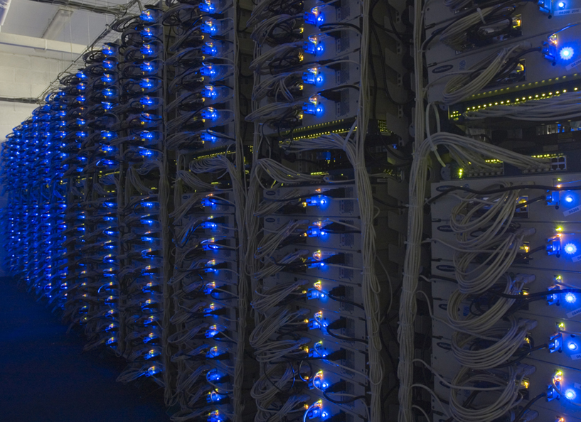

Slide 34
Large-scale Computing
Large-scale computing for data mining problems on commodity hardware
Challenges:
How do you distribute computation?
How can we make it easy to write distributed programs?
Machines fail:
One server may stay up 3 years (1,000 days)
If you have 1,000 servers, expect to loose 1/day
With 1M machines 1,000 machines fail every day!

Slide 35
An Idea and a Solution
Issue: Copying data over a network takes time
Idea:
Bring computation to data
Store files multiple times for reliability
Spark/Hadoop address these problems
Storage Infrastructure – File system
Google: GFS. Hadoop: HDFS
Programming model
MapReduce
Spark

Slide 36
Storage Infrastructure
Problem:
If nodes fail, how to store data persistently?
Answer:
Distributed File System
Provides global file namespace
Typical usage pattern:
Huge files (100s of GB to TB)
Data is rarely updated in place
Reads and appends are common

Slide 37
Distributed File System
Chunk servers
File is split into contiguous chunks
Typically each chunk is 16-64MB
Each chunk replicated (usually 2x or 3x)
Try to keep replicas in different racks
Master node
a.k.a. Name Node in Hadoop’s HDFS
Stores metadata about where files are stored
Might be replicated
Client library for file access
Talks to master to find chunk servers
Connects directly to chunk servers to access data

Slide 38
Distributed File System
Reliable distributed file system
Data kept in “chunks” spread across machines
Each chunk replicated on different machines
Seamless recovery from disk or machine failure
C₀
C₁
D₀
C₁
C₂
C₅
C₀
C₅
…
C₅
Chunk server 1
C₂
C₅
Chunk server 2
C₃
D₀
Chunk server 3
D₁
D₀
Chunk server N
C₂
Bring computation directly to the data!
Chunk servers also serve as compute servers
Notes:
38

Slide 39
Programming Model
MapReduce is a style of programming designed for:
Easy parallel programming
Invisible management of hardware and software failures
Easy management of very-large-scale data
It has several implementations, including Hadoop, Spark (used in this class), Flink, and the original Google implementation just called “MapReduce”

Slide 40
MapReduce: Overview
3 steps of MapReduce
Map:
Apply a user-written Map function to each input element
Mapper applies the Map function to a single element
Many mappers grouped in a Map task (the unit of parallelism)
The output of the Map function is a set of 0, 1, or more key-value pairs.
Group by key: Sort and shuffle
System sorts all the key-value pairs by key, and outputs key-(list of values) pairs
Reduce:
User-written Reduce function is applied to each key-(list of values)
Outline stays the same, Map and Reduce change to fit the problem

Slide 41
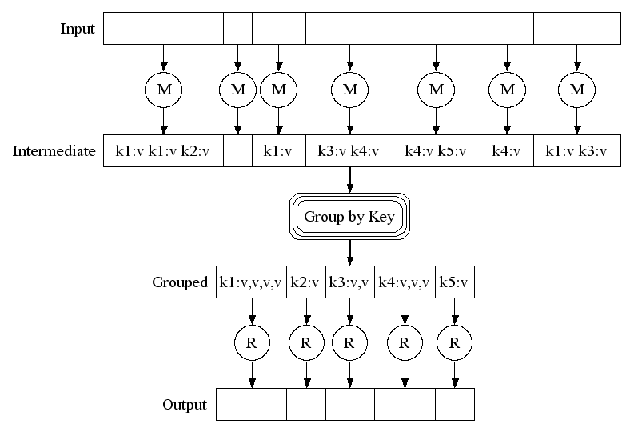
Map-Reduce: A diagram
MAP:
Read input and produces a set of key-value pairs
Group by key:
Collect all pairs with same key
(Hash merge, Shuffle, Sort, Partition)
Reduce:
Collect all values belonging to the key and output

Slide 42
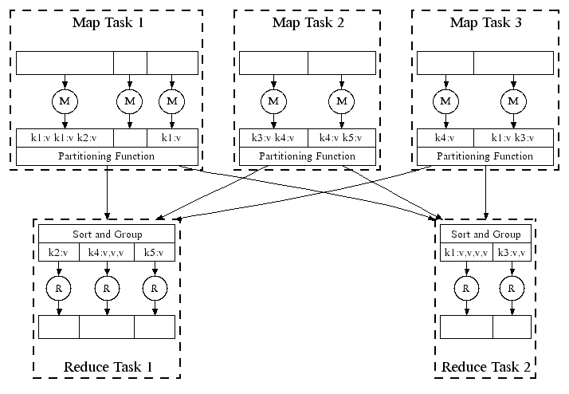
Map-Reduce: In Parallel
All phases are distributed with many tasks doing the work

Slide 43
MapReduce Pattern
key-value
pairs
Input
Output
Mappers
Reducers

Slide 44
Example: Word Counting
Example MapReduce task:
We have a huge text document
Count the number of times each distinct word appears in the file
Many applications of this:
Analyze web server logs to find popular URLs
Statistical machine translation:
Need to count number of times every 5-word sequence occurs in a large corpus of documents

Slide 45
MapReduce: Word Counting
Provided by the programmer
Provided by the programmer
MAP:
Read input and produces a set of key-value pairs
Group by key:
Collect all pairs with same key
Reduce:
Collect all values belonging to the key and output
The crew of the space shuttle Endeavor recently returned to Earth as ambassadors, harbingers of a new era of space exploration. Scientists at NASA are saying that the recent assembly of the Dextre bot is the first step in a long-term space-based man/mache partnership. '"The work we're doing now -- the robotics we're doing -- is what we're going to need ……………………..
(The, 1)
(crew, 1)
(of, 1)
(the, 1)
(space, 1)
(shuttle, 1)
(Endeavor, 1)
(recently, 1)
….
(crew, 1)
(crew, 1)
(space, 1)
(the, 1)
(the, 1)
(the, 1)
(shuttle, 1)
(recently, 1)
…
(crew, 2)
(space, 1)
(the, 3)
(shuttle, 1)
(recently, 1)
…
Sequentially read the data
Only sequential reads
Big document
(key, value)
(key, value)
(key, value)

Slide 46
Word Count Using MapReduce
map(key, value):
// key: document name; value: text of the document
for each word w in value:
emit(w, 1)
reduce(key, values):
// key: a word; value: an iterator over counts
result = 0
for each count v in values:
result += v
emit(key, result)

Slide 47
MapReduce: Environment
MapReduce environment takes care of:
Partitioning the input data
Scheduling the program’s execution across a set of machines
Performing the group by key step
In practice this is is the bottleneck
Handling machine failures
Managing required inter-machine communication

Slide 48
Dealing with Failures
Map worker failure
Map tasks completed or in-progress at worker are reset to idle and rescheduled
Reduce workers are notified when map task is rescheduled on another worker
Reduce worker failure
Only in-progress tasks are reset to idle and the reduce task is restarted

Slide 49
Spark

Slide 50
Problems with MapReduce
Two major limitations of MapReduce:
Difficultly of programming directly in MR
Many problems aren’t easily described as map-reduce
Performance bottlenecks, or batch not fitting the use cases
Persistence to disk typically slower than in-memory work
In short, MR doesn’t compose well for large applications
Many times one needs to chain multiple map-reduce steps

Slide 51
Data-Flow Systems
MapReduce uses two “ranks” of tasks: One for Map the second for Reduce
Data flows from the first rank to the second
Data-Flow Systems generalize this in two ways:
Allow any number of tasks/ranks
Allow functions other than Map and Reduce
As long as data flow is in one direction only, we can have the blocking property and allow recovery of tasks rather than whole jobs

Slide 52
Spark: Most Popular Data-Flow System
Expressive computing system, not limited to the map-reduce model
Additions to MapReduce model:
Fast data sharing
Avoids saving intermediate results to disk
Caches data for repetitive queries (e.g. for machine learning)
General execution graphs (DAGs)
Richer functions than just map and reduce
Compatible with Hadoop

Slide 53
Spark: RDD
Key concept Resilient Distributed Dataset (RDD)
Partitioned collection of records
Generalizes (key-value) pairs
Spread across the cluster, Read-only
Caching dataset in memory
Different storage levels available
Fallback to disk possible
RDDs can be created from Hadoop, or by transforming other RDDs (you can stack RDDs)
RDDs are best suited for applications that apply the same operation to all elements of a dataset

Slide 54
Spark RDD Operations
Transformations build RDDs through deterministic operations on other RDDs:
Transformations include map, filter, join, union, intersection, distinct
Lazy evaluation: Nothing computed until an action requires it
Actions to return value or export data
Actions include count, collect, reduce, save
Actions can be applied to RDDs; actions force calculations and return values

Slide 55
Task Scheduler: General DAGs
A:
B:
F:
Stage 1
groupBy
C:
D:
E:
join
= RDD
Stage 2
map
filter
Stage 3
= cached partition
Supports general task graphs
Pipelines functions where possible
Cache-aware data reuse & locality
Partitioning-aware to avoid shuffles
Notes:
NOT a modified version of Hadoop

Slide 56
Data Analytics Software Stack

Slide 57
Problems Suited for MapReduce

Slide 58
Example: Host size
Suppose we have a large web corpus
Look at the metadata file
Lines of the form: (URL, size, date, …)
For each host, find the total number of bytes
That is, the sum of the page sizes for all URLs from that particular host
Other examples:
Link analysis and graph processing
Machine Learning algorithms

Slide 59
Example: Language Model
Statistical machine translation:
Need to count number of times every 5-word sequence occurs in a large corpus of documents
Very easy with MapReduce:
Map:
Extract (5-word sequence, count) from document
Reduce:
Combine the counts

Slide 60
Example: Join By Map-Reduce
Compute the natural join R(A,B) ⋈ S(B,C)
R and S are each stored in files
Tuples are pairs (a,b) or (b,c)
A | B
a₁ | b₁
a₂ | b₁
a₃ | b₂
a₄ | b₃
B | C
b₂ | c₁
b₂ | c₂
b₃ | c₃
A | C
a₃ | c₁
a₃ | c₂
a₄ | c₃
⋈
=
S
R

Slide 61
Map-Reduce Join
Use a hash function h from B-values to 1...k
A Map process turns:
Each input tuple R(a,b) into key-value pair (b,(a,R))
Each input tuple S(b,c) into (b,(c,S))
Map processes send each key-value pair with key b to Reduce process h(b)
Hadoop does this automatically; just tell it what k is.
Each Reduce process matches all the pairs (b,(a,R)) with all (b,(c,S)) and outputs (a,b,c).

Slide 62
Problems NOT suitable for MapReduce
MapReduce is great for:
Problems that require sequential data access
Large batch jobs (not interactive, real-time)
MapReduce is inefficient for problems where random (or irregular) access to data required:
Graphs
Interdependent data
Machine learning
Comparisons of many pairs of items

Slide 63
Cost Measures for Algorithms
In MapReduce we quantify the cost of an algorithm using
Communication cost = total I/O of all processes
Elapsed communication cost = max of I/O along any path
(Elapsed) computation cost analogous, but count only running time of processes
Note that here the big-O notation is not the most useful (adding more machines is always an option)

Slide 64
Example: Cost Measures
For a map-reduce algorithm:
Communication cost = input file size + 2 × (sum of the sizes of all files passed from Map processes to Reduce processes) + the sum of the output sizes of the Reduce processes.
Elapsed communication cost is the sum of the largest input + output for any map process, plus the same for any reduce process

Slide 65
What Cost Measures Mean
Either the I/O (communication) or processing (computation) cost dominates
Ignore one or the other
Total cost tells what you pay in rent from your friendly neighborhood cloud
Elapsed cost is wall-clock time using parallelism

Slide 66
Cost of Map-Reduce Join
Total communication cost = O(|R|+|S|+|R ⋈ S|)
Elapsed communication cost = O(s)
We’re going to pick k and the number of Map processes so that the I/O limit s is respected
We put a limit s on the amount of input or output that any one process can have. s could be:
What fits in main memory
What fits on local disk
With proper indexes, computation cost is linear in the input + output size
So computation cost is like comm. cost

Slide 67
CS246: Mining massive datasets
Grab a handout at the back of the room

