Slide 1
MapReduce and Frequent Itemsets Mining
Kushaagra Goyal

Slide 2
MapReduce (Hadoop)
Programming model designed for:
Large Datasets (HDFS)
  Large files broken into chunks
  Chunks are replicated on different nodes
Easy Parallelization
  Takes care of scheduling
Fault Tolerance
  Monitors and re-executes failed tasks

Slide 3
MapReduce
3 Steps
Map:
  Apply a user written map function to each input element.
  The output of Map function is a set of key-value pairs.
GroupByKey :
  Sort and Shuffle : Sort all key-value pairs by key and output key-(list of value pairs)
Reduce
  User written reduce function applied to each key-[list of value] pairs

Slide 4
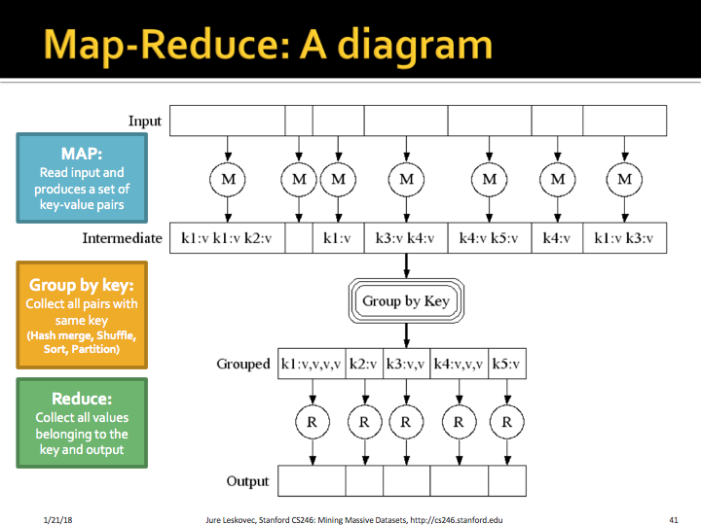

Slide 5
Coping with Failure
MapReduce is designed to deal with compute nodes failing
Output from previous phases is stored. Re-execute failed tasks, not whole jobs.
Blocking Property: no output is used until the task is complete. Thus, we can restart a Map task that failed without fear that a Reduce task has already used some output of the failed Map task.

Slide 6
Data Flow Systems
MapReduce uses two ranks of tasks:
  One is Map and other is Reduce
  Data flows from first rank to second rank
Data Flow Systems generalise this:
  Allow any number of tasks
  Allow functions other than Map and Reduce
Spark is the most popular data-flow system.
  RDD’s : Collection of records
  Spread across clusters and read-only.

Slide 7
Frequent Itemsets
The Market-Basket Model
  Items
  Baskets
  Count how many baskets contain an itemset
  Support threshold => frequent itemsets
Application
  Confidence
    Pr(D | A, B, C)

Slide 8
Computation Model
Count frequent pairs
Main memory is the bottleneck
How to store pair counts?
  Triangular matrix/Table
Frequent pairs -> frequent items
A-Priori Algorithm
  Pass 1 - Item counts
  Pass 2 - Frequent items + pair counts
PCY
  Pass 1 - Hash pairs into buckets
    Infrequent bucket -> infrequent pairs
  Pass 2 - Bitmap for buckets
    Count pairs w/ frequent items and frequent bucket

Slide 9
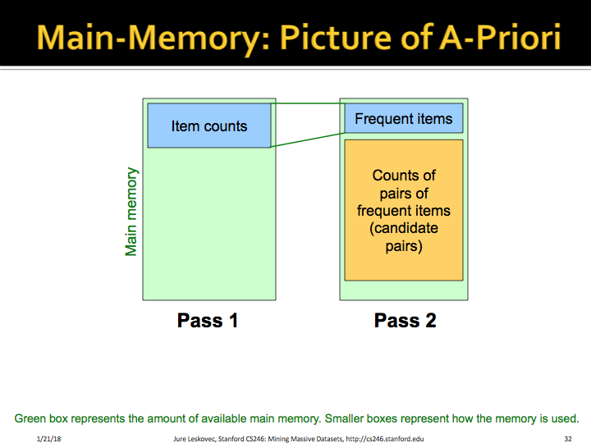

Slide 10
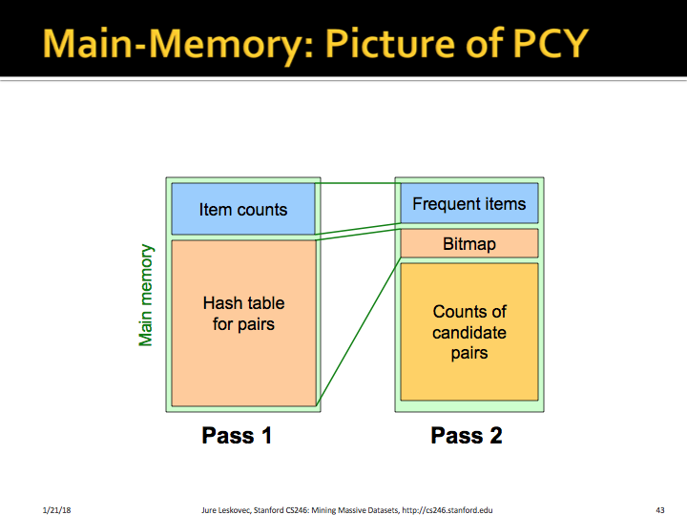

Slide 11
All (Or Most) Frequent Itemsets
Handle Large Datasets
Simple Algorithm
  Sample from all baskets
  Run A-Priori/PCY in main memory with lower threshold
  No guarantee
SON Algorithm
  Partition baskets into subsets
  Frequent in the whole => frequent in at least one subset
Toivonen’s Algorithm
  Negative Border - not frequent in the sample but all immediate subsets are
  Pass 2 - Count frequent itemsets and sets in their negative border
  What guarantee?

Slide 12
Locality Sensitive Hashing and Clustering
Heather Blundell

Slide 13
Locality-Sensitive Hashing
Main idea:
What: hashing techniques to map similar items to the same bucket → candidate pairs
Benefits: O(N) instead of O(N²): avoid comparing all pairs of items
  Downside: false negatives and false positives
Applications: similar documents, collaborative filtering, etc.
For the similar document application, the main steps are:
Shingling - converting documents to set representations
Minhashing - converting sets to short signatures using random permutations
Locality-sensitive hashing - applying the “b bands of r rows” technique on the signature matrix to an “s-shaped” curve

Slide 14
Locality-Sensitive Hashing
Shingling:
Convert documents to set representation using sequences of k tokens
Example: abcabc with k = 2 shingle size and character tokens → {ab, bc, ca}
Choose large enough k → lower probability shingle s appears in document
Similar documents → similar shingles (higher Jaccard similarity)
Jaccard Similarity: J(S₁, S₂) = |S₁ ∩ S₂| / |S₁ ∪ S₂|
Minhashing:
Creates summary signatures: short integer vectors that represent the sets and reflect their similarity

Slide 15
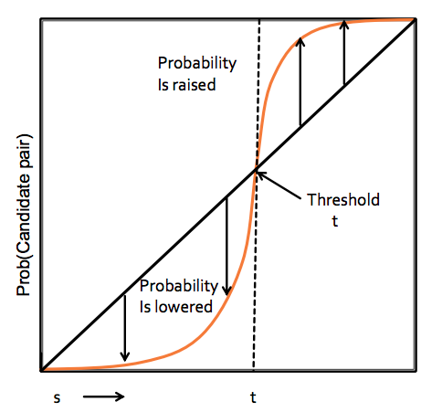
Locality-Sensitive Hashing
General Theory:
Distance measures d (similar items are “close”):
  Ex) Euclidean, Jaccard, Cosine, Edit, Hamming
LSH families:
  A family of hash functions H is (d₁, d₂, p₁, p₂)-sensitive if for any x and y:
    If d(x, y) <= d₁, Pr [h(x) = h(y)] >= p₁; and
    If d(x, y) >= d₂, Pr [h(x) = h(y)] <= p₂.
Amplification of an LSH families (“bands” technique):
  AND construction (“rows in a band”)
  OR construction (“many bands”)
  AND-OR/OR-AND compositions

Slide 16
Locality-Sensitive Hashing
Suppose that two documents have Jaccard similarity s.
Step-by-step analysis of the banding technique (b bands of r rows each)
Probability that signatures agree in all rows of a particular band:
  s^{r}
Probability that signatures disagree in at least one row of a particular band:
  1 - s^{r}
Probability that signatures disagree in at least one row of all of the bands:
  (1 - s^{r})^{b}
Probability that signatures agree in all rows of a particular band ⇒ Become candidate pair:
  1 - (1 - s^{r})^{b}

Slide 17
Locality-Sensitive Hashing
A general strategy for composing families of minhash functions:
AND construction (over r rows in a single band):
(d₁, d₂, p₁, p₂)-sensitive family ⇒ (d₁, d₂, p₁^{r}, p₂^{r})-sensitive family
Lowers all probabilities
OR construction (over b bands):
(d₁, d₂, p₁, p₂)-sensitive family ⇒ (d₁, d₂, 1 - (1 - p₁)^{b}, 1 - (1 - p₂)^{b})-sensitive family
Makes all probabilities rise
We can try to make p₁ → 1 (lower false negatives) and p₂ → 0 (lower false positives), but this can require many hash functions.

Slide 18
Clustering
What: Given a set of points and a distance measure, group them into “clusters” so that a point is more similar to other points within the cluster compared to points in other clusters (unsupervised learning - without labels)
How: Two types of approaches
Point assignments
  Initialize centroids
  Assign points to clusters, iteratively refine
Hierarchical:
  Each point starts in its own cluster
  Agglomerative: repeatedly combine nearest clusters

Slide 19
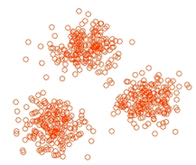
Point Assignment Clustering Approaches
Best for spherical/convex cluster shapes
k-means: initialize cluster centroids, assign points to the nearest centroid, iteratively refine estimates of the centroids until convergence
  Euclidean space
  Sensitive to initialization (K-means++)
  Good values of “k” empirically derived
  Assumes dataset can fit in memory
BFR algorithm: variant of k-means for very large datasets (residing on disk)
  Keep running statistics of previous memory loads
  Compute centroid, assign points to clusters in a second pass

Slide 20
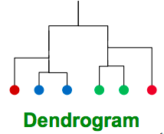
Hierarchical Clustering
Can produce clusters with unusual shapes
  e.g. concentric ring-shaped clusters
Agglomerative approach:
  Start with each point in its own cluster
  Successively merge two “nearest” clusters until convergence
Differences from Point Assignment:
  Location of clusters: centroid in Euclidean spaces, “clustroid” in non-Euclidean spaces
  Different intercluster distance measures: e.g. merge clusters with smallest max distance (worst case), min distance (best case), or average distance (average case) between points from each cluster
  Which method works best depends on cluster shapes, often trial and error

Slide 21
Dimensionality Reduction and Recommender Systems
Qijia Jiang

Slide 22
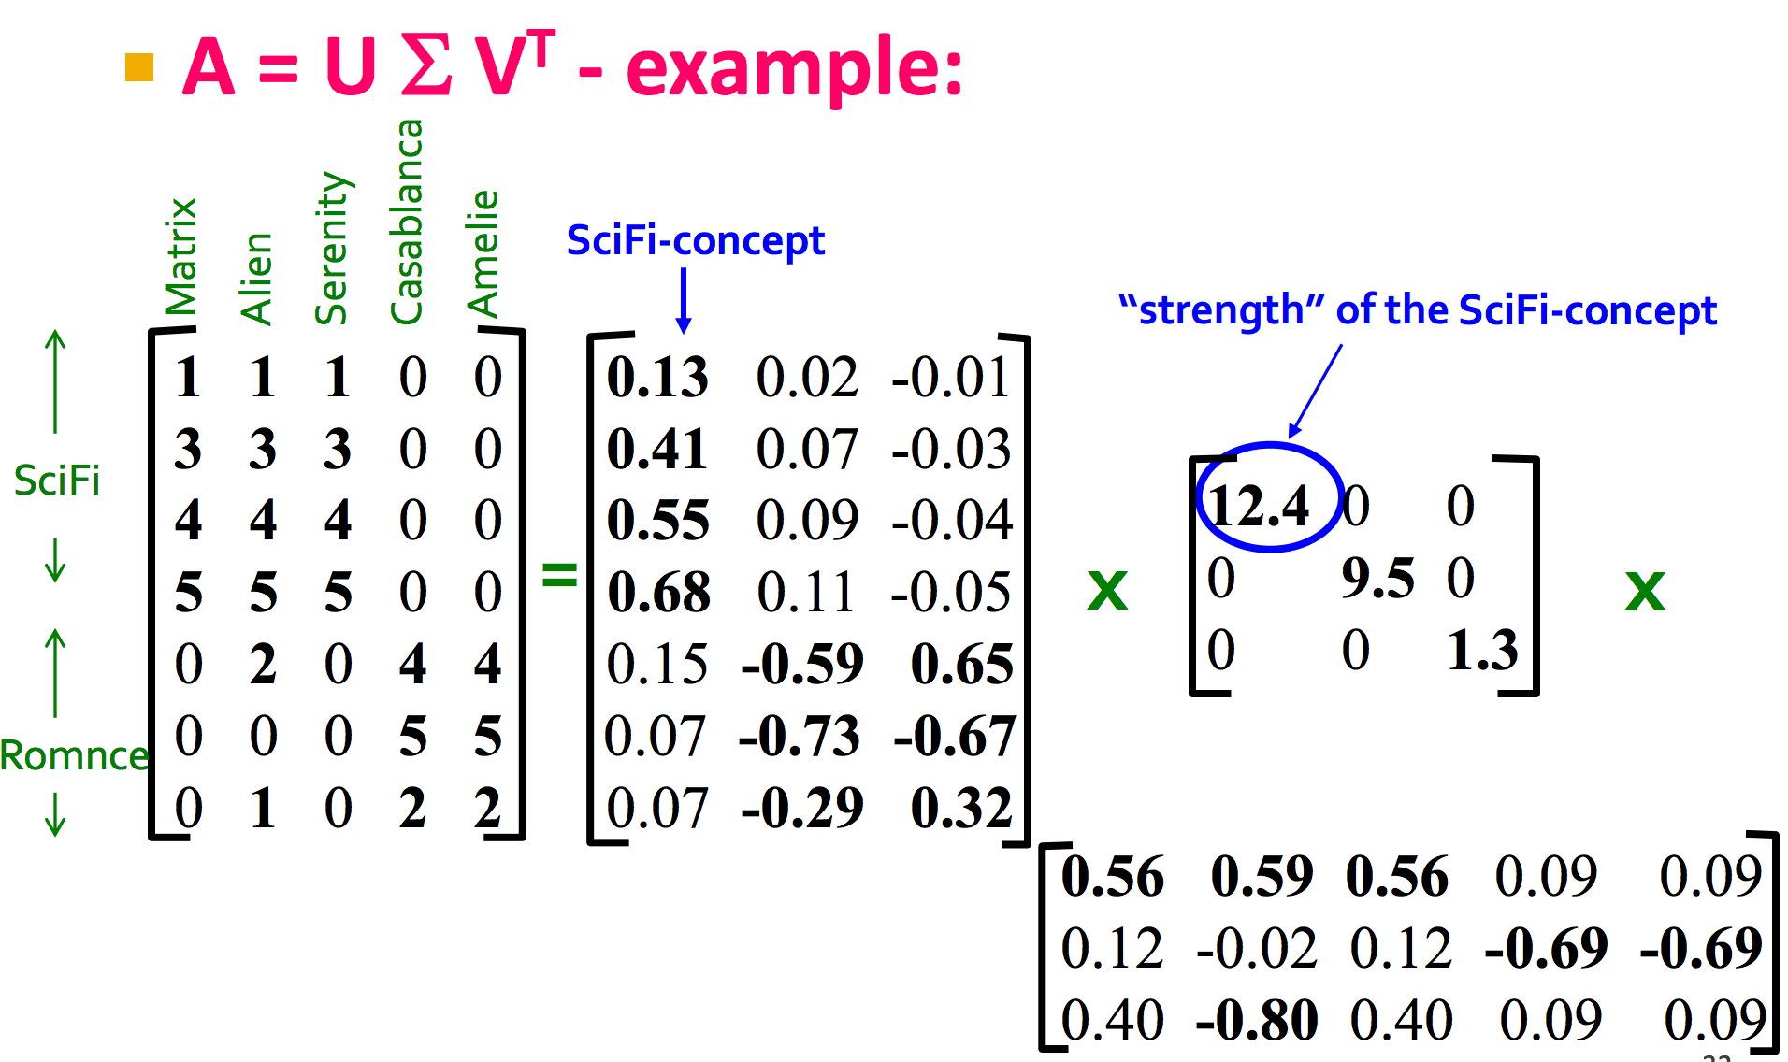
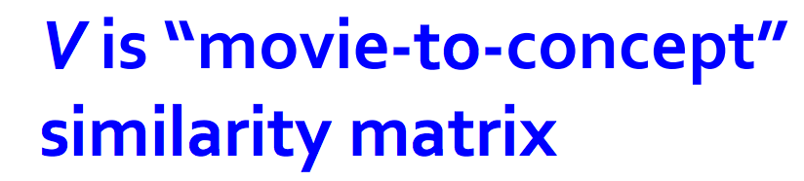
Dimensionality Reduction
Motivation
  Discover hidden structure
  Concise description
    Save storage
    Faster processing
Methods
  SVD
    M = UΣV^{T}
      U user-to-concept matrix
      V movie-to-concept matrix
      Σ “strength” of each concept
  CUR Decomposition
    M = CUR
Notes:
Have 3 concepts in the user-by-movie example
“Strength”: how important a particular concept is in determining final rating
Change of basis: a_{i}*v₁ gives projection of user i’s rating on “sci-fi” axis for example so we can argue about similarity of users in latent space

Slide 23
SVD
M = UΣV^{T}
  U^{T}U = I, V^{T}V = I,Σ diagonal
  Best low-rank approximation (singular value thresholding)
Algorithm
  Find Σ, V
    Find eigenpairs of M^{T}M -> (D, V)
    Σ is square root of eigenvalues D
    V is the right singular vectors
    Similarly U can be read off from eigenvectors of MM^{T}
  Power method: random init + repeated matrix-vector multiply (normalized) gives principal evec

Slide 24
CUR
M = CUR
Non-uniform sampling
  Row/Column importance proportional to norm
  U: pseudoinverse of submatrix with sampled rows R & columns C
Compared to SVD
  Interpretable (actual columns & rows)
  Sparsity preserved (U,V dense but C,R sparse)
  May output redundant features
Notes:
No orthogonality can give redundant features
Direction of maximum variance if no outlier

Slide 25

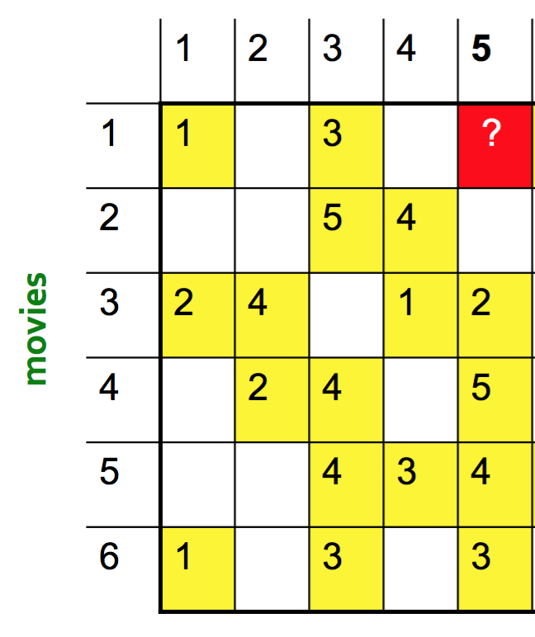
Recommender Systems: Content-Based
What: Given a bunch of users, items and ratings, want to predict missing ratings
How: Recommend items to customer x similar to previous items rated highly by x
Content-Based
  Collect user profile x and item profile i
  Estimate utility: u(x,i) = cos(x,i)
Notes:
Item profile: vector of features
User profile: weighted average of rated item profiles

Slide 26
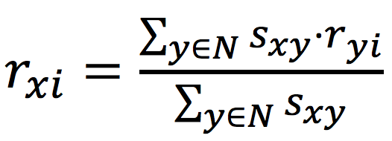
Recommender Systems: Collaborative Filtering
user-user CF vs item-item CF
  user-user CF: estimate a user’s rating based on ratings of similar users who have rated the item; similar definition for item-item CF
Similarity metrics
  Jaccard similarity: binary
  Cosine similarity: treats missing ratings as “negative”
  Pearson correlation coeff: remove mean of non-missing ratings (standardized)
Prediction of item i from user x: (s_{xy} = sim(x,y))
Remove baseline estimate and only model rating deviations from baseline estimate, so that we’re not affected by user/item bias
Notes:
Exploit quality judgements of other users
Prediction is weighted average of ratings given by “neighboring users” (who have rated the item)

Slide 27

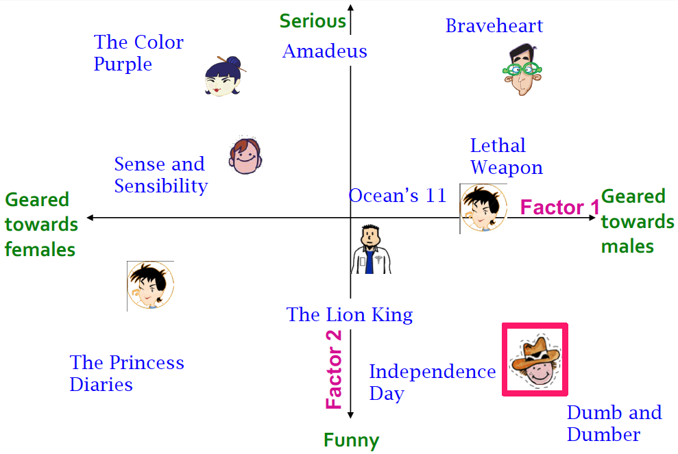
Recommender Systems: Latent Factor Models
Motivation: Collaborative filtering is a local approach to predict ratings based on finding neighbors. Matrix factorization takes a more global view.
Intuition: Map users and movies to (lower-dimensional) latent-factor space. Make prediction based on these latent factors.
Model: for user x and movie i
Notes:
p_{x} : user(x)-by-factor; q_{i}: item(i)-by-factor
No orthogonality constraint on P, Q

Slide 28
Recommender Systems: Latent Factor Models
Only sum over observed ratings in the training set
Use regularization to prevent overfitting
Can solve via SGD (alternating update for P, Q)
Can be extended to include biases (and temporal biases)
Notes:
b_{x}: bias for user x; b_{i}: bias for iterm i

Slide 29
PageRank
Jessica Su

Slide 30
PageRank
PageRank is a method for determining the importance of webpages
  Named after Larry Page
Rank of a page depends on how many pages link to it
Pages with higher rank get more of a vote
The vote of a page is evenly divided among all pages that it links to

Slide 31
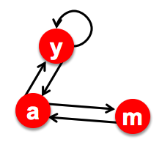
Example
r_{a} = r_{y}/2 + r_{m}
r_{y} = r_{y}/2 + r_{a}/2
r_{m} = r_{a} / 2

Slide 32
Example
Deal with pathological situations by adding
a random teleportation term
r_{a} = 0.8(r_{y}/2 + r_{m}) + 0.2/3
r_{y} = 0.8(r_{y}/2 + r_{a}/2) + 0.2/3
r_{m} = 0.8 (r_{a} / 2) + 0.2/3

Slide 33

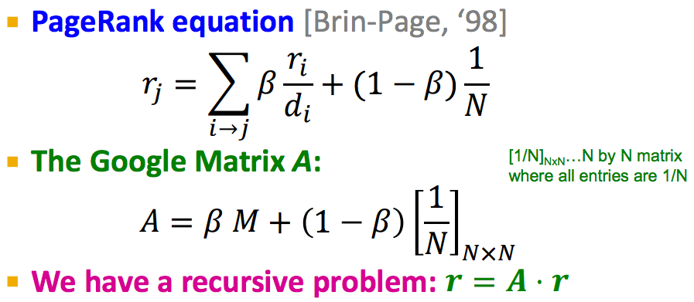
PageRank

Slide 34
Hubs and Authorities
Similar to PageRank
Every webpage gets two scores: an “authority” score, which measures the quality of the webpage, and a “hub” score, which measures how good it is at linking to good webpages
Mutually recursive definition:
  Good hubs link to good authorities
  Good authorities are linked to by good hubs

Slide 35
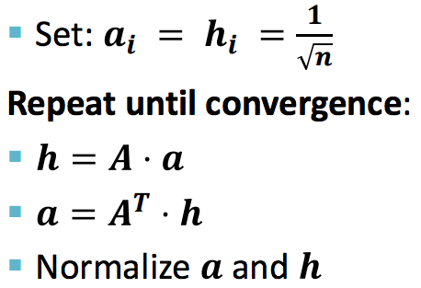
Hubs and Authorities
(sum contributions of outbound links)
(sum contributions of inbound links)

Slide 36
Social Network Algorithms
Ansh Shukla

Slide 37
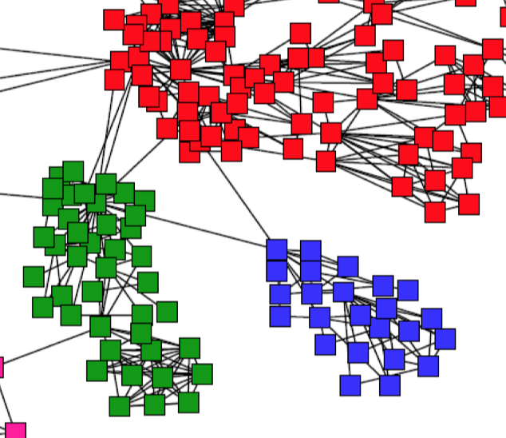
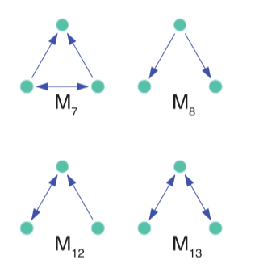
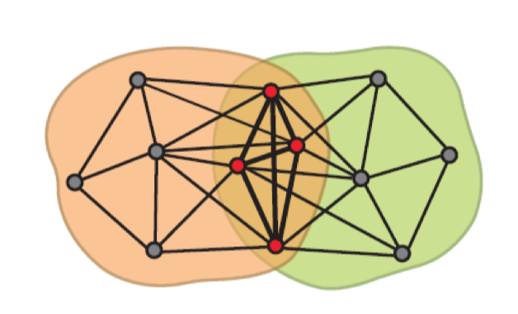
Graph Algorithms
Problem: Finding “communities” in large graphs
    A community is any structure we’re interested by in the graph.
    Examples of properties we might care about: overlap, triangles, density.

Slide 38


Personalized PageRank with Sweep
Problem: Finding densely linked, non-overlapping communities.
Intuition: Give a score to all nodes, rank nodes by score, and then partition the ranked list into clusters.
What to know:
(Algorithm) Approximate Personalized PageRank –
    Frame PPR in terms of lazy random walk
    While error measure is too high
        Run one step of lazy random walk

Slide 39
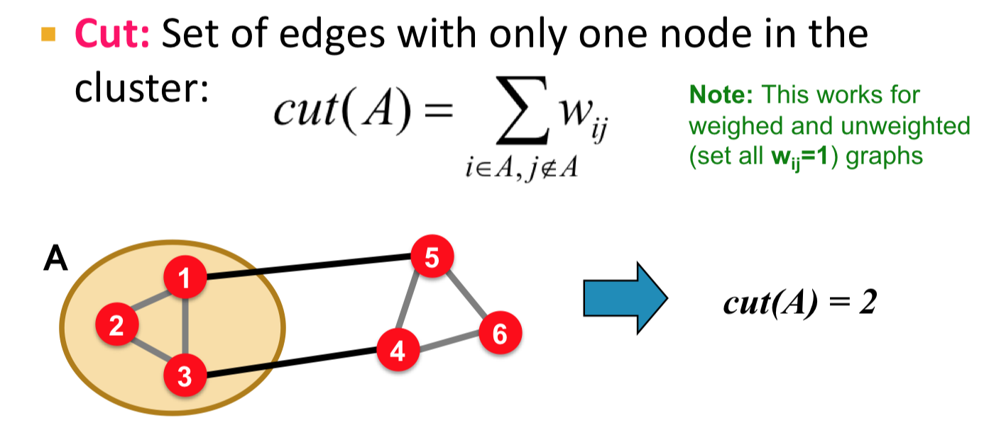
Personalized PageRank with Sweep
Problem: Finding densely linked, non-overlapping communities.
Intuition: Give a score to all nodes, rank nodes by score, and then partition the ranked list into clusters.
What to know:

Slide 40
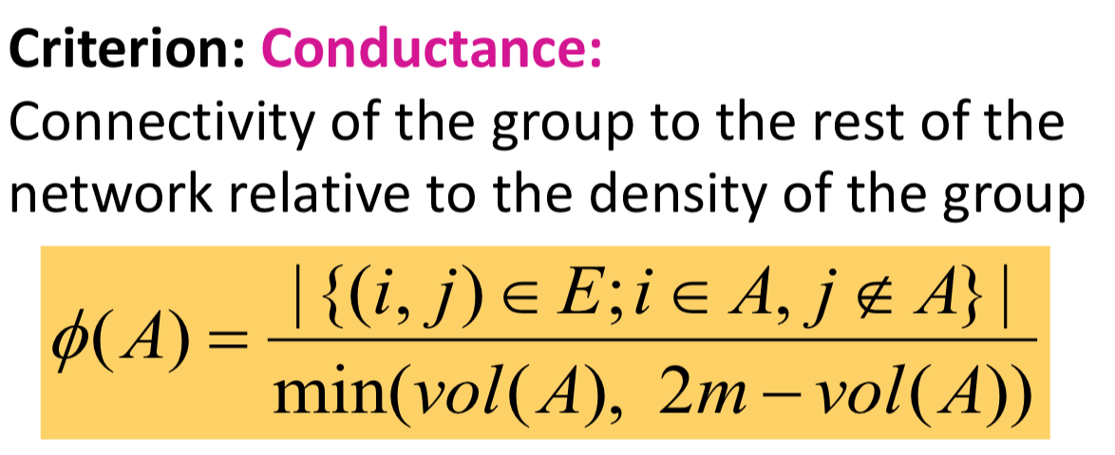
Personalized PageRank with Sweep
Problem: Finding densely linked, non-overlapping communities.
Intuition: Give a score to all nodes, rank nodes by score, and then partition the ranked list into clusters.
What to know:

Slide 41
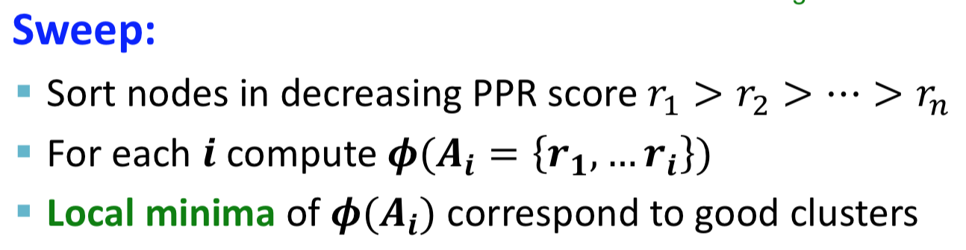
Personalized PageRank with Sweep
Problem: Finding densely linked, non-overlapping communities.
Intuition: Give a score to all nodes, rank nodes by score, and then partition the ranked list into clusters.
What to know:

Slide 42
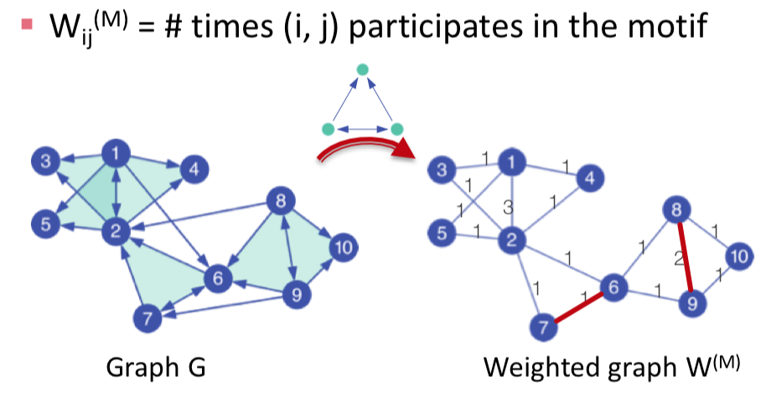
Motif-based spectral clustering
Problem: Finding densely linked, non-overlapping communities (as before), but changing our definition of “densely linked”.
Intuition: Modify graph so edge weights correspond to our notion of density, modify conductance criteria, run PPR w/ Sweep.
What to know:

Slide 43

Motif-based spectral clustering
Problem: Finding densely linked, non-overlapping communities (as before), but changing our definition of “densely linked”.
Intuition: Modify graph so edge weights correspond to our notion of density, modify conductance criteria, run PPR w/ Sweep.
What to know:

Slide 44
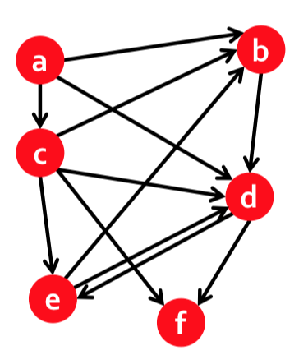

Searching for small communities (trawling)
Problem: Finding complete bipartite subgraphs Ks,t
Intuition: Reframe the problem as one of finding frequent itemsets: think of each vertex as a basket defined by its neighbors. Run A-priori with frequency threshold s to get item sets of size t.
What to know:

Slide 45
Detecting overlapping communities with AGM
Problem: Understand structural properties of individual communities given a graph where communities overlap (i.e. vertex may belong to multiple communities).
Intuition: Beforehand, decide (random, parameterized) model for how communities are created. Pick parameters for the model which maximize the chance that it created the community you’re looking at. Infer structural properties from maximized parameters.

Slide 46
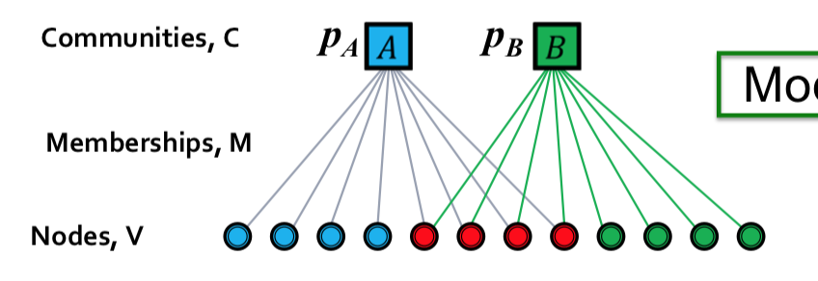
Detecting overlapping communities with AGM
Problem: Understand structural properties of individual communities given a graph where communities overlap.
Intuition: Decide model for how communities are created. Maximize likelihood of community analyzed.
What to know: AGM model parameterized by:
B(V, C, M, {pc})

Slide 47
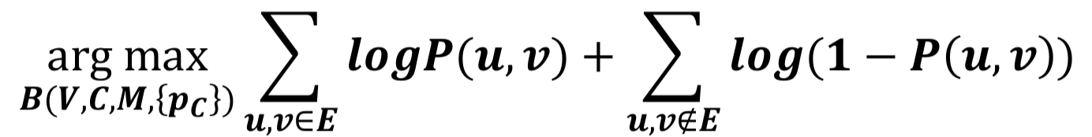
Detecting overlapping communities with AGM
Problem: Understand structural properties of individual communities given a graph where communities overlap.
Intuition: Decide model for how communities are created. Maximize likelihood of community analyzed.
What to know: Setting up a likelihood expression given a model.

Slide 48
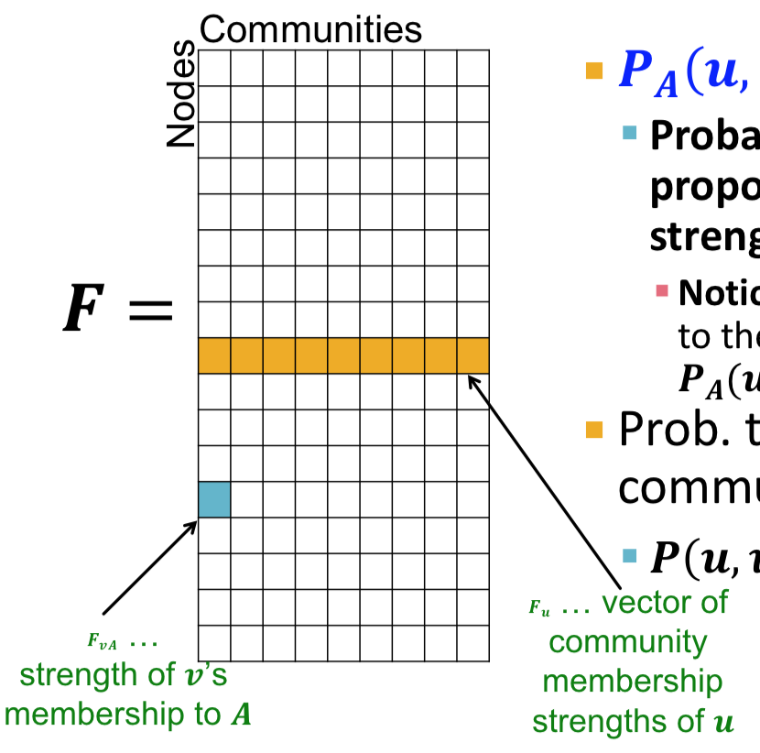
Detecting overlapping communities with AGM
Problem: Understand structural properties of individual communities given a graph where communities overlap.
Intuition: Decide model for how communities are created. Maximize likelihood of community analyzed.
What to know: Computational simplification of individual community affiliations boosts instead of global ones.

Slide 49
Detecting overlapping communities with AGM
Problem: Understand structural properties of individual communities given a graph where communities overlap.
Intuition: Decide model for how communities are created. Maximize likelihood of community analyzed.
What to know: Setting up gradient descent for the log-likelihood maximization problem.

Slide 50
Large-Scale Machine Learning
Wanzi Zhou

Slide 51
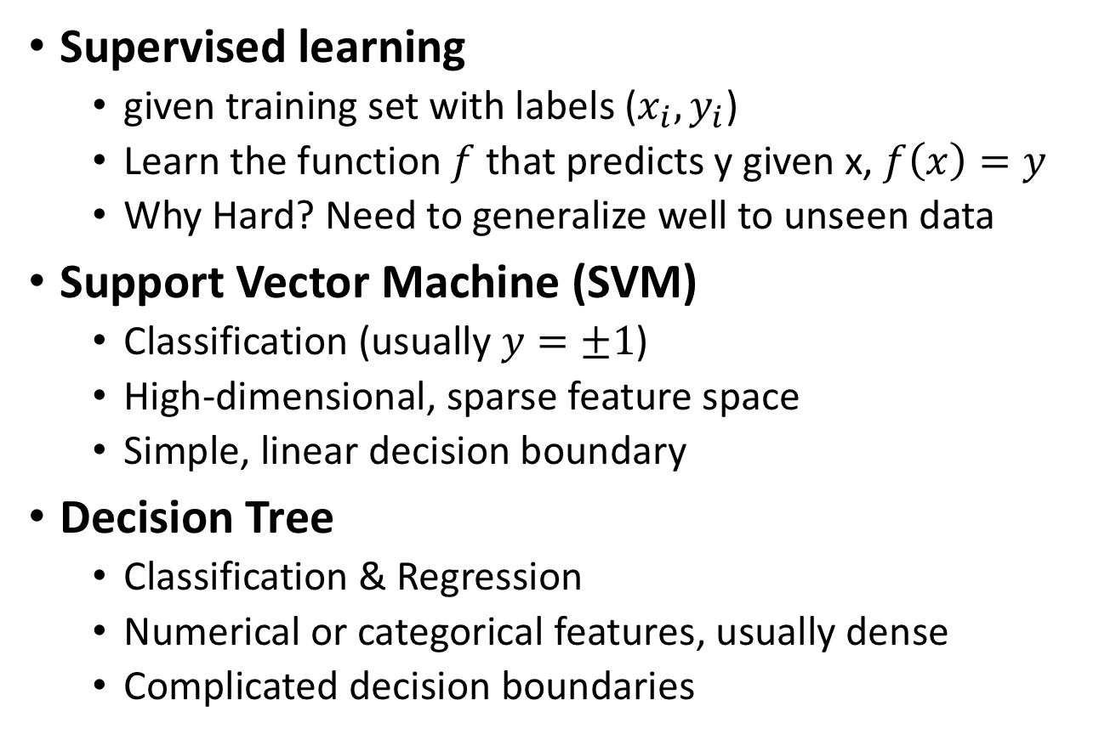
Large-scale machine learning
High Level
Supervised learning
  given training set with labels ($x_{i}, y_{i}$)
  Learn the function $f$ that predicts y given x, $f\left(x\right)=y$
  Why Hard? Need to generalize well to unseen data
Support Vector Machine (SVM)
  Classification (usually $y=±1$)
  High-dimensional, sparse feature space
  Simple, linear decision boundary
Decision Tree
  Classification & Regression
  Numerical or categorical features, usually dense
  Complicated decision boundaries

Slide 52
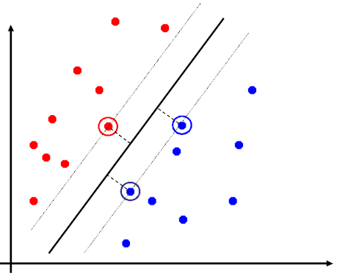

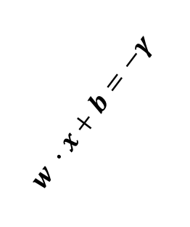
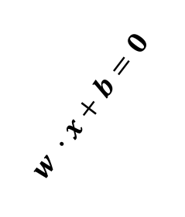
SVM
  Given training data
  $$\left(x_{1},y_{1}\right)…(x_{n},y_{n})$$
  x: d-dimensional, real valued
  $$x_{i}=(x_{i}^{\left(1\right)}, x_{i}^{\left(2\right)},…,, x_{i}^{\left(d\right)})$$
  $$y_{i}=−1 or+1$$
  $A,B,C$: support vectors, uniquely define the decision boundary
  Margin $γ$: distance of closest example from the decision line/hyperplane
  Goal: maximize margin $γ$, find separating hyperplane with the largest distance possible from both positive / negative point
$$w ∙x+b=γ$$
$$w ∙x+b=0$$
$$w ∙x+b=−γ$$
A
B
C

Slide 53
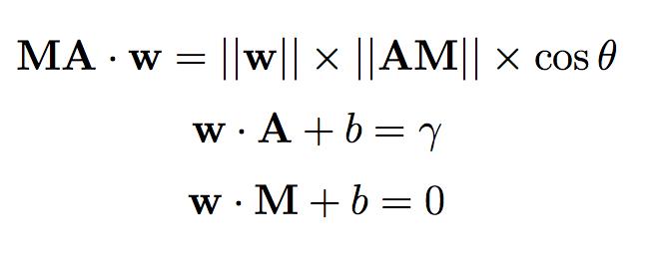
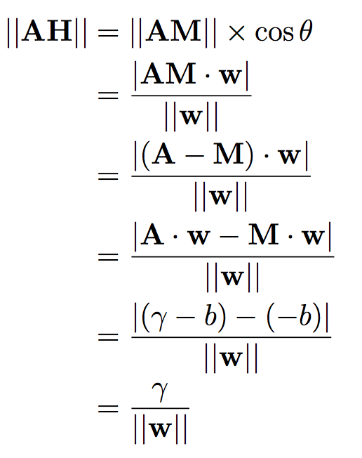
  From maximize $γ$ to minimize $\frac{1}{2}{\left|\left|w\right|\right|}^{2}$
$$w ∙x+b=γ$$
  A lying on support plane
  Goal: Maximize distance $\left|\left|AH\right|\right|$
$$w ∙x+b=0$$
A
w
$$w ∙x+b=−γ$$
$$θ$$
H
M
  Distance from A to H: $γ$measured in $||w||$
  Scale $γ$ and $||w||$ both by 2, nothing changes, thus we can either
  Normalize w, i.e $\left|\left|w\right|\right|=1$, maximize $γ$ $⟺$
  fix margin $γ=1$, minimize length of w
  We use the second way

Slide 54
  Optimization problem formalized
  fix margin $γ=1$, minimize length of w
  Data not separable, introduce penalty
Margin
Empirical loss L (how well we fit training data)
Regularization
parameter
  Penalize mispredicted points as well as correctly predicted points
  But within the margin

Slide 55
  How solve in large scale data
  Minimize cost function J
  Batch Gradient descent
  Stochastic gradient descent
  Minibatch gradient descent

Slide 56
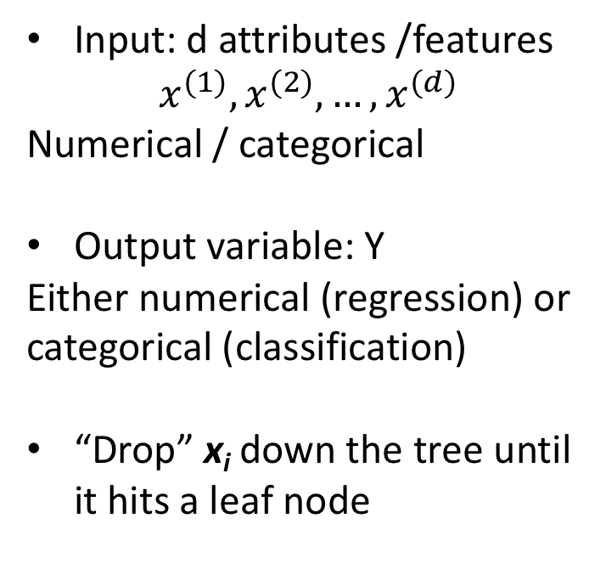
Decision Tree
A
  Input: d attributes /features
  $$x^{(1)}, x^{(2)},…, x^{(d)}$$
  Numerical / categorical
  Output variable: Y
  Either numerical (regression) or categorical (classification)
  “Drop” x_{i} down the tree until it hits a leaf node
X⁽¹⁾<v⁽¹⁾
Y=
0.42
C
D
F
F
G
H
I
  Three problems:
  How to split
  When to stop
  How to predict

Slide 57
How to split
measure the quality of a split based on some criterion
  Regression: Purity Split on node $(x^{\left(i\right)},v)$,
  create $D, D_{L},D_{R}$ (parent / left child/ right child dataset)
  $$\left|D\right|⋅Var\left(D\right)−\left(\left|D_{L}\right|⋅Var\left(D_{L}\right)+\left|D_{R}\right|⋅Var\left(D_{R}\right)\right)$$
  Classification: Information Gain IG(Y|X)
  How much information about Y is contained in X.
  $$IG\left(Y | X\right)=H\left(Y\right)−H(Y|X)$$
  Entropy $H\left(x\right)=− \sum_{j=1}^{n}{p_{j} log p_{j}}$
  Conditional entropy
  $H\left(Y | X\right)= \sum_{j=1}^{n}{P\left(X=v_{j}\right) H(Y|X=v_{j})}$

Slide 58
When to stop
Leaf is pure (variance is small)
# examples in a leaf is small
How to predict (many options)
Regression
predict average $y_{i}$ of examples in the leaf
Build linear regression model on the example points
Classification
Predict most common $y_{i}$ in the leaf

Slide 59
Building decision trees with map reduce: PLANET
Tree small (in memory), data too large to keep in memory
Hundreds of numerical attributes
target variable numerical
Build the decision tree one level at a time
Master Node
Keeps track of the model
and decides how to grow the tree
Mapper
Reducer
Mapper
Master
node
Reducer
Mapper
Reducer
MapReduce
Given a set of split
candidates compute their quality
Mapper
Reducer
Mapper

Slide 60
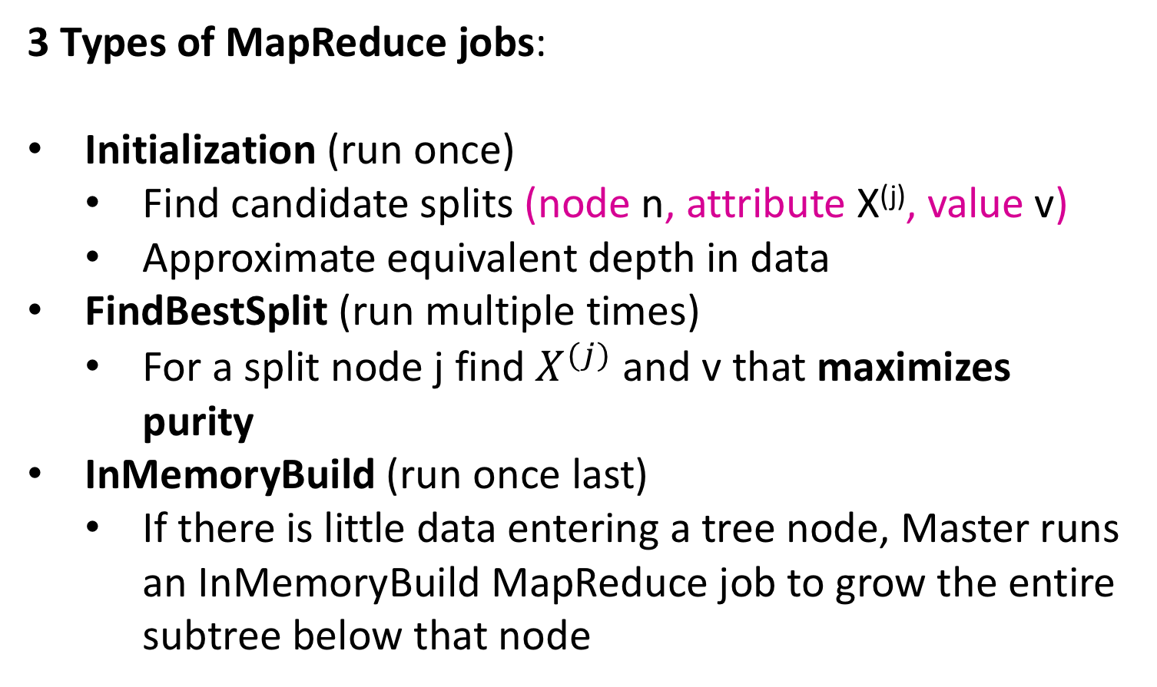
3 Types of MapReduce jobs:
Initialization (run once)
  Find candidate splits (node n, attribute X^{(j)}, value v)
  Approximate equivalent depth in data
FindBestSplit (run multiple times)
  For a split node j find $X^{(j)}$ and v that maximizes purity
InMemoryBuild (run once last)
  If there is little data entering a tree node, Master runs an InMemoryBuild MapReduce job to grow the entire subtree below that node
D
j
D_{L}
D_{R}
X^{(j)} < v

Slide 61
Bagging
idea:
  Learn multiple trees over independent samples of the training data
  Predictions from each tree are averaged to compute the ﬁnal model prediction
  Sample training data with replacement
  Feature bagging: random sample features for different trees
  (break correlation between different decision trees)
Notes:
According to the learning ensemble this will usually gives us higher performance.

Slide 62
Streaming Algorithms
Jessica Su

Slide 63
Reservoir sampling
How to pick a random element of an array?

Slide 64
Reservoir sampling
How to pick a random element of an array?
  Choose a random integer, and pick the element at that index

Slide 65
Reservoir sampling
How to pick a random element of an array?
  Choose a random integer, and pick the element at that index
How to pick s random elements from an infinite stream of elements?

Slide 66
Reservoir sampling
How to pick a random element of an array?
  Choose a random integer, and pick the element at that index
How to pick s random elements from an infinite stream of elements?
  What does this mean? At any given point in the stream, you should be able to output an “answer.”

Slide 67
Reservoir sampling
How to pick a random element of an array?
  Choose a random integer, and pick the element at that index
How to pick s random elements from an infinite stream of elements?
  What does this mean? At any given point in the stream, you should be able to output an “answer.”
  Maintain a set of s elements that may be updated every time a new element is added to the stream
  At any given point, each element that has been seen so far should be equally likely to be in the set of s elements.

Slide 68
Reservoir sampling
Save the first s elements

Slide 69
Reservoir sampling
Save the first s elements
Suppose we have seen the first n – 1 elements, and now the nth element arrives

Slide 70
Reservoir sampling
Save the first s elements
Suppose we have seen the first n – 1 elements, and now the nth element arrives
With probability s/n, keep the nth element, and replace a randomly chosen saved element with the nth element.

Slide 71
Reservoir sampling
Save the first s elements
Suppose we have seen the first n – 1 elements, and now the nth element arrives
With probability s/n, keep the nth element, and replace a randomly chosen saved element with the nth element.
Otherwise, discard the nth element.

Slide 72
Reservoir sampling
Save the first s elements
Suppose we have seen the first n – 1 elements, and now the nth element arrives
With probability s/n, keep the nth element, and replace a randomly chosen saved element with the nth element.
Otherwise, discard the nth element.
Induction: After n elements, the sample contains each element seen so far with probability s/n

Slide 73
Bloom filters
You have a stream of ads. How to make sure a user doesn’t see the same ad multiple times?

Slide 74
Bloom filters
You have a stream of ads. How to make sure a user doesn’t see the same ad multiple times?
Naïve approach: store the ads in a hash table.

Slide 75
Bloom filters
You have a stream of ads. How to make sure a user doesn’t see the same ad multiple times?
Naïve approach: store the ads in a hash table.
  This takes O(# ads) space!

Slide 76
Bloom filters
You have a stream of ads. How to make sure a user doesn’t see the same ad multiple times?
Naïve approach: store the ads in a hash table.
  This takes O(# ads) space!
What if we want to use at most 100 slots of memory?

Slide 77
Bloom filters
What if we want to use at most 100 slots of memory?
Create a bit array B of size 100, initialized to all 0’s

Slide 78
Bloom filters
What if we want to use at most 100 slots of memory?
Create a bit array B of size 100, initialized to all 0’s
Create a hash function that hashes ads to 100 different possible buckets

Slide 79
Bloom filters
What if we want to use at most 100 slots of memory?
Create a bit array B of size 100, initialized to all 0’s
Create a hash function that hashes ads to 100 different possible buckets
When an ad is seen, hash the ad to a bucket (say, bucket 79), and set B[79] = 1

Slide 80
Bloom filters
How to check whether an ad has been seen?

Slide 81
Bloom filters
How to check whether an ad has been seen?
Suppose the ad hashes to bucket 79

Slide 82
Bloom filters
How to check whether an ad has been seen?
Suppose the ad hashes to bucket 79
If B[79] = 0, you know the ad has NOT been seen

Slide 83
Bloom filters
How to check whether an ad has been seen?
Suppose the ad hashes to bucket 79
If B[79] = 0, you know the ad has NOT been seen
If B[79] = 1, the ad might have been seen, but we also might have seen a different ad that happened to hash to the same bucket.

Slide 84
Bloom filters
How to check whether an ad has been seen?
Suppose the ad hashes to bucket 79
If B[79] = 0, you know the ad has NOT been seen
If B[79] = 1, the ad might have been seen, but we also might have seen a different ad that happened to hash to the same bucket.
Reduce false positives by using multiple hash functions and checking if ALL of the bits corresponding to the hash functions are 1.

Slide 85
Computational Advertising
Hiroto Udagawa

Slide 86
Advertising: Bipartite Matching
1
a
2
b
3
c
Boys
4
d
Girls
M = {(1,a),(2,b),(3,d)} is a matching
Cardinality of matching = |M| = 3

Slide 87
Advertising: Online Algorithms and Competitive Ratio
Question: How to find a maximum matching for a given bipartite graph
Polynomial offline algorithm exists, but what’s the best we can do in online setting?
Competitive ratio =
min_{all possible inputs I} (|M_{greedy}|/|M_{opt}|)
(greedy’s worst performance over all possible inputs I)
In maximization problem, competitive ratio <=1
In minimization problem, competitive ratio >= 1
Greedy bipartite matching algorithm: competitive ratio = 1/2.
  Easy to find examples, proofs are more difficult

Slide 88
Advertising: Adwords and Click Through Rate
Adwords problem is example of online algorithm
Instead of sorting advertisers by bid, sort by expected revenue
Advertiser
Bid
CTR
Bid * CTR
B
$0.75
2%
1.5 cents
C
$0.50
2.5%
1.125 cents
A
$1.00
1%
1 cent
Challenges:
CTR of an ad is unknown
Advertisers have limited budges and bid on multiple queries

Slide 89
Advertising: Greedy vs BALANCE Algorithm
Simplified setting:
  There is 1 ad shown for each query
  All advertisers have the same budget B
  All ads are equally likely to be clicked
  Value of each ad is the same (=1)
Greedy Algorithm: Pick any advertiser who has a bid for query
  Competitive ratio is 1/2.
BALANCE Algorithm: Pick advertiser with largest unspent budget
  Competitive ratio is (1-1/e) = 0.63
  No online algorithm can do better!

Slide 90
Advertising: 2 Case Analysis
B
Queries allocated to A₁ in optimal solution
Queries allocated to A₂ in optimal solution
A₁
A₂
Opt revenue = 2B
Balance revenue = 2B-x
x
B
We claim x < B/2
=> Competitive Ratio = 3/4.
y
x
Neither
Balance allocation
A₁
A₂

Slide 91
Advertising: Generalized BALANCE Algorithm
Generalized Scenario:
  Arbitrary bids and arbitrary budgets
BALANCE algorithm has arbitrary bad competitive ratio
  competitive ratio -> 0
Generalized BALANCE: consider query q, bidder i
  Bid = x_{i}
  Budget = b_{i}
  Amount spent so far = m_{i}
  Fraction of budget left over f_{i} = 1-m_{i}/b_{i}
  Define ψ_{i}(q) = x_{i}(1-e^{-fi})
Allocate query q to bidder i with largest value of ψ_{i}(q)
Same competitive ratio (1-1/e) = 0.63

Slide 92
Learning Through Experimentation
Chang Yue

Slide 93
Learning Through Experimentation
Take action, get reward, learn from that reward.
Doing this repeatedly is called Learning Through Experimentation.
Approach: formalize as a Multiarmed Bandits. Take action = pull an arm.

Slide 94
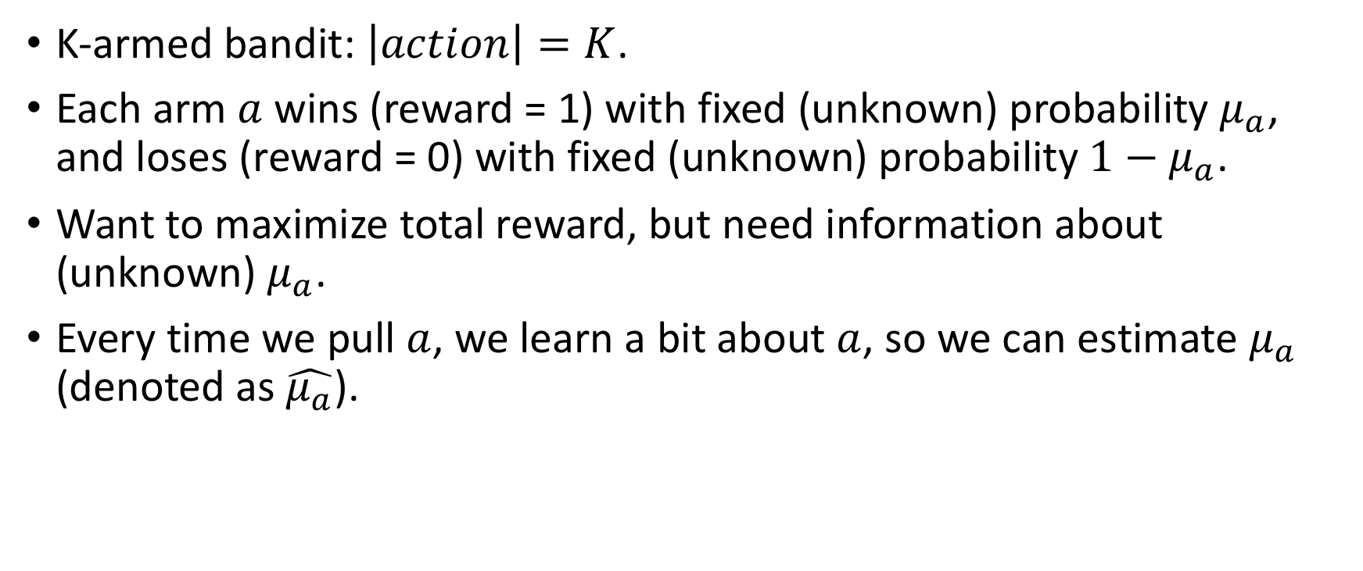
Multiarmed Bandits
K-armed bandit: $\left|action\right|=K$.
Each arm $a$ wins (reward = 1) with fixed (unknown) probability $μ_{a}$, and loses (reward = 0) with fixed (unknown) probability $1−μ_{a}$.
Want to maximize total reward, but need information about (unknown) $μ_{a}$.
Every time we pull $a$, we learn a bit about $a$, so we can estimate $μ_{a}$ (denoted as $\hat{μ_{a}}$).

Slide 95
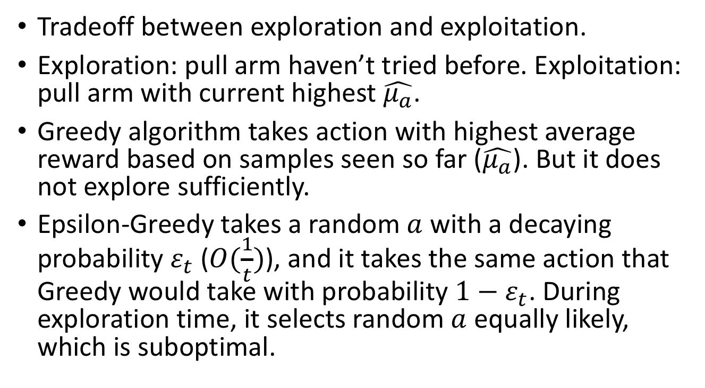
Bandit Algorithm: Greedy and Epsilon-Greedy
Tradeoff between exploration and exploitation.
Exploration: pull arm haven’t tried before. Exploitation: pull arm with current highest $\hat{μ_{a}}$.
Greedy algorithm takes action with highest average reward based on samples seen so far ($\hat{μ_{a}}$). But it does not explore sufficiently.
Epsilon-Greedy takes a random $a$ with a decaying probability $ε_{t}$ ($O(\frac{1}{t})$), and it takes the same action that Greedy would take with probability ${1−ε}_{t}$. During exploration time, it selects random $a$ equally likely, which is suboptimal.

Slide 96
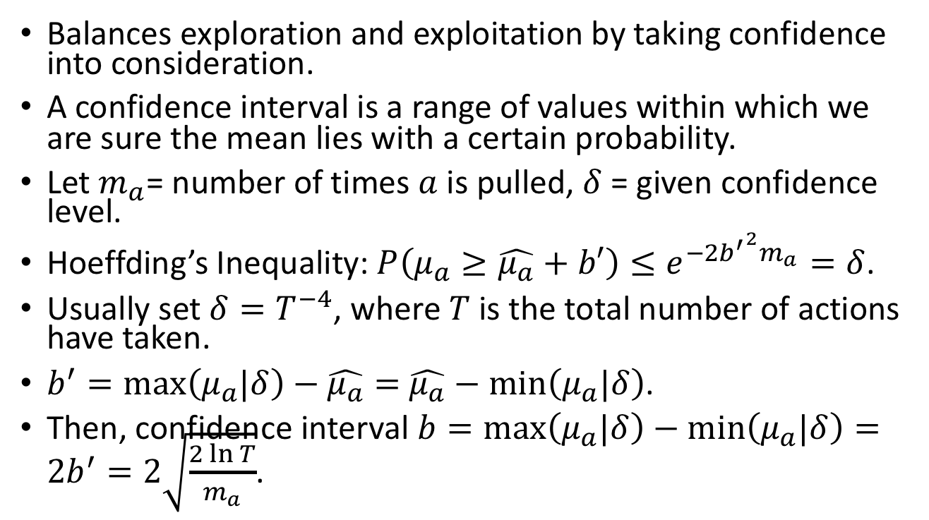

Bandit Algorithm: ${UCB}_{1}$
Balances exploration and exploitation by taking confidence into consideration.
A confidence interval is a range of values within which we are sure the mean lies with a certain probability.
Let $m_{a}$= number of times $a$ is pulled, $δ$ = given confidence level.
Hoeffding’s Inequality: $P\left(μ_{a}≥\hat{μ_{a}}+b′\right)≤e^{−2{b^{′}}^{2}m_{a}}=δ$.
Usually set $δ=T^{−4}$, where $T$ is the total number of actions have taken.
$b^{′}=\max\left(μ_{a}|δ\right)−\hat{μ_{a}}=$ $\hat{μ_{a}}−min\left(μ_{a}|δ\right)$.
Then, confidence interval $b=\max\left(μ_{a}|δ\right)−\min\left(μ_{a}|δ\right)=2b^{′}=2\sqrt{\frac{2\ln{T}}{m_{a}}}$.

Slide 97
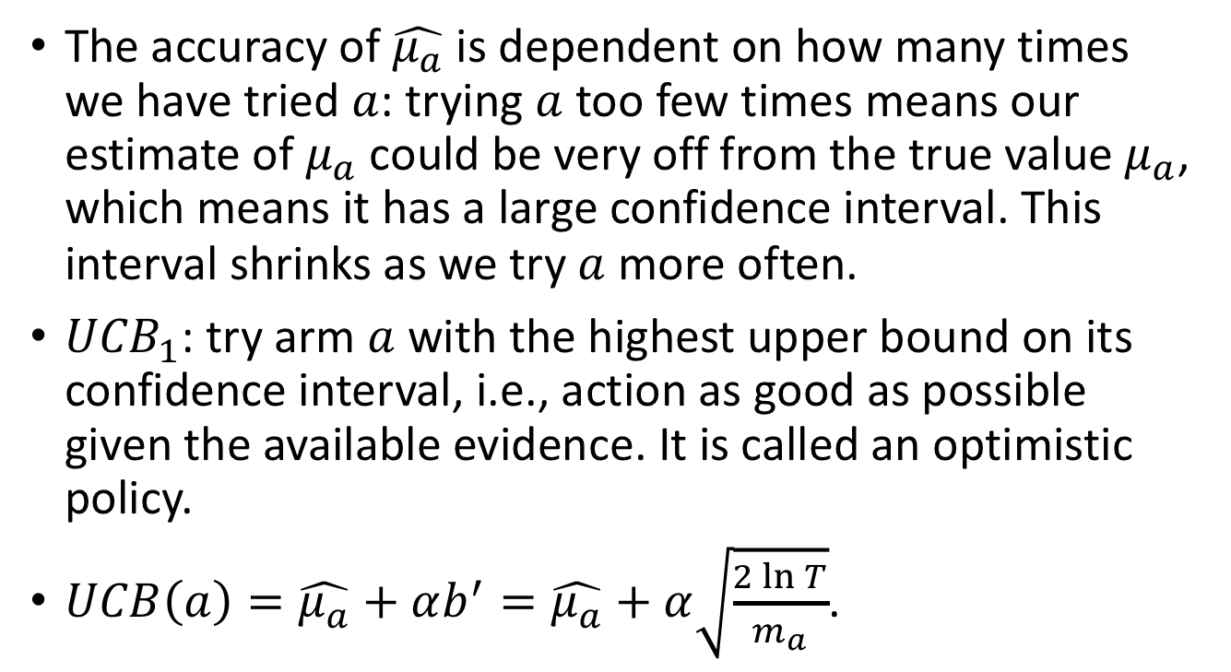
Bandit Algorithm: ${UCB}_{1}$
The accuracy of $\hat{μ_{a}}$ is dependent on how many times we have tried $a$: trying $a$ too few times means our estimate of $μ_{a}$ could be very off from the true value $μ_{a}$, which means it has a large confidence interval. This interval shrinks as we try $a$ more often.
${UCB}_{1}$: try arm $a$ with the highest upper bound on its confidence interval, i.e., action as good as possible given the available evidence. It is called an optimistic policy.
$UCB\left(a\right)=\hat{μ_{a}}+αb^{′}=\hat{μ_{a}}+α\sqrt{\frac{2\ln{T}}{m_{a}}}$.

Slide 98
Optimizing Submodular Functions
Praty Sharma

Slide 99
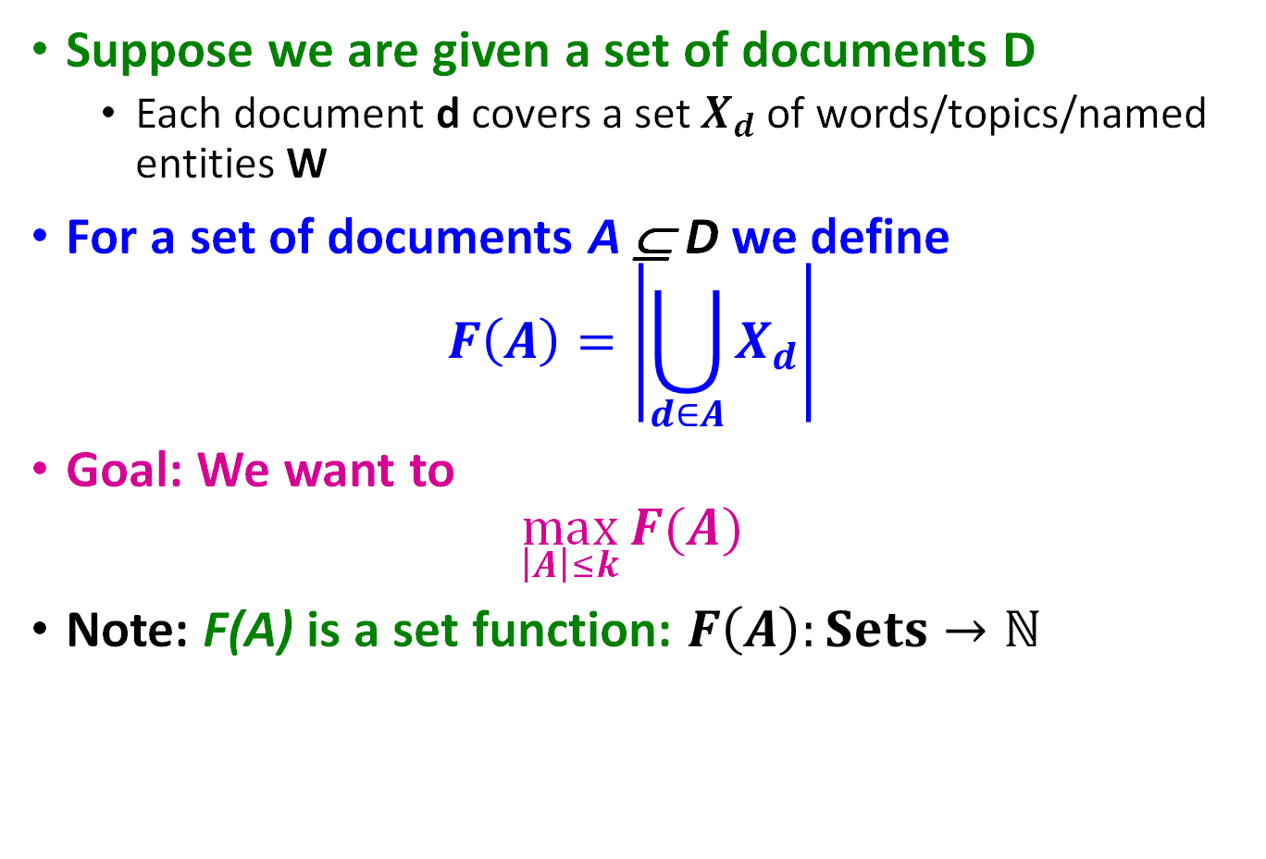
Set Cover Problem
Suppose we are given a set of documents D
  Each document d covers a set $X_{d}$ of words/topics/named entities W
For a set of documents A ⊆ D we define
$$F\left(A\right)=\left|\bigcup_{d∈A}{X_{d}}\right|$$
Goal: We want to
$$\max_{\left|A\right|≤k}{F(A)}$$
Note: F(A) is a set function: $F\left(A\right):Sets→ℕ$

Slide 100


Simple Greedy Heuristic
Simple Heuristic: Greedy Algorithm:
Start with $A0=\{ \}$
For $i=1…k$
  Find set $d$ that $max⁡F(A_{i−1}∪\{d\})$
  Let $A_{i}=A_{i−1 } \{d\}$
Example:
  Eval. $F\left(\left\{d_{1}\right\}\right),…, F(\{d_{m}\})$, pick best (say $d_{1}$)
  Eval. $F\left(\left\{d_{1}\}∪\{d_{2}\right\}\right),…, F(\{d_{1}\}∪\{d_{m}\})$, pick best (say $d_{2}$)
  Eval. $F({\{d}_{1},d_{2}\}∪\{d_{3}\}),…, F(\{d_{1},d_{2}\}∪\{d_{m}\})$, pick best
  And so on…
$$F\left(A\right)=\left|\bigcup_{d∈A}{X_{d}}\right|$$

Slide 101
Approximation Guarantee
Greedy produces a solution A
where: F(A) ≥ (1-1/e)*OPT (F(A) ≥ 0.63*OPT)
[Nemhauser, Fisher, Wolsey ’78]
Claim holds for functions F(·) with 2 properties:
  F is monotone: (adding more docs doesn’t decrease coverage)
  if A ⊆ B then F(A) ≤ F(B) and F({})=0
  F is submodular:
  adding an element to a set gives less improvement
  than adding it to one of its subsets

Slide 102
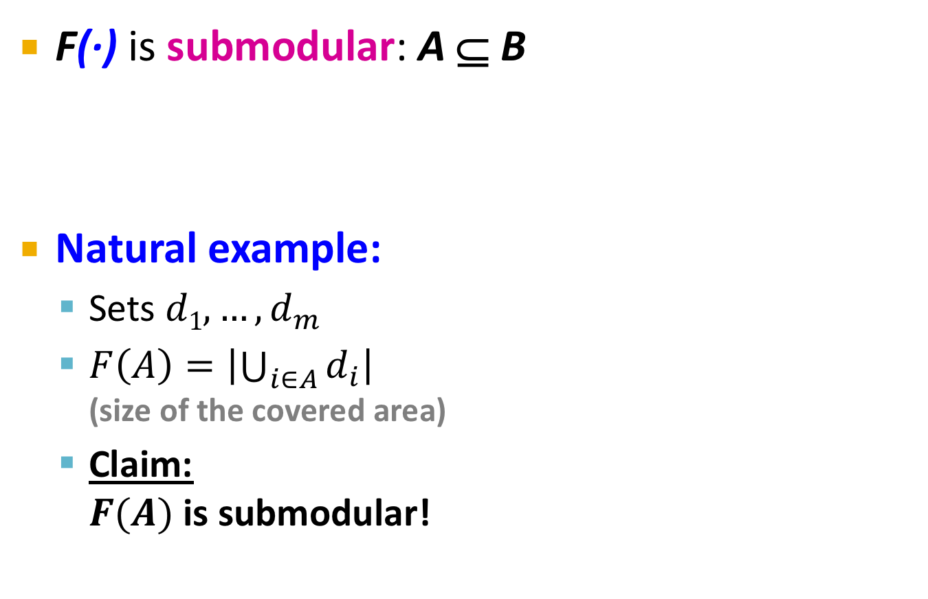
Submodularity Definition
F(·) is submodular: A ⊆ B
Natural example:
  Sets $d1, …, d_{m}$
  $F\left(A\right)=\left|\bigcup_{i∈A}{d_{i}}\right|$
  (size of the covered area)
  Claim:
  $F(A)$ is submodular!
F(A ∪ d) – F(A) ≥ F(B ∪ d) – F(B)
Gain of adding d to a small set
Gain of adding d to a large set
A
d
B
d
Notes:
SPLIT

Slide 103

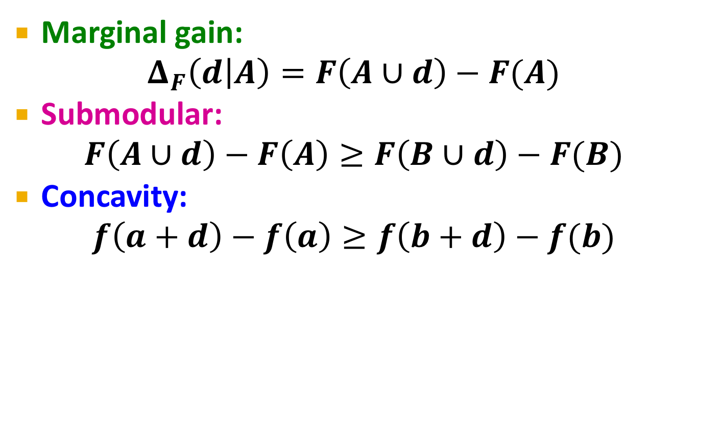

Submodularity & Concavity
Marginal gain:
$$Δ_{F}\left(d | A\right)=F\left(A∪d\right)−F(A)$$
Submodular:
$F\left(A∪d\right)−F\left(A\right)≥F\left(B∪d\right)−F(B)$
Concavity:
$f\left(a+d\right)−f\left(a\right)≥f\left(b+d\right)−f(b)$
$$A⊆B$$
$$a≤b$$
F(A)
|A|

Slide 104
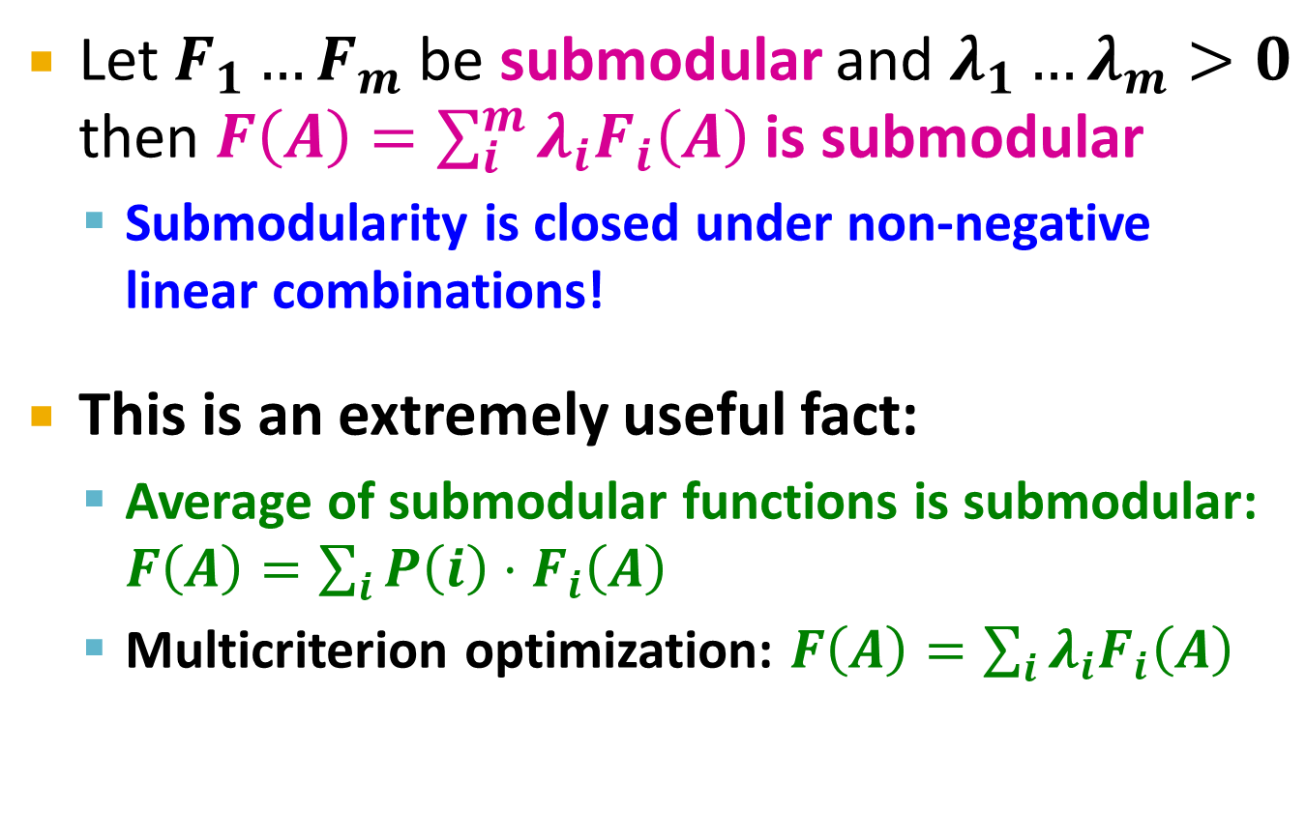
Submodularity: Useful Fact
Let $F_{1}…F_{m}$ be submodular and $λ_{1}…λ_{m}>0$ then $F\left(A\right)=\sum_{i}^{m}{λ_{i}F_{i}\left(A\right)}$ is submodular
  Submodularity is closed under non-negative linear combinations!
This is an extremely useful fact:
  Average of submodular functions is submodular: $F\left(A\right)=\sum_{i}{P\left(i\right)⋅F_{i}\left(A\right)}$
  Multicriterion optimization: $F\left(A\right)=\sum_{i}{λ_{i}F_{i}\left(A\right)}$

Slide 105
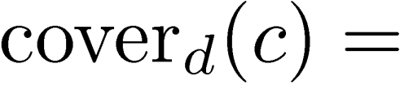
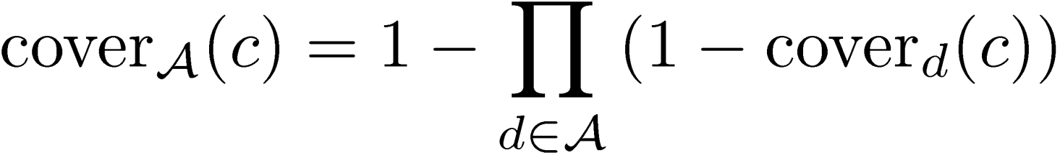
Probabilistic Set Cover
Document coverage function:
probability document d covers
concept c
    Cover_{d}(c) can also model how relevant is concept c for user u
Set coverage function:
  Prob. that at least one document in A covers c
Objective:
concept weights
Notes:
Previously, a set of docs A covered c if at least one of the docs in A contained c
Now we have a probabilistic notion of document covg, so we’ll define set covg in the analogous way.

Slide 106
Optimizing F(A)
The objective function is also submodular
  Intuitive diminishing returns property
  Greedy algorithm leads to a (1 – 1/e) ~ 63% approximation, i.e., a near-optimal solution

Slide 107

Speeding up Greedy
Greedy algorithm is slow!
  At each iteration we need to
  re-evaluate marginal gains of
  all remaining documents
  Runtime $O(|D|·K)$ for
  selecting $K$ documents out of the set of $D$ of them
Greedy
Marginal gain:
F(A∪x)-F(A)
a
b
c
d
e
Add document with
highest marginal gain

Slide 108
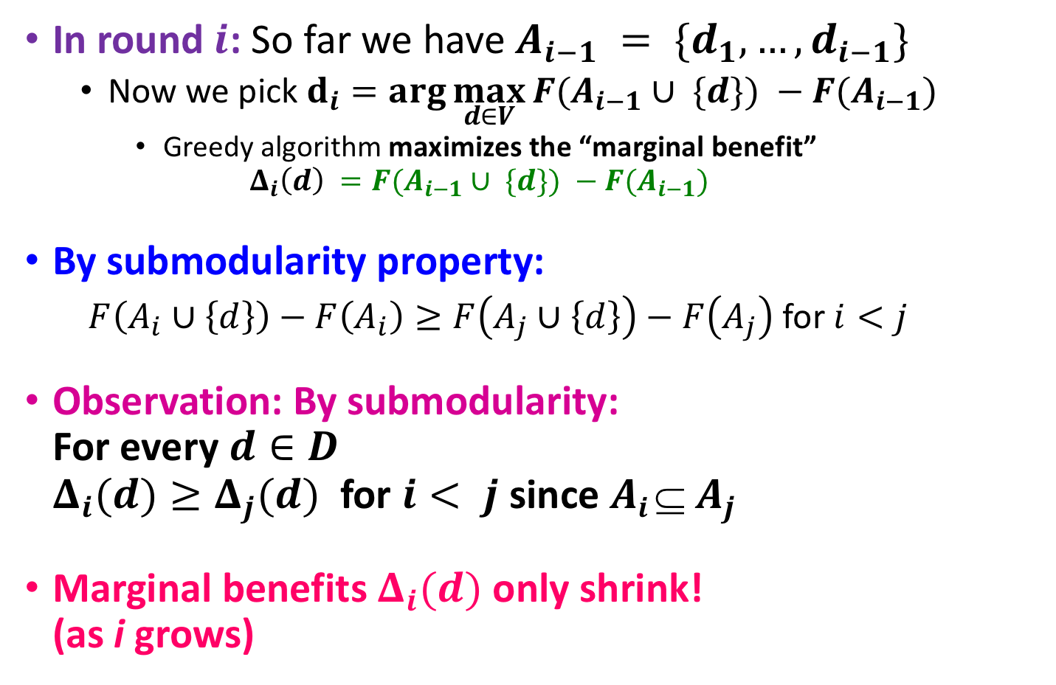
Speeding up Greedy
[Leskovec et al., KDD ’07]
In round $i$: So far we have $A_{i−1} = \{d_{1},…,d_{i−1}\}$
  Now we pick $d_{i}=\arg{\max_{d∈V}{F(A_{i−1}∪ \{d\}) −F(A_{i−1})}}$
    Greedy algorithm maximizes the “marginal benefit”
    $Δ_{i}\left(d\right) =F(A_{i−1}∪ \{d\}) −F(A_{i−1})$
By submodularity property:
  $F\left(A_{i}∪\left\{d\right\}\right)−F\left(A_{i}\right)≥F\left(A_{j}∪\left\{d\right\}\right)−F\left(A_{j}\right)$ for $i<j$
Observation: By submodularity:
For every $d∈D$
$Δ_{i}(d)≥Δ_{j}(d)$ for $i< j$ since $Ai  A_{j}$
Marginal benefits $Δ_{i}(d)$ only shrink!
(as i grows)
Δ_{i}(d)
≥ Δ _{j}(d)
d
Selecting document d in step i covers more words than selecting d at step j (j>i)

Slide 109
Lazy Greedy
[Leskovec et al., KDD ’07]
Idea:
  Use Δ_{i} as upper-bound on Δ_{j} (j > i)
Lazy Greedy:
  Keep an ordered list of marginal benefits Δ_{i} from previous iteration
  Re-evaluate Δ_{i} only for top element
  Re-sort and prune
Upper bound on
Marginal gain Δ₁
a
A₁={a}
b
c
d
e
F(A ∪ {d}) – F(A) ≥ F(B ∪ {d}) – F(B)
A ⊆ B

Slide 110
Lazy Greedy
[Leskovec et al., KDD ’07]
Idea:
  Use Δ_{i} as upper-bound on Δ_{j} (j > i)
Lazy Greedy:
  Keep an ordered list of marginal benefits Δ_{i} from previous iteration
  Re-evaluate Δ_{i} only for top element
  Re-sort and prune
Upper bound on
Marginal gain Δ₂
a
A₁={a}
b
c
d
e
F(A ∪ {d}) – F(A) ≥ F(B ∪ {d}) – F(B)
A ⊆ B

Slide 111
Lazy Greedy
[Leskovec et al., KDD ’07]
Idea:
  Use Δ_{i} as upper-bound on Δ_{j} (j > i)
Lazy Greedy:
  Keep an ordered list of marginal benefits Δ_{i} from previous iteration
  Re-evaluate Δ_{i} only for top element
  Re-sort and prune
Upper bound on
Marginal gain Δ₂
a
A₁={a}
d
A₂={a,b}
b
e
c
F(A ∪ {d}) – F(A) ≥ F(B ∪ {d}) – F(B)
A ⊆ B
Notes:
If that removes it from the top, pick next sensor
Continue until top remains unchanged

Slide 112
Summary so far
Summary:
  Diversity can be formulated as a set cover
  Set cover is submodular optimization problem
  Can be (approximately) solved using greedy algorithm
  Lazy-greedy gives significant speedup
400
exhaustive search
300
(all subsets)
Lower is better
naive
running time (seconds)
200
greedy
100
Lazy
0
1
2
3
4
5
6
7
8
9
10
number of blogs selected

