Slide 1
Multi-armed Bandits: Learning through Experimentation
CS246: Mining Massive Datasets
Caroline Lo, Stanford University
http://cs246.stanford.edu

Slide 2
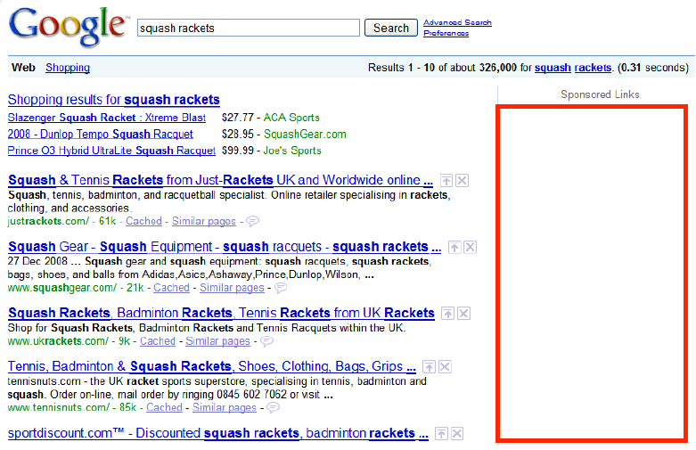
Learning through Experimentation
Web advertising
We’ve learned how to match advertisers to queries in real-time
But how to estimate the CTR (Click-Through Rate)?
Recommendation engines
We’ve learned how to build recommender systems
But how to solve the cold-start problem?
Notes:
The most we can do so far is to build some sort of classifier – but how do we incorporate new information?
Recommender system: think about Amazon. New products are added every day.

Slide 3
Learning through Experimentation
What do CTR and cold start have in common?
Getting the answer requires experimentation
With every ad we show/ product we recommend we gather more data about the ad/product
Theme: Learning through experimentation
Notes:
Learn through active expeiments (a form of active learning)

Slide 4
Example: Web Advertising
Google’s goal: Maximize revenue
The old way: Pay by impression (CPM)

Slide 5
Example: Web Advertising
Google’s goal: Maximize revenue
The old way: Pay by impression (CPM)
Best strategy: Go with the highest bidder
But this ignores “effectiveness” of an ad
The new way: Pay per click! (CPC)
Best strategy: Go with expected revenue
What’s the expected revenue of ad a for query q?
E[revenue_{a,q}] = P(click_{a} | q) * amount_{a,q}
Prob. user will click on ad a given that she issues query q
(Unknown! Need to gather information)
Bid amount for ad a on query q
(Known)

Slide 6
Other Applications
Clinical trials:
Investigate effects of different treatments while minimizing patient losses
Adaptive routing:
Minimize delay in the network by investigating different routes
Asset pricing:
Figure out product prices while trying to make most money

Slide 7
Approach: Multiarmed Bandits

Slide 8
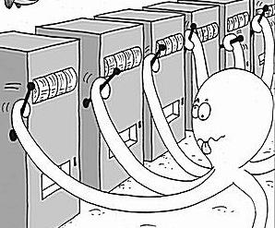
Approach: Multiarmed Bandits

Slide 9
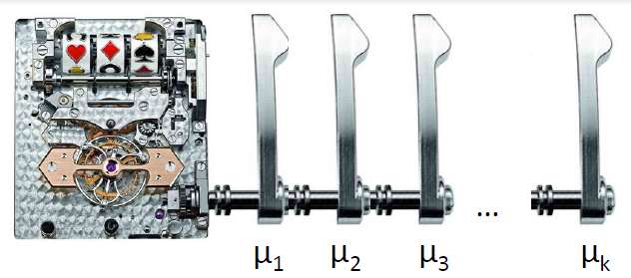
k-Armed Bandit
Each arm a
Wins (reward=1) with fixed (unknown) prob. μ_{a}
Loses (reward=0) with fixed (unknown) prob. 1-μ_{a}
All draws are independent given μ₁ … μ_{k}
How to pull arms to maximize total reward?

Slide 10
k-Armed Bandit
How does this map to our advertising example?
Each query is a bandit
Each ad is an arm
We want to estimate the arm’s probability of winning μ_{a} (i.e., the ad’s CTR μ_{a})
Every time we pull an arm we do an ‘experiment’

Slide 11
Stochastic k-Armed Bandit
The setting:
Set of k choices (arms)
Each choice a is tied to a probability distribution P_{a} with average reward/payoff μ_{a} (between [0, 1])
We play the game for T rounds
For each round t:
(1) We pick some arm j
(2) We win reward $X_{t}$ drawn from P_{j}
Note reward is independent of previous draws
Our goal is to maximize $\sum_{t=1}^{T}{X_{t}}$
We don’t know μ_{a}! But every time we pull some arm a we get to learn a bit about μ_{a}

Slide 12
Online Optimization
Online optimization with limited feedback
Like in online algorithms:
Have to make a choice each time
But we only receive information about the chosen action
Choices | X₁ | X₂ | X₃ | X₄ | X₅ | X₆ | …
a₁ |  |  |  |  | 1 | 1
a₂ | 0 |  | 1 | 0
…
a_{k} |  | 0
Time

Slide 13
Solving the Bandit Problem
Policy: a strategy/rule that in each iteration tells me which arm to pull
Hopefully policy depends on the history of rewards
How to quantify performance of the algorithm? Regret!

Slide 14
Performance Metric: Regret
$μ_{a}$ is the mean of $P_{a}$
Payoff/reward of best arm: $μ^{∗}=\max_{a}{μ_{a}}$
Let $a_{1},a_{2}…a_{T}$ be the sequence of arms pulled
Instantaneous regret at time $t$: $r_{t}=μ^{∗}−μ_{a_{t}}$
Total regret:
$$R_{T}=\sum_{t=1}^{T}{r_{t}}$$
Typical goal: Want a policy (arm allocation strategy) that guarantees: $\frac{R_{T}}{T}→0$ as $T→∞$
Note: Ensuring $R_{T}/T→0$ is stronger than maximizing payoffs (minimizing regret), as it means that in the limit we discover the true best arm.

Slide 15
Allocation Strategies
If we knew the payoffs, which arm would we pull?
$$Pick \arg{\max_{a}{μ_{a}}}$$
We’d always pull the arm with the highest average reward.
But we don’t know which arm that is without exploring/experimenting with the arms first.
$X_{a,j}$… payoff received when pulling arm $a$ for $j$-th time

Slide 16
Exploration vs. Exploitation
Minimizing regret illustrates a classic problem in decision making:
We need to trade off exploration (gathering data about arm payoffs) and exploitation (making decisions based on data already gathered)
Exploration: Pull an arm we never pulled before
Exploitation: Pull an arm $a$ for which we currently have the highest estimate of $μ_{a}$

Slide 17
Algorithm: Epsilon-Greedy
Algorithm: Epsilon-Greedy
For t=1:T
Set $ε_{t}=O(1/t)$
With prob. $ε_{t}$: Explore by picking an arm chosen uniformly at random
With prob. ${1−ε}_{t}$: Exploit by picking an arm with highest empirical mean payoff
Theorem [Auer et al. ‘02] For suitable choice of $ε_{t}$ it holds that $R_{T}=O(k\log{T)}\overset{⇒}{}\frac{R_{T}}{T}=O\left(\frac{k\log{T}}{T}\right)→0$
k…number of arms

Slide 18
Issues with Epsilon Greedy
What are some issues with Epsilon Greedy?
“Not elegant”: Algorithm explicitly distinguishes between exploration and exploitation
More importantly: Exploration makes suboptimal choices (since it picks any arm with equal likelihood)
Idea: When exploring/exploiting we need to compare arms

Slide 19
Comparing Arms
Suppose we have done experiments:
Arm 1: 1 0 0 1 1 0 0 1 0 1
Arm 2: 1
Arm 3: 1 1 0 1 1 1 0 1 1 1
Mean arm values:
Arm 1: 5/10, Arm 2: 1, Arm 3: 8/10
Which arm would you pick next?
Idea: Don’t just look at the mean (that is, expected payoff) but also the confidence!

Slide 20
Confidence Intervals (1)
A conﬁdence interval is a range of values within which we are sure the mean lies with a certain probability
We could believe $μ_{a}$ is within [0.2,0.5] with probability 0.95
If we have tried an action less often, our estimated reward is less accurate so the conﬁdence interval is larger
Interval shrinks as we get more information (i.e. try the action more often)

Slide 21
Confidence Intervals (2)
Assuming we know the confidence intervals
Then, instead of trying the action with the highest mean we can try the action with the highest upper bound on its conﬁdence interval
This is called an optimistic policy
We believe an action is as good as possible given the available evidence

Slide 22
Confidence Based Selection
99.99% confidence interval
After more exploration
$$μ_{a}$$
$$μ_{a}$$
arm a
arm a

Slide 23
Calculating Confidence Bounds
Suppose we fix arm a:
Let $Y_{a,1}…Y_{a,m}$ be the payoffs of arm a in the first m trials
$Y_{a,1}…Y_{a,m}$ are i.i.d. rnd. vars. with values in [0,1]
Expected mean payoff of arm a: $μ_{a}=E[Y_{a,m}]$
Our estimate: $\hat{μ_{a,m}}=\frac{1}{m}\sum_{ℓ=1}^{m}{Y_{a,ℓ}}$
Want to find confidence bound $b$ such that with high probability $\left|μ_{a}−\hat{μ_{a,m}}\right|≤b$
Also want $b$ to be as small as possible (why?)
Goal: Want to bound $P(\left|μ_{a}−\hat{μ_{a,m}}\right|≤b)$

Slide 24
Hoeffding’s Inequality
Hoeffding’s inequality bounds $P(\left|μ_{a}−\hat{μ_{a,m}}\right|≤b)$
Let $Y_{1}…Y_{m}$ be i.i.d. rnd. vars. with values between [0,1]
Let $μ=E[Y]$ and $\hat{μ_{m}}=\frac{1}{m}\sum_{ℓ=1}^{m}{Y_{ℓ}}$
Then: $P\left(\left|μ−\hat{μ_{m}}\right|≥b\right)≤exp\left(−2b^{2}m\right)=δ$
To find out the confidence interval $b$ (for a given confidence level $δ$) we solve:
$e^{−2b^{2}m}≤δ$ then $−2b^{2}m≤ln⁡(δ)$
So: $b≥\sqrt{\frac{\ln\left(1/δ\right)}{2 m}}$

Slide 25
UCB1 Algorithm
[Auer et al. ‘02]
UCB1 (Upper confidence sampling) algorithm
Set: $\hat{μ_{1}}=…=\hat{μ_{k}}=0$ and $m_{1}=…=m_{k}=0$
$\hat{μ_{a}}$ is our estimate of payoff of arm $i$
$m_{a}$ is the number of pulls of arm $i$ so far
For t = 1:T
For each arm a calculate: $UCB\left(a\right)=\hat{μ_{a}}+\sqrt{\frac{2 ln t}{m_{a}}}$
Pick arm $j=arg max_{a} UCB\left(a\right)$
Pull arm $j$ and observe $y_{t}$
Set: $m_{j}←m_{j}+1$ and $\hat{μ_{j}}←\frac{1}{m_{j}}(y_{t}+\left(m_{j}−1\right) \hat{μ_{j}})$
Upper confidence interval (Hoeffding’s inequality)
Notes:
Plugging in alpha SQRT 2 ln t / m_a
Gives us that P(Y>mu + a) < T^-4 which converges to zero.
http://jeremykun.com/2013/10/28/optimism-in-the-face-of-uncertainty-the-ucb1-algorithm/

Slide 26
UCB1: Discussion
$UCB\left(a\right)=\hat{μ_{a}}+\sqrt{\frac{2 ln t}{m_{a}}}$
$t$ impacts the value of $δ$: $t=f\left(1/δ\right)$
Conﬁdence interval grows with the total number of actions $t$ we have taken
But shrinks with the number of times $m_{a}$ we have tried arm $a$
This ensures each arm is tried inﬁnitely often but still balances exploration and exploitation
$$b≥\sqrt{\frac{\ln\left(1/δ\right)}{2 m}}$$
“Optimism in face of uncertainty”:
The algorithm believes that it can obtain extra rewards by reaching the unexplored parts of the state space

Slide 27
Performance of UCB1
Theorem [Auer et al. 2002]
Suppose optimal mean payoff is $μ^{∗}=\max_{a}{μ_{a}}$
And for each arm let $Δ_{a}=μ^{∗}−μ_{a}$
Then it holds that
$$E\left[R_{T}\right]≤\left[8 \sum_{a:μ_{a}<μ^{∗}}{\frac{ln T}{Δ_{a}}}\right]+\left(1+\frac{π^{2}}{3}\right)\left(\sum_{i=a}^{k}{Δ_{a}}\right)$$
So: $O\left(\frac{R_{T}}{T}\right)≤k \frac{ln T}{T}$
$$O(k ln⁡T)$$
$$O(k)$$

Slide 28
Summary
k-armed bandit problem is a formalization of the exploration-exploitation tradeoff
Simple algorithms are able to achieve no regret (limit towards infinity)
Epsilon-greedy
UCB (Upper Confidence Sampling)

Slide 29
News Recommendation
Every round receive context [Li et al., WWW ‘10]
Context: User features, articles view before
Model for each article’s click-through rate

Slide 30
News Recommendation
Feature-based exploration:
Select articles to serve users based on contextual information about the user and the articles
Simultaneously adapt article selection strategy based on user-click feedback to maximize total number of user clicks

Slide 31
Example: A/B testing vs. Bandits
Imagine you have two versions of the website and you’d like to test which one is better
Version A has engagement rate of 5%
Version B has engagement rate of 4%
You want to establish with 95% confidence that version A is better
You’d need 22,330 observations (11,165 in each arm) to establish that
Use student’s t-test to establish the sample size
Can bandits do better?

Slide 32
Example: Bandits vs. A/B testing
How long it does it take to discover A > B?
A/B test: We need 22,330 observations. Assuming 100 observations/day, we need 223 days
Bandits: We use UCB1 and keep track of confidences for each version we stop as soon as A is better than B with 95% confidence. How much do we save?
175 days on the average!
48 days vs. 223 days
More at: http://bit.ly/1pywka4

