Slide 1
Linear Algebra Review (with a Small Dose of Optimization)
Hristo Paskov
CS246

Slide 2
Outline
Basic definitions
Subspaces and Dimensionality
Matrix functions: inverses and eigenvalue decompositions
Convex optimization

Slide 3
Vectors and Matrices
Vector $x∈ℝ^{d}$
$$x=\left[\begin{aligned}x_{1} \\ x_{2} \\ ⋮ \\ x_{d}\end{aligned}\right]$$
May also write
$$x={\left[\begin{matrix}x_{1} & x_{2} & … & x_{d}\end{matrix}\right]}^{T}$$

Slide 4
Vectors and Matrices
Matrix $M∈ℝ^{m×n}$
$$M=\left[\begin{matrix}M_{11} & ⋯ & M_{1n} \\ ⋮ & ⋱ & ⋮ \\ M_{m1} & ⋯ & M_{mn}\end{matrix}\right]$$
Written in terms of rows or columns
$$M=\left[\begin{aligned}r_{1}^{T} \\ ⋮ \\ r_{m}^{T}\end{aligned}\right]=\left[\begin{matrix}c_{1} & … & c_{n}\end{matrix}\right]$$
$$r_{i}={\left[\begin{matrix}M_{i1} & … & M_{in}\end{matrix}\right]}^{T} c_{i}={\left[\begin{matrix}M_{1i} & … & M_{mi}\end{matrix}\right]}^{T}$$

Slide 5
Multiplication
Vector-vector: $x,y∈ℝ^{d}→ℝ$
$$x^{T}y=\sum_{i=1}^{d}{x_{i}y_{i}}$$
Matrix-vector: $x∈ℝ^{n},M∈ℝ^{m×n}→ℝ^{m}$
$$Mx=\left[\begin{aligned}r_{1}^{T} \\ ⋮ \\ r_{m}^{T}\end{aligned}\right]x=\left[\begin{aligned}r_{1}^{T}x \\ ⋮ \\ r_{m}^{T}x\end{aligned}\right]$$

Slide 6
Multiplication
Matrix-matrix: $A∈ℝ^{m×k},B∈ℝ^{k×n}→ℝ^{m×n}$
$$3$$
$$4$$
$$4$$
$$3$$
=
$$5$$
$$5$$

Slide 7
Multiplication
Matrix-matrix: $A∈ℝ^{m×k},B∈ℝ^{k×n}→ℝ^{m×n}$
$a_{i}$ rows of $A$, $b_{j}$ cols of $B$
$$AB=\left[A\begin{matrix}b_{1} & … & {Ab}_{n}\end{matrix}\right]=\left[\begin{aligned}a_{1}^{T}B \\ ⋮ \\ a_{m}^{T}B\end{aligned}\right]=\left[\begin{matrix}a_{1}^{T}b_{1} & ⋯ & a_{1}^{T}b_{n} \\ ⋮ & a_{i}^{T}b_{j} & ⋮ \\ a_{m}^{T}b_{1} & ⋯ & a_{m}^{T}b_{n}\end{matrix}\right]$$

Slide 8
Multiplication Properties
Associative
$$\left(AB\right)C=A\left(BC\right)$$
Distributive
$$A\left(B+C\right)=AB+BC$$
NOT commutative
$$AB≠BA$$
Dimensions may not even be conformable

Slide 9
Useful Matrices
Identity matrix $I∈ℝ^{m×m}$
$AI=A, IA=A$
$$\left[\begin{matrix}1 & 0 & 0 \\ 0 & 1 & 0 \\ 0 & 0 & 1\end{matrix}\right] I_{ij}=\left\{\begin{aligned}0 i≠j \\ 1 i=j\end{aligned}\right.$$
Diagonal matrix $A∈ℝ^{m×m}$
$$A=diag\left(a_{1},…,a_{m}\right)=\left[\begin{matrix}a_{1} & ⋯ & 0 \\ ⋮ & a_{i} & ⋮ \\ 0 & ⋯ & a_{m}\end{matrix}\right]$$

Slide 10
Useful Matrices
Symmetric $A∈ℝ^{m×m}:A=A^{T}$
Orthogonal $U∈ℝ^{m×m}:$
$$U^{T}U=UU^{T}=I$$
Columns/ rows are orthonormal
Positive semidefinite $A∈ℝ^{m×m}$:
$$x^{T}Ax≥0 for all x∈ℝ^{m}$$
Equivalently, there exists $L∈ℝ^{m×m}$
$$A=LL^{T}$$

Slide 11
Outline
Basic definitions
Subspaces and Dimensionality
Matrix functions: inverses and eigenvalue decompositions
Convex optimization

Slide 12
Norms
Quantify “size” of a vector
Given $x∈ℝ^{n}$, a norm satisfies
$\left\|cx\right\|=\left|c\right|\left\|x\right\|$
$\left\|x\right\|=0⇔x=0$
$\left\|x+y\right\|≤\left\|x\right\|+\left\|y\right\|$
Common norms:
Euclidean $L_{2}$-norm: ${\left\|x\right\|}_{2}=\sqrt{x_{1}^{2}+…+x_{n}^{2}}$
$L_{1}$-norm: ${\left\|x\right\|}_{1}=\left|x_{1}\right|+…+\left|x_{n}\right|$
$L_{∞}$-norm: ${\left\|x\right\|}_{∞}=\max_{i}\left|x_{i}\right|$

Slide 13
Linear Subspaces

Slide 14
Linear Subspaces
Subspace $𝒱⊂ℝ^{n}$ satisfies
$0∈𝒱$
If $x,y∈𝒱$ and $c∈ℝ$, then $c\left(x+y\right)∈𝒱$
Vectors $x_{1},…,x_{m}$ span $𝒱$ if
$$𝒱=\left\{\sum_{i=1}^{m}{α_{i}x_{i}} | α∈ℝ^{m}\right\}$$

Slide 15
Linear Independence and Dimension
Vectors $x_{1},…,x_{m}$ are linearly independent if
$\sum_{i=1}^{m}{α_{i}x_{i}}=0⟺α=0$
Every linear combination of the $x_{i}$ is unique
$Dim\left(𝒱\right)=m$ if $x_{1},…,x_{m}$ span $𝒱$ and are linearly independent
If $y_{1},…,y_{k}$ span $𝒱$then
$k≥m$
If $k>m$ then $y_{i}$ are NOT linearly independent

Slide 16
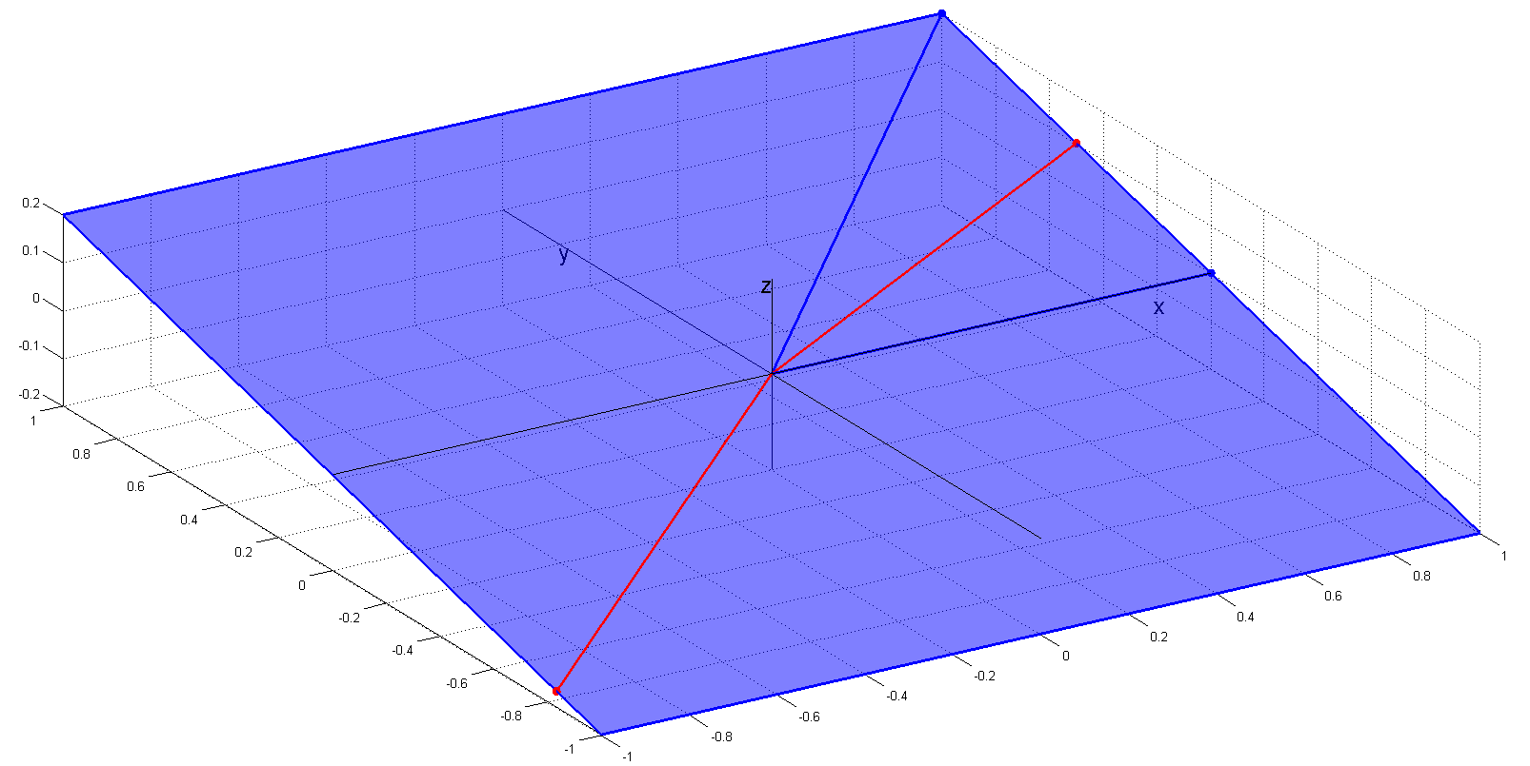
Linear Independence and Dimension

Slide 17
Matrix Subspaces
Matrix $M∈ℝ^{m×n}$ defines two subspaces
Column space $col\left(M\right)=\left\{Mα | α∈ℝ^{n}\right\}⊂ℝ^{m}$
Row space $row\left(M\right)=\left\{M^{T}β | β∈ℝ^{m}\right\}⊂ℝ^{n}$
Nullspace of $M$: $null\left(M\right)=\left\{x∈ℝ^{n} | Mx=0\right\}$
$null\left(M\right)⊥row\left(M\right)$
$dim\left(null\left(M\right)\right)+dim\left(row\left(M\right)\right)=n$
Analog for column space

Slide 18
Matrix Rank
$rank\left(M\right)$ gives dimensionality of row and column spaces
If $M∈ℝ^{m×n}$ has rank $k$, can decompose into product of $m×k$ and $k×n$ matrices
$$M$$
$$rank=k$$
$$k$$
=
$$m$$
$$m$$
$$n$$
$$n$$
$$k$$

Slide 19
Properties of Rank
For $A,B∈ℝ^{m×n}$
$rank\left(A\right)≤\min\left(m,n\right)$
$rank\left(A\right)=rank\left(A^{T}\right)$
$rank\left(AB\right)≤\min\left(rank\left(A\right),rank\left(B\right)\right)$
$rank\left(A+B\right)≤rank\left(A\right)+rank\left(B\right)$
$A$ has full rank if $rank\left(A\right)=\min\left(m,n\right)$
If $m>rank\left(A\right)$ rows not linearly independent
Same for columns if $n>rank\left(A\right)$

Slide 20
Outline
Basic definitions
Subspaces and Dimensionality
Matrix functions: inverses and eigenvalue decompositions
Convex optimization

Slide 21
Matrix Inverse
$M∈ℝ^{m×m}$ is invertible iff $rank\left(M\right)=m$
Inverse is unique and satisfies
$M^{−1}M=MM^{−1}=I$
${\left(M^{−1}\right)}^{−1}=M$
${\left(M^{T}\right)}^{−1}={\left(M^{−1}\right)}^{T}$
If $A$ is invertible then $MA$ is invertible and ${\left(MA\right)}^{−1}=A^{−1}M^{−1}$

Slide 22
Systems of Equations
Given $M∈ℝ^{m×n}, y∈ℝ^{m}$ wish to solve
$$Mx=y$$
Exists only if $y∈col\left(M\right)$
Possibly infinite number of solutions
If $M$ is invertible then $x=M^{−1}y$
Notational device, do not actually invert matrices
Computationally, use solving routines like Gaussian elimination

Slide 23
Systems of Equations
What if $y∉col\left(M\right)$?
Find $x$ that gives $\hat{y}=Mx$ closest to $y$
$\hat{y}$ is projection of $y$ onto $col\left(M\right)$
Also known as regression
Assume $rank\left(M\right)=n<m$
$$x={\left(M^{T}M\right)}^{−1}M^{T}y \hat{y}=M{\left(M^{T}M\right)}^{−1}M^{T}y$$
Invertible
Projection matrix

Slide 24
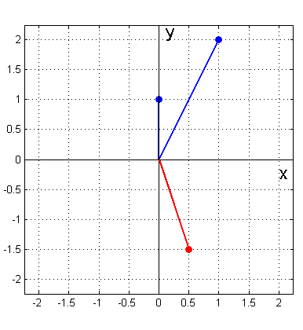
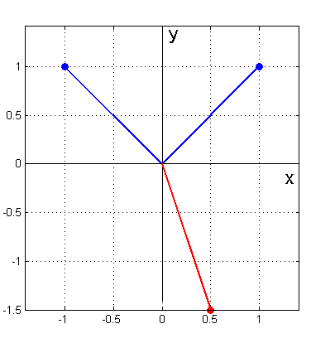
Systems of Equations
$$\left[\begin{matrix}1 & 0 \\ 2 & 1\end{matrix}\right]\left[\begin{aligned}.5 \\ −2.5\end{aligned}\right]=\left[\begin{aligned}.5 \\ −1.5\end{aligned}\right]$$
$$\left[\begin{matrix}−1 & 1 \\ 1 & 1\end{matrix}\right]\left[\begin{aligned}−1 \\ −.5\end{aligned}\right]=\left[\begin{aligned}.5 \\ −1.5\end{aligned}\right]$$

Slide 25
Eigenvalue Decomposition
Eigenvalue decomposition of symmetric $M∈ℝ^{m×m}$ is
$$M=QΣQ^{T}=\sum_{i=1}^{m}{λ_{i}q_{i}q_{i}^{T}}$$
$Σ=diag\left(λ_{1},…,λ_{n}\right)$ contains eigenvalues of $M$
$Q$ is orthogonal and contains eigenvectors $q_{i}$ of $M$
If $M$ is not symmetric but diagonalizable
$$M=QΣQ^{−1}$$
$Σ$ is diagonal by possibly complex
$Q$ not necessarily orthogonal

Slide 26
Characterizations of Eigenvalues
Traditional formulation
$$Mx=λx$$
Leads to characteristic polynomial
$$det\left(M−λI\right)=0$$
Rayleigh quotient (symmetric $M$)
$$\max_{x}{\frac{x^{T}Mx}{{\left\|x\right\|}_{2}^{2}}}$$

Slide 27
Eigenvalue Properties
For $M∈ℝ^{m×m}$ with eigenvalues $λ_{i}$
$tr\left(M\right)=\sum_{i=1}^{m}{λ_{i}}$
$det\left(M\right)=λ_{1}λ_{2}…λ_{m}$
$rank\left(M\right)=\#λ_{i}≠0$
When $M$ is symmetric
Eigenvalue decomposition is singular value decomposition
Eigenvectors for nonzero eigenvalues give orthogonal basis for $row\left(M\right)=col\left(M\right)$

Slide 28
Simple Eigenvalue Proof
Why $det\left(M−λI\right)=0$?
Assume $M$ is symmetric and full rank
$M=QΣQ^{T}$
$M−λI=QΣQ^{T}−λI=Q\left(Σ−λI\right)Q^{T}$
If $λ=λ_{i}$, $i^{th}$ eigenvalue of $M−λI$ is 0
Since $det\left(M−λI\right)$ is product of eigenvalues, one of the terms is $0$, so product is 0
$$QQ^{T}=I$$

Slide 29
Outline
Basic definitions
Subspaces and Dimensionality
Matrix functions: inverses and eigenvalue decompositions
Convex optimization

Slide 30
Convex Optimization
Find minimum of a function subject to solution constraints
Business/economics/ game theory
Resource allocation
Optimal planning and strategies
Statistics and Machine Learning
All forms of regression and classification
Unsupervised learning
Control theory
Keeping planes in the air!

Slide 31
Convex Sets
A set $C$ is convex if $∀x,y∈C$ and $∀α∈\left[0,1\right]$
$$αx+\left(1−α\right)y∈C$$
Line segment between points in $C$ also lies in $C$
Ex
Intersection of halfspaces
$L_{p}$ balls
Intersection of convex sets

Slide 32
Convex Functions
A real-valued function $f$ is convex if $domf$ is convex and $∀x,y∈domf$ and $∀α∈\left[0,1\right]$
$$f\left(αx+\left(1−α\right)y\right)≤αf\left(x\right)+\left(1−α\right)f\left(y\right)$$
Graph of $f$ upper bounded by line segment between points on graph
$$\left(x,f\left(x\right)\right)$$
$$\left(y,f\left(y\right)\right)$$

Slide 33
Gradients
Differentiable convex $f$ with $domf=ℝ^{d}$
Gradient $∇f$ at $x$ gives linear approximation
$$∇f={\left[\begin{matrix}\frac{δf}{δx_{1}} & … & \frac{δf}{δx_{d}}\end{matrix}\right]}^{T}$$
$$f$$
$$f\left(x\right)+w^{T}∇f$$
$$x$$

Slide 34
Gradients
Differentiable convex $f$ with $domf=ℝ^{d}$
Gradient $∇f$ at $x$ gives linear approximation
$$∇f={\left[\begin{matrix}\frac{δf}{δx_{1}} & … & \frac{δf}{δx_{d}}\end{matrix}\right]}^{T}$$
$$f$$
$$f\left(x\right)+w^{T}∇f$$
$$x$$

Slide 35
Gradient Descent
To minimize $f$move down gradient
But not too far!
Optimum when $∇f=0$
Given $f$, learning rate $α$, starting point $x_{0}$
$$x=x_{0}$$
Do until $∇f=0$
$x=x−α∇f$

Slide 36
Stochastic Gradient Descent
Many learning problems have extra structure
$$f\left(θ\right)=\sum_{i=1}^{n}{L\left({θ;x}_{i}\right)}$$
Computing gradient requires iterating over all points, can be too costly
Instead, compute gradient at single training example

Slide 37
Stochastic Gradient Descent
Given $f\left(θ\right)=\sum_{i=1}^{n}{L\left({θ;x}_{i}\right)}$, learning rate $α$, starting point $θ_{0}$
$θ=θ_{0}$
Do until $f\left(θ\right)$ nearly optimal
For $i=1 to n$ in random order
$θ=θ−α∇L\left({θ;x}_{i}\right)$
Finds nearly optimal $θ$

Slide 38
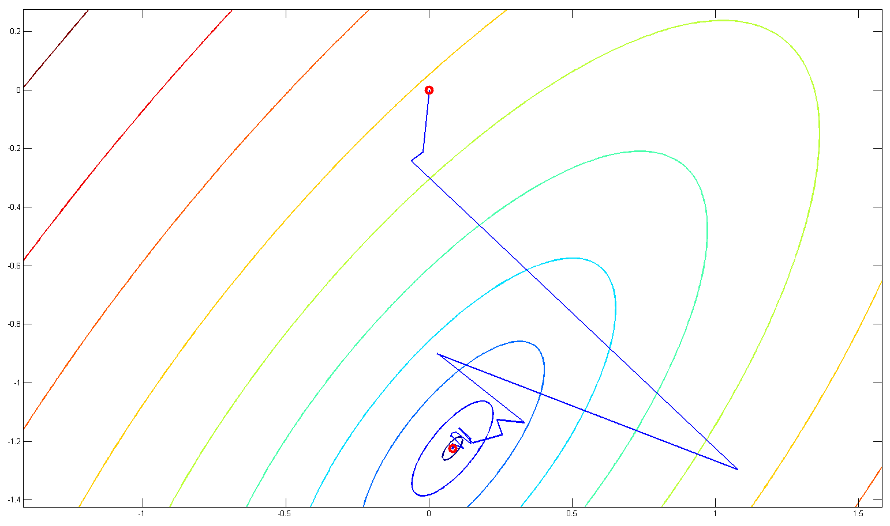
Minimize $\sum_{i=1}^{n}{{\left(y_{i}−θ^{T}x_{i}\right)}^{2}}$

Slide 39
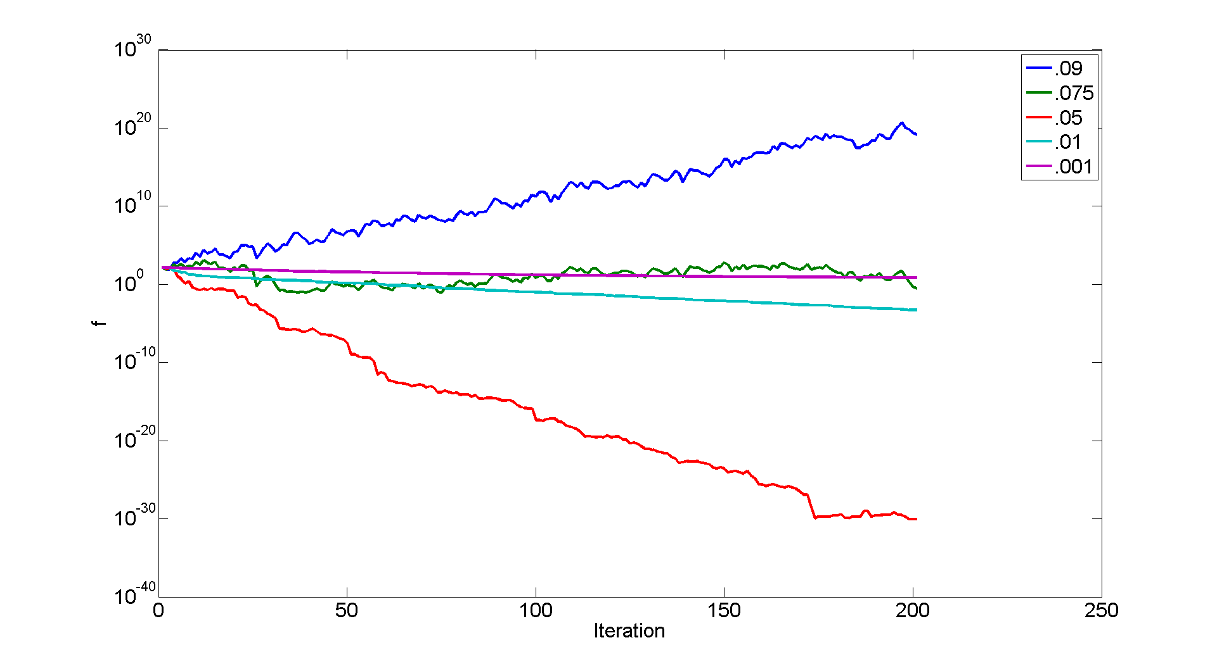
Learning Parameter

