Slide 1

Higher-Order Organization of Complex Networks
Austin Benson, David Gleich, Jure Leskovec

Slide 2
Higher-Order Structures
Small subgraphs (motifs, graphlets)
are building blocks of networks
Notes:
Networks are not composed only of edges but these edges form small subgraphs, which we call motifs or graphlets.
And these higher-order structures are building blocks of networks.
For example, here are all possible directed connected subgraphs on 3 nodes.

Slide 3
Higher-Order Structures
Higher-order structures are fundamental for control and function of complex systems:
Social networks [Watts, Strogatz ‘98]
Metabolic networks [Milo et al. ‘02]
Protein networks [Alon ‘07] [Vinayagama et al.’16]
Transportation networks [Rosvall ‘14]
Neural networks [Park, Friston ‘13]
Food webs [Stouffer et al. ‘12]
Notes:
Triangular motifs are crucial for social networks (5),
Feedforward loops have proven fundamental to understanding transcriptional regulation networks (4),
Two-hop paths are essential to understanding air traffic patterns (7).
Rich-club motifs are key to the behavior of the brain (6),
All these results based on simply counting the subgraphs in a different network.

Slide 4
Higher-Order Organization
Prior work is based on simply counting frequencies of individual subgraphs
We still lack understanding of higher-order organization of complex systems

Slide 5
This talk: Higher-order Organization
What is higher order organization of networks?
How do we extract it?

Slide 6
This talk: Modules of Motifs
Find modules based on motifs!
Network:
Motif:
[Serrour, Arenas, Gomez '11]

Slide 7
Modules of Motifs
Different motifs reveal different
modular structures!

Slide 8
How do we find
modules of network
motifs?

Slide 9
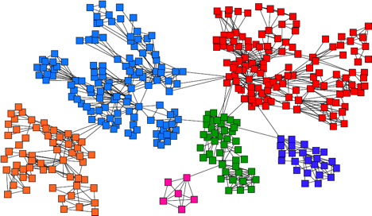
Background: Communities
Old idea: Find densely connected sets of nodes

Slide 10

Background: Communities
Define an objective function $φ(S)$
Good community S cuts few edges while keeping many inside the set S
S
S

Slide 11
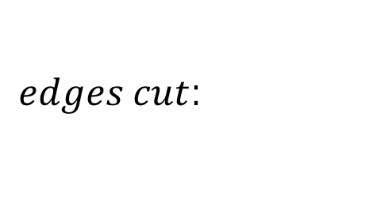
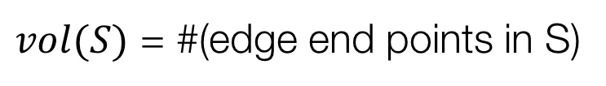
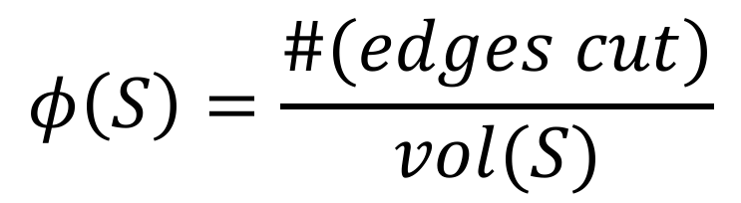
Defining an Objective Function
Conductance of a cluster S:
Lower conductance means a better cluster
$$φ\left(S\right)=\frac{\#(edges cut)}{vol(S)}$$
$edges cut$:
$vol(S)$ = #(edge end points in S)
Notes:
Notice, conductance is defined over individual edges.

Slide 12
How do we
generalize conductance
to network motifs?

Slide 13
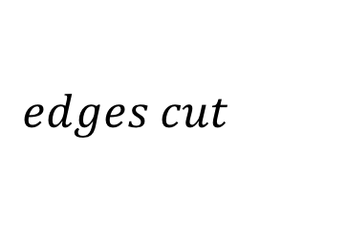
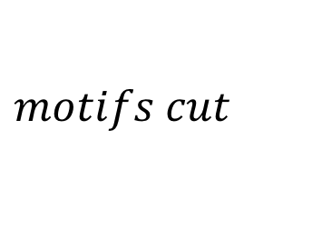
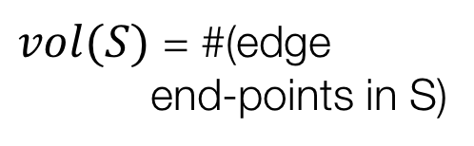
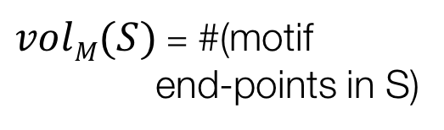
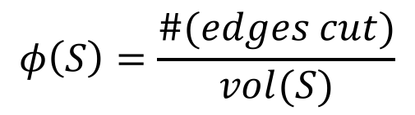
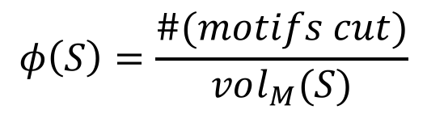
Defining Motif Conductance
Generalize Cut and Volume to motifs:
$$edges cut$$
$$motifs cut$$
$vol(S)$ = #(edge
end-points in S)
$volM(S)$ = #(motif
end-points in S)
$$φ\left(S\right)=\frac{\#(edges cut)}{vol(S)}$$
$$φ\left(S\right)=\frac{\#(motifs cut)}{vol_{M}(S)}$$
[Benson, Gleich, Leskovec, Science 2016]

Slide 14
Motif Conductance: Example
Motif:
Network:

Slide 15
Higher-order Partitioning
How do we find clusters of motifs?
  Given a motif M and a graph G
  Find a set of nodes S that
  minimizes motif conductance
Bad news: Finding set S with the minimal motif conductance is computationally intractable (NP-hard)!
[Benson, Gleich, Leskovec, Science 2016]

Slide 16
Motif Spectral Clustering
Solution: Motif Spectral Clustering
  Input: Graph G and motif M
  Using G form a new weighted graph W
  Apply spectral clustering on W
  Output the clusters
Theorem: Resulting clusters will obtain near optimal motif conductance
[Benson, Gleich, Leskovec, Science 2016]

Slide 17
Motif Spectral Clustering
1
1
1
1
3
1
1
1
1
1
2
1
1
1
1
Graph G
Weighted graph W^{(M)}
W_{ij}^{(M)} = # of times edge (i,j) participates in motif M

Slide 18
Motif Spectral Clustering
Insight:
Spectral clustering on weighted graph W^{(M)} finds clusters of low motif conductance:
1
1
1
1
3
1
1
1
1
1
2
1
1
1
1
Weighted graph W^{(M)}
W_{ij}^{(M)} = # of times edge (i,j) participates in motif M

Slide 19
Motif Spectral Clustering: 1
Step 1: Form weighted graph W^{(M)}

Slide 20
Motif Spectral Clustering: 2
Diagonal degree matrix
Step 2: Compute Fiedler vector f^{(M)} associated with λ₂ of the Laplacian of W^{(M)}

Slide 21
Motif Spectral Clustering: 3
Step 3: Sort nodes by values in f^{(M)}: f₁, f₂, …f_{n}
Let S_{r} = {f₁, …, f_{r}} and compute the motif conductance of each S_{r}

Slide 22
Motif Cheeger Inequality
Theorem: The algorithm finds a set of nodes S for which
In other words: Clusters S found by our method are provably near optimal
… motif conductance of S found by our algorithm
… motif conductance of optimal set S*
Notes:
S is within a quadratic factor of optimal

Slide 23
Advantages
Easy to implement: ~10 lines of Matlab
Scalable to large networks
(1.4B edge graphs)
General: Can be applied to directed, signed, and weighted networks
Code available: http://snap.stanford.edu/higher-order/

Slide 24
Summary
Generalization of community detection to higher-order structures
Motif-conductance objective admits a motif Cheeger inequality
Simple, fast, and scalable:

Slide 25
Applications
1) We don’t know a motif of interest
  Food webs and new applications
2) We know the motif of interest
  Regulatory transcription networks, connectome, social networks
3) We seek richer information from data
  Transportation networks

Slide 26
Application 1:
We do not know
the motif of interest

Slide 27
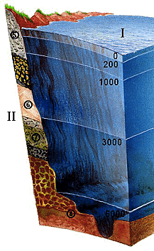
Application 1: Food webs
Florida Bay food web:
Nodes: species in
the ecosystem
Edges: carbon exchange
(who eats whom)
Different motifs capture different energy flow patterns:

Slide 28
Florida Bay Food Web
Which motif organizes the food web?
Approach:
Run motif spectral clustering separately for each of the 13 motifs
Examine the Sweep profile to see which motif gives best clusters

Slide 29
Florida Bay Food Web

Slide 30
Food Web: Observations
Observation:
Network organizes
based on motif M₆ (but not M₅ or M₈)
There exist good cuts for M₆ but not for M₅ or M₈

Slide 31
Food Web: Clusters
Pelagic fishes
and benthic prey
Benthic Fishes
Micronutrient
sources
Benthic
Macroinvertibrates
M₆ reveals known aquatic layers with higher accuracy (84% vs. 65%)
Notes:
Our framework identifies these modules with higher accuracy (84%) than existing methods (65–69%)

Slide 32
Structure of Aquatic Layers
Aquatic layers organize based on M₆
Many instances of M₆ inside
Few instances of M₆ cross

Slide 33
Application 2:
Signed networks

Slide 34
(2) Gene Regulatory Networks
Nodes are groups of genes in mRNA
Edges are directed transcriptional regulation relationships
The “feedforward loop” motif represents biological function [Alon ‘07]

Slide 35
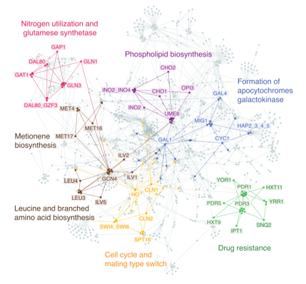
Yeast Regulatory Network
97% detection accuracy (vs. 68-82%)
Notes:
Clusters show functional modules consisting of several motifs (coherent feedforward loops), which were previously studied individually (45). The higher-order clustering framework identifies the functional modules with higher accuracy (97%) than existing methods (68–82%)

Slide 36
Structure of Modules
Feed forward loops:
Notes:
In these clusters, all edges have positive sign. The func- tionality of the motifs in the modules correspond to drug resistance (C) or cell cycle and mating type match (D). The clustering suggests that coherent feedforward loops function together as a single processing unit rather than as independent elements.

Slide 37
Application 3:
Exploring richer
information from data

Slide 38
(4) Transportation Networks
North American air transport network:
Nodes are airports
Unweighted directed edges reflect reachability
(Based on Freyet al.’s 2007)

Slide 39
Transportation Networks
Want to understand hub-and-spoke structure of the network
Use “anchored” motifs:

Slide 40
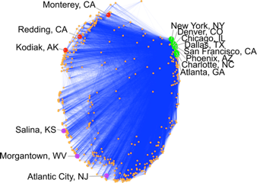
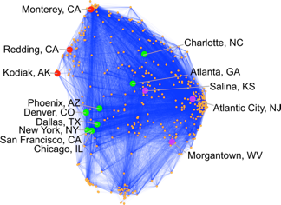
Transportation Networks
Motif-based spectral embedding
Edge-based spectral embedding
West coast non-hubs
Atlanta, the top hub, is
next to Salina, a non-hub.
Secondary spectral coordinate
Top U.S. hubs
Primary spectral coordinate
East coast non-hubs

Slide 41
(3) Neuronal Networks
Bi-Fan motif is overexpressed
in C. Elegans network [Milo ‘02]
Cluster the network based on this motif!
Notes:
The cluster contains three ring motor neurons (RMEL/V/R; cyan) with many outgoing connections, serving as the source of information;
Six inner labial sensory neurons (IL2DL/VR/R/DR/VL; orange) with many incoming connections, serving as the destination of information; and four URA neurons (purple) acting as intermediaries.
These RME neurons have been proposed as pioneers for the nerve ring (20),
while the IL2 neurons are known regulators of nictation (21),
and the higher-order cluster exposes their organization.
The cluster also reveals that RIH serves as a critical intermediary of information processing.
This neuron has incoming links from all three RME neurons, outgoing connections to five of the six IL2 neurons, and the largest total number of connections of any neuron in the cluster.

Slide 42
C. Elegans: Best Cluster
Node locations represent spatial coordinates of corresponding neurons

Slide 43
C. Elegans Network
Ring motor (RME*) neurons act as inputs
Inner labial sensory (IL2*) neurons are the destinations
URA neurons act as intermediaries
Notes:
The cluster contains three ring motor neurons (RMEL/V/R; cyan) with many outgoing connections, serving as the source of information;
Six inner labial sensory neurons (IL2DL/VR/R/DR/VL; orange) with many incoming connections, serving as the destination of information;
and four URA neurons (purple) acting as intermediaries.
These RME neurons have been proposed as pioneers for the nerve ring (20),
while the IL2 neurons are known regulators of nictation (21),
and the higher-order cluster exposes their organization.
The cluster also reveals that RIH serves as a critical intermediary of information processing.
This neuron has incoming links from all three RME neurons, outgoing connections to five of the six IL2 neurons

Slide 44
Summary
Community detection of higher-order structures
Provably finds good clusters
Simple, fast, and scalable
Can be applied to directed, signed, and weighted networks

Slide 45
Paper, Data, Code
Paper:
Higher-order Organization of Complex Networks. Austin R. Benson, David F. Gleich, and Jure Leskovec. Science, 2016.
Code & Data:
http://snap.stanford.edu/higher-order/

