Slide 1
Deep Learning for Network Biology
Marinka Zitnik and Jure Leskovec
Stanford University

Slide 2
This Tutorial
snap.stanford.edu/deepnetbio-ismb
ISMB 2018
July 6, 2018, 2:00 pm - 6:00 pm

Slide 3
This Tutorial
1) Node embeddings
Map nodes to low-dimensional embeddings
Applications: PPIs, Disease pathways
2) Graph neural networks
Deep learning approaches for graphs
Applications: Gene functions
3) Heterogeneous networks
Embedding heterogeneous networks
Applications: Human tissues, Drug side effects

Slide 4
Outline of This Section
Practical advice and demos
Future directions & conclusion

Slide 5
Practical Advice and Demos

Slide 6
Demo: Diseases

Slide 7
Demo: Protein Interactions

Slide 8
General Tips
Network data preprocessing is important:
renormalization tricks
variance-scaled initialization
network data whitening
Use the ADAM optimizer:
ADAM naturally takes care of decaying the learning rate
ReLU (activation function) often works really well
No activation function at your output layer:
Easy mistake if you build layers with a shared function
Include bias term in every layer
Graph convolution layer of size 64 or 128 is plenty

Slide 9
Debugging Deep Networks
Debug?!:
Loss/accuracy not converging during training
Important for model development:
Overfit on training data:
Accuracy should be essentially 100% or error close to 0
If neural network cannot overfit a single data point, something is wrong
Scrutinize your loss function!
Scrutinize your visualizations!

Slide 10
Future Directions and Opportunities
Material based on:
Zitnik et al. 2018. Machine Learning for Integrating Data in Biology and Medicine: Principles, Practice, and Opportunities.
Camacho et al. 2018 Next-Generation Machine Learning for Biological Networks. Cell.

Slide 11
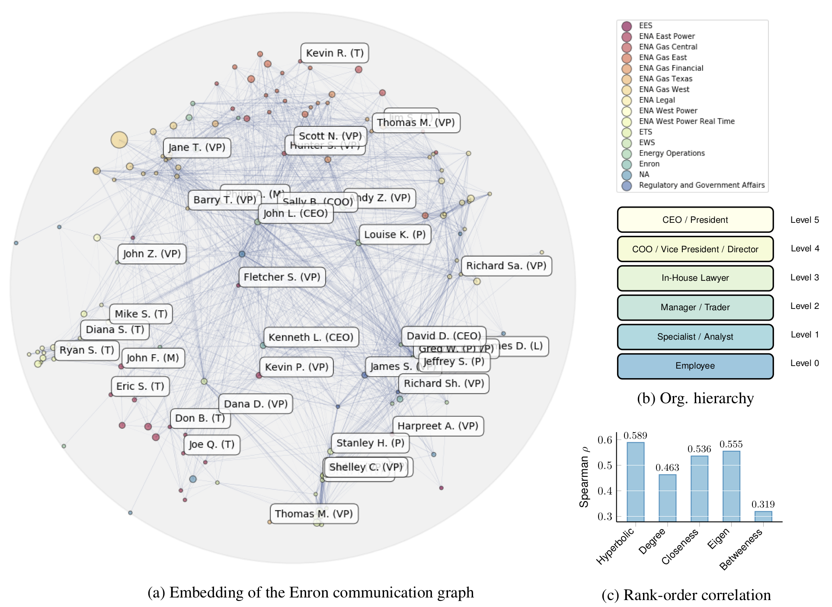
Learning Hierarchies
Hierarchical structures are ubiquitous in network biology
Challenges:
How to infer hierarchies from pairwise similarity scores?
How to learn continuous representations of hierarchies?
How to exploit the properties of networks’ hyperbolic geometry?
Image from: Nickel et al. 2018. Learning Continuous Hierarchies in the Lorentz Model of Hyperbolic Geometry. ICML.

Slide 12
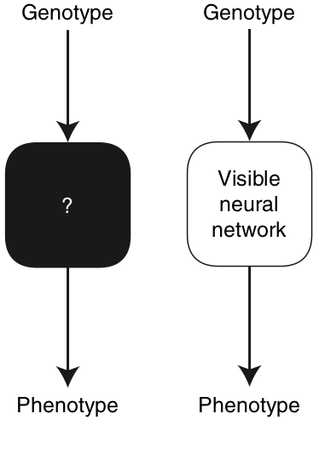
Explainability
Interpretable
Image from: Ma et al. 2018. Using deep learning to model the hierarchical structure and function of a cell. Nature Methods. Ribeiro et al. 2016. “Why Should I Trust You?” Explaining the Predictions of Any Classifier. KDD.

Slide 13
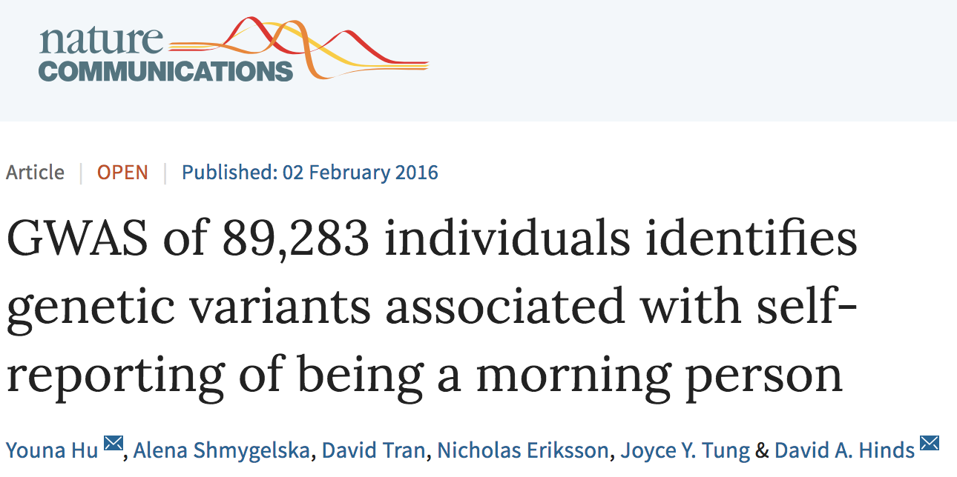
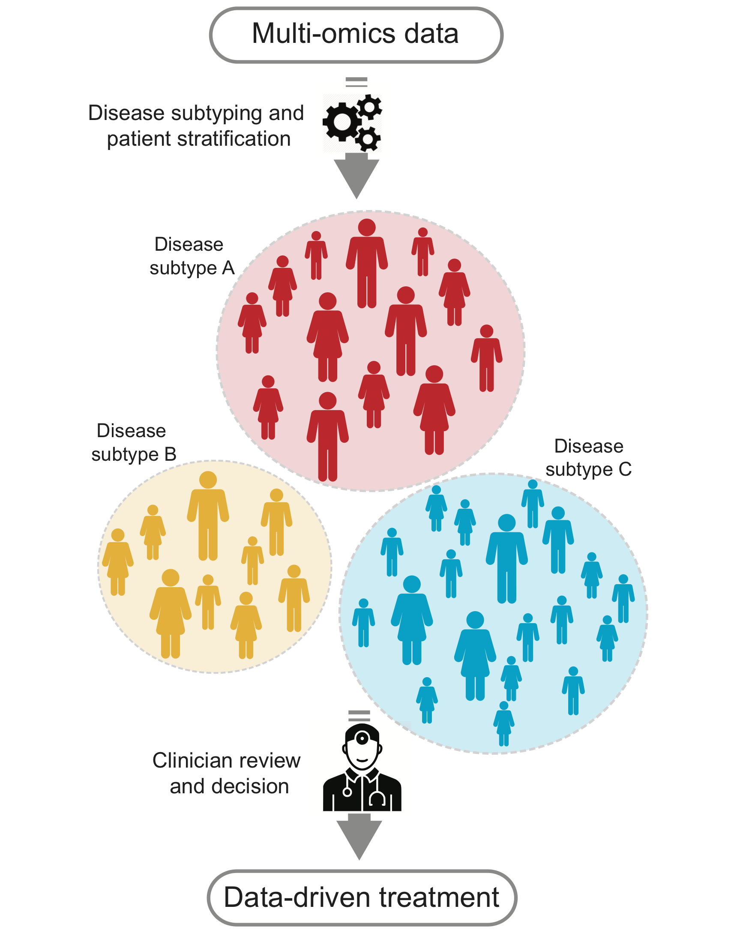
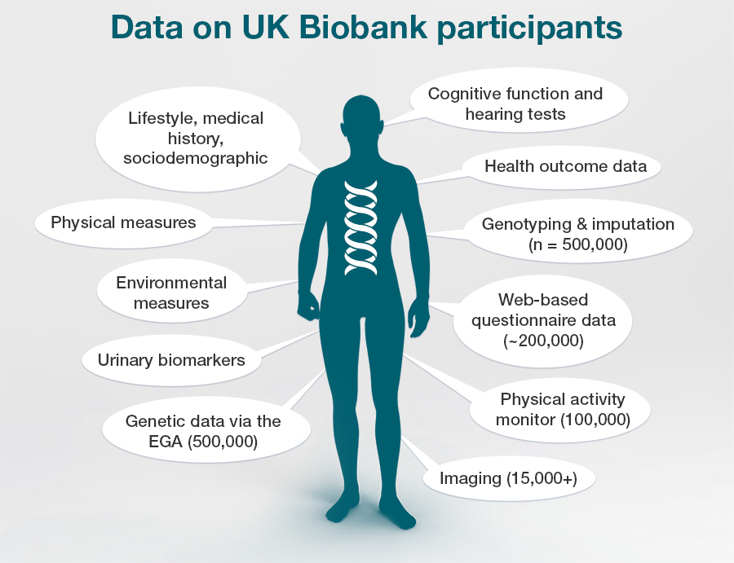
Internet-Based Phenotyping
Self-reported & ecological data
UK Biobank: A prospective cohort of 500 K people to support the investigation of risk factors for major diseases of middle and old age
Image from: Zitnik et al. 2018. Machine Learning for Integrating Data in Biology and Medicine: Principles, Practice, and Opportunities.
.

Slide 14
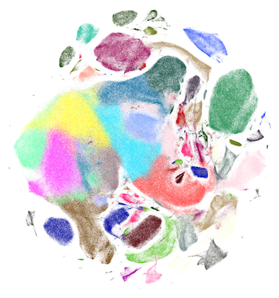
Giga-Scale Network Data
Goal: Handle massive graphs
Challenge: Existing methods do not scale to new high-throughput datasets
Idea: Use graph neural networks with efficient batch optimization and parameter sharing
E.g., The Human Cell Atlas: cell-cell similarity networks
Image from: Wolf et al. 2018. SCANPY: large-scale single-cell gene expression data analysis. Genome Biology.

Slide 15
This Tutorial
1) Node embeddings
Map nodes to low-dimensional embeddings
Applications: PPIs, Disease pathways
2) Graph neural networks
Deep learning approaches for graphs
Applications: Gene functions
3) Heterogeneous networks
Embedding heterogeneous networks
Applications: Human tissues, Drug side effects

Slide 16
Deep Learning for Network Biology
How to Start?

Slide 17
Tutorial Resources
Network analytics tools in SNAP
Deep learning code bases:
End-to-end examples in Tensorflow/PyTorch
Popular code bases for graph neural nets
Easy to adapt and extend for your application
Network data:
snap.stanford.edu/projects.html:
CRank, Decagon, MAMBO, NE, OhmNet, Pathways, and many others

Slide 18
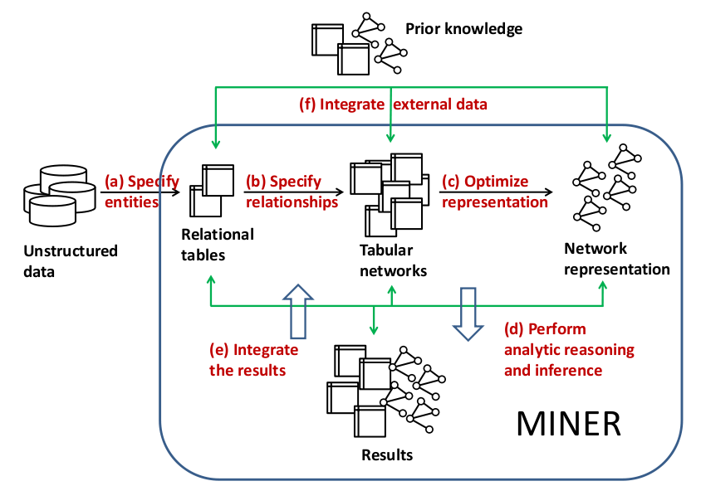
Network Analytics with SNAP
Stanford Network Analysis Platform (SNAP) is our general purpose, high-performance system for analysis and manipulation of large networks
http://snap.stanford.edu
Scales to massive networks with hundreds of millions of nodes and billions of edges
SNAP software: C++, Python
Software requirements: none

Slide 19
BioSNAP: Network Data
Biomedical network dataset collection:
Different types of biomedical networks
Ready to use for:
Algorithm benchmarking
Method development
Knowledge discovery
Easy to link entities across datasets
Dataset | #Items | Raw Size
DisGeNet | 30K | 10MB
STRING | 10M | 1TB
OMIM | 25K | 100MB
CTD | 55K | 1.2GB
HPRD | 30K | 30MB
BioGRID | 64K | 100MB
DrugBank | 7K | 60MB
Disease Ontology | 10K | 5MB
Protein Ontology | 200K | 130MB
Mesh Hierarchy | 30K | 40MB
PubChem | 90M | 1GB
DGIdb | 5K | 30MB
Gene Ontology | 45K | 10MB
MSigDB | 14K | 70MB
Reactome | 20K | 100MB
GEO | 1.7M | 80GB
ICGC (66 cancer projects) | 40M | 1TB
GTEx | 50M | 100GB
Many more…
Total: 250M entities,
2.2TB raw network data

Slide 20
Deep Learning Code Bases
Node2vec:
https://github.com/aditya-grover/node2vec (Python)
https://github.com/snap-stanford/snap/tree/master/examples/node2vec (C++)
Graph Convolutional Networks (GCNs):
https://github.com/tkipf/gcn (Tensorflow)
https://github.com/tkipf/pygcn (PyTorch)
https://github.com/tkipf/keras-gcn (Keras)
GraphSAGE:
https://github.com/williamleif/GraphSAGE (Tensorflow)
https://github.com/williamleif/graphsage-simple (Pytorch)
Metapath2vec and metapath2vec++ (Python):
https://ericdongyx.github.io/metapath2vec/m2v.html
OhmNet (Python):
https://github.com/marinkaz/ohmnet
Decagon (Tensorflow):
https://github.com/marinkaz/decagon

Slide 21
Deep Learning for Network Biology
Next-Generation Machine Learning for Networks in Biology and Medicine

Slide 22
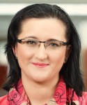
Industry Partnerships
PhD Students
Claire Donnat
Mitchell Gordon
David
Hallac
Emma
Pierson
Geet Sethi
Funding
Himabindu
Lakkaraju
Rex Ying
Tim
Althoff
Will
Hamilton
Alex Porter
Post-Doctoral Fellows
Collaborators
Dan Jurafsky, Linguistics, Stanford University
Christian Danescu-Miculescu-Mizil, Information Science, Cornell University
Stephen Boyd, Electrical Engineering, Stanford University
David Gleich, Computer Science, Purdue University
VS Subrahmanian, Computer Science, University of Maryland
Sarah Kunz, Medicine, Harvard University Russ Altman, Medicine, Stanford University
Jochen Profit, Medicine, Stanford University
Eric Horvitz, Microsoft Research
Jon Kleinberg, Computer Science, Cornell University
Sendhill Mullainathan, Economics, Harvard University
Scott Delp, Bioengineering, Stanford University
Jens Ludwig, Harris Public Policy, University of Chicago
Baharan Mirzasoleiman
Marinka
Zitnik
Michele
Catasta
Srijan
Kumar
Research
Staff
Stephen
Bach
Adrijan Bradaschia
Rok
Sosic

Slide 23
Many interesting high-impact projects in Machine Learning and Large Biomedical Data
Applications: Precision Medicine & Health, Drug Repurposing, Drug Side Effect modeling, Network Biology, and many more

