Slide 1



Deep Learning for Network Biology
Marinka Zitnik and Jure Leskovec
Stanford University

Slide 2

This Tutorial
snap.stanford.edu/deepnetbio-ismb
ISMB 2018
July 6, 2018, 2:00 pm - 6:00 pm

Slide 3
Why networks?
Networks are a general language for describing and modeling complex systems

Slide 5
Network!

Slide 6
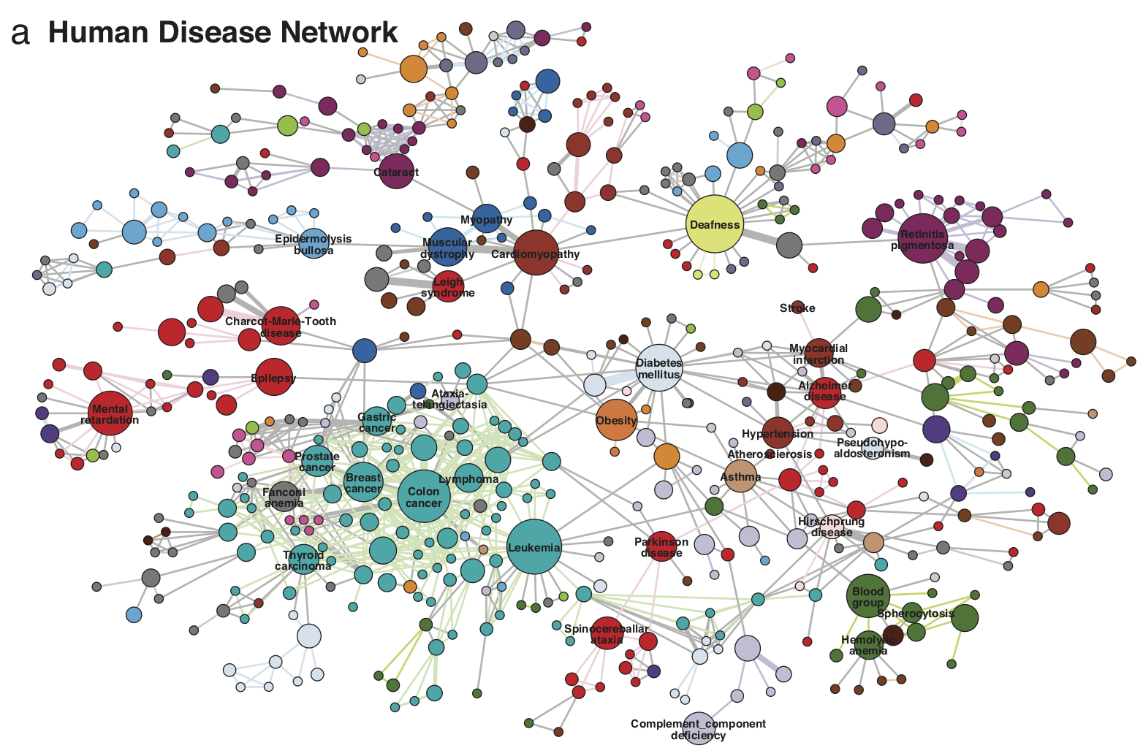
Why Networks? Why Now?
Question: How are human genetic diseases and the corresponding disease genes related to each other?
Findings: Genes associated with similar diseases are likely to interact and have similar expression
Image from: Goh et al. 2007. The human disease network. PNAS.

Slide 7
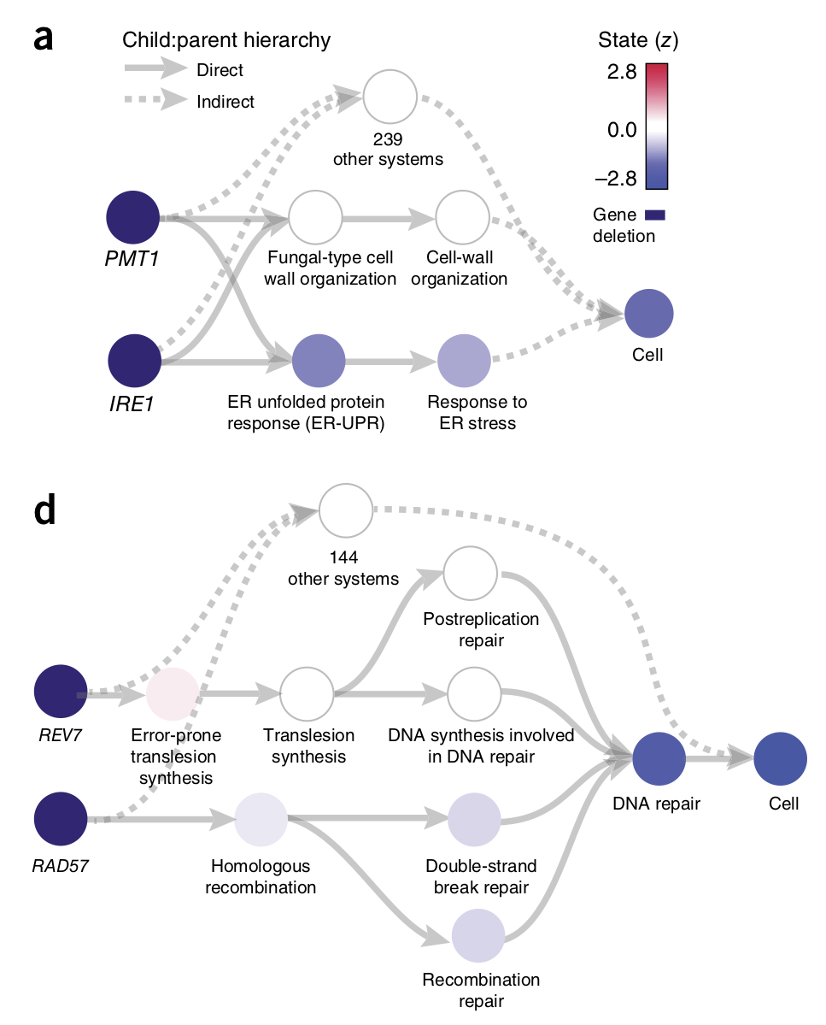
Why Networks? Why Now?
Question: How to simulate a basic eukaryotic cell?
Findings: Simulations reveal molecular mechanisms of cell growth, drug resistance and synthetic life
Image from: Ma et al. 2018. Using deep learning to model the hierarchical structure and function of a cell. Nature Methods.

Slide 8

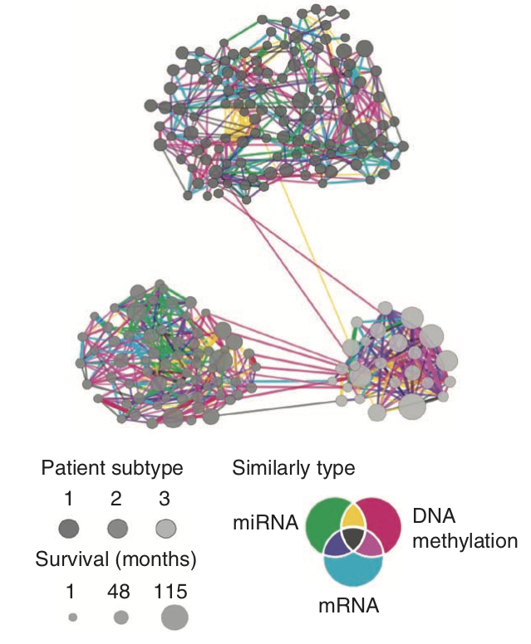
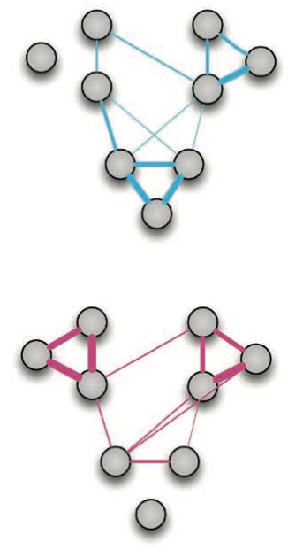
Why Networks? Why Now?
Question: How to discover heterogeneity of cancer?
Findings: Analysis identifies new cancer subtypes with distinct patient survival
Image from: Wang et al. 2014. Similarity network fusion for aggregating data types on a genomic scale. Nature Methods.

Slide 9
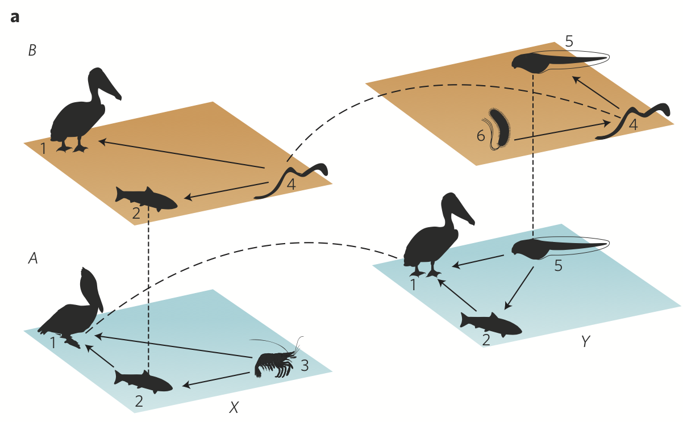
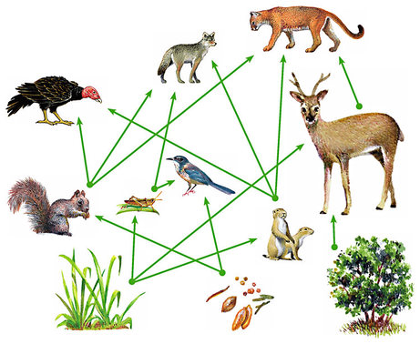
Why Networks? Why Now?
Question: How to study ecological systems?
Findings: Pollinators interact with flowers in one season but not in another, and the same flower species interact with both pollinators and herbivores
Image from: Pilosof et al. 2017. The multilayer nature of ecological networks. Nature Ecology and Evolution.

Slide 10
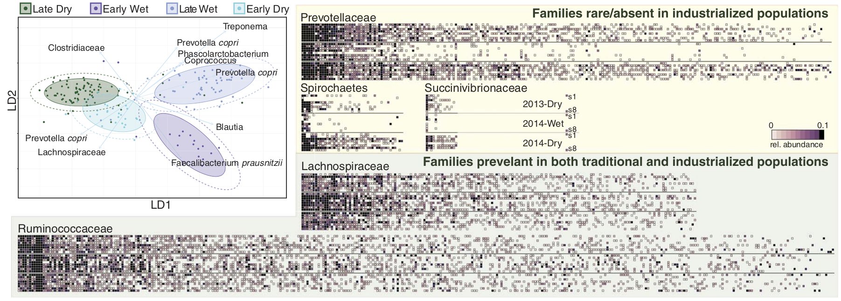
Why Networks? Why Now?
Question: What are features of human microbiome?
Findings: Microbiota reflects the seasonal availability of different types of food and differentiate industrialized and traditional populations
Image from: Smits et al. 2017. Seasonal cycling in the gut microbiome of the Hadza hunter-gatherers of Tanzania. Science.

Slide 11
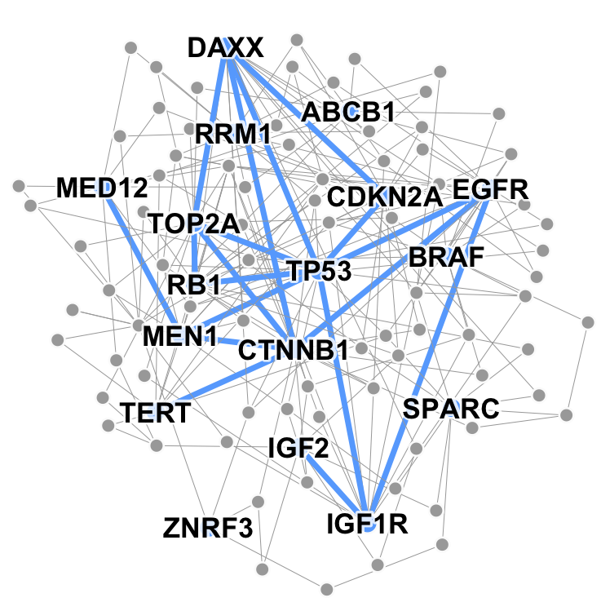
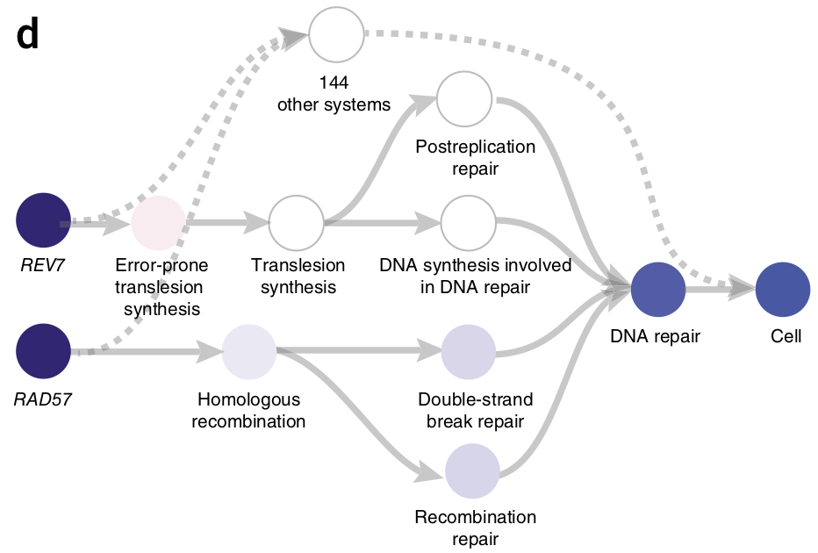
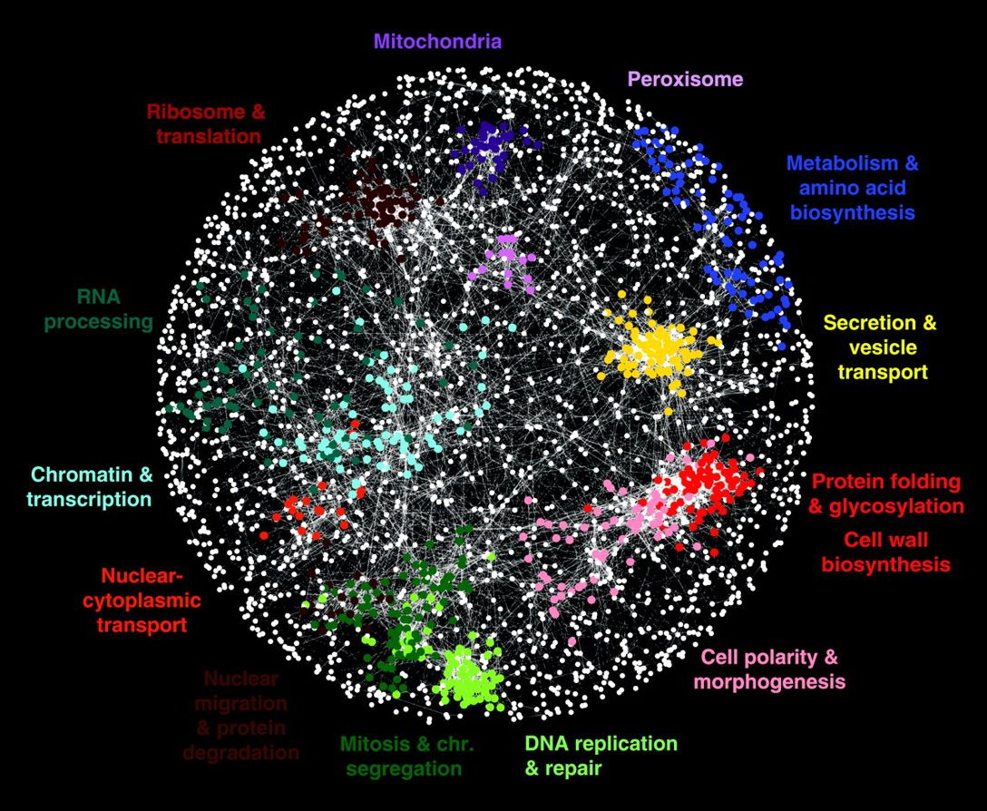
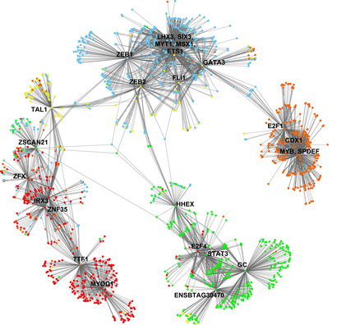
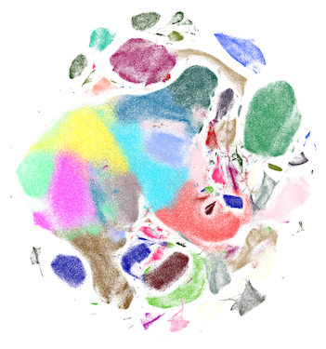
Many Data are Networks
Patient networks
Hierarchies of cell systems
Disease pathways
Genetic interaction
networks
Gene co-expression
networks
Cell-cell similarity networks

Slide 12
Ways to Analyze Networks
Predict a type of a given node
  Node classification
Predict whether two nodes are linked
  Link prediction
Identify densely linked clusters of nodes
  Community detection
  How similar are two nodes/networks
  Network similarity

Slide 13
Example: Node Classification
?
?
?
?
Machine Learning
?

Slide 14
Example: Node Classification
Classifying the function of proteins in the interactome!
Image from: Ganapathiraju et al. 2016. Schizophrenia interactome with 504 novel protein–protein interactions. Nature.

Slide 15
Example: Link Prediction
?
?
x
?
Machine Learning

Slide 16
Example: Link Prediction
Predicting which diseases a new molecule might treat!

Slide 17
Example: Community Detection
?
?
?
?
?
?
?
Machine Learning
?
?

Slide 18
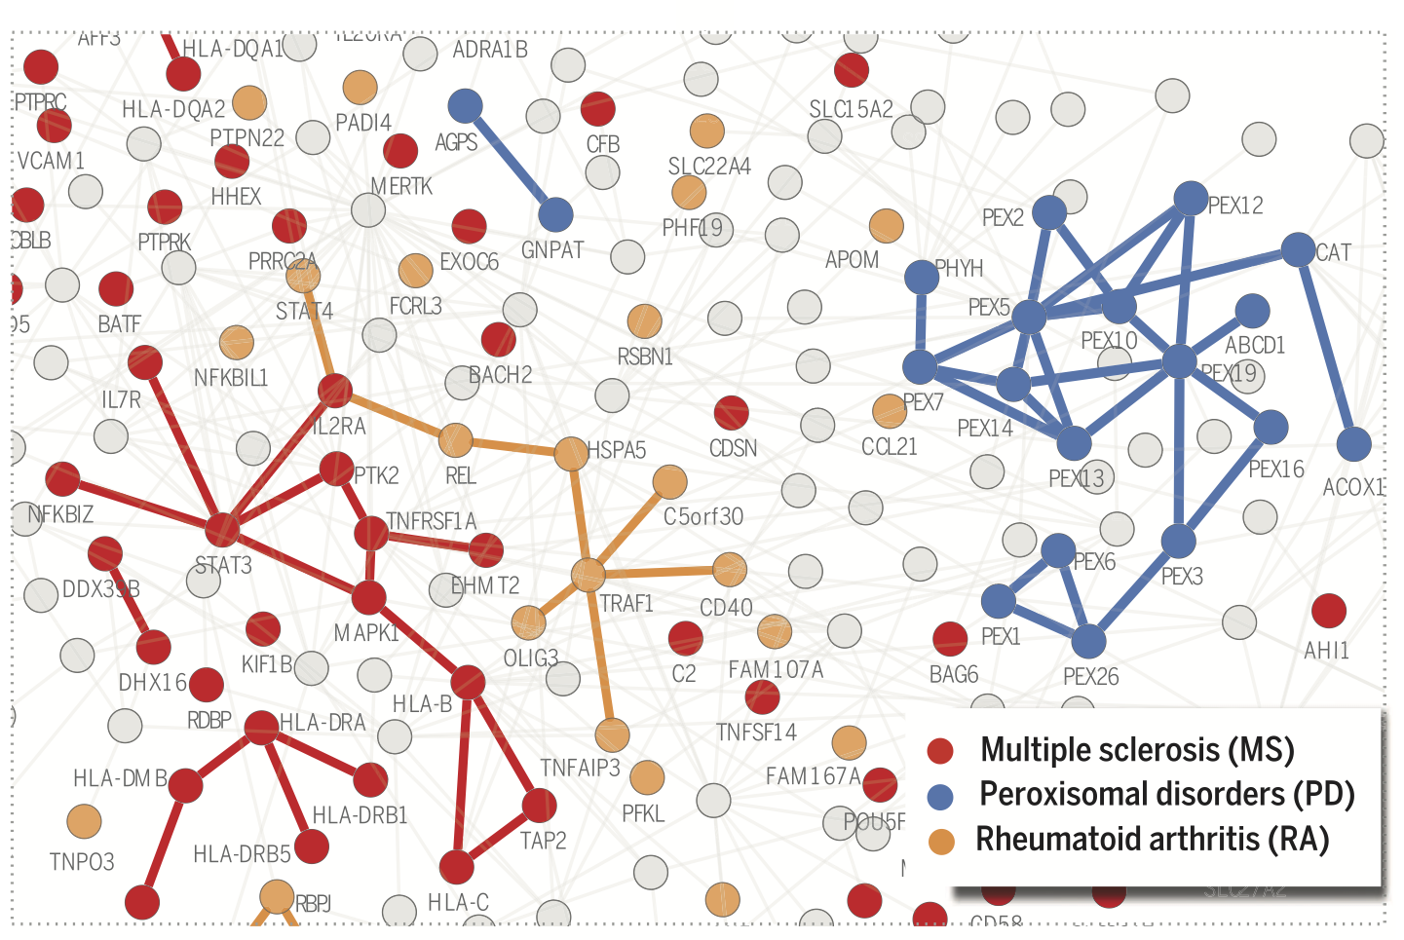
Example: Community Detection
Identifying disease proteins in the interactome!
Image from: Menche et al. 2015. Uncovering disease-disease relationships through the incomplete interactome. Science.

Slide 19
Network Analytics Lifecycle
(Supervised) Machine Learning Lifecycle: This feature, that feature. Every single time!
Raw Data
Structured Data
Learning Algorithm
Model
Feature Engineering
Automatically
learn the features
Downstream
prediction task

Slide 20


Feature Learning in Graphs
Goal: Efficient task-independent feature learning for machine learning
in networks!
node
vec
u
$$f:u→ℝ^{d}$$
$$ℝ^{d}$$
Feature representation, embedding

Slide 21
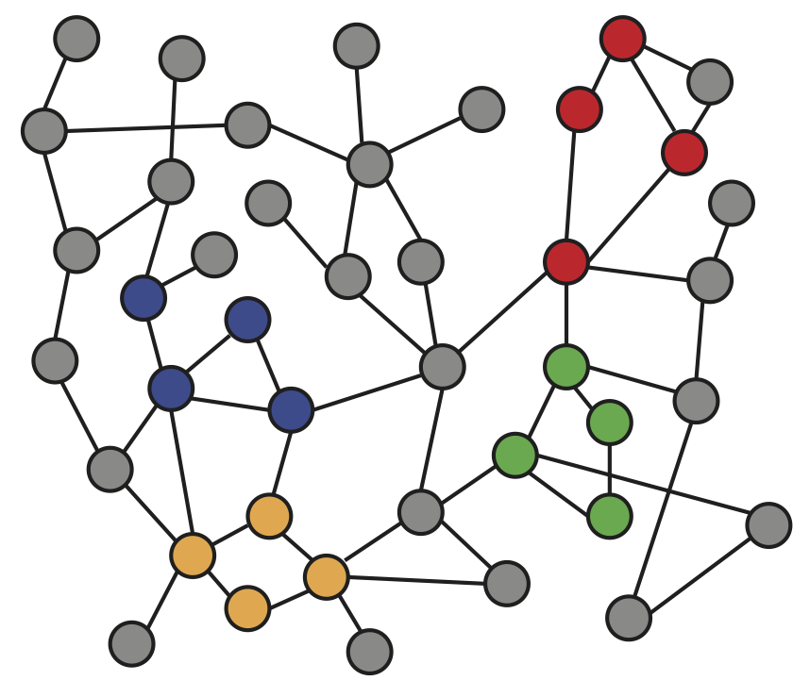
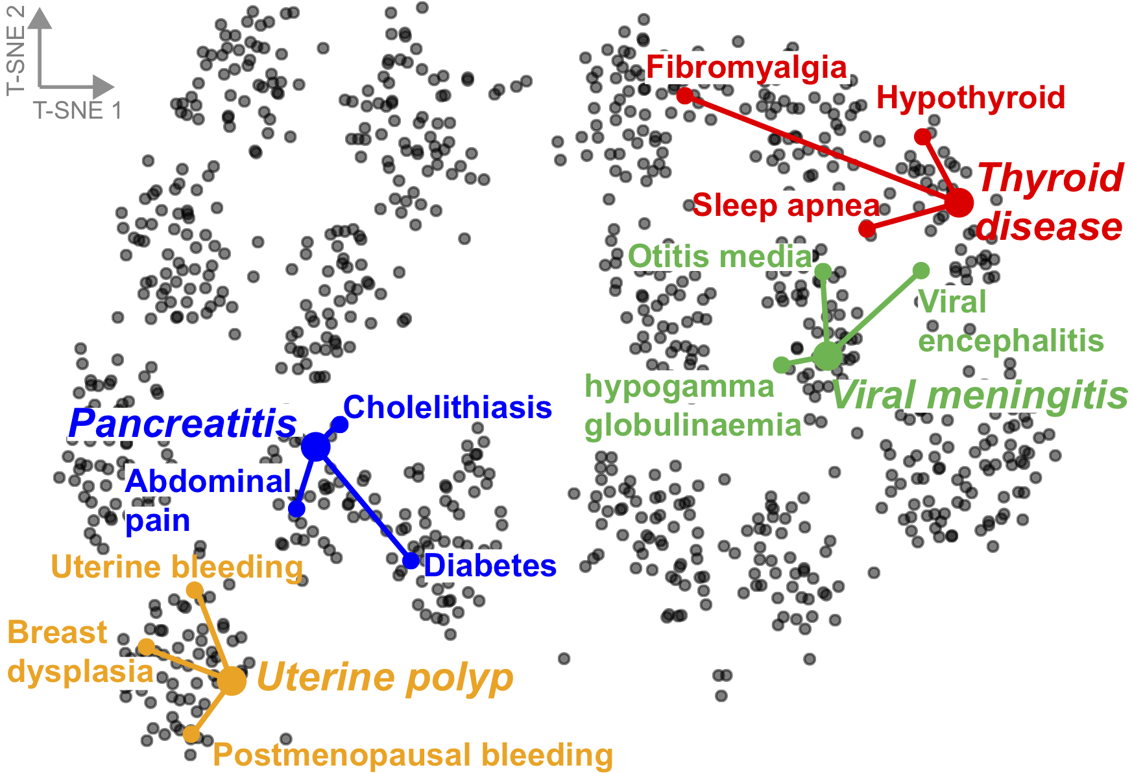
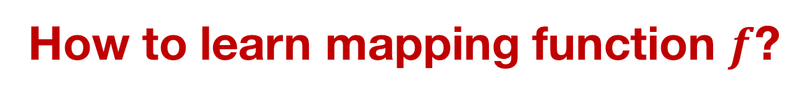
Feature Learning in Graphs
f ( ) =
Disease similarity
network
2-dimensional node
embeddings
Input
Output
How to learn mapping function $f$?

Slide 22
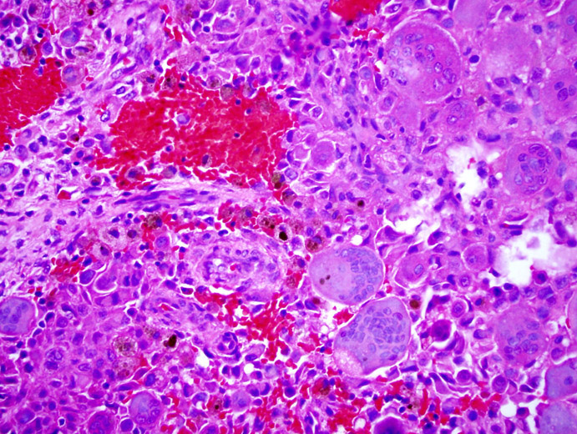
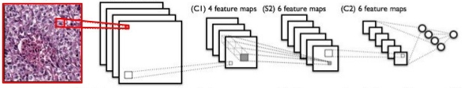
Why Is It Hard?
Modern deep learning toolbox is designed for grids or simple sequences
  Images have 2D grid structure
  Can define convolutions (CNN)

Slide 23
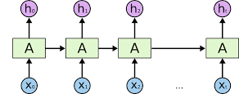
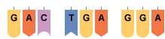
Why Is It Hard?
Modern deep learning toolbox is designed for grids or simple sequences
  Text and sequences have linear 1D structure
  Can define sliding window, RNNs, word2vec, etc.

Slide 24
Why Is It Hard?
But networks are far more complex!
  Arbitrary size and complex topological structure (i.e., no spatial locality like grids)
  No fixed node ordering or reference point
  Often dynamic and have multimodal features
vs.
Text
Networks
Images

Slide 25
This Tutorial
1) Node embeddings
  Map nodes to low-dimensional embeddings
  Applications: PPIs, Disease pathways
2) Graph neural networks
    Deep learning approaches for graphs
    Applications: Gene functions
  3) Heterogeneous networks
    Embedding heterogeneous networks
    Applications: Human tissues, Drug side effects

Slide 26
Tutorial Resources
Network analytics tools in SNAP
Network data:
  snap.stanford.edu/projects.html:
    CRank, Decagon, MAMBO, NE, OhmNet, Pathways, and many others
Deep learning code bases:
    End-to-end examples in Tensorflow/PyTorch
    Popular code bases for graph neural nets
    Easy to adapt and extend for your application

Slide 27
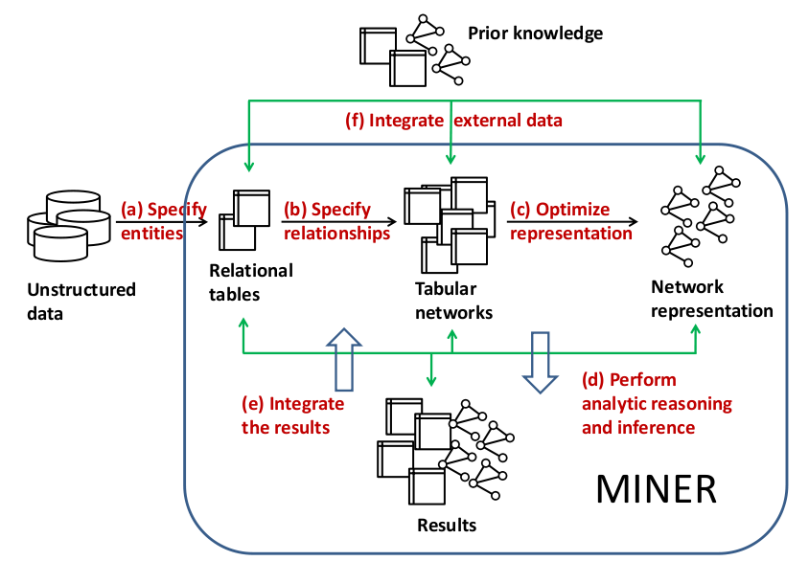
Network Analytics in SNAP
Stanford Network Analysis Platform (SNAP)
is our general purpose, high-performance system for analysis and manipulation of large networks
  http://snap.stanford.edu
  Scales to massive networks with hundreds of millions of nodes and billions of edges
SNAP software: C++, Python
Software requirements: none

Slide 28

BioSNAP: Network Data
Biomedical network dataset collection:
Different types of biomedical networks
Ready to use for:
  Algorithm benchmarking
  Method development
  Knowledge discovery
Easy to link entities across datasets
Dataset | #Items | Raw Size
DisGeNet | 30K | 10MB
STRING | 10M | 1TB
OMIM | 25K | 100MB
CTD | 55K | 1.2GB
HPRD | 30K | 30MB
BioGRID | 64K | 100MB
DrugBank | 7K | 60MB
Disease Ontology | 10K | 5MB
Protein Ontology | 200K | 130MB
Mesh Hierarchy | 30K | 40MB
PubChem | 90M | 1GB
DGIdb | 5K | 30MB
Gene Ontology | 45K | 10MB
MSigDB | 14K | 70MB
Reactome | 20K | 100MB
GEO | 1.7M | 80GB
ICGC (66 cancer projects) | 40M | 1TB
GTEx | 50M | 100GB
Many more…
Total: 250M entities,
2.2TB raw network data

Slide 29
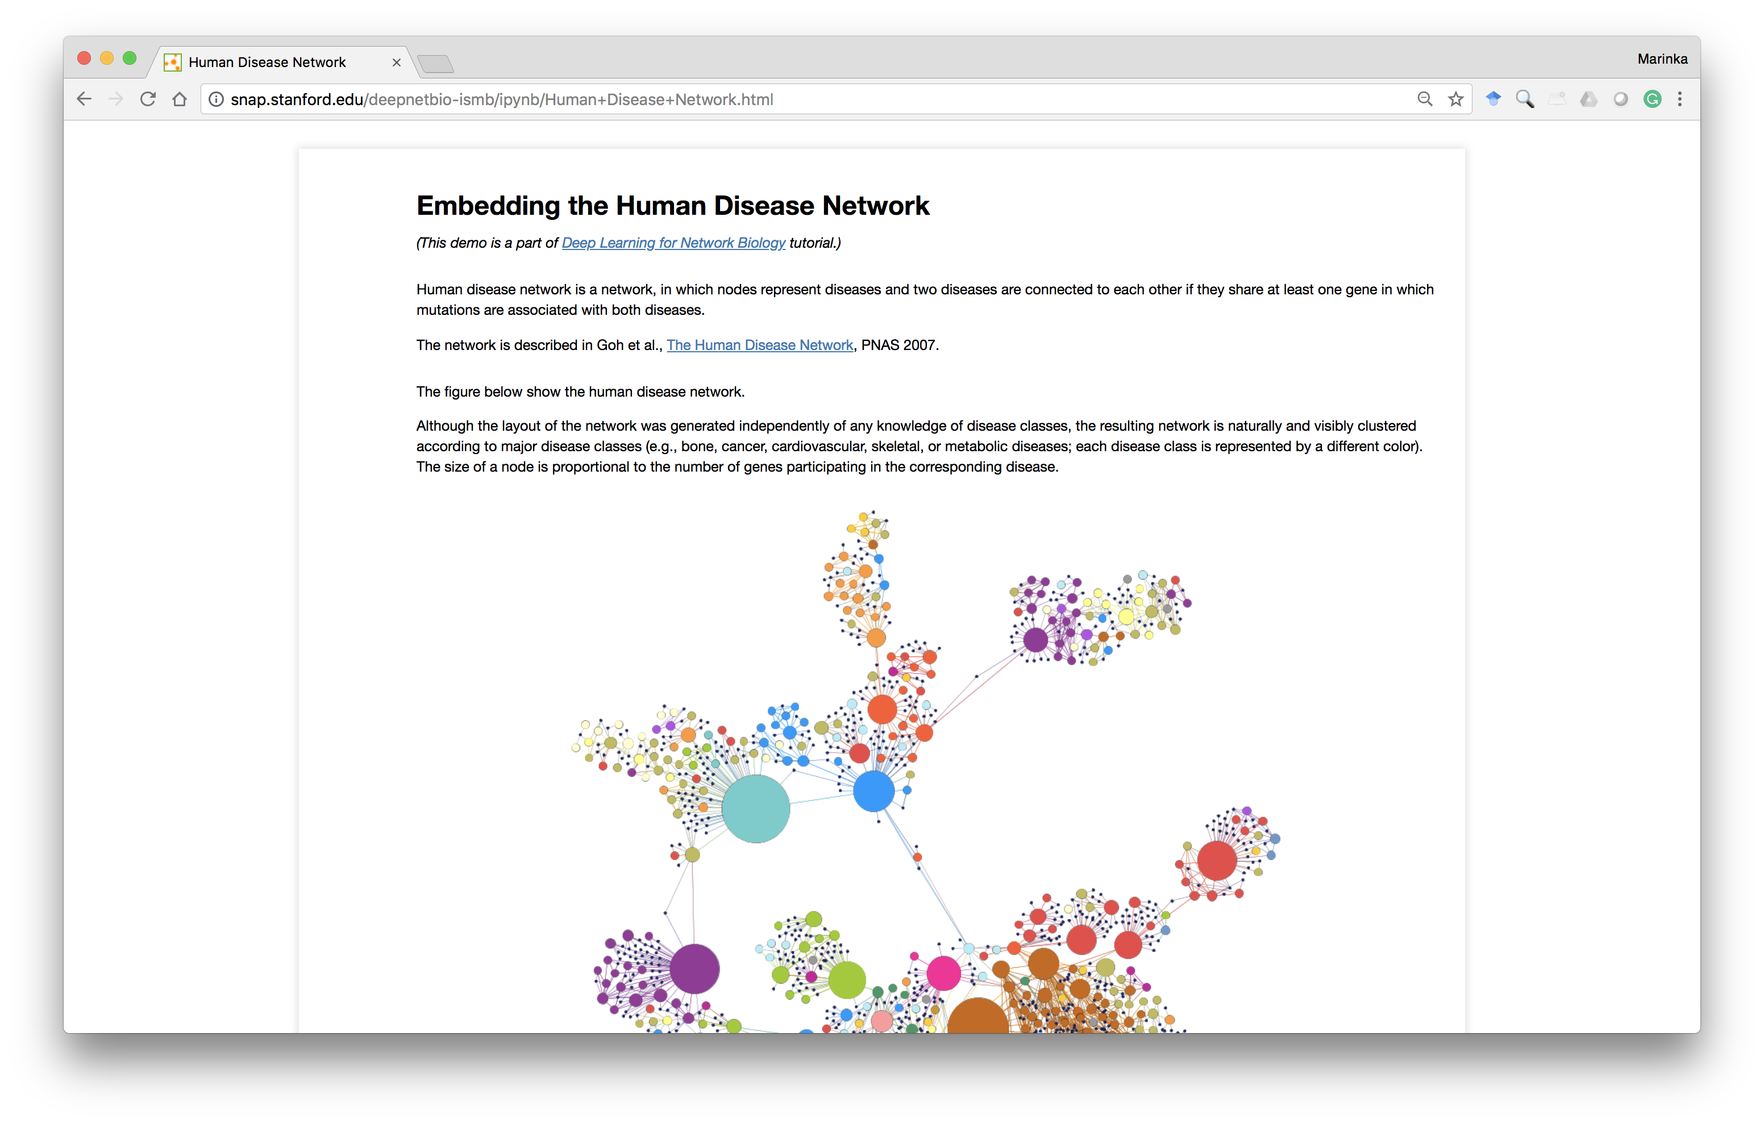
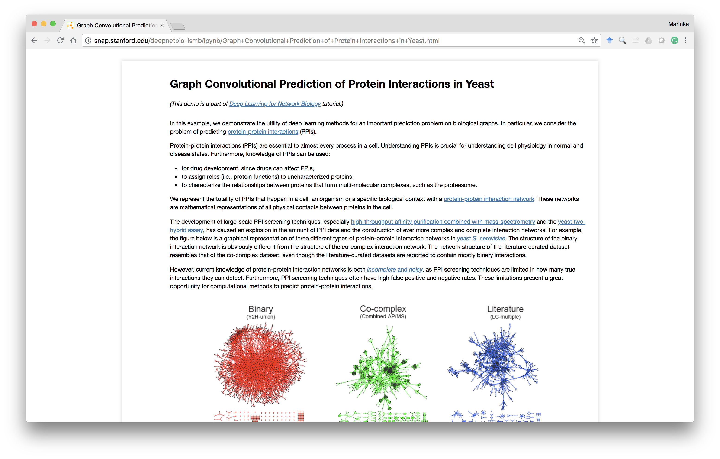
Deep Learning Code Bases
  This tutorial: Using graph neural networks:
    End-to-end examples in Tensorflow/PyTorch
    Popular code bases for graph neural nets
    Easy to adapt and extend for your application

Slide 30






















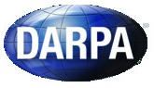










Industry Partnerships
PhD Students
Claire
Donnat
Mitchell
Gordon
David
Hallac
Emma
Pierson
Geet
Sethi
Funding
Himabindu
Lakkaraju
Rex
Ying
Tim
Althoff
Will
Hamilton
Alex
Porter
Post-Doctoral Fellows
Collaborators
Dan Jurafsky, Linguistics, Stanford University
Christian Danescu-Miculescu-Mizil, Information Science, Cornell University
Stephen Boyd, Electrical Engineering, Stanford University
David Gleich, Computer Science, Purdue University
VS Subrahmanian, Computer Science, University of Maryland
Sarah Kunz, Medicine, Harvard University
Russ Altman, Medicine, Stanford University
Jochen Profit, Medicine, Stanford University
Eric Horvitz, Microsoft Research
Jon Kleinberg, Computer Science, Cornell University
Sendhill Mullainathan, Economics, Harvard University
Scott Delp, Bioengineering, Stanford University
Jens Ludwig, Harris Public Policy, University of Chicago
Baharan
Mirzasoleiman
Marinka
Zitnik
Michele
Catasta
Srijan
Kumar
Research
Staff
Stephen
Bach
Adrijan
Bradaschia
Rok
Sosic

Slide 31

Many interesting high-impact projects
in Machine Learning and Large Biomedical Data
Applications: Precision Medicine & Health, Drug Repurposing, Drug Side Effect modeling, Network Biology, and many more

