Slide 1

Theory of
Locality Sensitive Hashing
CS246: Mining Massive Datasets
Jure Leskovec, Stanford University
http://cs246.stanford.edu

Slide 2
Recap: Finding similar documents
Task: Given a large number (N in the millions or billions) of documents, find “near duplicates”
Problem:
  Too many documents to compare all pairs
Solution: Hash documents so that similar documents hash into the same bucket
  Documents in the same bucket are then
  candidate pairs whose similarity is then evaluated

Slide 3
Recap: The Big Picture
Candidate
pairs:
those pairs
of signatures
that we need
to test for
similarity
Shingling
Min-Hash-
ing
Locality-
sensitive
Hashing
Docu-
ment
The set
of strings
of length k
that appear
in the doc-
ument
Signatures:
short integer
vectors that
represent the
sets, and
reflect their
similarity

Slide 4
Recap: 3 Essential Steps
Shingling: Convert docs to sets of items
  Document is a set of k-shingles
Min-Hashing: Convert large sets into short signatures, while preserving similarity
  Want hash func. that Pr[h_{π}(C₁) = h_{π}(C₂)] = sim(C₁, C₂)
    For the Jaccard similarity Min-Hash has this property!
Locality-sensitive hashing: Focus on pairs of signatures likely to be from similar documents
  Split signatures into bands and hash them
  Documents with similar signatures get hashed into same buckets: Candidate pairs

Slide 5
Recap: Shingles
A k-shingle (or k-gram) is a sequence of k tokens that appears in the document
  Example: k=2; D₁ = abcab
  Set of 2-shingles: C₁ = S(D₁) = {ab, bc, ca}
Represent a doc by a set of hash values of its k-shingles
A natural similarity measure is then the Jaccard similarity:
sim(D₁, D₂) = |C₁∩C₂|/|C₁∪C₂|
    Similarity of two documents is the Jaccard similarity of their shingles

Slide 6
Recap: Minhashing
Min-Hashing: Convert large sets into short signatures, while preserving similarity: Pr[h(C₁) = h(C₂)] = sim(D₁, D₂)
Permutation π
Input matrix (Shingles x Documents)
Signature matrix M
2
4
3
4
7
2
6
1
5
1
0
1
0
2
1
2
1
3
2
1
0
0
1
2
1
4
1
7
1
0
1
0
1
1
2
1
2
6
3
0
1
0
1
Similarities of columns and
signatures (approx.) match!
1-3 2-4 1-2 3-4
Col/Col 0.75 0.75 0 0
Sig/Sig 0.67 1.00 0 0
1
6
0
1
0
1
5
7
1
0
1
0
4
5
1
0
1
0

Slide 7
Recap: LSH
Hash columns of the signature matrix M:
Similar columns likely hash to same bucket
  Divide matrix M into b bands of r rows (M=b·r)
  Candidate column pairs are those that hash
  to the same bucket for ≥ 1 band
Buckets
Prob. of sharing
≥ 1 bucket
Threshold s
b bands
r rows
Similarity
Matrix M

Slide 8
Today: Generalizing Min-hash
Signatures: short integer signatures that reflect point similarity
Candidate pairs:
those pairs of signatures that we need to test for similarity
Hash
func.
Locality-
sensitive
Hashing
Points
Design a locality sensitive
hash function (for a given
distance metric)
Apply the
“Bands” technique

Slide 9
The S-Curve
The S-curve is where the “magic” happens
Remember:
Probability of
equal hash-values
= similarity
Threshold s
Probability=1 if t>s
Probability of sharing
≥ 1 bucket
No chance
if t<s
Similarity t of two sets
Similarity t of two sets
This is what 1 hash-code gives you
Pr[h_{π}(C₁) = h_{π}(C₂)] = sim(D₁, D₂)
This is what we want!
How to get a step-function?
By choosing r and b!

Slide 10
How Do We Make the S-curve?
Remember: b bands, r rows/band
Let sim(C₁ , C₂) = s
What’s the prob. that at least 1 band is equal?
Pick some band (r rows)
  Prob. that elements in a single row of
  columns C₁ and C₂ are equal = s
  Prob. that all rows in a band are equal = s^{r}
  Prob. that some row in a band is not equal = 1 - s^{r}
Prob. that all bands are not equal = (1 - s^{r})^{b}
Prob. that at least 1 band is equal = 1 - (1 - s^{r})^{b}
P(C₁, C₂ is a candidate pair) = 1 - (1 - s^{r})^{b}

Slide 11
Picking r and b: The S-curve
Picking r and b to get the best S-curve
  50 hash-functions (r=5, b=10)
Prob. sharing a bucket
Similarity, s

Slide 12
S-curves as a func. of b and r
r = 1..10, b = 1
r = 5, b = 1..50
Given a fixed
threshold s.
We want choose r and b such that the P(Candidate pair) has a “step” right around s.
Prob(Candidate pair)
r = 10, b = 1..50
Prob(Candidate pair)
r = 1, b = 1..10
Similarity
Similarity
prob = 1 - (1 - t ^{r})^{b}

Slide 13
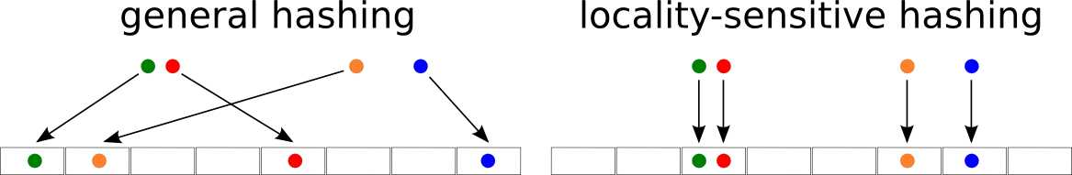
Theory of LSH
Candidate
pairs:
those pairs
of signatures
that we need
to test for
similarity
Min-Hash-
ing
Locality-
sensitive
Hashing
Signatures:
short vectors
that represent
the sets, and
reflect their
similarity

Slide 14
Theory of LSH
We have used LSH to find similar documents
  More generally, we found similar columns in large sparse matrices with high Jaccard similarity
Can we use LSH for other distance measures?
  e.g., Euclidean distances, Cosine distance
  Let’s generalize what we’ve learned!

Slide 15
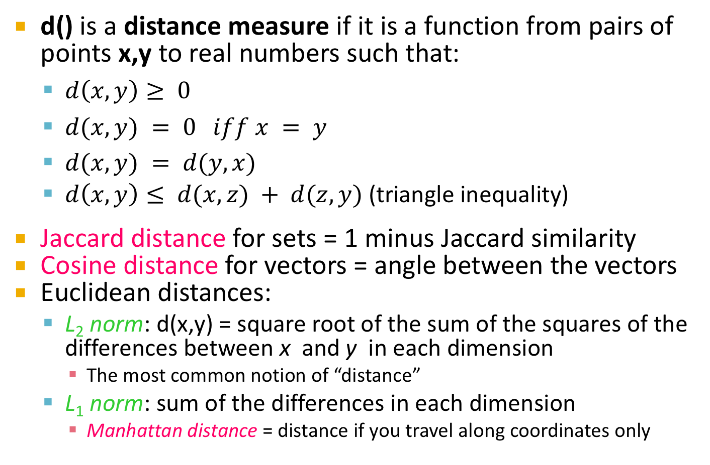
Distance Measures
d() is a distance measure if it is a function from pairs of points x,y to real numbers such that:
  $d\left(x,y\right)≥ 0$
  $d(x,y) = 0 iff x = y$
  $d(x,y) = d(y,x)$
  $d\left(x,y\right)≤ d(x,z) + d(z,y)$ (triangle inequality)
Jaccard distance for sets = 1 minus Jaccard similarity
Cosine distance for vectors = angle between the vectors
Euclidean distances:
  L₂ norm: d(x,y) = square root of the sum of the squares of the differences between x and y in each dimension
    The most common notion of “distance”
  L₁ norm: sum of the differences in each dimension
    Manhattan distance = distance if you travel along coordinates only

Slide 16
Why is J.D. a Distance Measure
d(x,y) > 0 because |x∩y| < |x∪y|
  Thus, similarity < 1 and distance = 1 – similarity > 0
d(x,x) = 0 because x∩x = x∪x.
And if x ≠ y, then |x∩y| is strictly less than |x∪y|, so sim(x,y) < 1; thus d(x,y) > 0
d(x,y) = d(y,x) because union and intersection are symmetric
d(x,y) < d(x,z) + d(z,y) trickier:
1 - |x ∩z| + 1 - |y ∩z| > 1 -|x ∩y|
|x ∪z| |y ∪z| |x ∪y|

Slide 17
Triangle Inequality for J.D.
d(x,z)
d(z,y)
d(x,y)
1 - |x ∩z| + 1 - |y ∩z| > 1 -|x ∩y|
|x ∪z| |y ∪z| |x ∪y|
Remember: |a ∩b|/|a ∪b| = probability that minhash(a) = minhash(b).
Thus, 1 - |a ∩b|/|a ∪b| = probability that minhash(a) ≠ minhash(b).
Need to show: prob[minhash(x) ≠ minhash(y)] < prob[minhash(x) ≠ minhash(z)] + prob[minhash(z) ≠ minhash(y)]
Notes:
Here’s the inequality that says the Jaccard distance from x to z plus the Jaccard distance from z to y is equal to or greater than the Jaccard distance from x to y. That is, this (POINT) is the Jaccard similarity of x and z – the size of their intersection divided by the size of their union. So this is the Jaccard distance from x to z (POINT). Similarly, this (POINT) is the Jaccard distance from z to y (POINT), and this is the Jaccard distance from x to y.
Click 1
Remember that we proved the Jaccard similarity between sets “a” and b (POINT) is the probability that the minhash values of “a” and b are the same.
Click 2
Or put another way, this (POINT) is the probability that minhash of “a” and b are different.

Slide 18
Proof: Triangle Inequality for J.D.
Whenever minhash(x) ≠ minhash(y), at least one of minhash(x) ≠ minhash(z) and minhash(z) ≠ minhash(y) must be true:
minhash(x) ≠ minhash(y
minhash(x) ≠ minhash(z)
minhash(z) ≠ minhash(y)
Notes:
But the probability that minhash of x and y differ cannot be greater than the probability that the minhash of x and z differ plus the probability that minhash of y and z differ. By what we saw on the previous slide, this claim is equivalent to the triangle inequality.
Click 1
The reason is that whenever minhash of x and y are different, it is impossible for both minhash of x to equal minhash of z, and for minhash of z to equal minhash of y. Because then, by transitivity of “equals,” minhash of x would equal minhash of y.
Click 2
In terms of Venn diagrams, let the plane represent triples of sets x, y, and z. Here are those triples where the minhash values of x and z differ.
Click 3
And here are the triples where the minhashes of y and z differ.
Click 4
And contained within their union is the set of triples where x and y have different minhash values.

Slide 19
Families of Hash Functions
For Min-Hashing signatures, we got a Min-Hash function for each permutation of rows
A “hash function” is any function that allows us to say whether two elements are “equal”
    Shorthand: h(x) = h(y) means “h says x and y are equal”
A family of hash functions is any set of hash functions from which we can pick one at random efficiently
  Example: The set of Min-Hash functions generated from permutations of rows

Slide 20
Locality-Sensitive (LS) Families
Suppose we have a space S of points with
a distance measure d(x,y)
A family H of hash functions is said to be
(d₁, d₂, p₁, p₂)-sensitive if for any x and y in S:
  If d(x, y) < d₁, then the probability over all h∈ H,
  that h(x) = h(y) is at least p₁
  If d(x, y) > d₂, then the probability over all h∈ H,
  that h(x) = h(y) is at most p₂
Critical assumption
  With a LS Family we can do LSH!

Slide 21
A (d₁,d₂,p₁,p₂)-sensitive function
Small distance,
high probability
Distance
threshold t
p₁
Pr[h(x) = h(y)]
p₂
Large distance,
low probability
of hashing to
the same value
d₁
d₂
Distance d(x,y)
Notes:
Here’s a picture of what we know about the probability of h(x) equaling h(y). For distances d1 and below, we know the probability is at least p1, and for distances d2 and above, we know the probability is at most p2. Between distances d1 and d2, we know nothing. However, we shall try to make the difference between d1 and d2 very small, and the distance between p1 and p2 as large as we can. That will give us the S-curve we want, although since we are now talking about distances rather than similarities, the S-curve is backwards. It drops down precipitously between the distances d1 and d2, rather than rising precipitously (DRAW in BLUE).

Slide 22
Example of LS Family: Min-Hash
Let:
  S = space of all sets,
  d = Jaccard distance,
  H is family of Min-Hash functions for all permutations of rows
Then for any hash function h∈ H:
Pr[h(x) = h(y)] = 1 - d(x, y)
  Simply restates theorem about Min-Hashing
  in terms of distances rather than similarities

Slide 23
Example: LS Family – (2)
Claim: Min-hash H is a (1/3, 2/3, 2/3, 1/3)-sensitive family for S and d.
For Jaccard similarity, Min-Hashing gives a (d₁,d₂,(1-d₁),(1-d₂))-sensitive family for any d₁<d₂
Then probability
that Min-Hash values
agree is > 2/3
If distance < 1/3
(so similarity ≥ 2/3)

Slide 24
Amplifying a LS-Family
Can we reproduce the
“S-curve” effect we saw
before for any LS family?
The “bands” technique we learned for signature matrices carries over to this more general setting
Can do LSH with any (d₁, d₂, p₁, p₂)-sensitive family!
Two constructions:
  AND construction like “rows in a band”
  OR construction like “many bands”
Prob. of sharing
a bucket
Similarity t

Slide 25
Amplifying Hash Functions:
AND and OR

Slide 26
AND of Hash Functions
Given family H, construct family H’ consisting of r functions from H
For h = [h₁,…,h_{r}] in H’, we say
h(x) = h(y) if and only if h_{i}(x) = h_{i}(y) for all i
  Note this corresponds to creating a band of size r
Theorem: If H is (d₁, d₂, p₁, p₂)-sensitive,
then H’ is (d₁,d₂, (p₁)^{r}, (p₂)^{r})-sensitive
Proof: Use the fact that h_{i} ’s are independent
1 ≤ i ≤ r
Also lowers probability
for small distances (Bad)
Lowers probability for
large distances (Good)

Slide 27
Subtlety Regarding Independence
Independence of hash functions (HFs) really means that the prob. of two HFs saying “yes” is the product of each saying “yes”
  But two particular hash functions could be highly correlated
    For example, in Min-Hash if their permutations agree in the first one million entries
  However, the probabilities in definition of a
  LSH-family are over all possible members of H, H’ (i.e., average case and not the worst case)

Slide 28
OR of Hash Functions
Given family H, construct family H’ consisting
of b functions from H
For h = [h₁,…,h_{b}] in H’,
h(x) = h(y) if and only if h_{i}(x) = h_{i}(y) for at least 1 i
Theorem: If H is (d₁, d₂, p₁, p₂)-sensitive,
then H’ is (d₁, d₂, 1-(1-p₁)^{b}, 1-(1-p₂)^{b})-sensitive
Proof: Use the fact that h_{i}’s are independent
Raises probability for
small distances (Good)
Raises probability for
large distances (Bad)

Slide 29
Effect of AND and OR Constructions
AND makes all probs. shrink, but by choosing r correctly, we can make the lower prob. approach 0 while the higher does not
OR makes all probs. grow, but by choosing b correctly, we can make the upper prob. approach 1 while the lower does not
AND
r=1..10, b=1
Prob. sharing a bucket
Prob. sharing a bucket
OR
r=1, b=1..10
Similarity of a pair of items
Similarity of a pair of items

Slide 30
Combine AND and OR Constructions
By choosing b and r correctly, we can make the lower probability approach 0 while the higher approaches 1
As for the signature matrix, we can use the AND construction followed by the OR construction
  Or vice-versa
  Or any sequence of AND’s and OR’s alternating
Notes:
Here’s a summary of what happens when we apply the AND and OR constructions.
Click 1
AND makes both the high and low probabilities shrink, because we are taking two probabilities, which are less than 1, and raising them to the r-th power. What we need to do is pick r big enough that the low probability becomes close to 0, yet pick r small enough that the high probability stays significantly above 0. It’s a balancing act, but we’ll see in a moment how it works in practice.
Click 2
The analogous story applies to the OR construction. Both probabilities grow, but we contrive to select a value of b that makes the high probability get very close to 1, while still keeping the low probability significantly away from 1.

Slide 31
Composing Constructions
r-way AND followed by b-way OR construction
  Exactly what we did with Min-Hashing
    AND: If bands match in all r values hash to same bucket
    OR: Cols that have ≥ 1 common bucket → Candidate
Take points x and y s.t. Pr[h(x) = h(y)] = s
  H will make (x,y) a candidate pair with prob. s
Construction makes (x,y) a candidate pair with probability 1-(1-s^{r})^{b} The S-Curve!
  Example: Take H and construct H’ by the AND construction with r = 4. Then, from H’, construct H’’ by the OR construction with b = 4

Slide 32
Table for Function 1-(1-s⁴)⁴
s | p=1-(1-s⁴)⁴
.2 | .0064
.3 | .0320
.4 | .0985
.5 | .2275
.6 | .4260
.7 | .6666
.8 | .8785
.9 | .9860
r = 4, b = 4 transforms a (.2,.8,.8,.2)-sensitive family into a (.2,.8,.8785,.0064)-sensitive family.

Slide 33
How to choose r and b

Slide 34
Picking r and b: The S-curve
Picking r and b to get desired performance
  50 hash-functions (r = 5, b = 10)
Blue area X: False Negative rate
These are pairs with sim > s but the X fraction won’t share a band and then will never become candidates. This means we will never consider these pairs for (slow/exact) similarity calculation!
Green area Y: False Positive rate
These are pairs with sim < s but
we will consider them as candidates. This is not too bad, we will consider them for (slow/exact) similarity computation and discard them.
Threshold s
Prob(Candidate pair)
Similarity s

Slide 35
Picking r and b: The S-curve
Picking r and b to get desired performance
  50 hash-functions (r * b = 50)
r=2, b=25
r=5, b=10
r=10, b=5
Threshold s
Prob(Candidate pair)
Similarity s

Slide 36
OR-AND Composition
Apply a b-way OR construction followed by
an r-way AND construction
Transforms similarity s (probability p)
into (1-(1-s)^{b})^{r}
  The same S-curve, mirrored horizontally and vertically
Example: Take H and construct H’ by the OR construction with b = 4. Then, from H’, construct H’’ by the AND construction
with r = 4

Slide 37
Table for Function (1-(1-s)⁴)⁴
s | p=(1-(1-s)⁴)⁴
.1 | .0140
.2 | .1215
.3 | .3334
.4 | .5740
.5 | .7725
.6 | .9015
.7 | .9680
.8 | .9936
Prob(Candidate pair)
Similarity s
The example transforms a (.2,.8,.8,.2)-sensitive family into a (.2,.8,.9936,.1215)-sensitive family

Slide 38
Cascading Constructions
Example: Apply the (4,4) OR-AND construction followed by the (4,4) AND-OR construction
Transforms a (.2, .8, .8, .2)-sensitive family into a (.2, .8, .9999996, .0008715)-sensitive family
  Note this family uses 256 (=4*4*4*4) of the
  original hash functions

Slide 39
General Use of S-Curves
For each AND-OR S-curve 1-(1-s^{r})^{b}, there is a threshold t, for which 1-(1-t^{r})^{b} = t
Above t, high probabilities are increased; below t, low probabilities are decreased
You improve the sensitivity as long as the low probability is less than t, and the high probability is greater than t
  Iterate as you like.
Similar observation for the OR-AND type of S-curve: (1-(1-s)^{b})^{r}
Notes:
What I’d like to do now is explain how to select the values of r and b for AND and OR constructions.
Click 1
Let’s look at the function that we have called the S-curve (POINT). This is a function of the probability p, and it has two parameters r and b. An interesting observation is that this curve (DRAW an S-curve to the right) has a fixed point t, such that if p=t, then the result of applying the function to t is t itself. To see that t exists, look at where the curve intersects the line with slope 1 through the origin (DRAW). Where they intersect is the point (t,t) (POINT).
Click 2
Above probability t, applying the S-curve function increases the probability, while below t, the probability decreases.
Click 3
We can conclude that, as long as the two probabilities are on opposite sides of t, the construction where you do an r-way AND followed by a b-way OR will move both probabilities in the direction we want them to go. We can then iterate this construction as many times as we like, and both probabilities will keep improving.
There is an analogous observation about a construction where we do a OR followed by AND. The S-curve formula is a little different, but the ideas are quite the same.

Slide 40
Visualization of Threshold
Probability
Is raised
Threshold
t
Prob(Candidate pair)
Probability
Is lowered
s
t
Notes:
Here’s a picture suggesting what happens for the S-curves that we get for both the AND-OR and the OR-AND constructions.
Click 1
The threshold t is defined by the place where the S-curve and the straight line cross.
Click 2
For probabilities p below t, applying the S-curve function lowers the probability.
Click 3
While for probabilities above t, the S-curve sends p to a higher probability.

Slide 41
Summary
Pick any two distances d₁ < d₂
Start with a (d₁, d₂, (1- d₁), (1- d₂))-sensitive family
Apply constructions to amplify
(d₁, d₂, p₁, p₂)-sensitive family,
where p₁ is almost 1 and p₂ is almost 0
The closer to 0 and 1 we get, the more
hash functions must be used!

Slide 42
LSH for other distance metrics

Slide 43
LSH for other Distance Metrics
LSH methods for other distance metrics:
  Cosine distance: Random hyperplanes
  Euclidean distance: Project on lines
Signatures: short integer signatures that reflect their similarity
Candidate pairs:
those pairs of signatures that we need to test for similarity
Hash
func.
Locality-
sensitive
Hashing
Points
Design a (d₁, d₂, p₁, p₂)-sensitive family of hash functions (for that particular distance metric)
Amplify the family using AND and OR constructions
Depends on the distance function used

Slide 44
Summary of what we will learn
Signatures: short integer signatures that reflect their similarity
Candidate pairs:
those pairs of signatures that we need to test for similarity
Hash
func.
Locality-
sensitive
Hashing
Data
0 | 1 | 0 | 0
1 | 1 | 1 | 0
0 | 0 | 0 | 1
0 | 1 | 0 | 1
0 | 0 | 1 | 0
1 | 0 | 0 | 1
Documents
MinHash
1 | 5 | 1 | 5
2 | 3 | 1 | 3
6 | 4 | 6 | 4
“Bands” technique
Candidate pairs
0 | 1 | 0 | 0
1 | 1 | 1 | 0
0 | 0 | 0 | 1
0 | 1 | 0 | 1
0 | 0 | 1 | 0
1 | 0 | 0 | 1
Random
Hyperplanes
Data points
-1 | +1 | -1 | -1
+1 | +1 | +1 | -1
-1 | -1 | -1 | -1
“Bands” technique
Candidate pairs

Slide 45
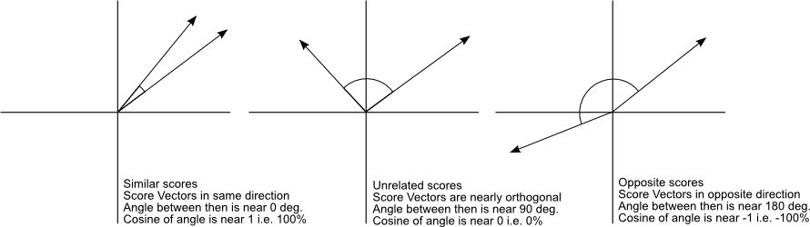
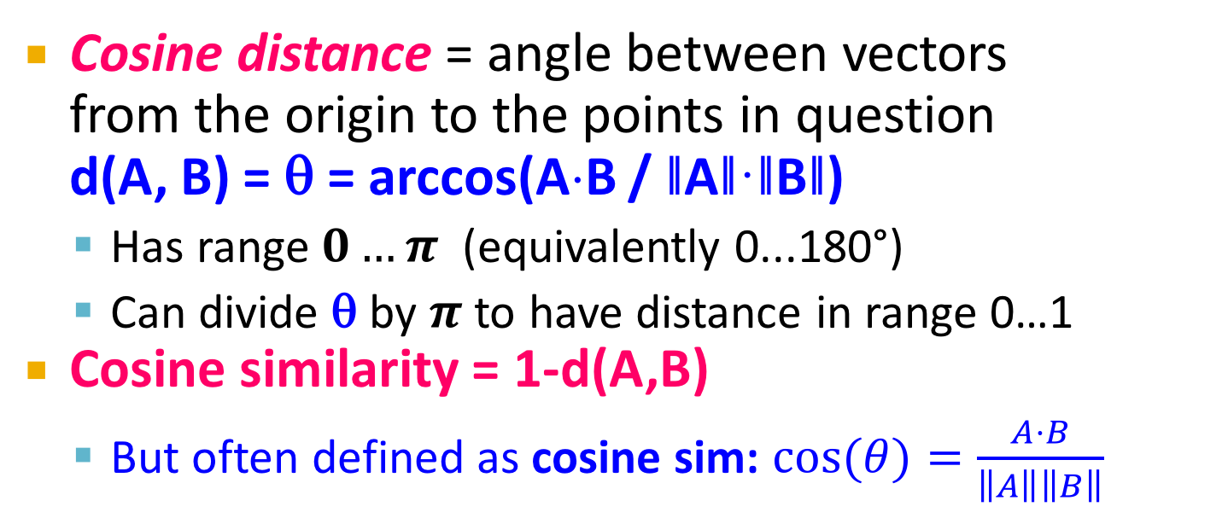
Cosine Distance
A
Cosine distance = angle between vectors
from the origin to the points in question
d(A, B) = θ = arccos(A⋅B / ǁAǁ·ǁBǁ)
  Has range$0…π$ (equivalently 0...180°)
  Can divide θ by $π$ to have distance in range 0…1
Cosine similarity = 1-d(A,B)
  But often defined as cosine sim: $cos(θ)=\frac{A⋅B}{\left\|A\right\|\left\|B\right\|}$
B
A⋅B
‖B‖
- Has range -1…1 for
general vectors
- Range 0..1 for
non-negative vectors
(angles up to 90°)

Slide 46
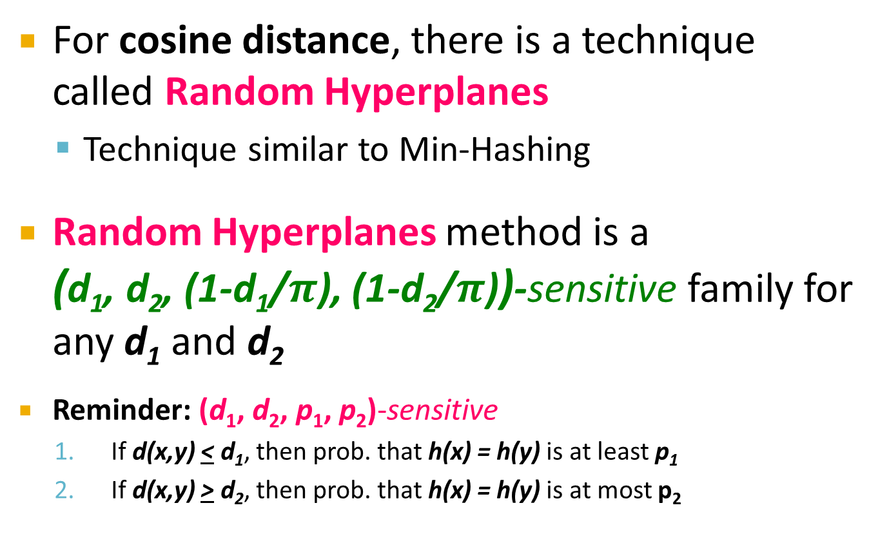
LSH for Cosine Distance
For cosine distance, there is a technique called Random Hyperplanes
  Technique similar to Min-Hashing
Random Hyperplanes method is a
(d₁, d₂, (1-d₁/$π$), (1-d₂/$π$))-sensitive family for any d₁ and d₂
Reminder: (d₁, d₂, p₁, p₂)-sensitive
  If d(x,y) < d₁, then prob. that h(x) = h(y) is at least p₁
  If d(x,y) > d₂, then prob. that h(x) = h(y) is at most p₂

Slide 47
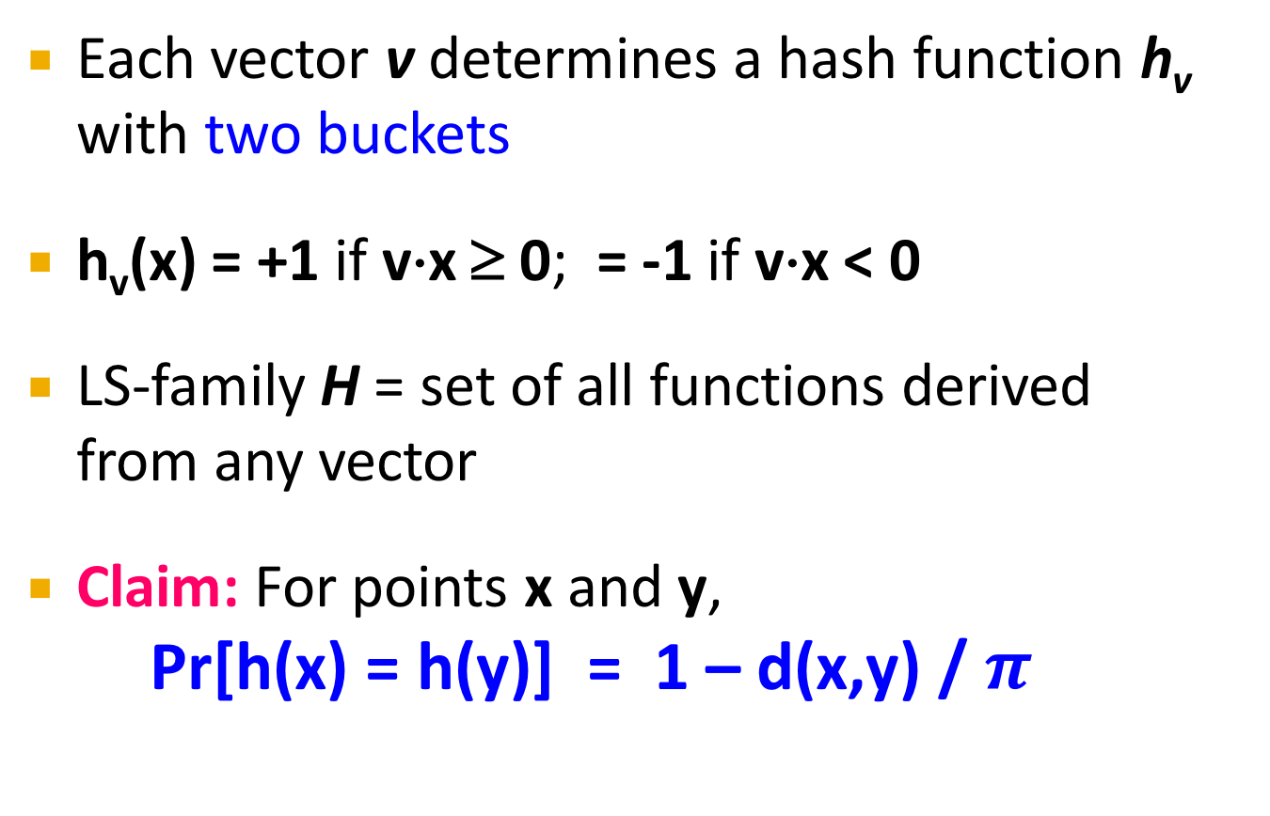
Random Hyperplanes
Each vector v determines a hash function h_{v} with two buckets
h_{v}(x) = +1 if v⋅x ≥ 0; = -1 if v⋅x < 0
LS-family H = set of all functions derived
from any vector
Claim: For points x and y,
Pr[h(x) = h(y)] = 1 – d(x,y) / $π$

Slide 48
Proof of Claim
Look in the
plane of x
and y.
v’
x
v
Hyperplane
normal to v’.
Here h(x) ≠ h(y)
θ
Hyperplane
normal to v.
Here h(x) = h(y)
y
Note: what is important is that
hyperplane is outside the angle,
not that the vector is inside.

Slide 49
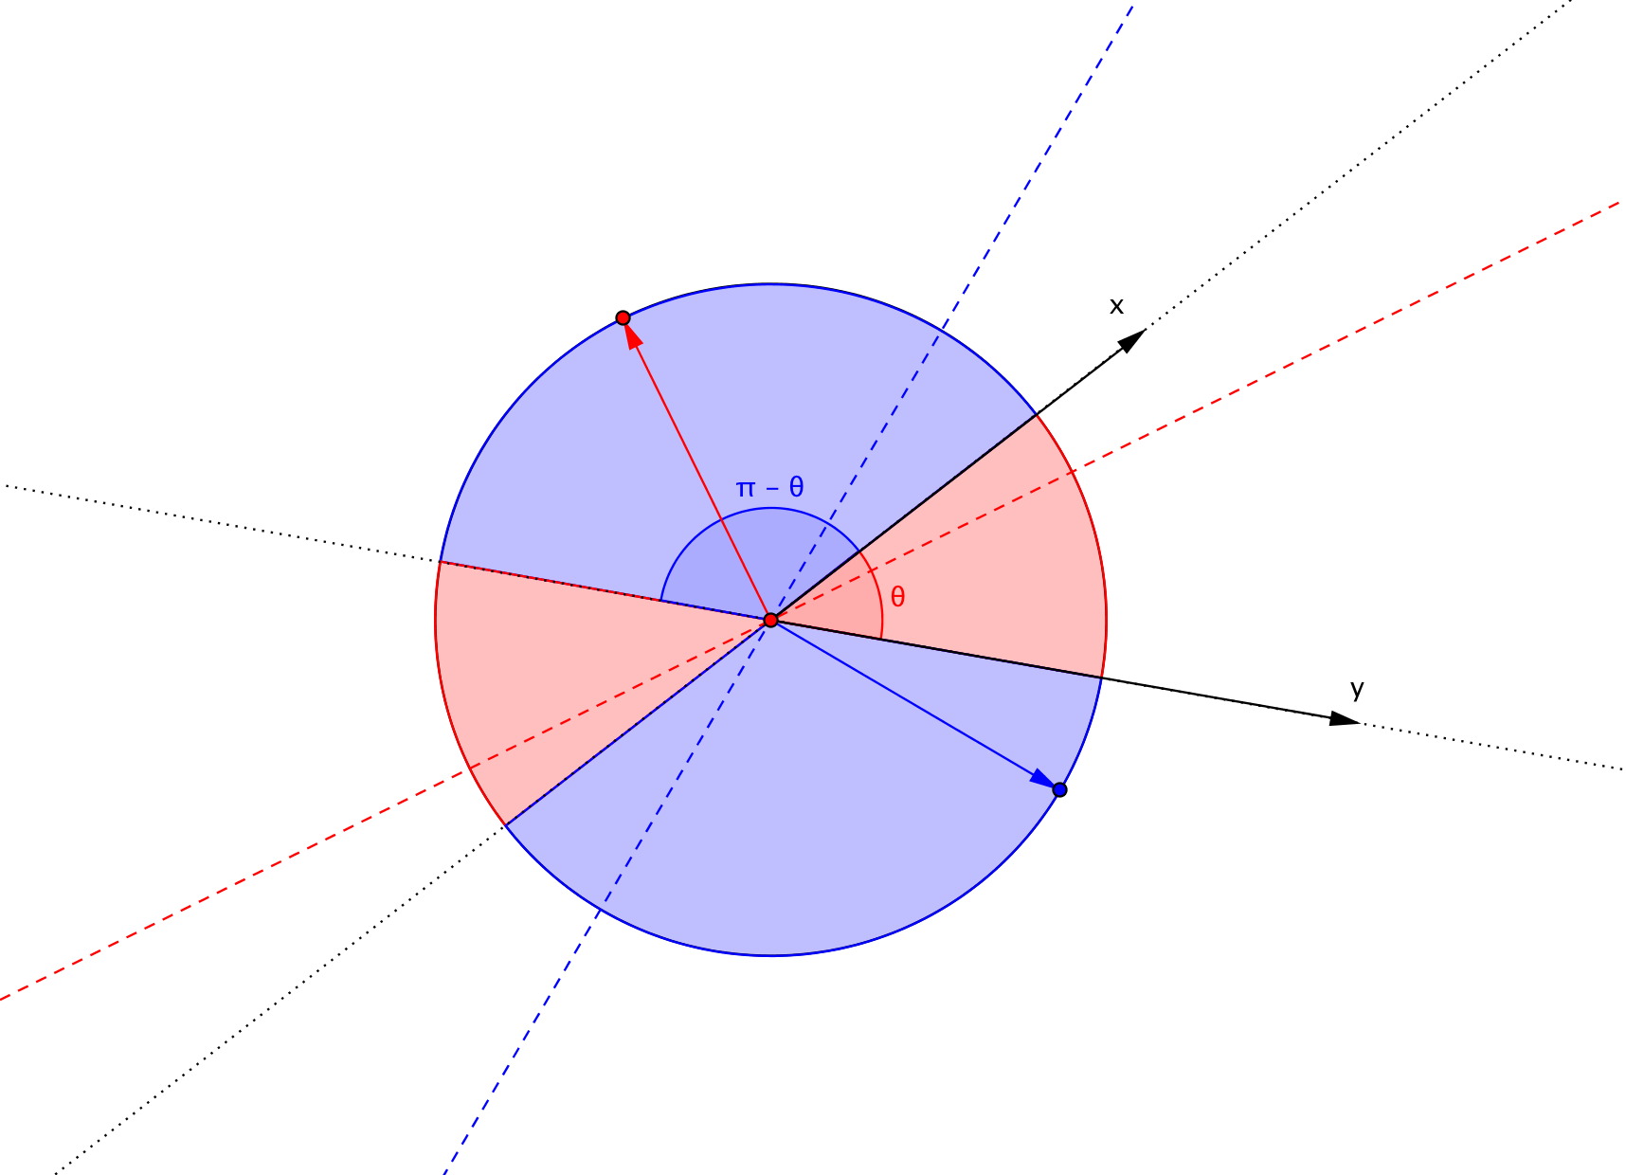
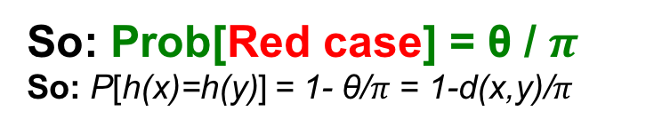
Proof of Claim
So: Prob[Red case] = θ / $π$
So: P[h(x)=h(y)] = 1- θ/$π$ = 1-d(x,y)/$π$

Slide 50
Signatures for Cosine Distance
Pick some number of random vectors, and hash your data for each vector
The result is a signature (sketch) of
+1’s and –1’s for each data point
Can be used for LSH like we used the
Min-Hash signatures for Jaccard distance
Amplify using AND/OR constructions

Slide 51
How to pick random vectors?
Expensive to pick a random vector in M dimensions for large M
  Would have to generate M random numbers
A more efficient approach
  It suffices to consider only vectors v
  consisting of +1 and –1 components
    Why? Assuming data is random, then vectors of +/-1 cover the entire space evenly (and does not bias in any way)

Slide 52
LSH for Euclidean Distance
Idea: Hash functions correspond to lines
Partition the line into buckets of size a
Hash each point to the bucket containing its projection onto the line
  An element of the “Signature” is a bucket id for that given projection line
Nearby points are always close;
distant points are rarely in same bucket

Slide 53
Projection of Points
v
v
v
v
v
v
Line
v
v
Buckets of size a
v
v
v
v
“Lucky” case:
  Points that are close hash in the same bucket
  Distant points end up in different buckets
Two “unlucky” cases:
  Top: unlucky quantization
  Bottom: unlucky projection

Slide 54
Multiple Projections
v
v
v
v
v
v
v
v

Slide 55
Projection of Points
Points at
distance d
If d << a, then
the chance the
points are in the
same bucket is
at least 1 – d/a.
Randomly
chosen line
Bucket
width a

Slide 56
Projection of Points
Points at
distance d
If d >> a, θ must
be close to 90º
for there to be
any chance points
go to the same
bucket.
θ
d cos θ
Randomly
chosen line
Bucket
width a
Notes:
Note: we have to be careful when picking random lines. Our assumption is that the angle distribution between lines is uniform. This may not be the case but until the prob of sharing a bucket is bigger than prob. of not sharing it, we are fine. LSH still works only we will need more functions (sensitivity of the family is a bit smaller)

Slide 57
An LS-Family for Euclidean Distance
If points are distance d < a/2, prob.
they are in same bucket ≥ 1- d/a = ½
If points are distance d > 2a apart, then they can be in the same bucket only if d cos θ ≤ a
  cos θ ≤ ½
  60 < θ < 90, i.e., at most 1/3 probability
Yields a (a/2, 2a, 1/2, 1/3)-sensitive family of
hash functions for any a
Amplify using AND-OR cascades

Slide 58
Fixup: Euclidean Distance
Projection method yields a (a/2, 2a, 1/2, 1/3)-sensitive family of hash functions
For previous distance measures, we could start with an (d₁, d₂, p₁, p₂)-sensitive family for any d₁ < d₂, and drive p₁ and p₂ to 1 and 0 by AND/OR constructions
Note: Here, we seem to need d₁ ≤ 4 d₂
  In the calculation on the previous slide we only considered cases d < a/2 and d > 2a

Slide 59
Fixup – (2)
But as long as d₁ < d₂, the probability of points at distance d₁ falling in the same bucket is greater than the probability of points at distance d₂ doing so
Thus, the hash family formed by projecting onto lines is an (d₁, d₂, p₁, p₂)-sensitive family
for some p₁ > p₂
  Then, amplify by AND/OR constructions

Slide 60
Summary
Signatures: short integer signatures that reflect their similarity
Candidate pairs:
those pairs of signatures that we need to test for similarity
Hash
func.
Locality-
sensitive
Hashing
Data
Design a (d₁, d₂, p₁, p₂)-sensitive family of hash functions (for that particular distance metric)
Amplify the family using AND and OR constructions
0 | 1 | 0 | 0
1 | 1 | 1 | 0
0 | 0 | 0 | 1
0 | 1 | 0 | 1
0 | 0 | 1 | 0
1 | 0 | 0 | 1
Documents
MinHash
1 | 5 | 1 | 5
2 | 3 | 1 | 3
6 | 4 | 6 | 4
“Bands” technique
Candidate pairs
0 | 1 | 0 | 0
1 | 1 | 1 | 0
0 | 0 | 0 | 1
0 | 1 | 0 | 1
0 | 0 | 1 | 0
1 | 0 | 0 | 1
Random
Hyperplanes
Data points
-1 | +1 | -1 | -1
+1 | +1 | +1 | -1
-1 | -1 | -1 | -1
“Bands” technique
Candidate pairs

Slide 61
Two Important Points
Property P(h(C₁)=h(C₂))=sim(C₁,C₂) of hash function h is the essential part of LSH, without it we can’t do anything
LS-hash functions transform data to signatures so that the bands technique (AND, OR constructions) can then be applied

