Slide 1
Submodular Optimization
Tim Althoff & Hima Lakkaraju

Slide 2
Announcement
Course evaluation is open on Axess
  Please fill out the form! Thanks!!!
  You’ll get to see your grades earlier!
We appreciate your feedback!

Slide 3




Motivation
Learned about: LSH/Similarity search & recommender systems
Search: “jaguar”
Uncertainty about the user’s information need
  Don’t put all eggs in one basket!
Relevance isn’t everything – need diversity!
Notes:
It’s boring

Slide 4













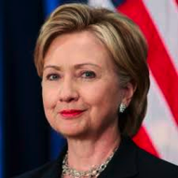

Many applications need diversity!
Recommendation:
Summarization:
“Robert Downey Jr.”
News Media:
Notes:
Uncertainty around information need => don’t put all eggs in one basket

Slide 5
Automatic Timeline Generation
[Althoff et al., KDD 2015]
Person
Timeline
Goal: Timeline should express his relationships to other people through events (personal, collaboration, mentorship, etc.)
Why timelines?
  Easier: Wikipedia article is 18 pages long
  Context: Through relationships & event descriptions
  Exploration: Can “jump” to other people

Slide 6
Problem Definition
Given:
  Relevant relationships
  Events covering some relationships each
Goal: Given a large set of events, pick a small subset that explains most known relationships (“the timeline”)
Notes:
(comes from mining web pages)
(comes from knowledge base)

Slide 7
Example Timeline
Demo available at: http://cs.stanford.edu/~althoff/timemachine/demo.html
“RDJr starred in Chaplin in 1992 together with Anthony Hopkins.”
Good overview
Notes:
http://cs.stanford.edu/~althoff/timemachine/demo.html

Slide 8










Why diversity?
User studies: People hate redundancy!
Iron Man
Award
Ceremony
Chaplin
Academy
Award N.
Iron Man
US Release
Iron Man
US Release
vs
Iron Man
EU Release
Rented Lips
US Release
Want to see more diverse set of relationships
Notes:
Left:
Robert Downey Jr
Jon Favreau (director and actor), got him again for other iron man movies, or the movie chef
Right: Rented Lips was directed by dad, one of his first roles
Oscar nomination for Chaplin
Diverse: Diversity means that we broadly cover the space of people connected to him

Slide 9
Diversity as Coverage
Notes:
How to encode diversity?

Slide 10
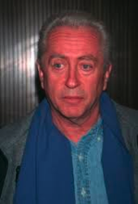




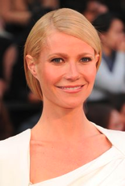


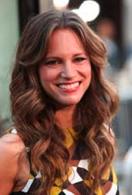





Encode Diversity as Coverage
Idea: Encode diversity as coverage problem
Example: Selecting events for timeline
  Try to cover all important relationships
Notes:
Jon Favreau
Gwyneth Paltraw
Robert Downey Sr

Slide 11

What is being covered?
Q: What is being covered?
A: Relationships
Q: Who is doing the covering?
A: Events
Captain America
Anthony Hopkins
Gwyneth Paltrow
Susan Downey
Downey Jr. starred in Chaplin together with Anthony Hopkins

Slide 12

Simple Coverage Model
Suppose we are given a set of events E
  Each event e covers a set of
  relationships
For a set of events we define:
Goal: We want to
Note: F(S) is a set function:
e
Cardinality
Constraint

Slide 13
Maximum Coverage Problem
Given universe of elements
and sets
Goal: Find set of k events X₁…X_{k} covering most of U
  More precisely: Find set of k events X₁…X_{k}whose size of the union is the largest
U: all relationships
X_{i}: relationships
covered by event i
X₃
X₁
U
X₂
X₄
Notes:
Maximum coverage problem
Related to set cover problem = identify the smallest number of sets to cover the entire universe of elements.
Bad news: A known NP-complete problem

Slide 14
Simple Greedy Heuristic
Simple Heuristic: Greedy Algorithm:
Start with S₀ = {}
For i = 1…k
  Take event e that max
  Let
Example:
  Eval. F({e₁}), …, F({e_{m}}), pick best (say e₁)
  Eval. F({e₁} u {e₂}), …, F({e₁} u {e_{m}}), pick best (say e₂)
  Eval. F({e₁, e₂} u {e₃}), …, F({e₁, e₂} u {e_{m}}), pick best
  And so on…

Slide 15
Simple Greedy Heuristic
Goal: Maximize the covered area

Slide 16
Simple Greedy Heuristic
Goal: Maximize the covered area

Slide 17
Simple Greedy Heuristic
Goal: Maximize the covered area

Slide 18
Simple Greedy Heuristic
Goal: Maximize the covered area

Slide 19
Simple Greedy Heuristic
Goal: Maximize the covered area

Slide 20
When Greedy Heuristic Fails?
A
B
C
Goal: Maximize the size of the covered area
Greedy first picks A and then C
But the optimal way would be to pick B and C

Slide 21
Bad News & Good News
Bad news: Maximum Coverage is NP-hard
Good news: Good approximations exist
  Problem has certain structure to it that even simple greedy algorithms perform reasonably well
  Details in 2nd half of lecture
Now: Generalize our objective for timeline generation
Notes:
Similar to Set Cover and Maximum Coverage

Slide 22
Not all relationships are equal
Objective values all relationships equally
Unrealistic: Some relationships are more important than others
  use different weights (“weighted coverage function”)
Notes:
Example: When Robert Downey Jr’s producer was his dad that might be more relevant than relationships to some random producer.
Point out that this is a generalization! w=1 gives previous model

Slide 23
Example weight function
  Use global importance weights
  How much interest is there?
  Could be measured as
    w(x) = # search queries for person X
    w(x) = # Wikipedia article views for X
    w(x) = # news article mentions for X
Captain America
Anthony Hopkins
Gwyneth Paltrow
Susan Downey
Captain America
Anthony Hopkins
Gwyneth Paltrow
Susan Downey
Notes:
Consider: throwing this out and just doing cooc

Slide 24
Better weight function
Captain America
Justin Bieber
Susan Downey
Tim Althoff
Applying global importance weights
Captain America
Justin Bieber
Susan Downey
Tim Althoff
Some relationships are not (too) globally important but (not) highly relevant to timeline
Need relevant to timeline instead of globally relevant
w(Susan Downey | RDJr) > w(Justin Bieber | RDJr)

Slide 25
Capturing relevance to timeline
Can use co-occurrence statistics
w(X | RDJr) = #(X and RDJr) / (#(RDJr) * #(X))
  Pointwise mutual information (PMI)
  How often do X and Y occur together compared to what you would expect if they were independent
  Accounts for popular entities (e.g., Justin Bieber)

Slide 26
Differentiating between events
How to differentiate between two events that cover the same relationships?
Example: Robert and Susan Downey
  Event 1: Wedding, August 27, 2005
  Event 2: Minor charity event, Nov 11, 2006
We need to be able to distinguish these!

Slide 27
Scoring of event timestamps
Further improvement when we not only score relationships but also score the event timestamp
where
Relationship (as before)
Timestamps
Again, use co-occurrences for weights w_{T}

Slide 28
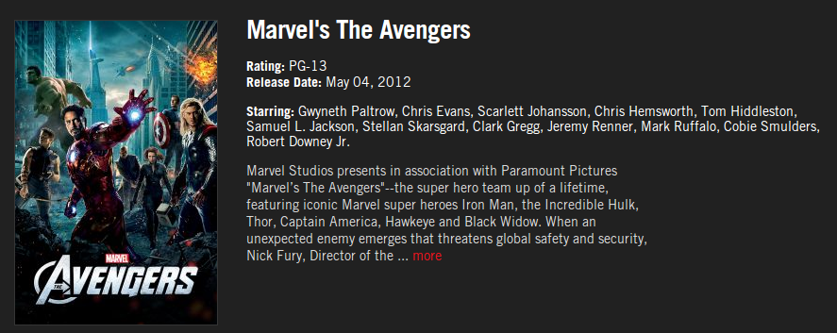
Co-occurrences on Web Scale
marvel.com
“Robert Downey Jr” and “May 4, 2012” occurs 173 times on 71 different webpages
US Release date of The Avengers
Use MapReduce on 10B web pages

Slide 29
Complete Optimization Problem
Generalized earlier coverage function to linear combination of weighted coverage functions
Goal:
Still NP-hard
(because generalization of NP-hard problem)
where

Slide 30
Next
How can we actually optimize this function?
What structure is there that will help us do this efficiently?
Any questions so far?

Slide 31
Approximate Solution
For this optimization problem, Greedy produces a solution S
s.t. F(S) ≥ (1-1/e)*OPT (F(S) ≥ 0.63*OPT)
[Nemhauser, Fisher, Wolsey ’78]
Claim holds for functions F(·) which are:
  Submodular, Monotone, Normal, Non-negative
  (discussed next)
Notes:
Spell out the equation 1 – 1/e
Just talk about submodular without introducing others

Slide 32
Submodularity: Definition 1
Definition:
Set function F(·) is called submodular if:
For all P,Q⊆ U:
F(P) + F(Q) ≥ F(P∪ Q) + F(P∩ Q)
+
≥
+
P
Q
P ∪ Q
P ∩ Q
Notes:
Lets chuck it out

Slide 33
Submodularity: Definition 2
Checking the previous definition is not easy in practice
Substitute P = A ∪ {d} and Q = B where A⊆ B and d∉ B in the definition above
  F(A∪ {d}) + F(B) ≥ F(A∪ {d} ∪ B) + F((A∪ {d}) ∩ B)
  F(A∪ {d}) + F(B) ≥ F(B∪{d}) + F(A)
  F(A∪ {d}) – F(A) ≥ F(B∪{d}) – F(B)
Notes:
Increase font on equations
Point to equations

Slide 34
Submodularity: Definition 2
Diminishing returns characterization
F(A ∪ d) – F(A) ≥ F(B ∪ d) – F(B)
Gain of adding d to a small set
Gain of adding d to a large set
B
+
d
Large improvement
A
+
d
Small improvement
Notes:
A \subset B

Slide 35
Submodularity: Diminishing Returns
F(A ∪ d) – F(A) ≥ F(B ∪ d) – F(B)
Gain of adding d to a small set
Gain of adding d to a large set
F(·)
  ∀A ⊆ B
F(B ∪ d)
F(B)
F(A ∪ d)
F(A)
Adding d to B helps less
than adding it to A!
Solution size |A|

Slide 36
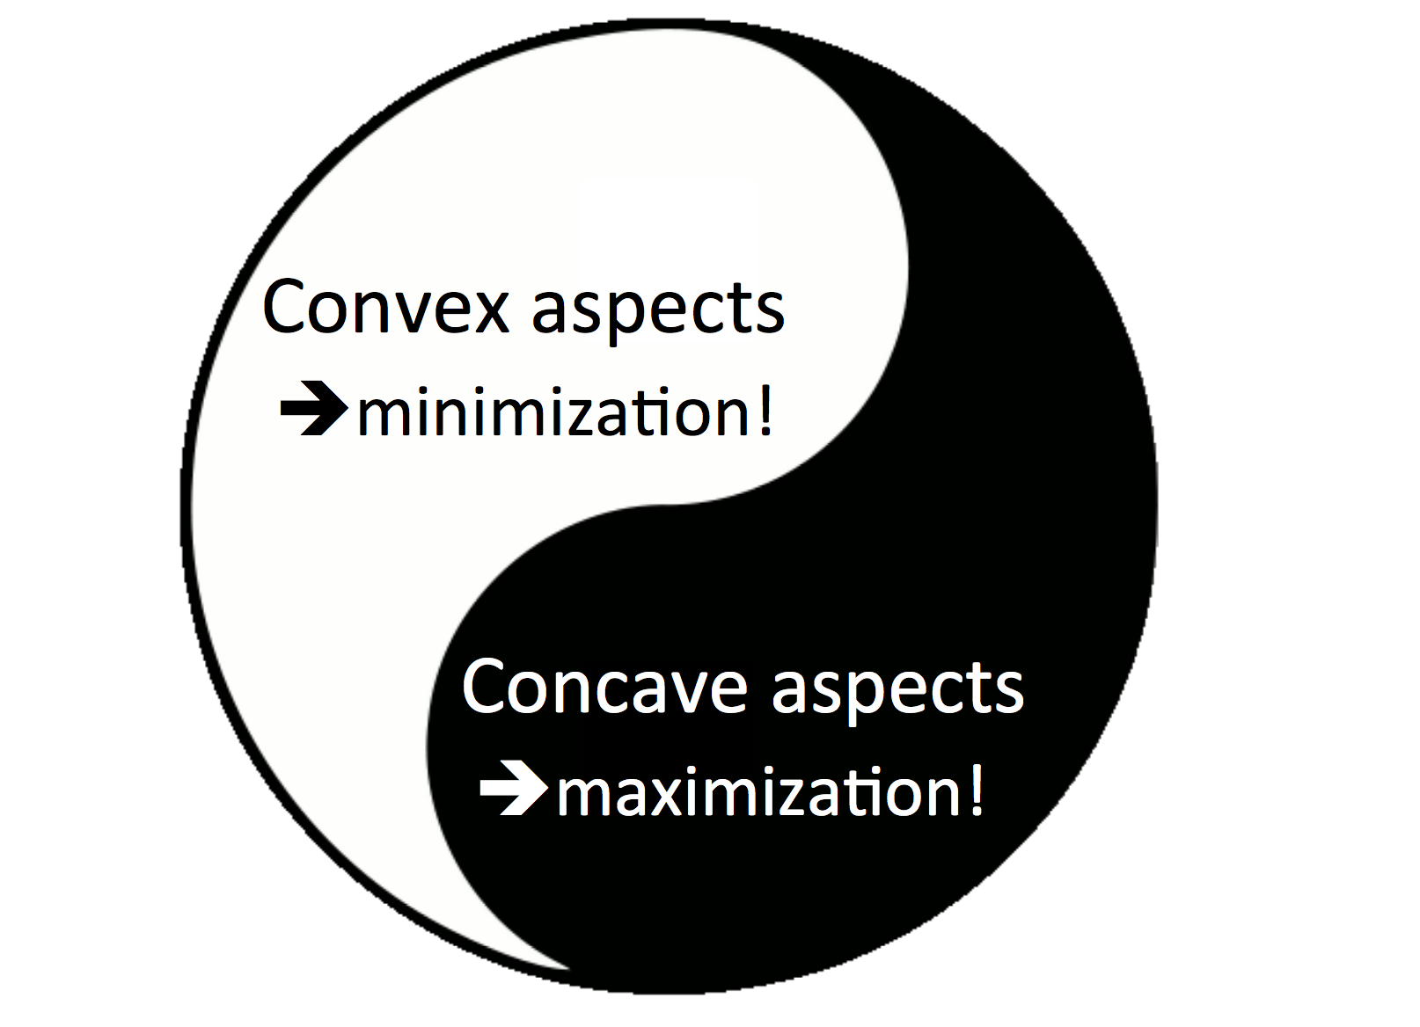
Two Faces of Submodular Functions
Submodularity is discrete analogue of convexity/concavity
Notes:
1. Those properties are pretty useful in actually solving opt. problems.

Slide 37
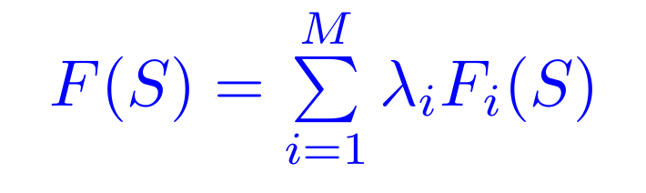
Submodularity: An important property
Let F₁ … F_{M} be submodular functions and
λ₁ … λ_{M} ≥ 0 and let S denote some solution set, then the non-negative linear combination F(S) (defined below) of these functions is also submodular.
Notes:
1. Move it to end

Slide 38
Submodularity: Approximation Guarantee
When maximizing a submodular function with cardinality constraints, Greedy produces a solution S for which F(S) ≥ (1-1/e)*OPT i.e., (F(S) ≥ 0.63*OPT)
[Nemhauser, Fisher, Wolsey ’78]
Claim holds for functions F(·) which are:
  Monotone: if A ⊆ B then F(A) ≤ F(B)
  Normal: F({}) = 0
  Non-negative: For any A, F(A) ≥ 0
  In addition to being submodular
Notes:
Spell out the equation 1 – 1/e
Just talk about submodular without introducing others

Slide 39
Back to our Timeline Problem

Slide 40
Simple Coverage Model
Suppose we are given a set of events E
  Each event e covers a set of
  relationships U
For a set of events we define:
Goal: We want to
Note: F(S) is a set function:
e
Cardinality
Constraint

Slide 41
Simple Coverage: Submodular?
Claim: is submodular.
A
Gain of adding X_{e} to a smaller set
X_{e}
B
X_{e}
Gain of adding X_{e} to a larger set
  ∀A ⊆ B
Notes:
A \subset B
Lot more red
Make it a slide for monotone, normal

Slide 42
Simple Coverage: Other Properties
Claim: is normal & monotone
Normality: When S is empty, is empty.
Monotonicity: Adding a new event to S can never decrease the number of relationships covered by S.
What about non-negativity?

Slide 43
Summary so far
 | Simple Coverage | Weighted Coverage (Relationships) | Weighted Coverage (Timestamps) | Complete Optimization Problem
Submodularity
Monotonicity
Normality
Notes:
1. Have a table here

Slide 44
Weighted Coverage (Relationships)
Claim: F(S) is submodular.
  Consider two sets A and B s.t. A ⊆ B ⊆ S and let us consider an event e ∉ B
  Three possibilities when we add e to A or B:
    Case 1: e does not cover any new relationships w.r.t both A and B
    F(A U {e}) – F(A) = 0 = F(B U {e}) – F(B)
where
Notes:
Change the proof
Make monotone, normal a separate slide
Weighted timestampe coverage in a separate slide

Slide 45
Weighted Coverage (Relationships)
Claim: F(S) is submodular.
  Three possibilities when we add e to A or B:
    Case 2: e covers some new relationships w.r.t A but not w.r.t B
    F(A U {e}) – F(A) = v where v ≥ 0
    F(B U {e}) – F(B) = 0
    Therefore, F(A U {e}) – F(A) ≥ F(B U {e}) – F(B)
Notes:
Change the proof
Make monotone, normal a separate slide
Weighted timestampe coverage in a separate slide

Slide 46
Weighted Coverage (Relationships)
Claim: F(S) is submodular.
  Three possibilities when we add e to A or B:
    Case 3: e covers some new relationships w.r.t both A and B
    F(A U {e}) – F(A) = v where v ≥ 0
    F(B U {e}) – F(B) = u where u ≥ 0
    But, v ≥ u because e will always cover fewer (or equal number of) new relationships w.r.t B than w.r.t A
Notes:
Change the proof
Make monotone, normal a separate slide
Weighted timestampe coverage in a separate slide

Slide 47
Weighted Coverage (Relationships)
Claim: F(S) is monotone and normal.
Normality: When S is empty, is empty.
Monotonicity: Adding a new event to S can never decrease the number of relationships covered by S.
where
Notes:
Change the proof
Make monotone, normal a separate slide
Weighted timestampe coverage in a separate slide

Slide 48
Summary so far
 | Simple Coverage | Weighted Coverage (Relationships) | Weighted Coverage (Timestamps) | Complete Optimization Problem
Submodularity
Monotonicity
Normality

Slide 49
Weighted Coverage (Timestamps)
Claim: F(S) is submodular, monotone and normal
Analogous arguments to that of weighted coverage (relationships) are applicable
Notes:
Change the proof
Make monotone, normal a separate slide
Weighted timestampe coverage in a separate slide

Slide 50
Summary so far
 | Simple Coverage | Weighted Coverage (Relationships) | Weighted Coverage (Timestamps) | Complete Optimization Problem
Submodularity
Monotonicity
Normality

Slide 51
Complete Optimization Problem
Generalized earlier coverage function to linear combination of weighted coverage functions
Goal:
Claim: F(S) is submodular, monotone and normal
where

Slide 52
Complete Optimization Problem
Submodularity: F(S) is a non-negative linear combination of two submodular functions. Therefore, it is submodular too.
Normality: F₁({}) = 0 = F₂({})
F₁({}) + F₂({}) = 0
Monotonicity: Let A ⊆ B ⊆ S,
F₁(A) ≤ F₁(B) and F₂(A) ≤ F₂(B)
F₁(A) + F₂(A) ≤ F₁(B) + F₂(B)
Notes:
Add proof for monotone, normal
Put the linear combination piece here

Slide 53
Summary so far
 | Simple Coverage | Weighted Coverage (Relationships) | Weighted Coverage (Timestamps) | Complete Optimization Problem
Submodularity
Monotonicity
Normality

Slide 54
Lazy Optimization of Submodular Functions

Slide 55
Greedy Solution
Greedy
Greedy Algorithm is Slow!
At each iteration, we need to evaluate marginal gains of all the remaining elements
Runtime O(|U| * K) for selecting K elements out of the set U
Marginal gain:
F(S∪x)-F(S)
a
b
c
d
e
Add element with
highest marginal gain

Slide 56
Speeding up Greedy
In round i:
  So far we have S_{i-1} = {e₁ … e_{i-1}}
  Now we pick an element e ∉ S_{i-1} which maximizes the marginal benefit Δ_{i} = F(S_{i-1} U {e}) – F(S_{i-1})
Observation:
  Marginal gain of any element e can never increase!
  For every element e, Δ_{i} (d) ≥ Δ_{j}(d) for all i < j
Notes:
1. Check if you want to change to u instead of d

Slide 57
Lazy Greedy
[Leskovec et al., KDD ’07]
Idea:
  Use Δ_{i} as upper-bound on Δ_{j} (j > i)
Lazy Greedy:
  Keep an ordered list of marginal benefits Δ_{i} from previous iteration
  Re-evaluate Δ_{i} only for top node
  Re-sort and prune
(Upper bound on)
Marginal gain Δ₁
a
A₁={a}
b
c
d
e
F(A ∪ {d}) – F(A) ≥ F(B ∪ {d}) – F(B)
A ⊆ B

Slide 58
Lazy Greedy
[Leskovec et al., KDD ’07]
Idea:
  Use Δ_{i} as upper-bound on Δ_{j} (j > i)
Lazy Greedy:
  Keep an ordered list of marginal benefits Δ_{i} from previous iteration
  Re-evaluate Δ_{i} only for top node
  Re-sort and prune
Upper bound on
Marginal gain Δ₂
a
A₁={a}
b
c
d
e
F(A ∪ {d}) – F(A) ≥ F(B ∪ {d}) – F(B)
A ⊆ B

Slide 59
Lazy Greedy
[Leskovec et al., KDD ’07]
Idea:
  Use Δ_{i} as upper-bound on Δ_{j} (j > i)
Lazy Greedy:
  Keep an ordered list of marginal benefits Δ_{i} from previous iteration
  Re-evaluate Δ_{i} only for top node
  Re-sort and prune
Upper bound on
Marginal gain Δ₂
a
A₁={a}
d
A₂={a,b}
b
e
c
F(A ∪ {d}) – F(A) ≥ F(B ∪ {d}) – F(B)
A ⊆ B
Notes:
If that removes it from the top, pick next sensor
Continue until top remains unchanged

Slide 60
Speed Up of Lazy Greedy Algorithm
[Leskovec et al., KDD ’07]
Lazy greedy offers significant speed-up over traditional greedy implementations in practice.
400
exhaustive search
300
(all subsets)
Lower is better
naive
running time (seconds)
200
greedy
100
Lazy
0
1
2
3
4
5
6
7
8
9
10
number of elements selected
Notes:
1. Change animation for “lower is better”

Slide 61
More about Submodular Optimization
 | Submodular Maximization | Submodular Minimization
Unconstrained
Constrained | NP-Hard but well-approximable with Greedy-style algorithms for cardinality, matroid constraints; Non-greedy for more complex (connectivity) constraints
Notes:
1. Empty everything except for constrained max.

Slide 62
More about Submodular Optimization
 | Submodular Maximization | Submodular Minimization
Unconstrained | NP-Hard but well-approximable (if non-negative)
Constrained | NP-Hard but well-approximable with Greedy-style algorithms for cardinality, matroid constraints; Non-greedy for more complex (connectivity) constraints
Notes:
1. Empty everything except for constrained max.

Slide 63
More about Submodular Optimization
 | Submodular Maximization | Submodular Minimization
Unconstrained | NP-Hard but well-approximable (if non-negative) | Polynomial time! Generally inefficient (n^6), but can exploit special cases (cuts; symmetry etc.)
Constrained | NP-Hard but well-approximable with Greedy-style algorithms for cardinality, matroid constraints; Non-greedy for more complex (connectivity) constraints
Notes:
1. Empty everything except for constrained max.

Slide 64
More about Submodular Optimization
 | Submodular Maximization | Submodular Minimization
Unconstrained | NP-Hard but well-approximable (if non-negative) | Polynomial time! Generally inefficient (n^6), but can exploit special cases (cuts; symmetry etc.)
Constrained | NP-Hard but well-approximable with Greedy-style algorithms for cardinality, matroid constraints; Non-greedy for more complex (connectivity) constraints | NP-Hard, hard to approximate, still useful algorithms
Notes:
1. Empty everything except for constrained max.

Slide 65
References
Andreas Krause, Daniel Golovin, Submodular Function Maximization
Leskovec et. al., Cost-effective Outbreak Detection in Networks, KDD 2007
Althoff et. al., TimeMachine: Timeline Generation for Knowledge-Base Entities, KDD 2015
ICML Tutorial: http://submodularity.org/submodularity-icml-part1-slides-prelim.pdf
Learning and Testing Submodular Functions: http://grigory.us/cis625/lecture3.pdf

