Slide 1

Recommender Systems:
Content-based Systems & Collaborative Filtering
CS246: Mining Massive Datasets
Jure Leskovec, Stanford University
http://cs246.stanford.edu

Slide 2
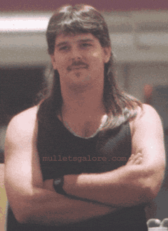
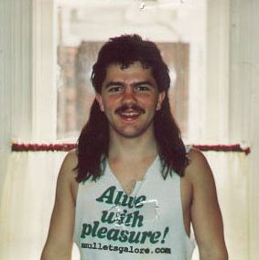
Example: Recommender Systems
Customer X
  Buys Metalica CD
  Buys Megadeth CD
Customer Y
  Does search on Metalica
  Recommender system suggests Megadeth from data collected from customer X

Slide 3










Recommendations
Examples:
Search
Recommendations
Items
Products, web sites,
blogs, news items, …

Slide 4
From Scarcity to Abundance
Shelf space is a scarce commodity for traditional retailers
  Also: TV networks, movie theaters,…
Web enables near-zero-cost dissemination
of information about products
  From scarcity to abundance
More choice necessitates better filters
  Recommendation engines
  How Into Thin Air made Touching the Void a bestseller:
    http://www.wired.com/wired/archive/12.10/tail.html
Notes:
In 1988, a British mountain climber named Joe Simpson wrote a book called Touching the Void, a harrowing account of near death in the Peruvian Andes. It got good reviews but, only a modest success, it was soon forgotten. Then, a decade later, a strange thing happened. Jon Krakauer wroteInto Thin Air, another book about a mountain-climbing tragedy, which became a publishing sensation. SuddenlyTouching the Void started to sell again.
Random House rushed out a new edition to keep up with demand. Booksellers began to promote it next to their Into Thin Air displays, and sales rose further. A revised paperback edition, which came out in January, spent 14 weeks on theNew York Times bestseller list. That same month, IFC Films released a docudrama of the story to critical acclaim. NowTouching the Void outsells Into Thin Air more than two to one.
What happened? In short, Amazon.com recommendations. The online bookseller's software noted patterns in buying behavior and suggested that readers who liked Into Thin Airwould also like Touching the Void. People took the suggestion, agreed wholeheartedly, wrote rhapsodic reviews. More sales, more algorithm-fueled recommendations, and the positive feedback loop kicked in.

Slide 5
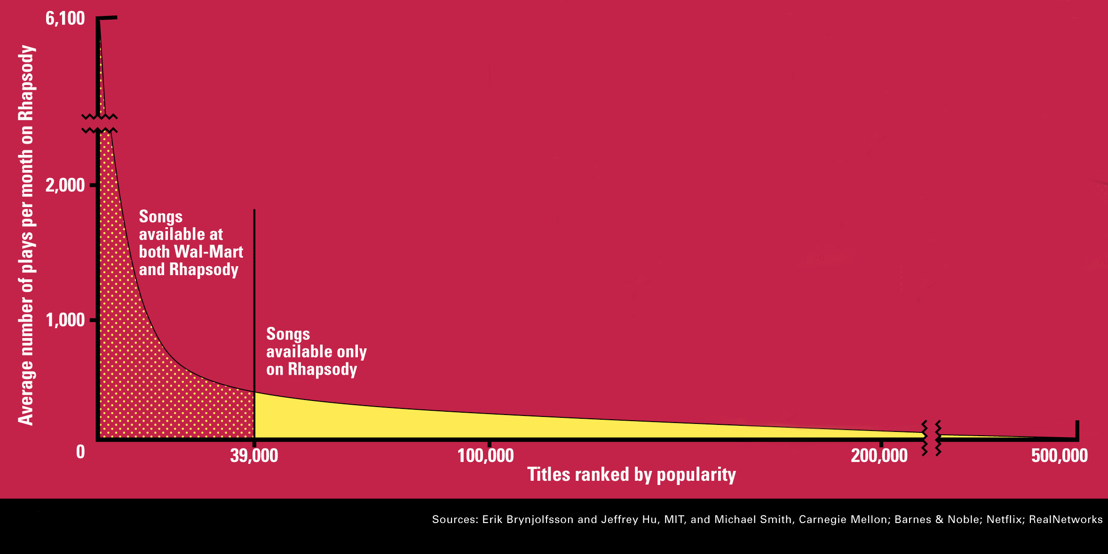
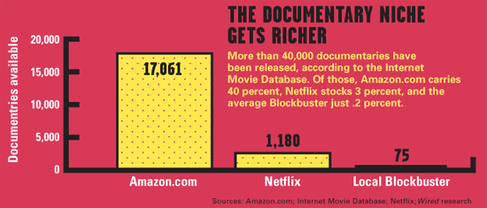
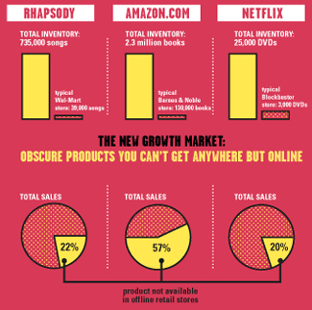
The Long Tail
Source: Chris Anderson (2004)

Slide 6
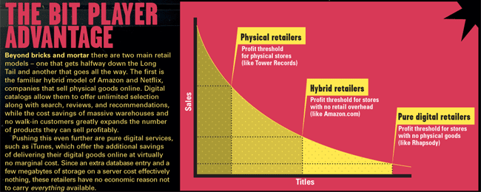
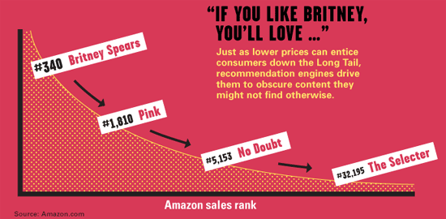
Physical vs. Online
    Read http://www.wired.com/wired/archive/12.10/tail.html to learn more!

Slide 7
Types of Recommendations
Editorial and hand curated
  List of favorites
  Lists of “essential” items
Simple aggregates
  Top 10, Most Popular, Recent Uploads
Tailored to individual users
  Amazon, Netflix, …

Slide 8
Formal Model
C = set of Customers
S = set of Items
Utility function u: C × S → R
  R = set of ratings
  R is a totally ordered set
  e.g., 0-5 stars, real number in [0,1]

Slide 9
Utility Matrix
Avatar
LOTR
Matrix
Pirates
Alice
Bob
Carol
David

Slide 10
Key Problems
Gathering “known” ratings for matrix
Extrapolate unknown ratings from known ratings
  Mainly interested in high unknown ratings
Evaluating extrapolation methods

Slide 11
Gathering Ratings
Explicit
  Ask people to rate items
  Doesn’t work well in practice – people
  can’t be bothered
Implicit
  Learn ratings from user actions
    E.g., purchase implies high rating
  What about low ratings?

Slide 12
Extrapolating Utilities
Key problem: matrix U is sparse
  Most people have not rated most items
  Cold start:
    New items have no ratings
    New users have no history
Three approaches to Recommender Systems:
  Content-based
  Collaborative
  Hybrid

Slide 13
Content-based Recommendations
Main idea: Recommend items to customer x similar to previous items rated highly by x
Example:
Movie recommendations
  Recommend movies with same actor(s),
  director, genre, …
Websites, blogs, news
  Recommend other sites with “similar” content

Slide 14
Plan of Action
Item profiles
likes
build
recommend
match
Red
Circles
Triangles
User profile

Slide 15
Item Profiles
For each item, create an item profile
Profile is a set (vector) of features
  Movies: author, title, actor, director,…
  Text: set of “important” words in document
How to pick important features?
  Usual heuristic from text mining is TF-IDF
  (Term frequency * Inverse Doc Frequency)
    Term … feature
    Document … item

Slide 16
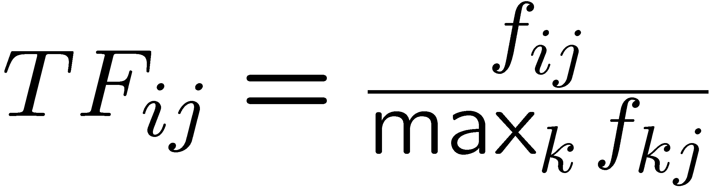
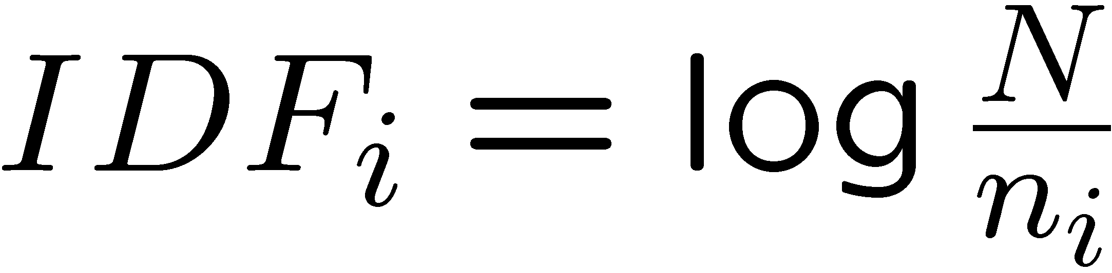
Sidenote: TF-IDF
f_{ij} = frequency of term (feature) i in document (item) j
n_{i} = number of docs that mention term i
N = total number of docs
TF-IDF score: w_{ij} = TF_{ij} × IDF_{i}
Doc profile = set of words with highest TF-IDF scores, together with their scores
Note: we normalize TF
to discount for “longer”
documents

Slide 17
User Profiles and Prediction
User profile possibilities:
  Weighted average of rated item profiles
  Variation: weight by difference from average
  rating for item
  …
Prediction heuristic:
  Given user profile u and item profile i, estimate u(u,i) = cos(u,i) = u·i/(|u||i|)
  Need efficient method to find items with high utility: LSH!

Slide 18
Pros: Content-based Approach
+: No need for data on other users
  No cold-start or sparsity problems
+: Able to recommend to users with
unique tastes
+: Able to recommend new and unpopular items
  No first-rater problem
Can provide explanations of recommended items by listing content-features that caused an item to be recommended

Slide 19
Cons: Content-based Approach
–: Finding the appropriate features is hard
  E.g., images, movies, music
–: Overspecialization
  Never recommends items outside user’s
  content profile
  People might have multiple interests
  Unable to exploit quality judgments of other users
–: Recommendations for new users
  How to build a user profile?

Slide 20
Collaborative Filtering

Slide 21
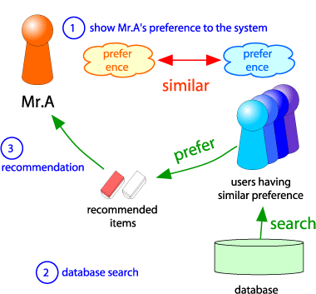
Collaborative Filtering
Consider user x
Find set N of other
users whose ratings
are “similar” to
x’s ratings
Estimate x’s ratings
based on ratings
of users in N
x
N

Slide 22
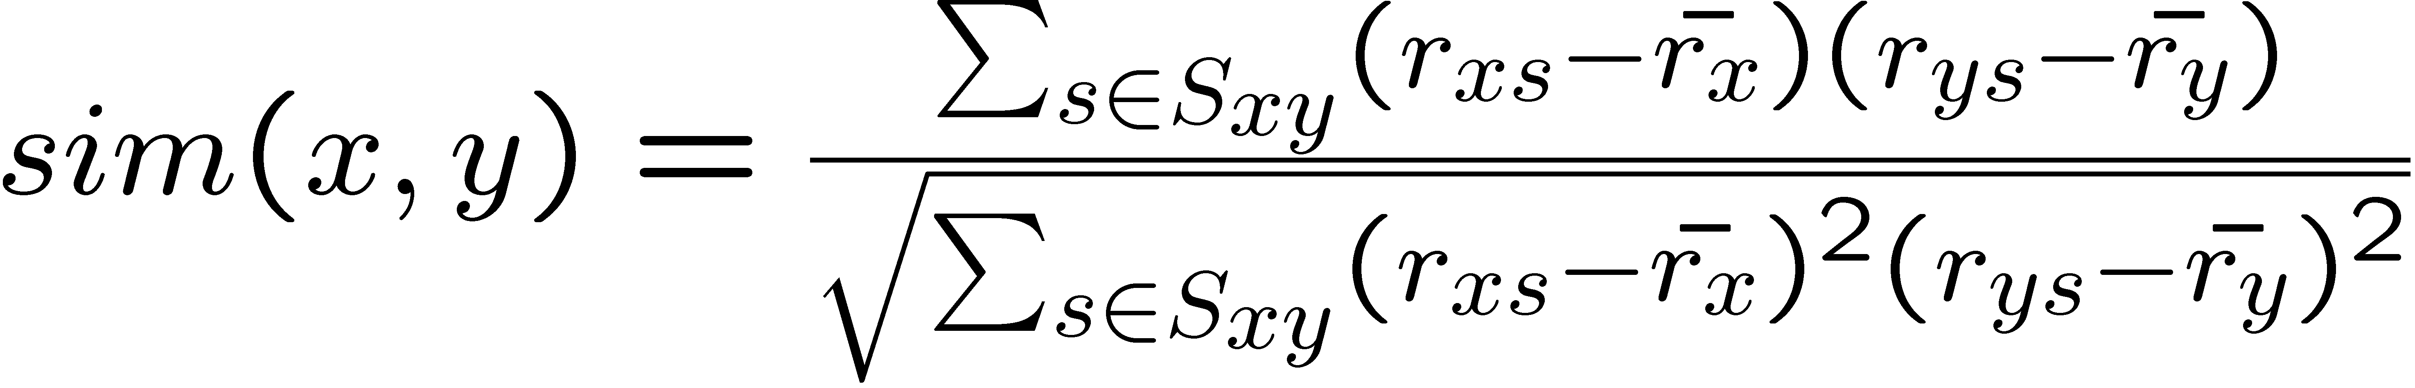
Similar Users
Let r_{x} be the vector of user x’s ratings
Jaccard similarity measure
  Problem: Ignores the value of the rating
Cosine similarity measure
  sim(x,y) = cos(r_{x} , r_{y})
  Problem: Treats missing ratings as “negative”
Pearson correlation coefficient
  S_{xy} = items rated by both users x and y
Notes:
-- Jaccard is not appropriate as we want to consider weights

Slide 23
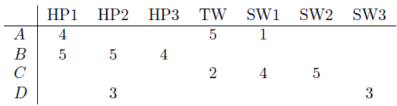
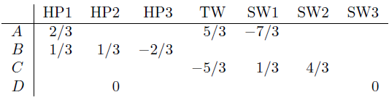
Similarity Metric
Intuitively we want: sim(A, B) > sim(A, C)
Jaccard similarity: 1/5 < 2/4
Cosine similarity: 0.386 > 0.322
  Considers missing ratings as “negative”
  Solution: subtract the mean
sim A,B vs. A,C:
0.092 > -0.559
Notice cos sim is correlation when data is centered at 0

Slide 24
Rating Predictions
Let r_{x} be the vector of user x’s ratings
Let N be the set of k users most similar to x who have rated item i
Possibilities for prediction for
item s of user x:
  r_{xi} = 1/k ∑_{y∈N} r_{yi}
  r_{xi} = (∑_{y∈N} sim(x,y) r_{yi}) / (∑_{y∈N} sim(x,y))
  Other options?
Many tricks possible…

Slide 25
Complexity
Skip! Breaks the flow of the lecture.
Expensive step is finding k most similar customers
  O(|C|)
Too expensive to do at runtime
  Could pre-compute
Naïve precomputation takes time O(N·|C|)
Can use clustering, partitioning as alternatives, but quality degrades

Slide 26
Item-Item Collaborative Filtering
So far: User-user collaborative filtering
Another view: Item-item
  For item i, find other similar items
  Estimate rating for item based
  on ratings for similar items
  Can use same similarity metrics and
  prediction functions as in user-user model
s_{ij}… similarity of items i and j
r_{uj}…rating of user u on item j
N(i;u)… set items rated by u similar to i

Slide 27
Item-Item CF (|N|=2)
users
12 | 11 | 10 | 9 | 8 | 7 | 6 | 5 | 4 | 3 | 2 | 1
 | 4 |  | 5 |  |  | 5 |  |  | 3 |  | 1 | 1
3 | 1 | 2 |  |  | 4 |  |  | 4 | 5 |  |  | 2
 | 5 | 3 | 4 |  | 3 |  | 2 | 1 |  | 4 | 2 | 3
 | 2 |  |  | 4 |  |  | 5 |  | 4 | 2 |  | 4
5 | 2 |  |  |  |  | 2 | 4 | 3 | 4 |  |  | 5
 | 4 |  |  | 2 |  |  | 3 |  | 3 |  | 1 | 6
movies
- unknown rating
- rating between 1 to 5

Slide 28
Item-Item CF (|N|=2)
users
12 | 11 | 10 | 9 | 8 | 7 | 6 | 5 | 4 | 3 | 2 | 1
 | 4 |  | 5 |  |  | 5 | ? |  | 3 |  | 1 | 1
3 | 1 | 2 |  |  | 4 |  |  | 4 | 5 |  |  | 2
 | 5 | 3 | 4 |  | 3 |  | 2 | 1 |  | 4 | 2 | 3
 | 2 |  |  | 4 |  |  | 5 |  | 4 | 2 |  | 4
5 | 2 |  |  |  |  | 2 | 4 | 3 | 4 |  |  | 5
 | 4 |  |  | 2 |  |  | 3 |  | 3 |  | 1 | 6
movies
- estimate rating of movie 1 by user 5

Slide 29
Item-Item CF (|N|=2)
users
12 | 11 | 10 | 9 | 8 | 7 | 6 | 5 | 4 | 3 | 2 | 1
 | 4 |  | 5 |  |  | 5 | ? |  | 3 |  | 1 | 1
3 | 1 | 2 |  |  | 4 |  |  | 4 | 5 |  |  | 2
 | 5 | 3 | 4 |  | 3 |  | 2 | 1 |  | 4 | 2 | 3
 | 2 |  |  | 4 |  |  | 5 |  | 4 | 2 |  | 4
5 | 2 |  |  |  |  | 2 | 4 | 3 | 4 |  |  | 5
 | 4 |  |  | 2 |  |  | 3 |  | 3 |  | 1 | 6
movies
Neighbor selection:
Identify movies similar to movie 1, rated by user 5

Slide 30
Item-Item CF (|N|=2)
users
12 | 11 | 10 | 9 | 8 | 7 | 6 | 5 | 4 | 3 | 2 | 1
 | 4 |  | 5 |  |  | 5 | ? |  | 3 |  | 1 | 1
3 | 1 | 2 |  |  | 4 |  |  | 4 | 5 |  |  | 2
 | 5 | 3 | 4 |  | 3 |  | 2 | 1 |  | 4 | 2 | 3
 | 2 |  |  | 4 |  |  | 5 |  | 4 | 2 |  | 4
5 | 2 |  |  |  |  | 2 | 4 | 3 | 4 |  |  | 5
 | 4 |  |  | 2 |  |  | 3 |  | 3 |  | 1 | 6
movies
Compute similarity weights:
s₁₃=0.2, s₁₆=0.3

Slide 31

Item-Item CF (|N|=2)
users
12 | 11 | 10 | 9 | 8 | 7 | 6 | 5 | 4 | 3 | 2 | 1
 | 4 |  | 5 |  |  | 5 | 2.6 |  | 3 |  | 1 | 1
3 | 1 | 2 |  |  | 4 |  |  | 4 | 5 |  |  | 2
 | 5 | 3 | 4 |  | 3 |  | 2 | 1 |  | 4 | 2 | 3
 | 2 |  |  | 4 |  |  | 5 |  | 4 | 2 |  | 4
5 | 2 |  |  |  |  | 2 | 4 | 3 | 4 |  |  | 5
 | 4 |  |  | 2 |  |  | 3 |  | 3 |  | 1 | 6
movies
Predict by taking weighted average:
r₁₅=(0.2*2+0.3*3)/(0.2+0.3)=2.6
$$r_{iu}=\frac{∑s_{ij}r_{ju}}{∑s_{ij}}$$

Slide 32

CF: Common Practice
Before:
Define similarity s_{ij} of items i and j
Select k nearest neighbors N(i; u)
  items most similar to i, that were rated by u
Estimate rating r_{ui} as the weighted average:
baseline estimate for r_{ui}
μ = overall mean movie rating
b_{u} = rating deviation of user u
= avg. rating of user u – μ
b_{i} = rating deviation of movie i

Slide 33
Item-Item vs. User-User
Avatar
LOTR
Matrix
Pirates
Alice
Bob
Carol
David
In practice, it has been observed that item-item often works better than user-user
Why?
  Items are simpler, users have multiple tastes
Notes:
There is a difference in the typical behavior of users and items, as it
pertains to similarity. Intuitively, items tend to be classifiable in simple
terms. For example, music tends to belong to a single genre. It is impossi-
ble, e.g., for a piece of music to be both 60’s rock and 1700’s baroque. On
the other hand, there are individuals who like both 60’s rock and 1700’s
baroque, and who buy examples of both types of music.
The consequence is that it is easier to discover items that are similar because they belong
to the same genre, than it is to detect that two users are similar because
they prefer one genre in common, while each also likes some genres that
the other doesn’t care for.

Slide 34
Pros/Cons of Collaborative Filtering
Works for any kind of item
  No feature selection needed
Cold Start:
  Need enough users in the system to find a match
Sparsity:
  The user/ratings matrix is sparse. Hard to find users that have rated the same items
First rater:
  Cannot recommend an item that has not been previously rated
  New items, Esoteric items
Popularity bias:
  Cannot recommend items to someone with
  unique taste
  Tends to recommend popular items

Slide 35
Hybrid Methods
Implement two or more different recommenders and combine predictions
  Perhaps using a linear model
Add content-based methods to
collaborative filtering
  Item profiles for new item problem
  Demographics to deal with new user problem

Slide 36
Evaluation
movies
1 | 3 | 4
 | 3 | 5 |  |  | 5
 |  | 4 | 5 |  | 5
 |  | 3
 |  | 3
2 |  |  | 2 |  | 2
 |  |  |  | 5
 | 2 | 1 |  |  | 1
 | 3 |  |  | 3
1
users

Slide 37
Evaluation
movies
1 | 3 | 4
 | 3 | 5 |  |  | 5
 |  | 4 | 5 |  | 5
 |  | 3
 |  | 3
2 |  |  | ? |  | ?
 |  |  |  | ?
 | 2 | 1 |  |  | ?
 | 3 |  |  | ?
1
users
Test Data Set

Slide 38
Evaluating Predictions
This discussion has been somewhat useless.
Could explain it better –check the book chapter!
Compare predictions with known ratings
  Root-mean-square error (RMSE)
  Precision at top 10: % of those in top10
  Rating of top 10: Average rating assigned to top 10
  Rank Correlation: Spearman’s correlation between system’s and user’s complete rankings.
Another approach: 0/1 model
  Coverage:
    Number of items/users for which system can make predictions
  Precision:
    Accuracy of predictions
  Receiver operating characteristic (ROC)
    Tradeoff curve between false positives and false negatives

Slide 39
Problems with Measures
Narrow focus on accuracy sometimes
misses the point
  Prediction Diversity
  Prediction Context
  Order of predictions
In practice, we care only to predict high ratings:
  RMSE might penalize a method that does well
  for high ratings and badly for others

Slide 40
*****Notes from 2012******
END
Discussion of evaluation metrics was not that useful.

Slide 41
Tip: Add Data
Skip!
Leverage all the Netflix data
  Don’t try to reduce data size in an
  effort to make fancy algorithms work
  Simple methods on large data do best
Add more data
  e.g., add IMDB data on genres
More data beats better algorithms
http://anand.typepad.com/datawocky/2008/03/more-data-usual.html

Slide 42
Finding Similar Vectors
Skip!
Common problem that comes up in many settings
Given a large number N of vectors in some high-dimensional space (M dimensions), find pairs of vectors that have high similarity
  e.g., user profiles, item profiles
We already know how to do this!
  Near-neighbor search in high dimensions (LSH)
  Dimensionality reduction

Slide 43
Next Topic: The Netflix Prize
Training data
  100 million ratings, 480,000 users, 17,770 movies
  6 years of data: 2000-2005
Test data
  Last few ratings of each user (2.8 million)
  Evaluation criterion: root mean squared error (RMSE)
  Netflix Cinematch RMSE: 0.9514
Competition
  2700+ teams
  $1 million prize for 10% improvement on Cinematch

Slide 44
Next: Latent Factor Models
Next topic: Recommendations via
Latent Factor models
The bubbles above represent products sized by sales volume. Products close to each other are recommended to each other.

Slide 45






Latent Factor Models (i.e., SVD)
[Bellkor Team]
serious
Braveheart
The Color Purple
Amadeus
Sense and Sensibility
Lethal Weapon
Geared towards
females
Ocean’s 11
Geared towards
males
Dave
The Lion King
Dumb and Dumber
The Princess
Diaries
Independence Day
Gus
escapist

Slide 46
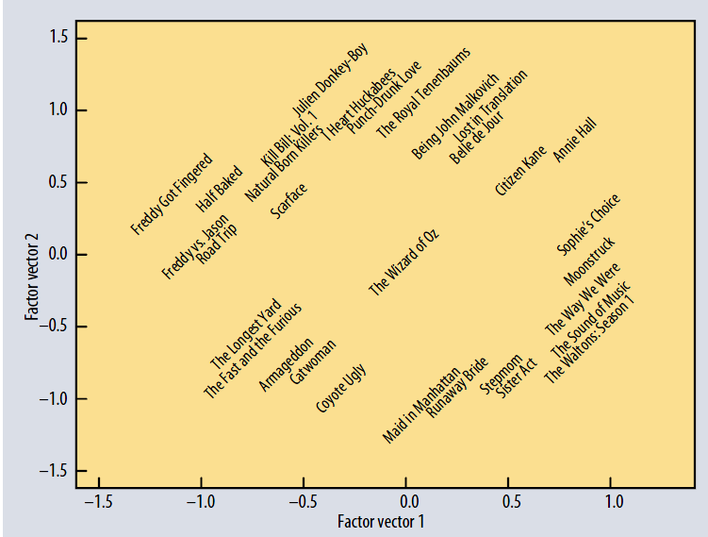
Koren, Bell, Volinksy, IEEE Computer, 2009

Slide 47
*****Notes from 2012******
Could include Ashton’s work about implicit feedback and Wikipedia elections (WSDM ‘12)

