Slide 1
CS246 TA Session: Hadoop Tutorial
Peyman kazemian
1/11/2011

Slide 2
Hadoop Terminology
Job: a full program – an execution of a Mapper and Reducer across data set
Task: An execution of a mapper or reducer on a slice of data
Task Attempt: A particular instance of an attempt to execute a task on a machine

Slide 3
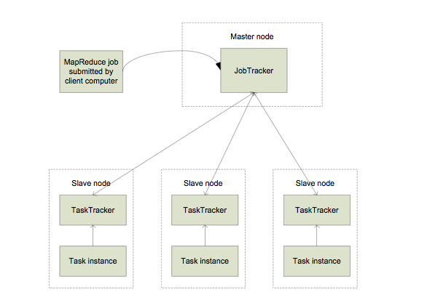
Hadoop Map Reduce at High Level

Slide 4
Hadoop Map Reduce at High Level
Master node runs JobTracker instance, which accepts Job requests from clients
TaskTracker instances run on slave nodes
TaskTracker forks separate Java process for task instances
MapReduce programs are contained in a Java JAR file. Running a MapReduce job places these files into the HDFS and notifies TaskTrackers where to retrieve the relevant program code
Data is already in HDFS.

Slide 5
Installing Map Reduce
Please follow the instructions here:
http://www.stanford.edu/class/cs246/cs246-11-mmds/hw_files/hadoop_install.pdf
Tip: Don’t forget to run ssh daemon (Linux) or activate sharing via ssh (Mac OS X: settings --> sharing). Also remember to open your firewall on port 22.

Slide 6
Writing Map Reduce code on Hadoop
We use Eclipse to write the code.
1) Create a new java project.
2) Add hadoop-version-core.jar as external archive to your project.
3) Write your source code in a .java file
4) Export JAR file. (File->Export and select JAR file. Then choose the entire project directory to export)

Slide 7
Writing Map Reduce code on Hadoop
Need to implement a ‘Map’ and ‘Reduce’ class. They should have ‘map’ and ‘reduce’ methods respectively.
void map(WritableComparable key,
Writable value,
OutputCollector output,
Reporter reporter)
Void reduce( WritableComparable key,
Iterator values,
OutputCollector output,
Reporter reporter)

Slide 8
What is Writeable?
Hadoop defines its own “box” classes forstrings (Text), integers (IntWritable), etc.
All values are instances of Writable
All keys are instances ofWritableComparable because they need to be compared.
Writable objects are mutable.

Slide 9
WordCount Example
import java.io.IOException;
import java.util.*;
import org.apache.hadoop.fs.Path;
import org.apache.hadoop.io.*;
import org.apache.hadoop.mapred.*;
public class WordCount{
public static class Map extends MapReduceBase implements Mapper<LongWritable, Text, Text, IntWritable> {
…
}
public static class Reduce extends MapReduceBase implements Reducer<Text, IntWritable, Text, InWritable> {
…
}
public static void main(String[]args) throws IOException{
…
}
}

Slide 10
WordCount Example
public static void main(String[]args) throws IOException{
JobConf conf = new JobConf(WordCount.class);
conf.setJobName("wordcount");
conf.setOutputKeyClass(Text.class);
conf.setOutputValueClass(IntWritable.class);
conf.setMapperClass(Map.class);
conf.setReducerClass(Reduce.class);
conf.setInputFormat(TextInputFormat.class);
conf.setOutputFormat(TextOutputFormat.class);
FileInputFormat.setInputPaths(conf, new Path(args[0]));
FileOutputFormat.setOutputPath(conf, new Path(args[1]));
try{
JobClient.runJob(conf);
}catch(IOException e){
System.err.println(e.getMessage());
}
}

Slide 11
WordCount Example
public static class Map extends MapReduceBase implements Mapper<LongWritable, Text, Text, IntWritable>{
private final static IntWritable one = new IntWritable(1);
private Text word = new Text();
public void map(LongWritable key, Text value, OutputCollector<Text, IntWritable> output, Reporter reporter) throws IOException{
String line = value.toString();
StringTokenizer tokenizer = new StringTokenizer(line);
while(tokenizer.hasMoreTokens()){
word.set(tokenizer.nextToken());
output.collect(word, one);
}
}
}
TIP: For cache coherency, define your intermediate values outside loops. Because Writable objects are mutable, this avoids unnecessary garbage collection

Slide 12
WordCount Example
public static class Reduce extends MapReduceBase implements Reducer<Text, IntWritable, Text, IntWritable>{
public void reduce(Text key, Iterator<IntWritable> values,
OutputCollector<Text, IntWritable> output, Reporter reporter)
throws IOException{
int sum = 0;
while (values.hasNext()){
sum += values.next().get();
}
output.collect(key, new IntWritable(sum));
}
}
CAUTION: values.next() returns the reference to the same object everytime it is called. So if you want to store the reducer input values, you need to copy it yourself.

Slide 13
References
Slides credited to:
http://www.cloudera.com/videos/programming_with_hadoop
http://www.cloudera.com/wp-content/uploads/2010/01/4-ProgrammingWithHadoop.pdf
http://arifn.web.id/blog/2010/01/23/hadoop-in-netbeans.html
http://www.infosci.cornell.edu/hadoop/mac.html

